Slide 1
Dance studio
Team Members:
Name: Arushi Agarwal
Name: Rutuja Wangwad

Slide 2
Motivation
This is the web based application for Dance academy. In this system it will display all information about academy and at the same time this project manages all activities dance academy. It has online application form which helps new users to apply through online.

Slide 3
Features
In this web-based system, it will be able to present viewer all related information about the academy as a normal website in the internet and at the same time allow management task to be done on the system.
The web-based system is important as to enable a better and more organized way in keeping track of the dance academy's daily business and its student's data.
Viewers will have an easy accessibility to all information of the dance academies.

Slide 4
Administrator has the full authorization of the system. Management will no longer need to go through papers of work and documentation which is time consuming.
Viewers will have an easy accessibility to all information of the dance academies. All information will be easily found from the internet.
User can register themselves online for their desired dance forms and can book classes as per their convenience.

Slide 5
OBJECTIVE
The main objective of developing this project is to provide an easier way for candidates to register online for dance classes. In the Online Dance Registration Project, we use PHP and MySQL database. This project has two modules i.e. admin and user.
We provide dance training for students at all levels of dance.
To combine the dance with fitness and isolation exercises.

Slide 6
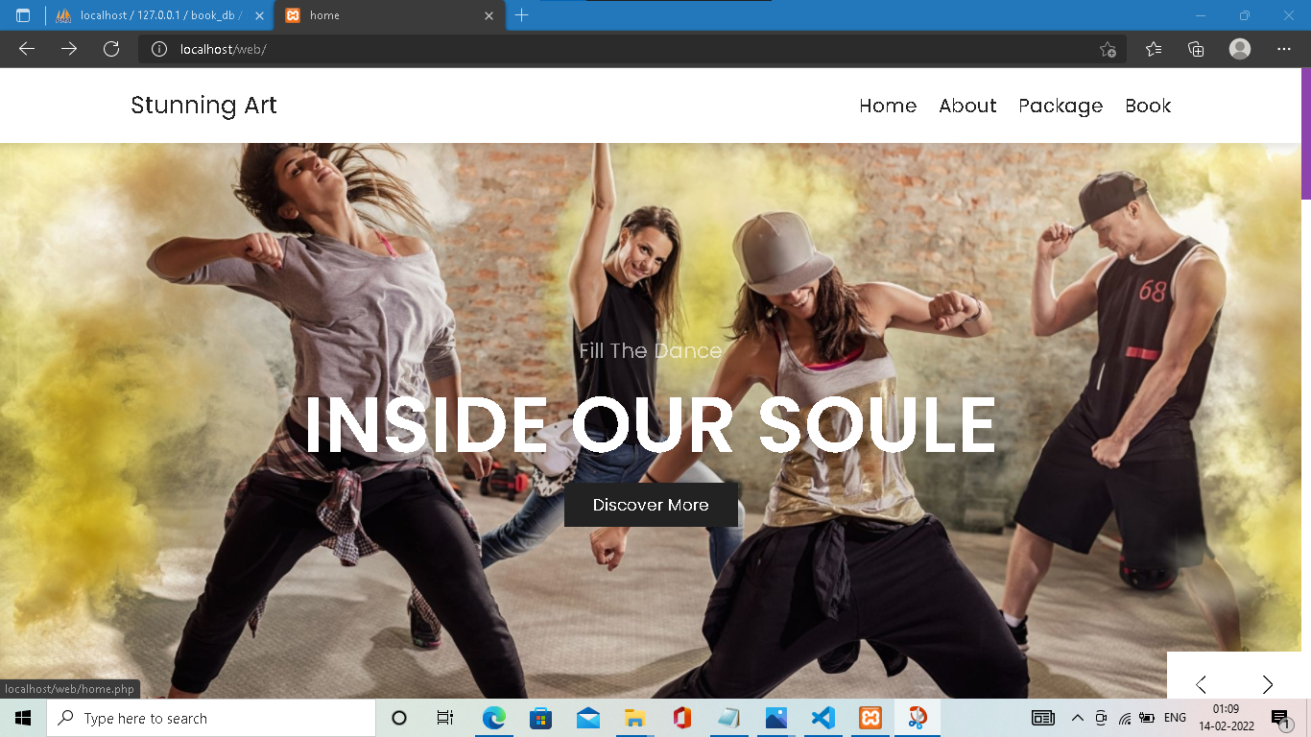
HOME

Slide 7
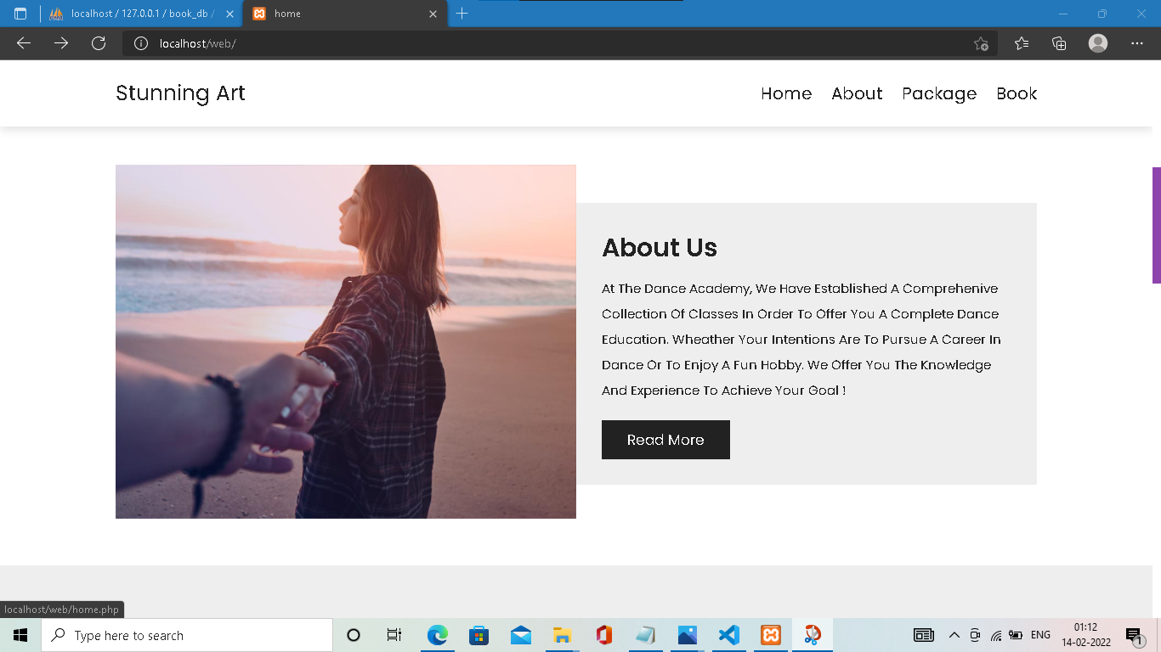
ABOUT US

Slide 8
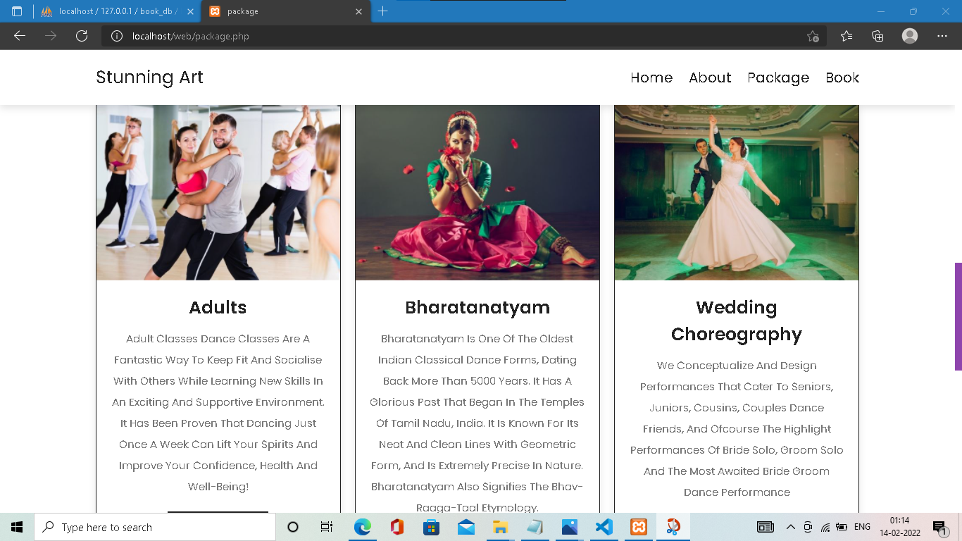
PACKAGES

Slide 9
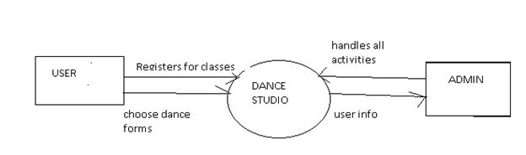
DFD

Slide 10
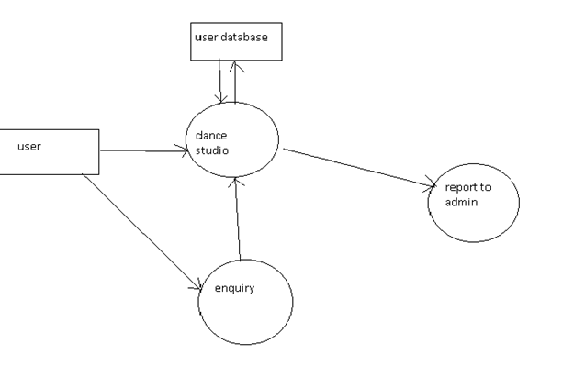
DFD

Slide 11
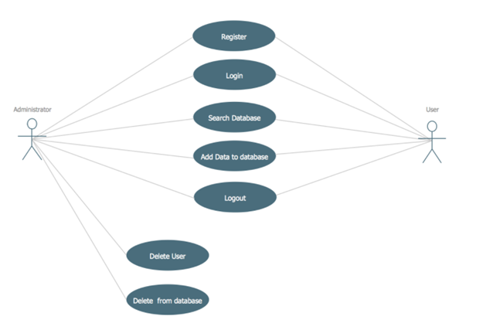

Slide 12
Implementation Details
Programming Language: PHP
Database: MySQL
Design and Interface: HTML, CSS
Script : JavaScript.
Software Requirements-
OPERATING SYSTEM - WINDOWS/LINUX/MAC/OS,
DATABASE - MYSQL,
PLATFORM – PHP,
WEB BROWSER – CHROME, JAVA SCRIPT.

Slide 13
Outputs and Report Testing
Installation test, functional test, load test, Data integrity test.
To register a new user, dance studio using to provide their email and phone number. It checks if the phone number or email already has a user in the database, if it doesn’t the user is then takes to a screen where they fill in their details which include full name, email, phone number, date, address, time a short description of themselves.

Slide 14
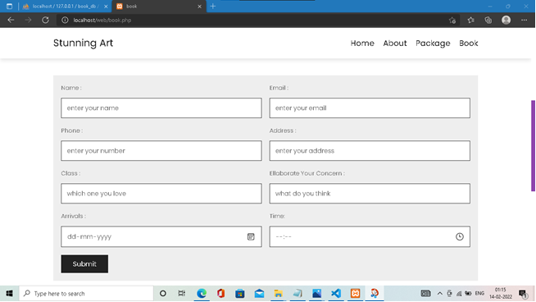
BOOKING CLASS

Slide 15
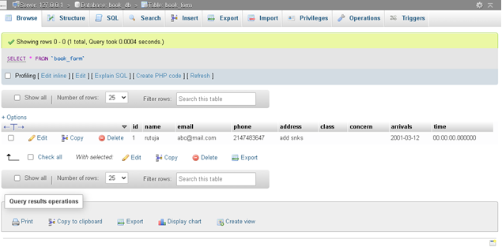
Database

Slide 16
Conclusion
This project aims to develop a dance academy management system in order to provide solutions to current problems and increase the efficiency.
Thus, our system meets the very basic and necessary needs of a viewers and also makes it easier for the administrator or the academy manger to fulfill the expectations of the customers. The website has been developed with much care that is free of error and at the same time it is efficient and more useful. The important thing is that the website robust.

Slide 17
Future Scope
The currently used Dance Academy Management System is the best suitable for the web pages on a computer system, there raised some issues while using it on cross-platform, i.e., if the viewing browser or platform of the web page changes, it misbehaves.
The future system will be supporting the web precisive, feature that display the web pages on any device as per its dimensions.
Even for register users, the future system can be developed on a mobile application providing all the services same as the web application.

