Slide 1
LSTM And DistilBERT for Sentiment Analysis
- Elish Patel (N01652547)
- Keyur Desai (N01666782)
- Rutu Patel (N01654478)

Slide 2
6.9 Million
Yelp Reviews focusing on restaurant businesses.

Slide 3
Data Overview
Data Composition:
Combined two datasets: one with business details (including reviews and categories) and another with text feedback.
Focus on Restaurants: Selected only the restaurant category using business IDs to match reviews with corresponding text feedback.
Preprocessing:
Text cleaning, tokenization, and sentiment labeling (positive, negative, neutral).

Slide 4
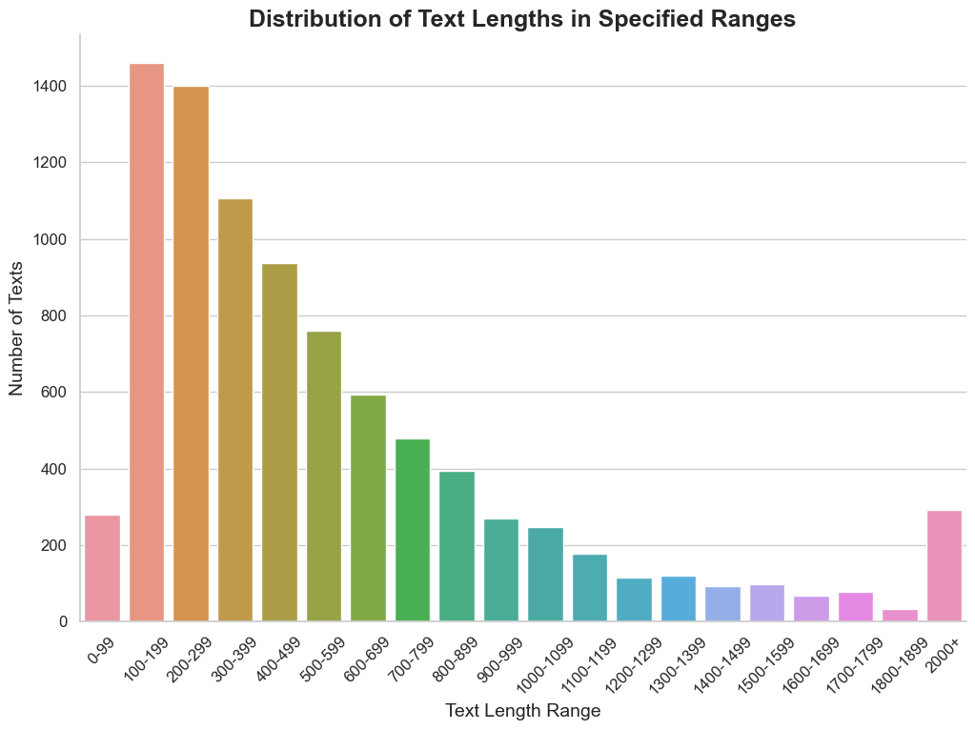
Data Distribution

Slide 5
Model Architecture And Training
LSTM
DistilBERT
Layers: Embedding, LSTM, Fully Connected, Softmax.
Purpose: Captures sequential dependencies in text data.
Training: Adam optimizer, Cross-Entropy Loss.
Layers: Pretrained Transformer, Fully Connected, Softmax.
Purpose: Captures contextual meaning with a lightweight Transformer model.
Training: Fine-tuning with AdamW, Cross-Entropy Loss.

Slide 6
Overall Challenges:
Data Handling: Processing and managing 6.9 million reviews was resource-intensive and required careful data preprocessing.
Computational Resources: Training DistilBERT on such a large dataset demanded high memory and processing power.
Scalability: Both models required careful consideration of scalability, especially given the size of the dataset.

Slide 7
Performance Evaluation
LSTM
DistilBERT
Test Accuracy :
63% | 77%
65% | 78%
65% | 77%
65% | 77%
Precision :
Recall :
F1 Score :

Slide 8
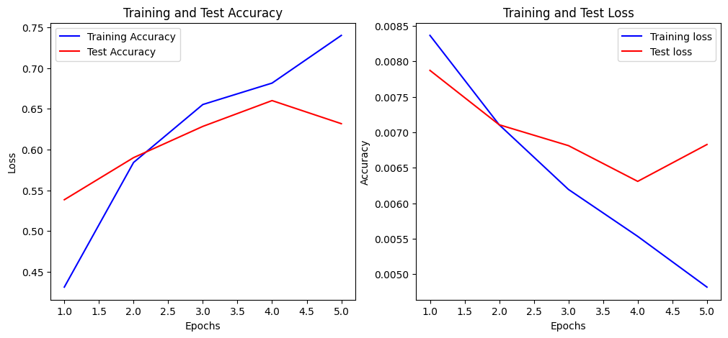
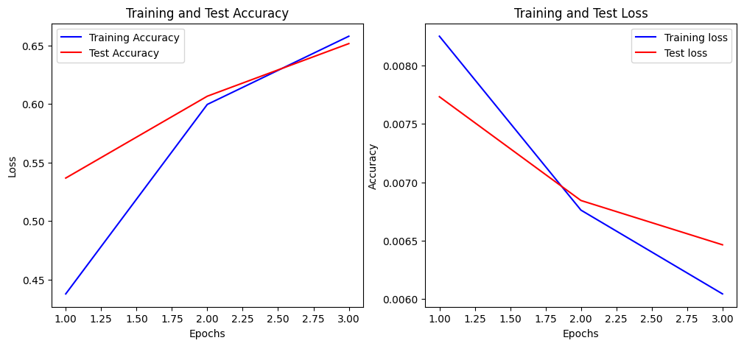
Result OF LSTM
Layers: 2
Dropout: 0.2
Optimizer: Adam
Epochs: 5
Accuracy: 63%
Layers: 3
Dropout: 0.3
Optimizer: AdamW
Epochs: 3
Accuracy: 65%

Slide 9
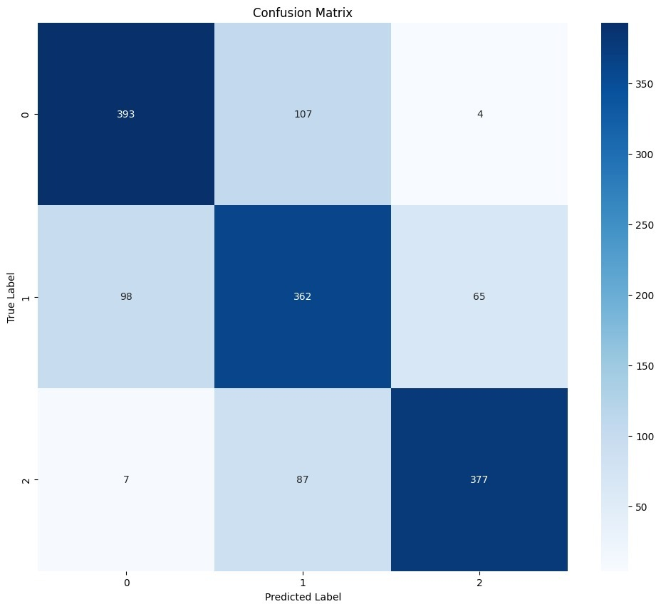
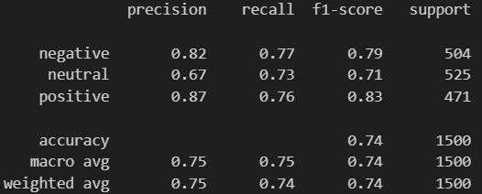
Result OF Bert
Train Batch Size: 64
Evaluation Batch Size: 64
Epochs:3

Slide 10
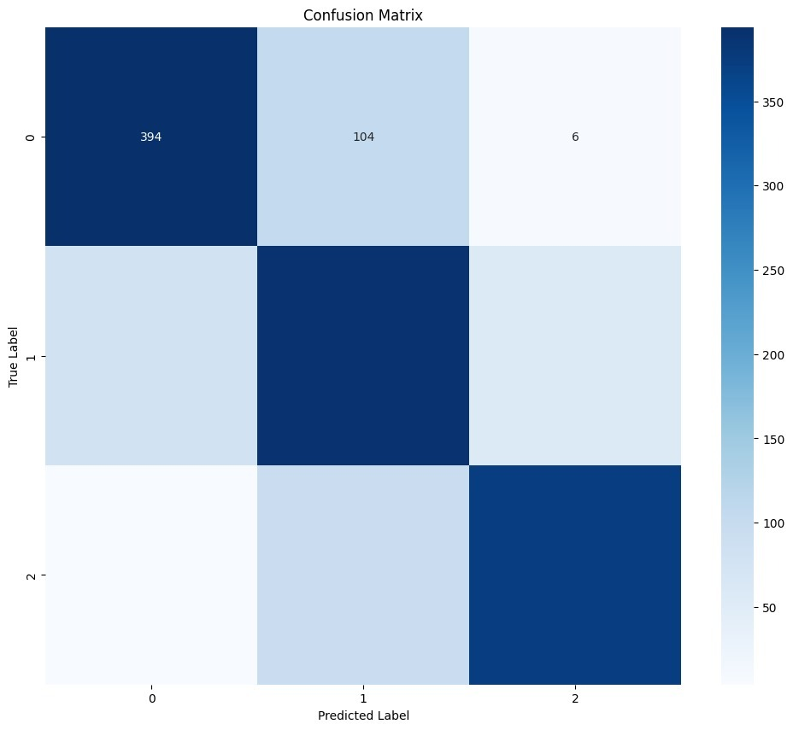
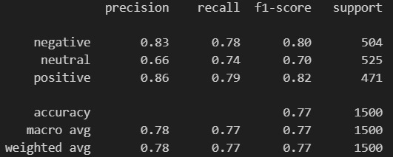
Result OF Bert
Train Batch Size: 16
Evaluation Batch Size: 64
Learning Rate: 5e-5
Weight Decay: 0.01
Epochs:3

Slide 11
Conclusion
LSTM proved more suitable for this large-scale task, balancing accuracy with computational efficiency.
DistilBERT, while powerful, required more resources and time, making it less practical for this specific project with 6000 reviews.

Slide 12
Thank You

