Slide 1
CELENA
Personal Digital Assistant
YouTube Comment Classification and Sentiment Analysis
By:
Rajesh Bhat
Rutu Desai
Shubham Kokane

Slide 2
INDEX
Objective
Motivation
Design Approach
Project Plan
Methodology
R Markdown
Shiny Application
Future Scope
Conclusion
Q&A

Slide 3
OBJECTIVE
The objective of the project is to develop an analytical application utilizing most of the concepts learnt in this course, which can derive topic of the subject presented in any given youtube video and the Public Sentiments /Ratings for the same using public comments available on the video.

Slide 4
MOTIVATION
In general, many of us have to spend time on going through the majority of the video or glance comment section to understand and realise the quality of the video, that could result in utter waste of time.
What if we could leverage smart assistance from a device which could summarize the comments section for us in the form of Overall Public Sentiment and Topics of the video?
Notes:
“Sky is the limit”, and then motivation of our project
Looking at the video length and feeling, is it worth it? What if my time will be wasted?
To avoid these kind of questions, we created an application which finds the topic of video for you and shows the overall sentiment of the comment section.

Slide 5
“CELENA - A Smart Digital Assistant.”
An application to get Topics and Public Sentiments using YouTube Comments.
Notes:
Can we add something as a quote to make everyone think about something or let’s say about Selena which we use as a name for our Application.

Slide 6
SOLUTION
CELENA born as a younger cousin of popular digital assistant available in the market such as “ALEXA” or “SIRI”.
User just have to provide URL of the video and CELENA will take care of the rest by applying different methods in the background to derive Ratings and Topics of the Video for the User within seconds.
Search for a specific Topic on YouTube and get different details about the Video and classify it using the application.

Slide 7
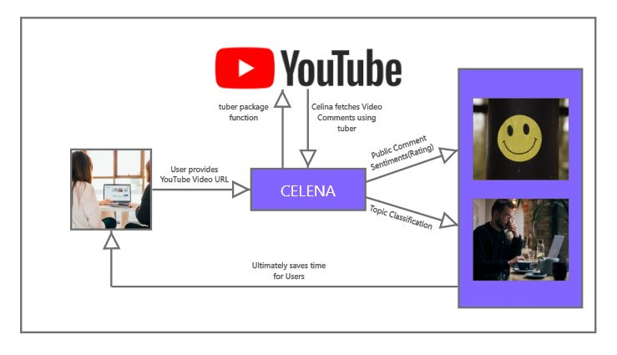
DESIGN APPROACH

Slide 8
PROJECT PLAN
Initial Phase of Project, brainstorming about the dataset scraping.
Started cleaning dataset to prepare for Topic Modelling.
Phase 1
Phase 3
Phase 2
Phase 4
Started working on using TubeR Package in R and got idea about how to scrape data and find insights from it.
Created Models and Shiny Application in R.

Slide 9
METHODOLOGY
Selenium -> tuber Package
Accessing YouTube API via R made easier.
Lots of functionalities to get different types of data from YouTube.
Used Corpus, DTM, LDA methods to get to the final results.
Shiny Application
3 main lines of code to run any Shiny App:
#ui <- fluidPage(Input(),Output())
#server <- function(input, output){}
#shinyApp(ui = ui, server = server)

Slide 10
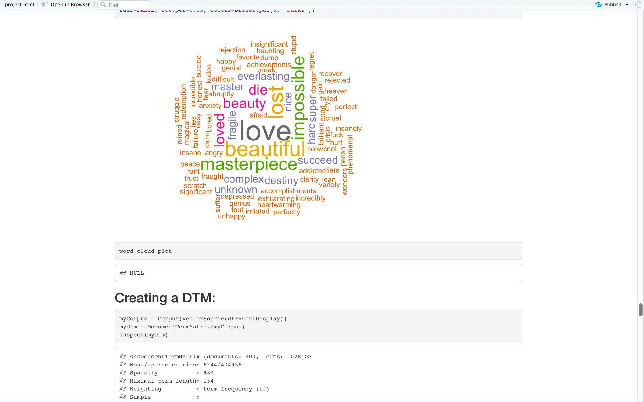
R MARKDOWN
Now we will explain the whole application with the help of .rmd file

Slide 11
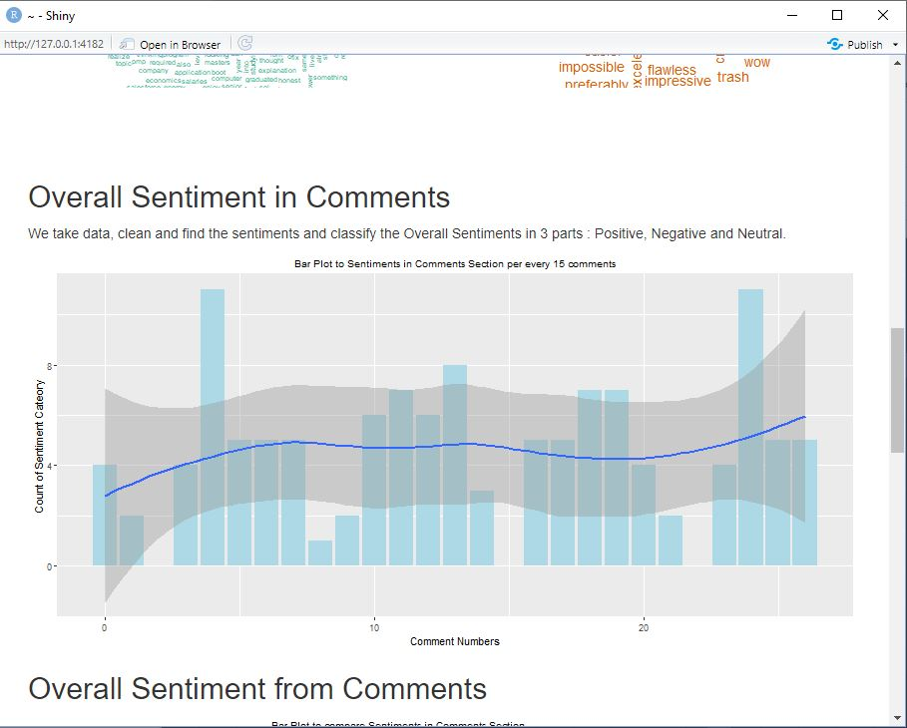
DESKTOP PROJECT
We have created a Shiny Application of our Project.

Slide 12
FUTURE SCOPE
We can also work with getting replies for each comments and using it in the model.
n-grams can be taken into consideration to make sentence more understandable.
We can also improve the sentiments by converting emoji’s to text by assigning proper meaning to that emoji.
User experience can be improved if Celena can listen to user request and respond with voice response rather than just reading comments, that could make Celina a popular mobile and web app.

Slide 13
CONCLUSION
Overall in the project, we were successfully able to apply many different concepts taught in the class and execute it.
We also learnt a lot of new concepts while working on the project and got a glimpse of how a product development cycle works in real world industry.
We were successfully able to do the following : text scraping, cleaning, processing and analysing data to make useful predictions.

Slide 14
CREDITS
Special thanks to all the people who made and released these awesome resources for free:
Presentation template by SlidesCarnival
Photographs by Unsplash

Slide 15
THANKS!
Any questions?

