Slide 1
Fury suggests
: Chatbot for Blood Report Explanation

Slide 2
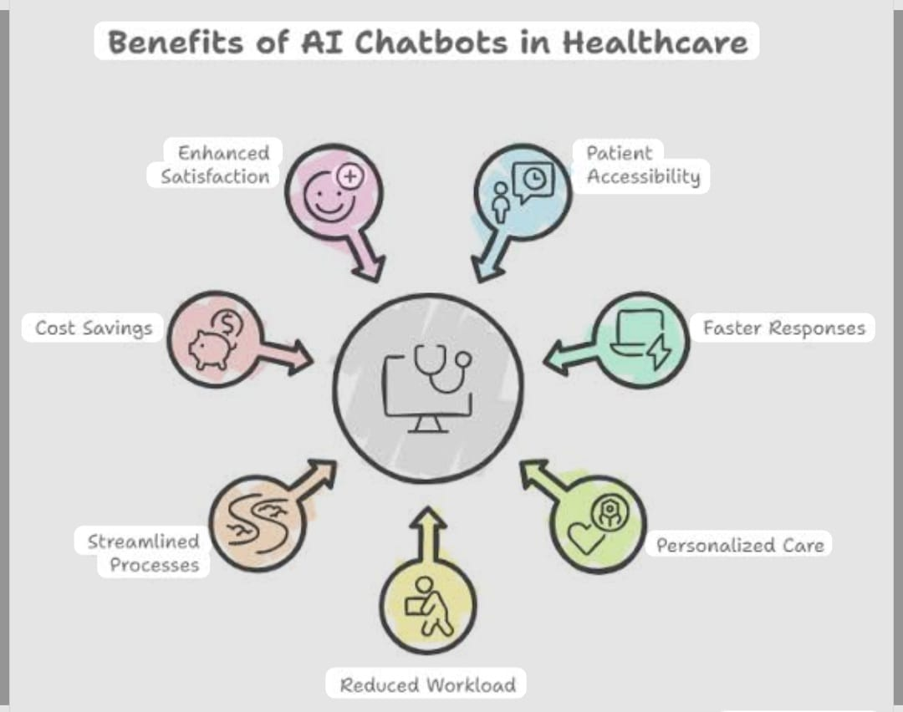
Points to be covered
Problem Statements
Agent functionality
Architecture & Workflow
Use Cases
Limitations
Future Scopes and Improvements

Slide 3

Existing PROBLEMS
REPORT
Manual Interpretation Errors
Lack of Personalized Analysis
Delayed Diagnosis
Poor Patient Understanding
Data Security & Privacy Issues
Limited Access in Rural Areas
Being Doubtful about the suggestions of doctor.

Slide 4

Functionalities
User Input Collection
Range-Based Comparison
Multi-Test Analysis Support
Instant Result Display
Basic Health Screening Assistance
User-Friendly Interaction
Medical Awareness Enhancement

Slide 5
Architecture & Workflow
ARCHITECTURE :
Input Layer: This is where the user enters medical report values such as cholesterol, WBC, TSH, creatinine, etc. The chatbot collects these values using input statements.
Processing Layer: In this part, the chatbot compares the entered values with predefined normal ranges. It uses simple if-else conditions to check whether the value is: Low, Normal or High. This is the decision-making part of the chatbot.
Output Layer: After comparison, the chatbot displays: Whether the value is normal or abnormal. Possible health risks related to abnormal values. The output is shown in simple language so that the user can understand easily.
WORKFLOW :
The user runs the program.
The chatbot asks the user to enter medical test values.
The program stores these values in variables.
It compares each value with standard normal ranges.
Based on the comparison, it decides the health condition using if-else statements.
The chatbot then prints the result and possible health issues.

Slide 6
Use cases
1. Use Case: Checking Cholesterol Level
Situation: A user receives a lipid profile report.
Example : User enters LDL = 145 mg/Dl
Chatbot Response : “LDL is HIGH → Risk of heart disease.”
Purpose : Helps user understand heart risk instantly.
2. Use Case: Detecting Thyroid Imbalance
Situation : User feels tired and checks thyroid report.
Example : User enters TSH = 6.5 mIU/L
Chatbot Response : “TSH HIGH → Possible Hypothyroidism.”
Purpose : Early idication of thyroid disorder.

Slide 7
Limitations
FEW LIMITATIONS ARE GIVEN BELOW
1. Not a Medical Diagnosis Tool:
The chatbot only provides basic analysis based on fixed ranges. It does not consider medical history, symptoms, or other health factors. It cannot confirm diseases and should not replace a doctor.
2. Fixed Reference Ranges:
The chatbot uses predefined normal values. However, medical ranges may vary based on age, gender, and lab standards, so the results may not always be fully accurate and precise.

Slide 8

Future Scopes and Improvements
Integration with Hospital Systems
The chatbot can be connected to hospital databases for automatic report reading.
AI & Machine Learning Integration
It can be upgraded to learn from medical data and provide smarter predictions.
Mobile App Development
The chatbot can be converted into an Android/iOS health application.

Slide 9
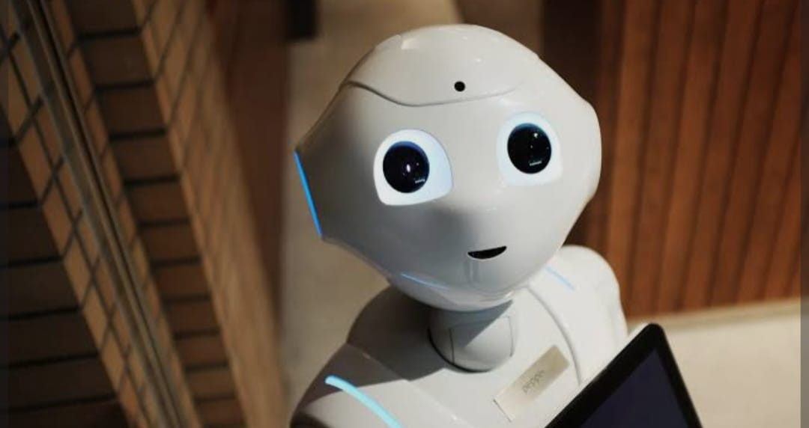
Thank you

