Slide 1
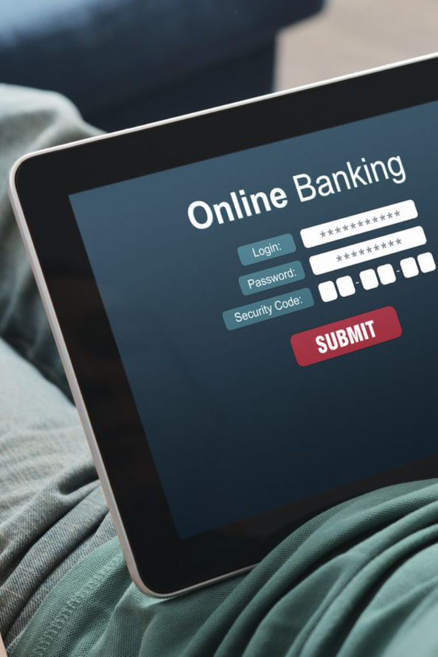
BankWave: Empowering Your Finances Online
In today's fast-paced digital world, the Bankwake: An online Banking Management System simplifies financial transactions, ensuring the safety of your money. Developed using HTML, CSS, JavaScript, JSP, Java, and SQL, it offers accessible, efficient, and secure banking functionalities.
by Team TechVangaurds

Slide 2

Importance of BankWave
1
Convenience 🌍
2
Efficiency ⏱️
Banking anytime and anywhere, without the need to visit a physical branch.
Streamlined processes, faster transactions, and real-time updates.
3
Accessibility ♿
Enabling banking services to users with physical disabilities.

Slide 3
Benefits of using the system
Enhanced Security 🔒
Cost Savings 💰
Financial Management Tools 📊
Reduced paper usage and lower operational costs for the bank.
Advanced encryption protocols and multi-factor authentication.
Budgeting, expense tracking, and financial planning features.

Slide 4
Technologies used in the system
HTML
CSS
Mark-up language for creating webpages and user interfaces.
Stylesheet language to control the visual presentation.
JavaScript
JSP
Programming language for adding interactive elements.
Java-based technology for generating dynamic web content.

Slide 5
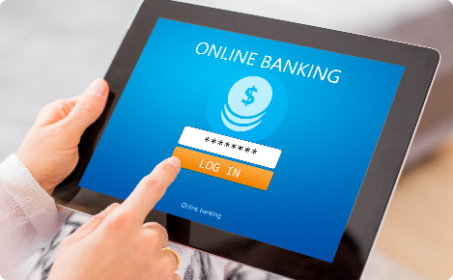
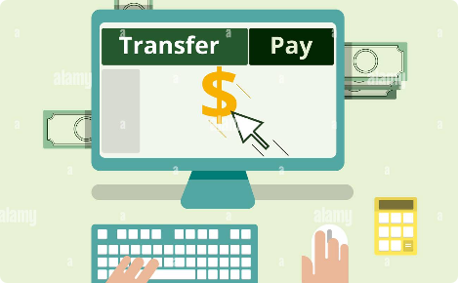
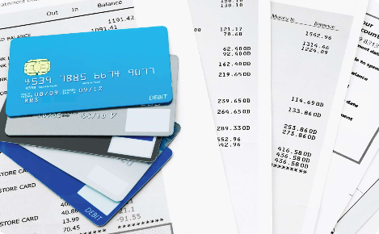
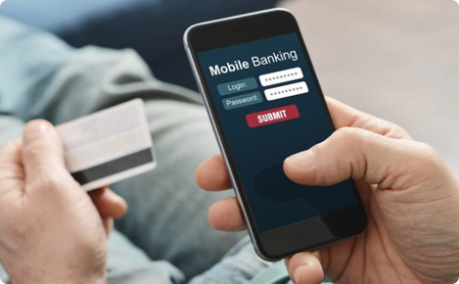
Functionalities of the system
Account Management
Fund Transfers
View balances, transaction history, and update personal details.
Transfer money securely between own accounts or to other recipients.
Bill Payments
Mobile Banking
Pay bills online, such as utilities, credit cards, and loans.
Access banking services via mobile devices with dedicated apps.

Slide 6

Security Features
1
Data Encryption
Securely encrypt customer data to protect against unauthorized access.
2
Multi-Factor Authentication
Implement additional layers of security using two or more authentication methods.
3
Transaction Monitoring
Real-time monitoring of transactions to detect and prevent fraudulent activities.

Slide 7
Conclusion
The BankWave: Empowering Your Finaces Online empowers users with convenient, efficient, and secure banking services. Leveraging cutting-edge technologies, it enhances the overall banking experience while ensuring the safety of your financial transactions.

