Slide 1
Adventure works
MENU
ANALYSIS
CONTACT
DATA ANALYSIS
GROUP - 1

Slide 2
P SRIMAN PATRO PREETI NANDI RUTUJA BALASAHEB GHANDGE YALAMANDALA SAI ROHITH RAHUL THAKUR RAKSHITHA M R CHAPPARAM PENCHALA VARA PRASAD
MENU
ANALYSIS
CONTACT
DATA ANALYSIS
TEAM MEMBERS

Slide 3
Project overview
The aim of this data analytics project is to analyze Adventure works sales data to uncover patterns, trends, and insights that can assist in improving Overall sales Regional performance, Identify sales trends , and customer targeting strategies. The project focuses on key performance indicators (KPIs) that provide a detailed understanding of sales behaviors across different segments.
To effectively visualize and interpret the data, we created interactive dashboards using the following tools:
Excel, Tableau, and Power BI . These dashboards allowed for a dynamic and detailed exploration of the data, providing actionable insights that can be easily communicated to stakeholders.

Slide 4
objective
The goal was to create an interactive and insightful tool that enables Adventure Works Cycles to monitor and enhance their sales strategies by identifying key trends and performance metrics across different regions, products, and customer segments.

Slide 5
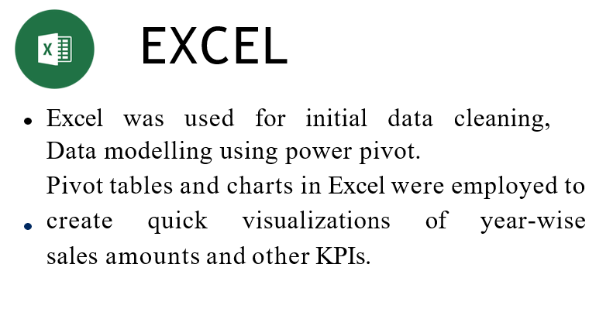
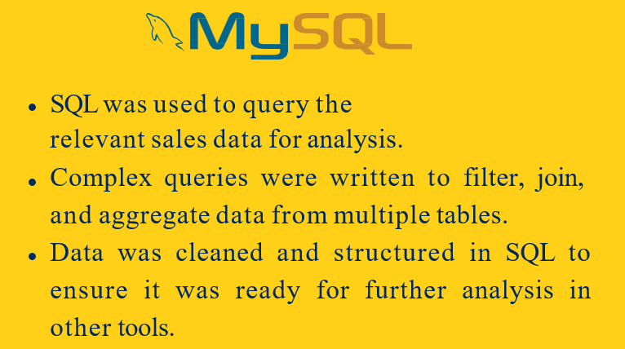
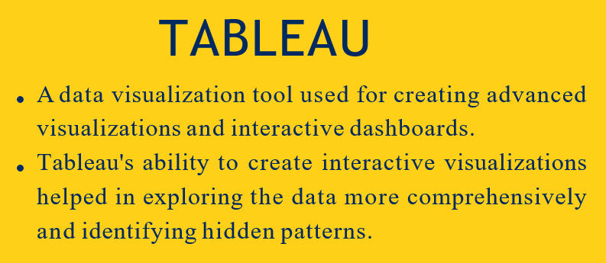
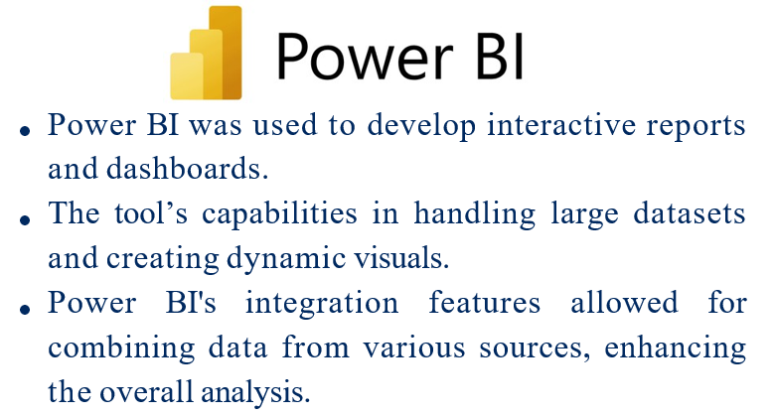
MODULES

Slide 6
kpi’s used in dashboard
KPI 1 : Year wise Sales
KPI 2 : Month wise Sales
KPI 3 : Quarter wise Sales
KPI 4 : Country wise Sales
KPI 5 : Month wise Sales & Production Cost

Slide 7
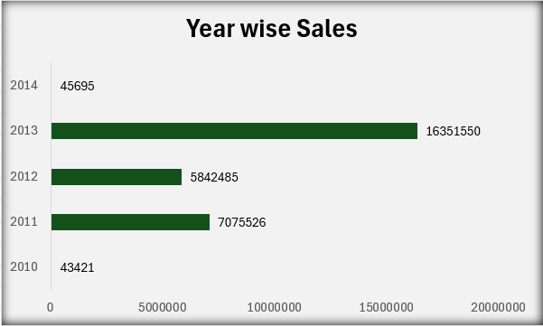
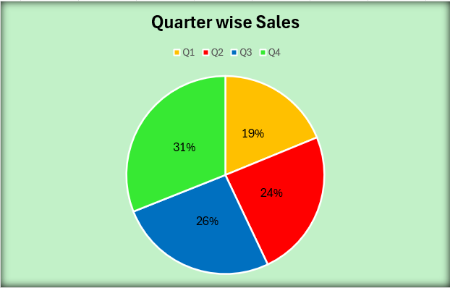
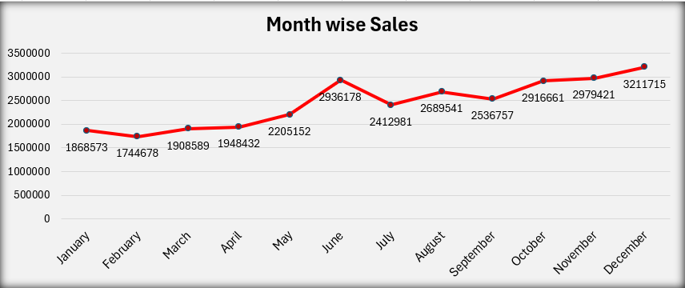
Kpi’s

Slide 8
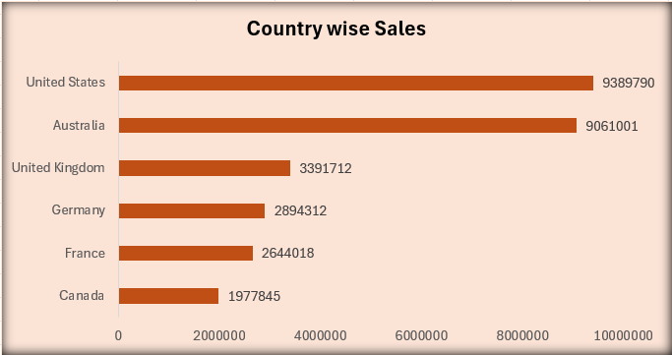
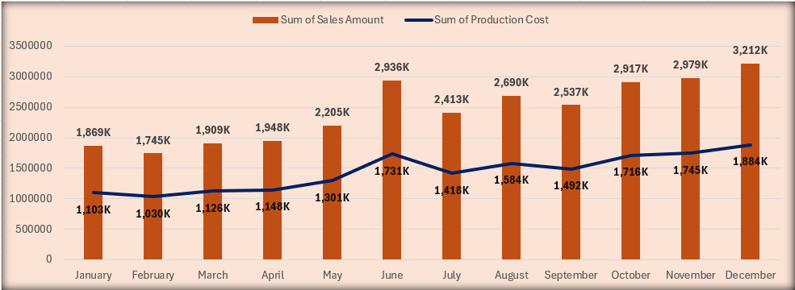
Kpi’s

Slide 9
Dashboards

Slide 10
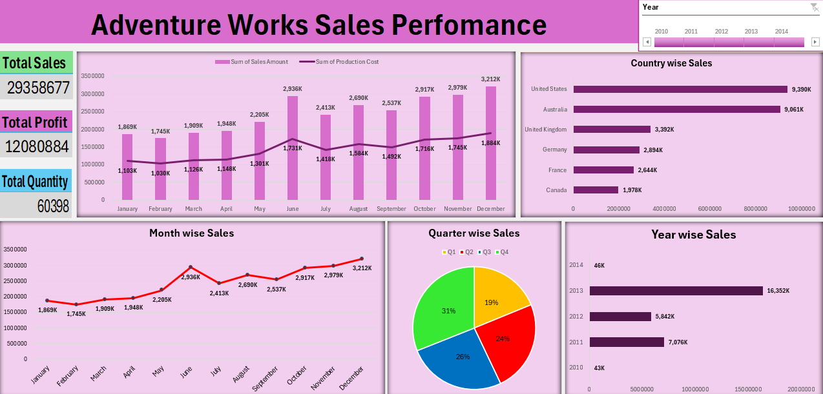
EXCEL DASHBOARD

Slide 11
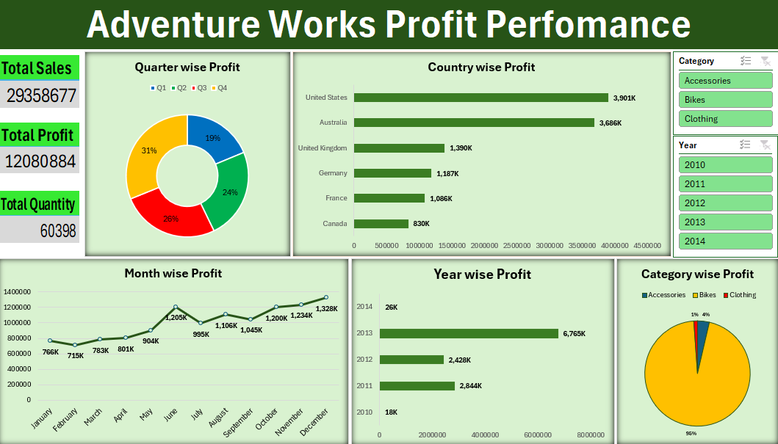
EXCEL DASHBOARD

Slide 12
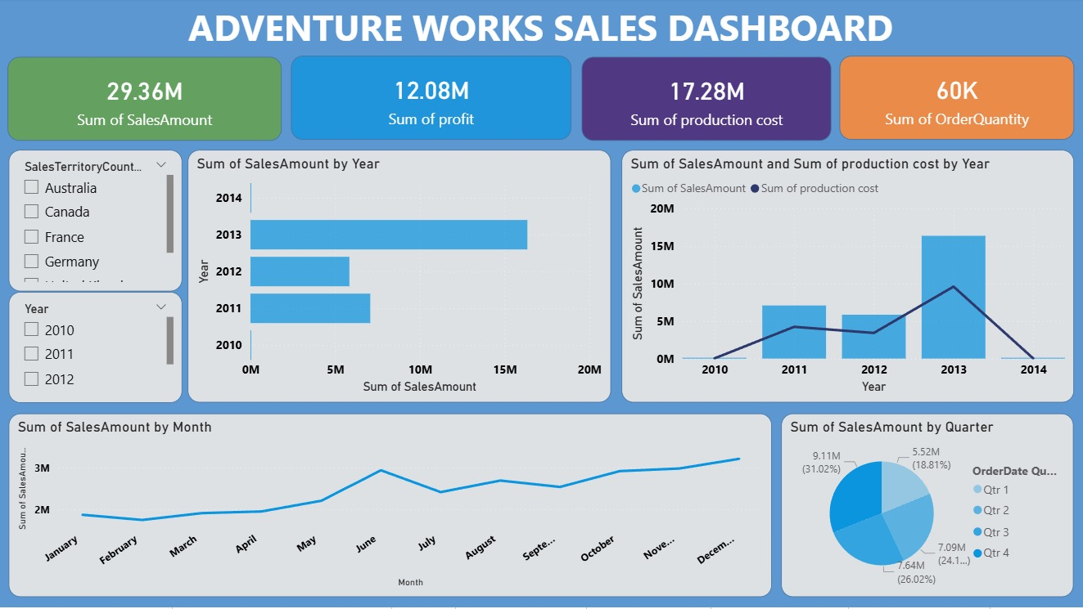
POWERBI DASHBOARD

Slide 13
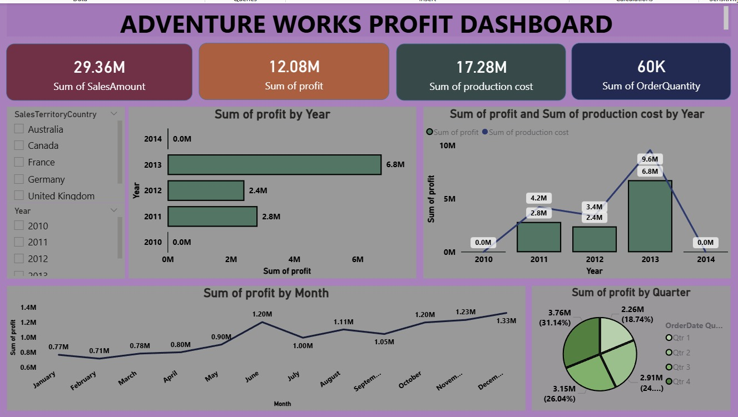
POWERBI DASHBOARD

Slide 14
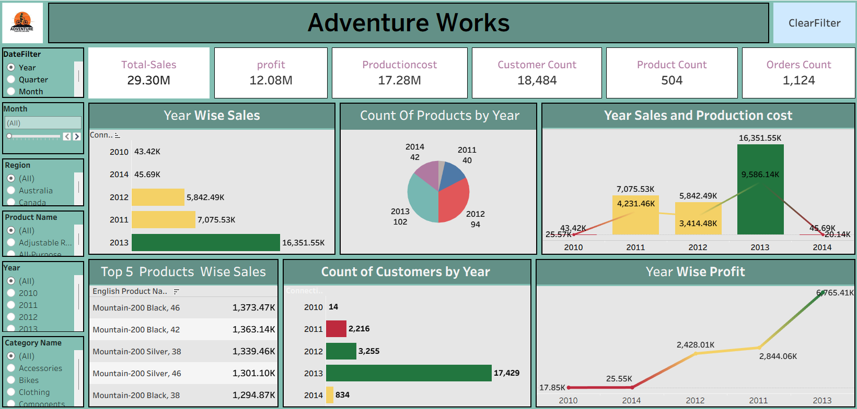
tableau DASHBOARD

Slide 15
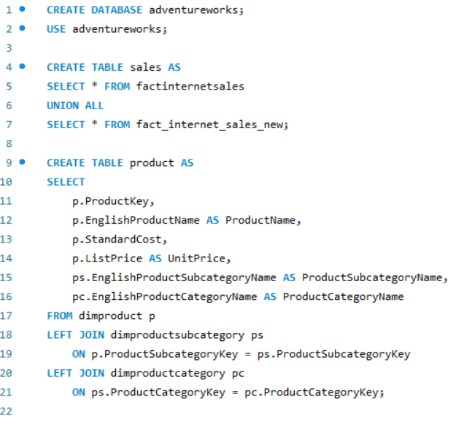
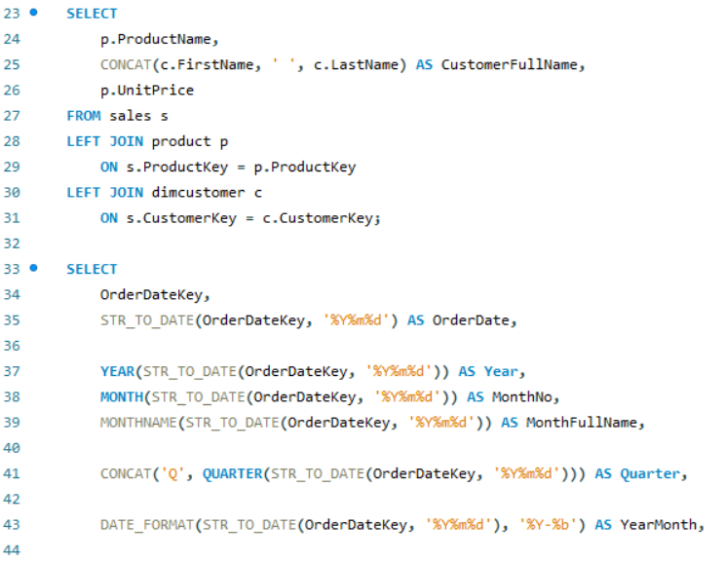
mysql queries

Slide 16
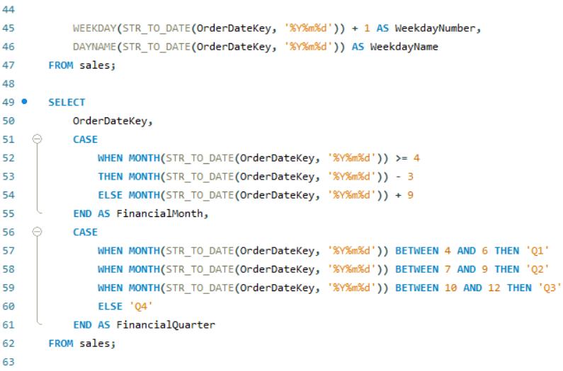
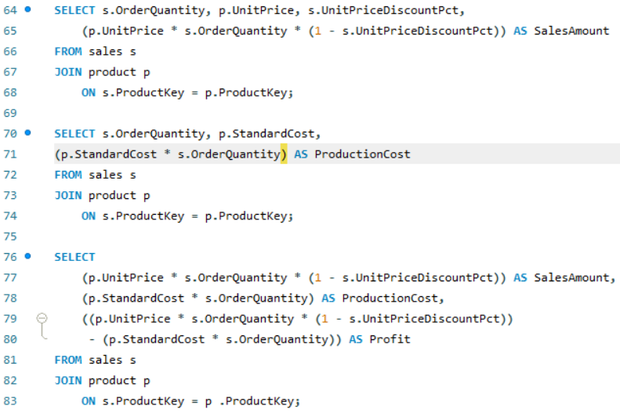
mysql queries

Slide 17
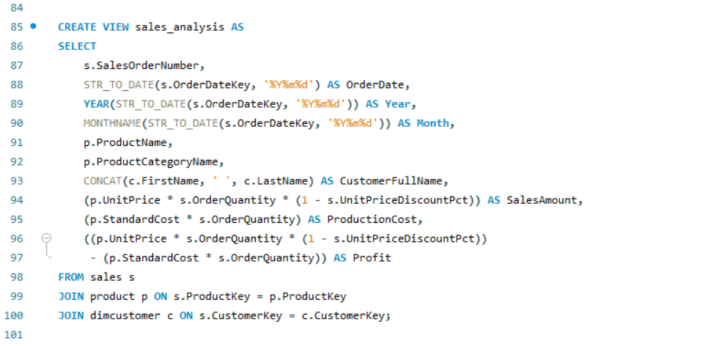
mysql queries

Slide 18
conclusion
The project has successfully uncovered significant trends and patterns in the sales portfolio, offering actionable insights that can be used to refine sales strategies, identify the sales trends, and improve customer targeting. The use of tools like Excel, Tableau, Power BI, and SQL was critical in preparing comprehensive dashboards that facilitate informed decision-making.

Slide 19
Thank you

