Slide 1
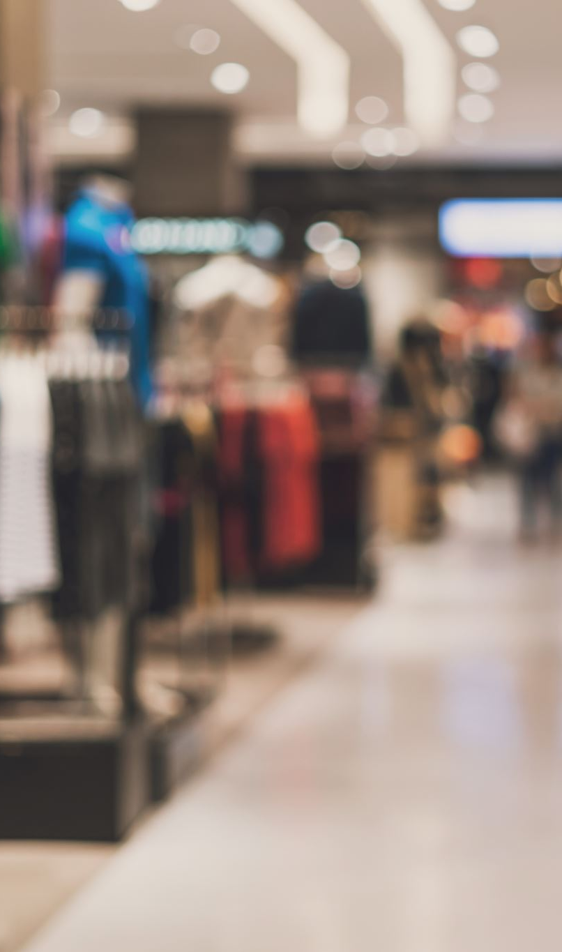
Shopping MMLU: The AI Benchmark Revolutionizing E-Commerce
Transforming Online Shopping with AI
Presented by Rutuja Patil

Slide 2
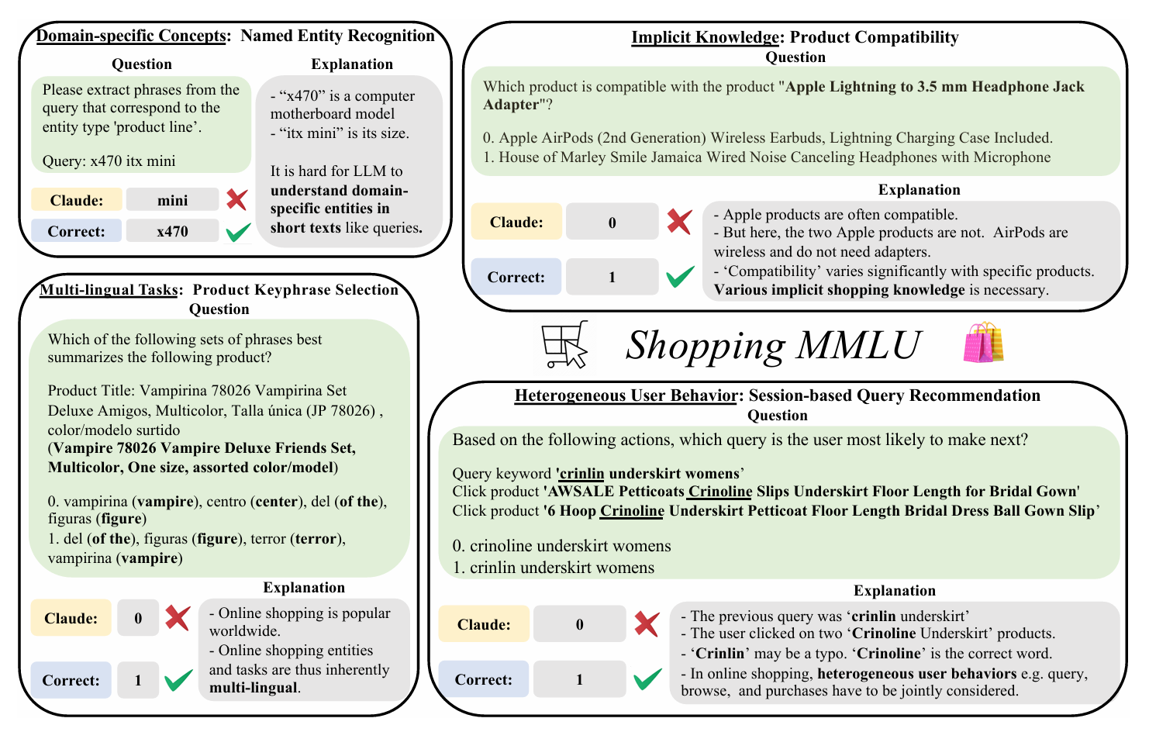
Introduction
Problem: Traditional AI systems struggle with multi-tasking in e-commerce.
Solution: Shopping MMLU – a benchmark designed to evaluate LLMs as shopping assistants.
Objective: To address dynamic, multi-tasking shopping tasks efficiently.

Slide 3
Need for Shopping MMLU
Example scenario: Searching for a phone with specific features.
Challenges for Traditional AI:
Limited to single or simple tasks.
Struggle with multilingual and complex queries.
Shopping MMLU's Purpose: To tackle multi-dimensional challenges.

Slide 4
Key Features of Shopping MMLU
Concept Understanding: Extract features, normalize brands, interpret sentiments.
Knowledge Reasoning: Multi-level reasoning (e.g., discounts, accessory compatibility).
User Behavior Alignment: Predicting based on user actions and queries.
Multilingual Capabilities: Universal shopping experiences in multiple languages.

Slide 5
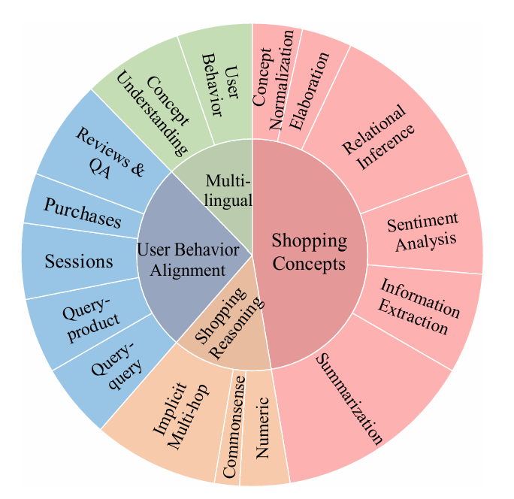
MMLU Data and Design
Data Sources: Amazon catalogs, user reviews, browsing sessions.
Task Formats:
Multiple-choice questions.
Retrieval tasks.
Ranking tasks.
Named Entity Recognition.
Text generation.
Evaluation Metrics: Accuracy, ROUGE-L, BLEU, NDCG.

Slide 6
Learnings and Insights
Proprietary Models Lead: Claude-3 Sonnet outperformed open-source LLMs, but gaps are narrowing.
Fine-Tuning Matters: Instruction Fine-Tuning boosts performance but beware of overfitting.
Few-Shot Learning: A challenge for shopping-specific tasks.
Knowledge Transfer: General knowledge adapts well to shopping tasks.

Slide 7
Future of E-Commerce with AI
Shopping Assistants: End-to-end shopping journey management.
Global Marketplaces: Language-agnostic shopping experiences.
Personalized Shopping: Tailor-made recommendations.

Slide 8
Conclusion
Key Takeaway: Shopping MMLU bridges gaps in AI’s e-commerce capabilities.
Impact: Benchmarks drive innovation for next-gen shopping experiences.
Vision: A seamless, smarter, AI-driven shopping ecosystem.

Slide 9
Closing Thoughts
'The future of online shopping is bright and smarter.'
Call-to-Action: Explore Shopping MMLU to innovate in e-commerce AI.
Reference: 2410.20745 - Shopping MMLU: A Massive Multi-Task Online Shopping Benchmark for Large Language Models –
Yilun Jin, Zheng Li, Chenwei Zhang, Tianyu Cao, Yifan Gao, Pratik Jayarao, MaoLi, Xin Liu, Ritesh Sarkhel, Xianfeng Tang, Haodong Wang, Zhengyang Wang, Wenju Xu, Jingfeng Yang, Qingyu Yin, Xian Li, Priyanka Nigam, Yi Xu, Kai Chen, Qiang Yang, Meng Jiang, Bing Yin∗

