Slide 1



Shield_Insurance
View in Power BI
Last data refresh:
8/16/2024 10:14:27 AM UTC
Downloaded at:
8/17/2024 4:28:27 PM UTC

Slide 2
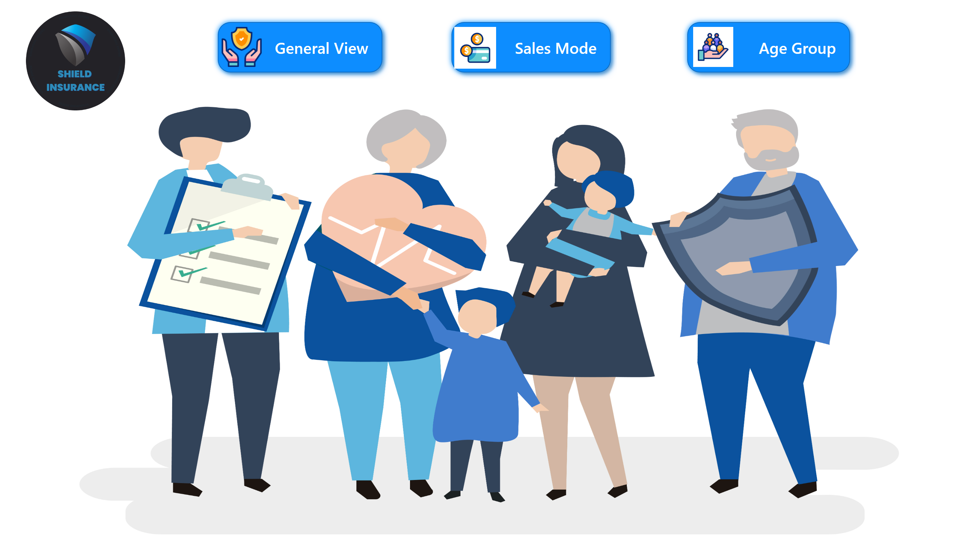
home
Notes:
image
No alt text provided
shape
No alt text provided
shape
No alt text provided
shape
No alt text provided
image
No alt text provided
image
No alt text provided
image
No alt text provided

Slide 3
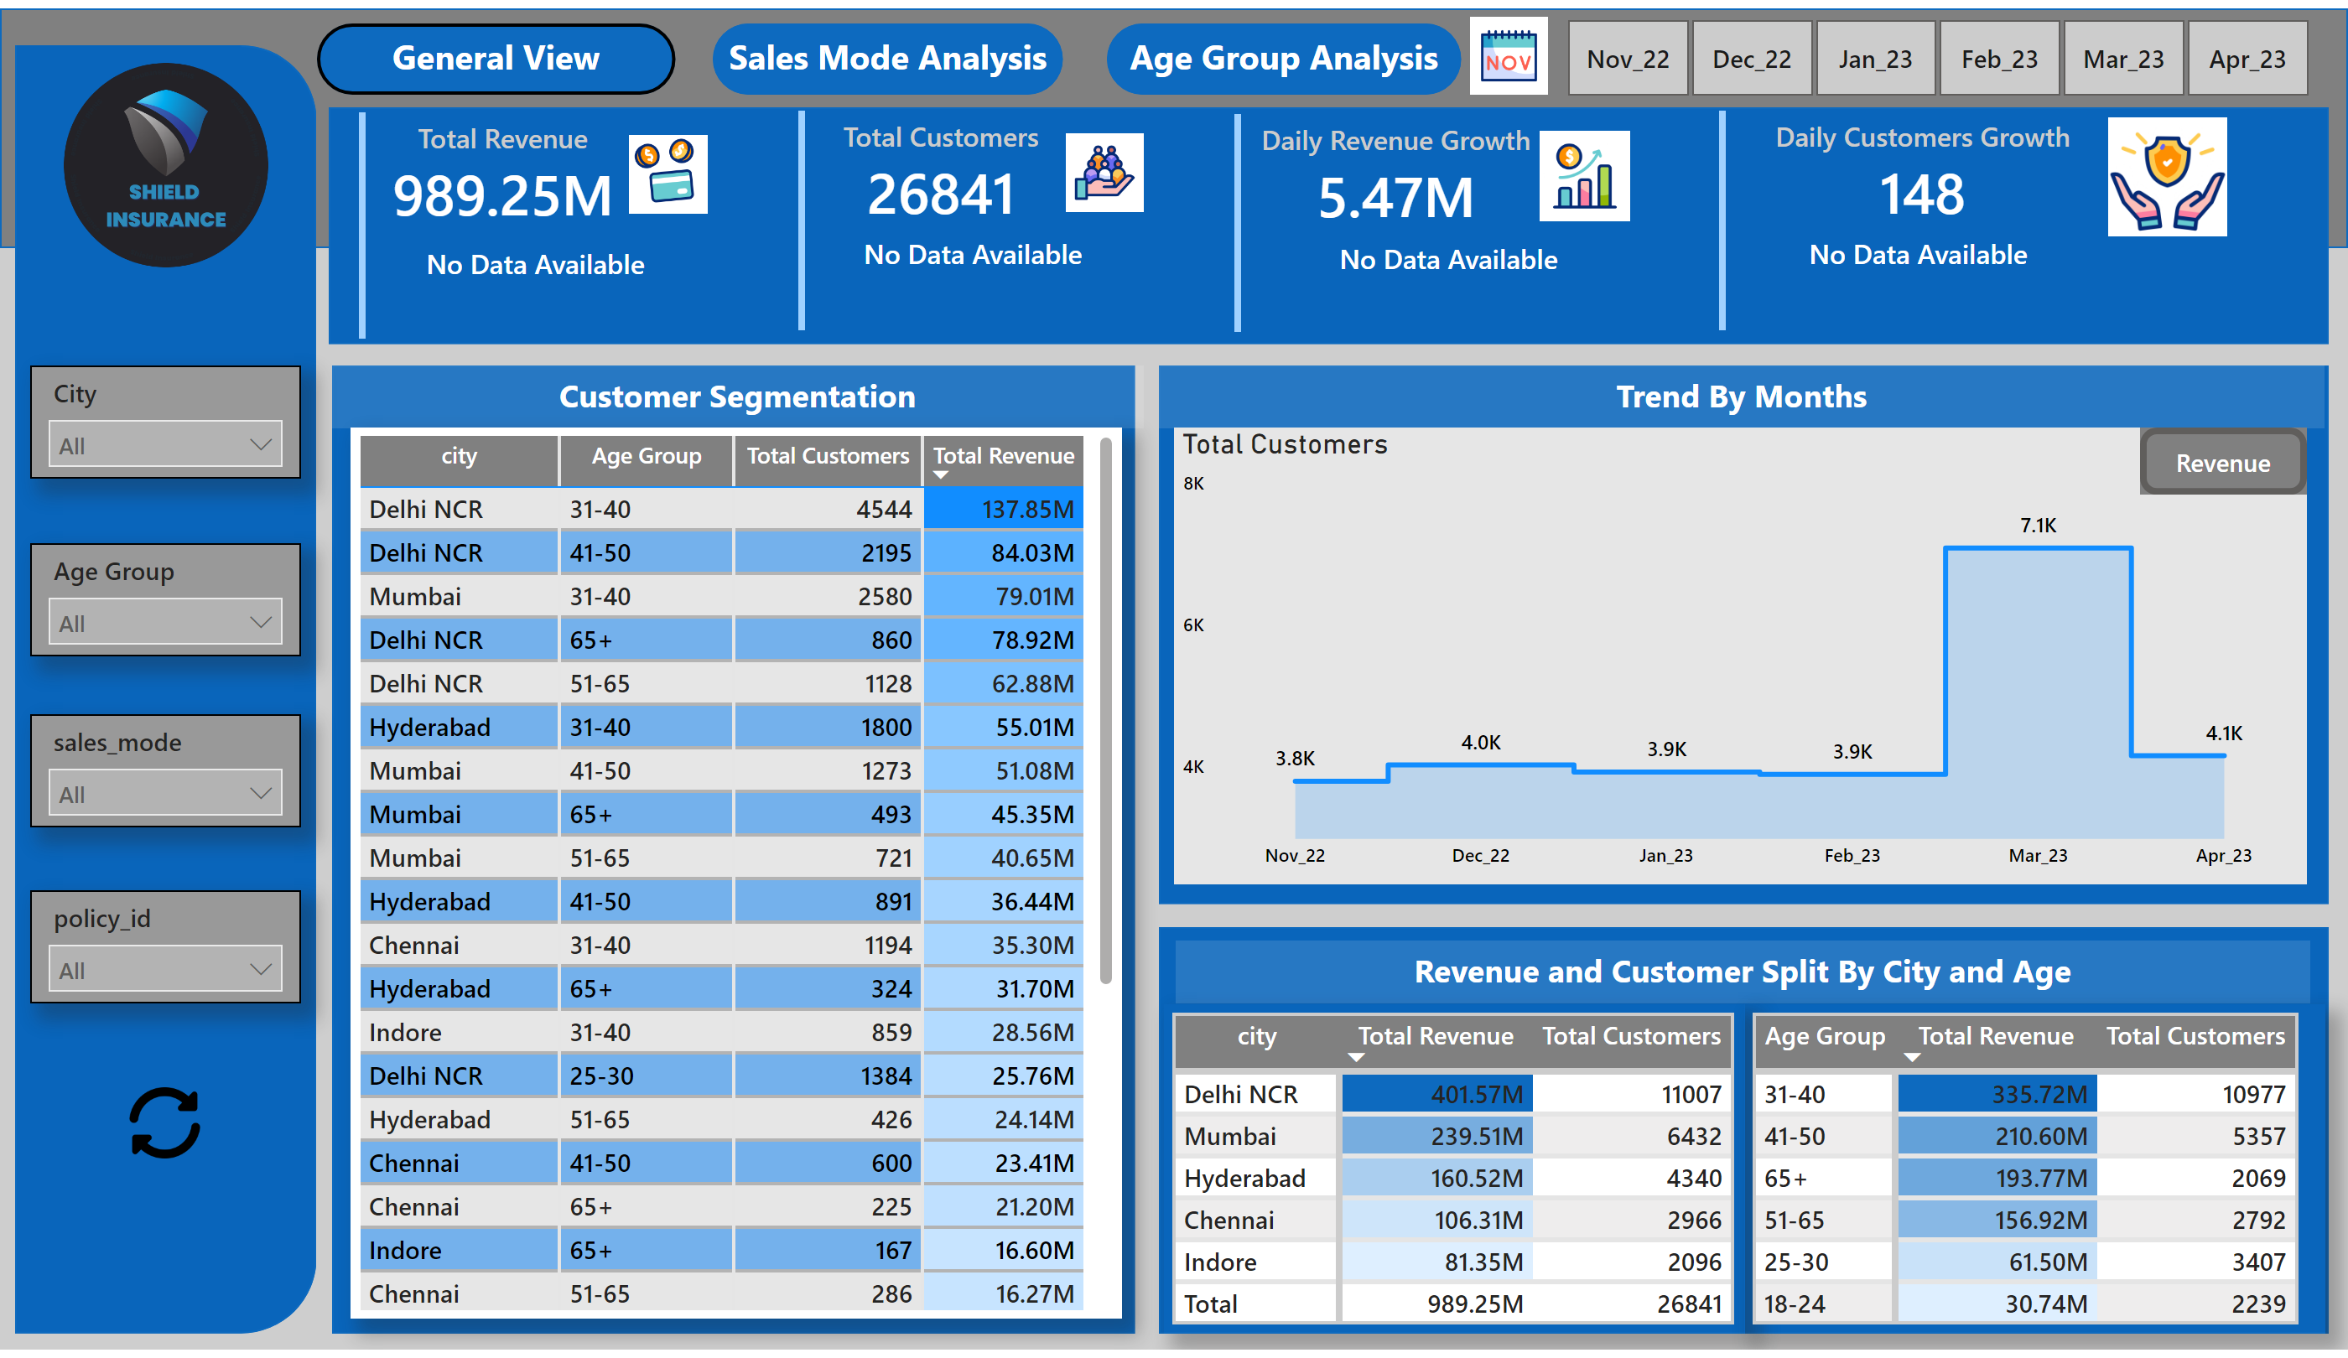
General View
Notes:
shape
No alt text provided
image
No alt text provided
pivotTable
No alt text provided
textbox
No alt text provided
slicer
No alt text provided
shape
No alt text provided
shape
No alt text provided
card
No alt text provided
cardVisual
No alt text provided
cardVisual
No alt text provided
card
No alt text provided
cardVisual
No alt text provided
cardVisual
No alt text provided
card
No alt text provided
card
No alt text provided
shape
No alt text provided
shape
No alt text provided
pivotTable
No alt text provided
shape
No alt text provided
textbox
No alt text provided
textbox
No alt text provided
lineChart
No alt text provided
Total Customers
No alt text provided
actionButton
No alt text provided
revenue button
No alt text provided
tableEx
No alt text provided
shape
No alt text provided
shape
No alt text provided
shape
No alt text provided
slicer
No alt text provided
slicer
No alt text provided
slicer
No alt text provided
slicer
No alt text provided
image
No alt text provided
image
No alt text provided

Slide 4
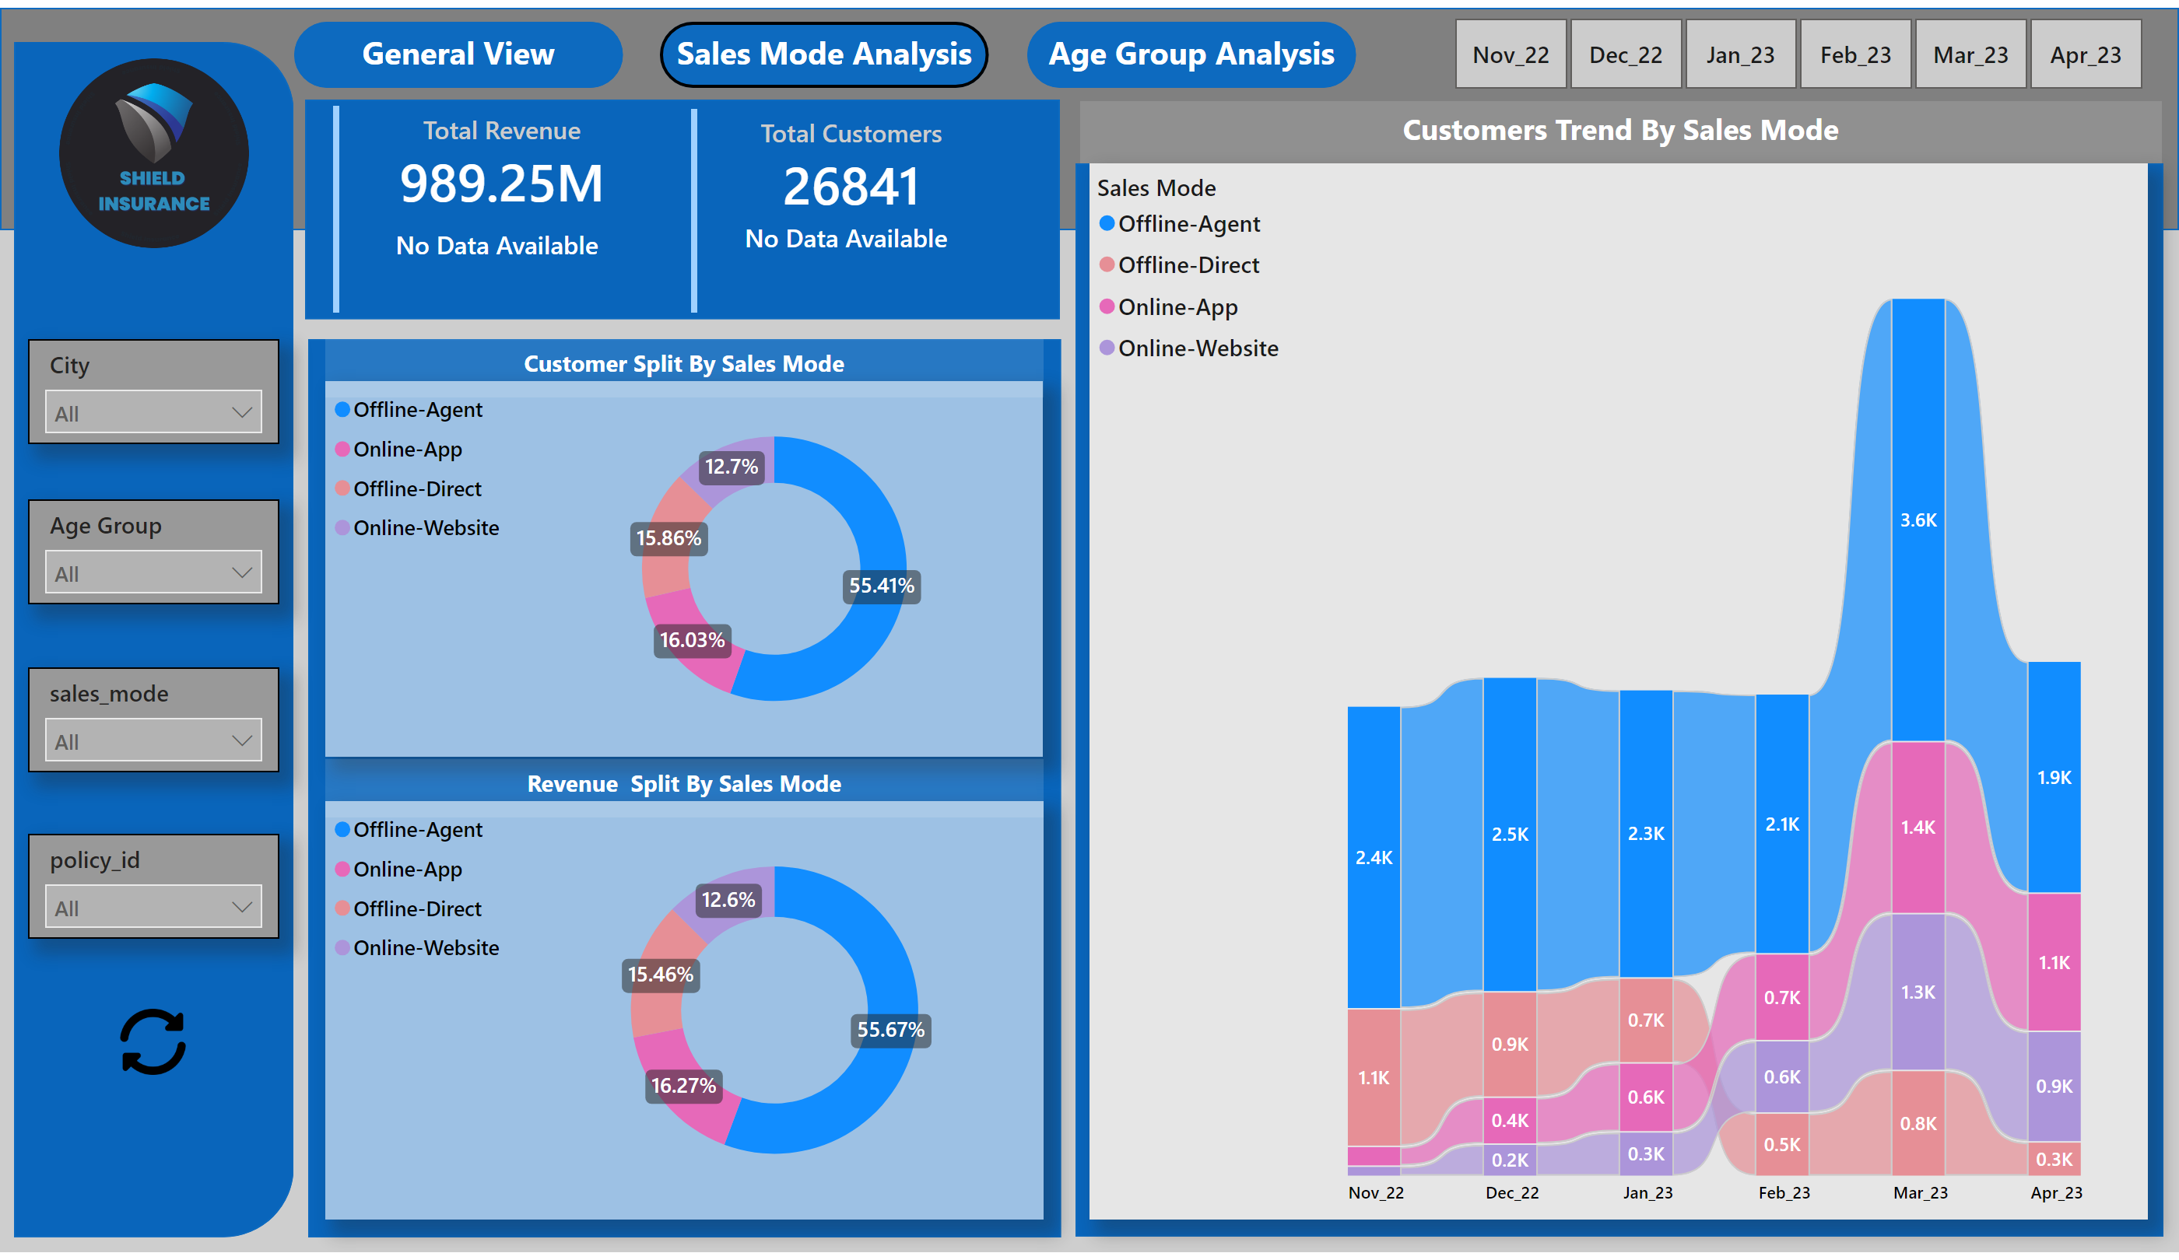
Sales View
Notes:
shape
No alt text provided
image
No alt text provided
slicer
No alt text provided
shape
No alt text provided
shape
No alt text provided
card
No alt text provided
cardVisual
No alt text provided
cardVisual
No alt text provided
card
No alt text provided
shape
No alt text provided
shape
No alt text provided
textbox
No alt text provided
textbox
No alt text provided
Total Revenue
No alt text provided
customers button
No alt text provided
donutChart
No alt text provided
donutChart
No alt text provided
Total Customers
No alt text provided
textbox
No alt text provided
shape
No alt text provided
shape
No alt text provided
shape
No alt text provided
slicer
No alt text provided
slicer
No alt text provided
slicer
No alt text provided
slicer
No alt text provided
image
No alt text provided

Slide 5
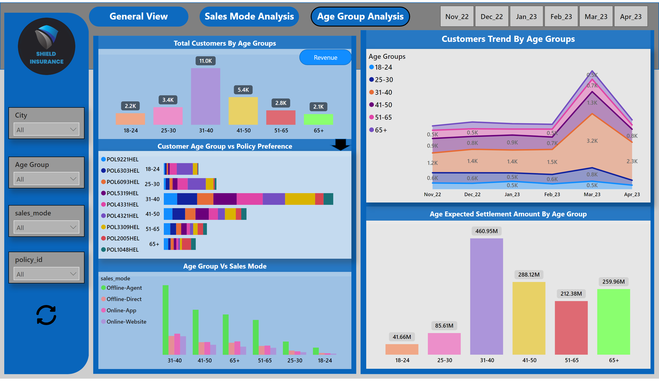
Age Group View
Notes:
shape
No alt text provided
image
No alt text provided
slicer
No alt text provided
shape
No alt text provided
shape
No alt text provided
shape
No alt text provided
textbox
No alt text provided
textbox
No alt text provided
lineChart
No alt text provided
actionButton
No alt text provided
barChart
No alt text provided
clusteredColumnChart
No alt text provided
Total Customers
No alt text provided
textbox
No alt text provided
shape
No alt text provided
shape
No alt text provided
shape
No alt text provided
Total Customers
No alt text provided
textbox
No alt text provided
columnChart
No alt text provided
textbox
No alt text provided
revenue
No alt text provided
shape
No alt text provided
slicer
No alt text provided
slicer
No alt text provided
slicer
No alt text provided
slicer
No alt text provided
columnChart
No alt text provided
textbox
No alt text provided
image
No alt text provided
pivotTable
No alt text provided
shape
No alt text provided
shape
No alt text provided

