Slide 1
Maharshi Karve Mahila Mahavidyalay, Wai
Checksum Error Detection Simulator Using Python
Subject: Computer Networks
Rutuja Vijay Mandhare
Shruti Navnath Babar
Aarti Arun Gaikwad
Academic Year 2026 - 2027

Slide 2
What is Checksum and Why This Project
Problem
Error detection is learnt only through paper numericals. Carry handling is error-prone and it is hard to see how one changed bit affects the result.
Checksum
Noise and interference can flip bits while data travels over a cable or wireless link. Checksum is an error detection technique: the sender adds 8-bit words with one's complement addition and sends the complement of the sum with the data. The receiver adds everything again; all ones (11111111) means the data is accepted.
Our Solution
A web-based simulator: enter 8-bit data, see the checksum, flip any bit, and watch the receiver detect the error instantly.
Same idea as the Internet checksum in IP, TCP and UDP.

Slide 3
How Checksum Works: Example
Add the words
Add all 8-bit words
Step | Value
Word 1 | 10110010
Word 2 | 11001010
Sum | 101111100
After wrap-around | 01111101
Checksum | 10000010
Receiver, no error | 01111101 + 10000010 = 11111111
Receiver, bit flipped | 01111111: error detected
1
Wrap the carry
Add carry beyond 8 bits back
2
Complement
Flip all bits: this is the checksum
3
Verify
Receiver sum must be 11111111
4

Slide 4
System Architecture and Tools
Web Browser
index.html, style.css, script.js
request
Flask Server
app.py: REST APIs
request
Python Logic
valid_word(), calculate_checksum()
response
response
POST /api/calculate
Input: words (8-bit strings). Output: checksum.
POST /api/verify
Input: words and checksum. Output: valid and message.
Python
Backend logic
Flask
Web framework
HTML, CSS, JS
Frontend
VS Code
Code editor

Slide 5
Core Logic in Python (app.py)
Wrap-around carry
total & 255 keeps 8 bits; total >> 8 adds the carry back
A. Checksum calculation
def calculate_checksum(words):
total = sum(int(word, 2) for word in words)
while total > 255:
total = (total & 255) + (total >> 8)
checksum_value = (~total) & 255
return format(checksum_value, "08b")
One's complement
~total & 255 flips all 8 bits
B. Checksum verification
total = sum(int(word, 2) for word in words) + int(checksum, 2)
while total > 255:
total = (total & 255) + (total >> 8)
if total == 255:
return jsonify({
"valid": True,
"message": "No error detected." })
return jsonify({
"valid": False,
"message": "Error detected in received data."
})
Verification
Add words and checksum; valid only if the result is 255
Input validation
valid_word() accepts exactly 8 characters of 0 or 1

Slide 6
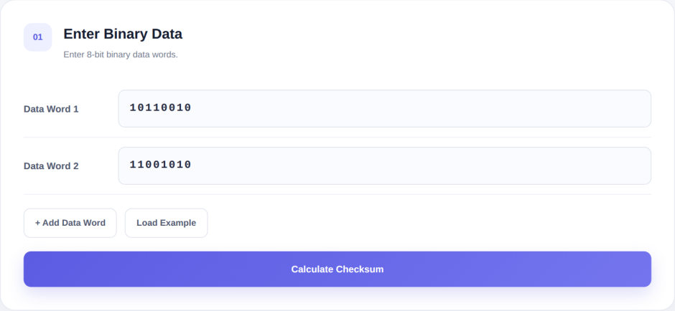
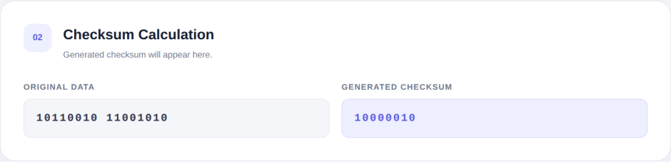
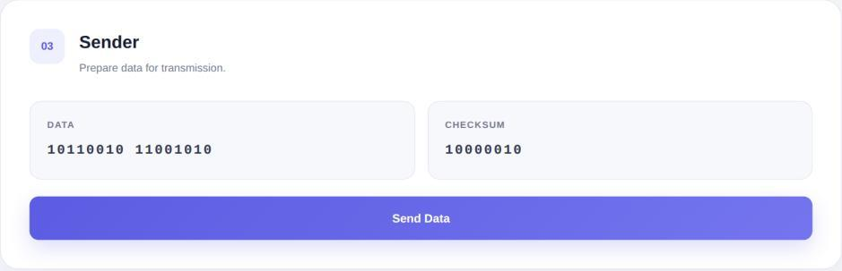
Demo: Sender Side
Step 01: Enter 8-bit data words
Step 02: Checksum generated by Python server
Step 03: Sender prepares the packet
Example data: 10110010 and 11001010 give checksum 10000010. Add more words with the Add Data Word button or use Load Example.

Slide 7
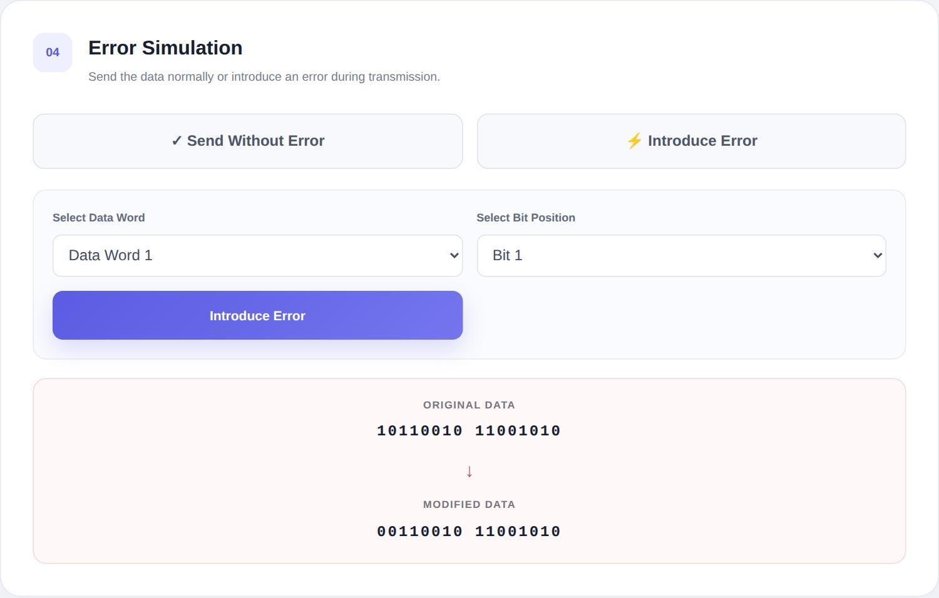
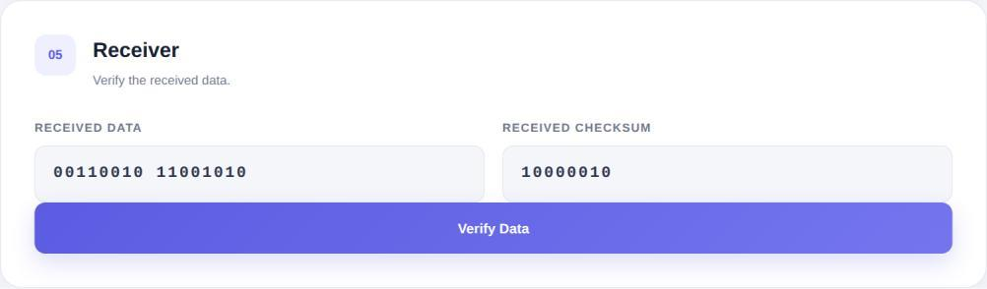


Demo: Error Simulation and Result
Step 04: Flip a bit during transmission
Step 05: Receiver verifies
Result with error
Result without error
Bit 1 of Data Word 1 flipped: 10110010 becomes 00110010 while the checksum stays 10000010.

Slide 8
Advantages and Future Scope
Future Enhancement
Advantages
Interactive way to learn checksum
Instant checksum and verification
Step-by-step, easy-to-use interface
Accurate one's complement logic with input validation
Separate HTML, CSS, JS and Python files: easy to extend
1
16-bit words and full Internet checksum
2
Text or file input
3
Multi-bit errors, random error generation
4
Step-by-step addition table
5
Login, history, online deployment

Slide 9
Thank You
We hope this project helps students understand error detection in a simple and practical way.

