Slide 1
Case Study 3
MovieLens EDA

Slide 2
Motivation
Size and Variety: The dataset is relatively large, containing a million ratings given by users to thousands of movies. This size allows for meaningful analysis and predictive modeling.
Real-World Application: Movie ratings data is relatable and easily understood by a wide audience, making it a good choice for educational and demonstration purposes. Additionally, it has practical applications, such as movie recommendation systems.
Availability and Openness: The dataset is readily available and has been used for research and educational purposes, making it easy to access and work with.

Slide 3
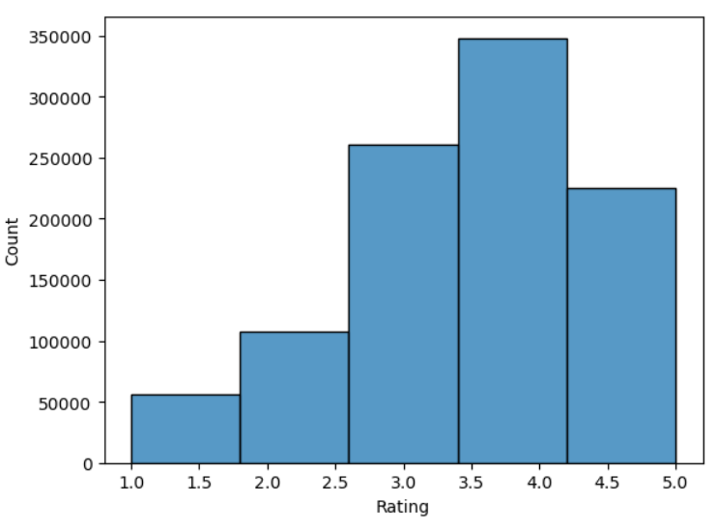
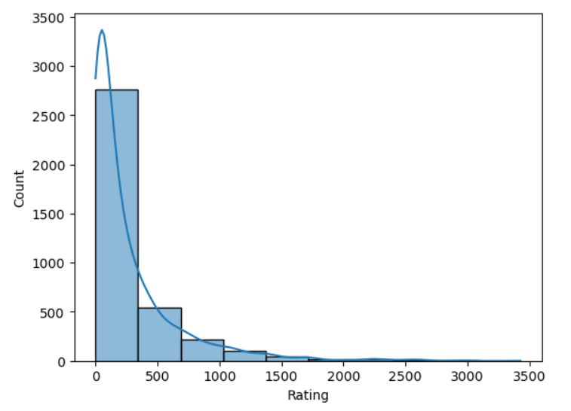
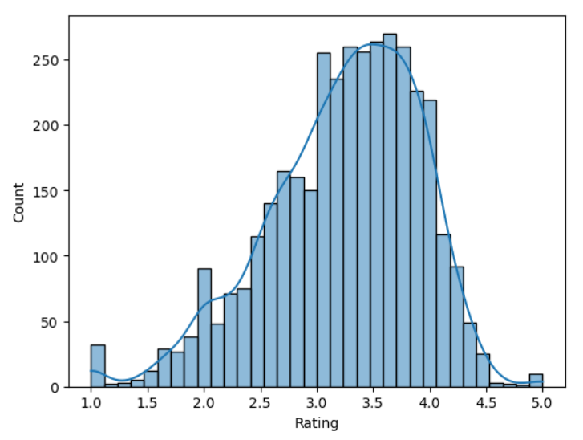
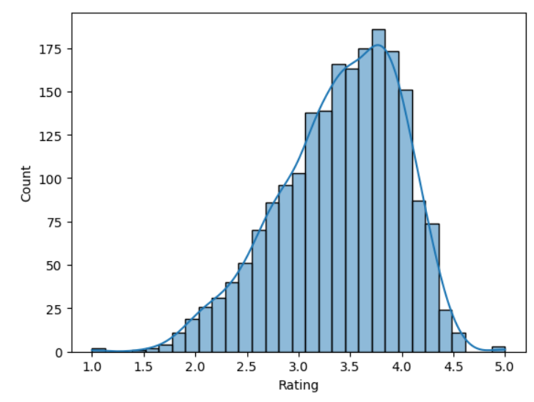
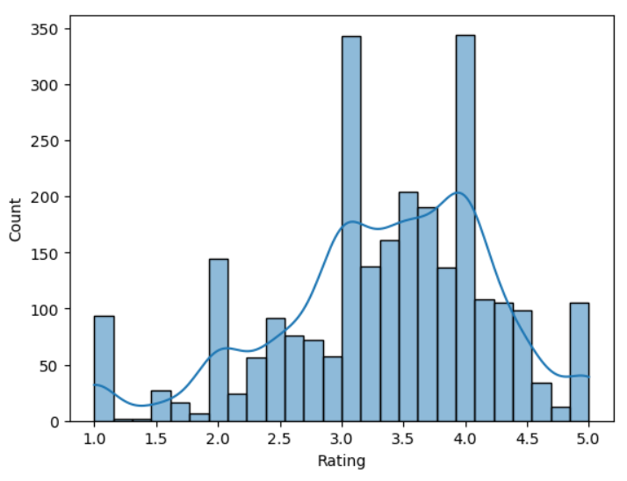
Exploratory Data Analysis
Overall Ratings
Number of ratings per movie
Average Rating per Movie
Average rating for movies
with 100 or more ratings
Average Ratings given by Children

Slide 4
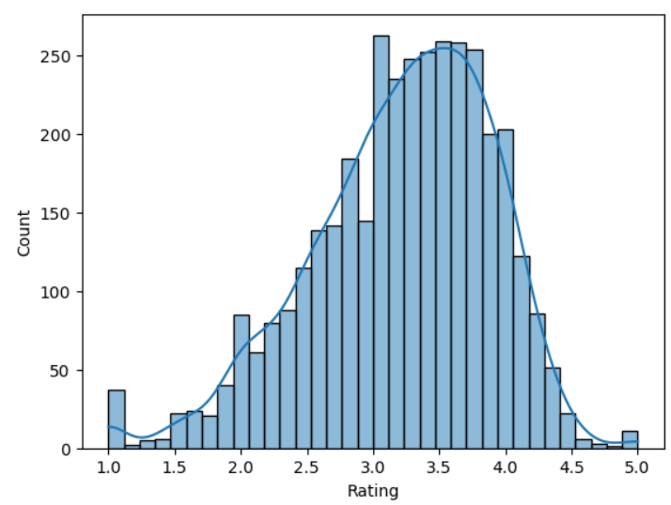
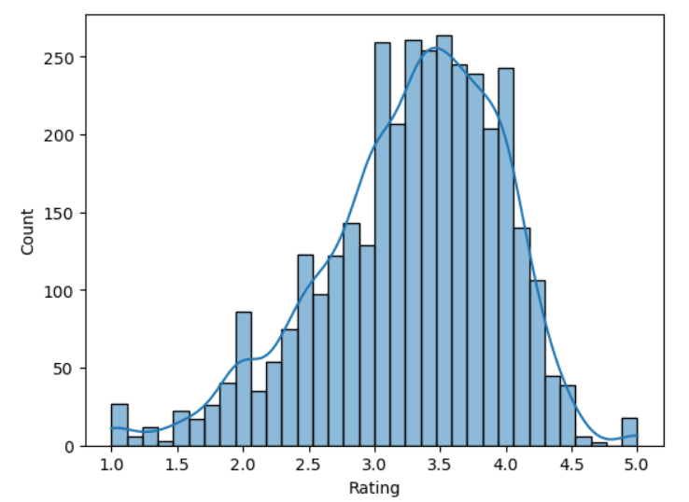
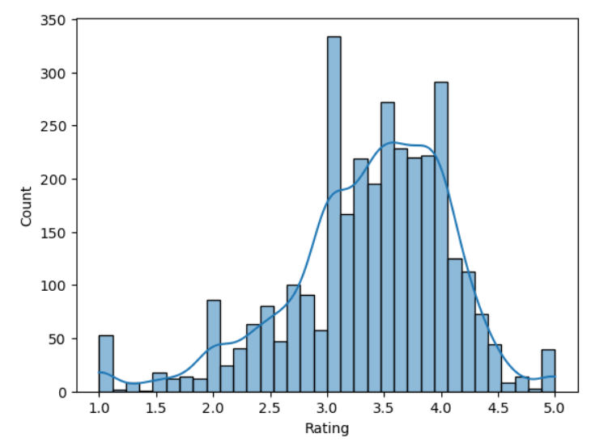
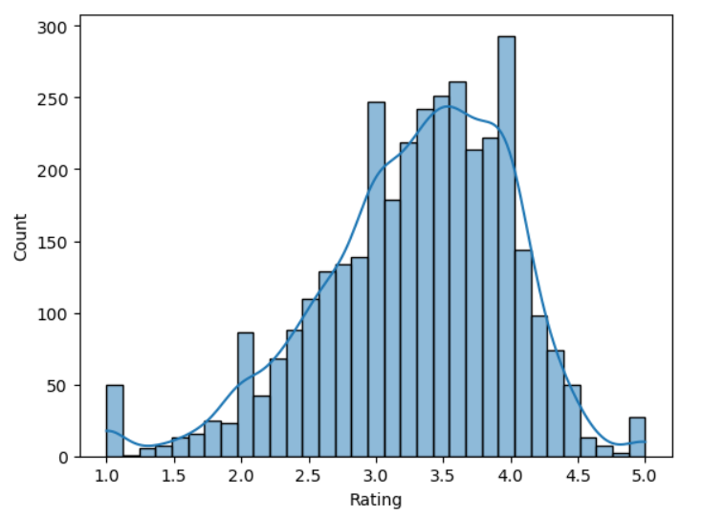
Exploratory Data Analysis
Average ratings given by Men
Average ratings given by men over 30
Average ratings given by women over 30
Average ratings given by women

Slide 5
Exploratory Data Analysis
Movies with average rating over 4.5: 21
Movies with average rating over 4.5 among men: 23
Movies with average rating over 4.5 among women: 51
Movies with median rating over 4.5 among men over age 30: 86
Movies with median rating over 4.5 among women over age 30: 149
Ten most popular movies:
American Beauty (1999): 3428
Star Wars: Episode IV - A New Hope (1977): 2990
Star Wars: Episode V - The Empire Strikes Back (1980): 2990
Star Wars: Episode VI - Return of the Jedi (1983): 2883
Jurassic Park (1993): 2672
Saving Private Ryan (1998): 2652
Terminator 2: Judgment Day (1991): 649
Matrix The (1999): 590
Back to the Future (1985): 2582
Silence of the Lambs The (1991): 2578

Slide 6
Conjectures
Conjecture 1: Older people (age above 30) are harder to please (lower average ratings)
Conjecture 2: age range (1-10) given more extreme ratings? Can we think children are more or less likely to rate a movie 1 or 5?
Conjecture 3: Men, as a group, tend to provide their own distinct set of ratings for movies within the MovieLens dataset. Their average ratings for various films might reflect certain preferences, genre inclinations, or specific storytelling elements that cater to or align with their tastes and interests.
Conjectures 4: Female reviewers within the MovieLens dataset offer a unique perspective on movies, resulting in varying average ratings across different films. Their ratings may reflect distinct genre preferences, storytelling elements, or cinematic aspects that particularly resonate with this demographic group, potentially influencing the overall perception and reception of these movies.
Conjecture 5: under what circumstances the rating given by one gender can be used to predict the rating given by the other gender. For example, are men and women more similar when they are younger or older?
Conjecture 6:If there's a high positive correlation between the ratings given by both genders for a specific type or genre of movies, it suggests a strong relationship. In such cases, the rating given by one gender might reasonably predict the rating given by the other gender. For instance, if men and women consistently give similar ratings to action movies, it might be possible to predict one gender's rating based on the other's.

Slide 7
Thank you

