Slide 1
Introduction to
Git and Github

Slide 2
What is Version Control?
Also known as Source control
Tracking and managing changes to Software code
Helps compare earlier versions
Keeps track change by each contributor
Helps in preventing concurrent work from conflicting
Even PyCharm has an option of keeping a track of local history till date
Example – Git is a Distributed Version Control System

Slide 3
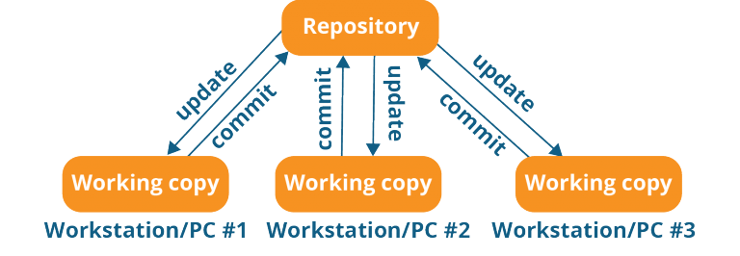
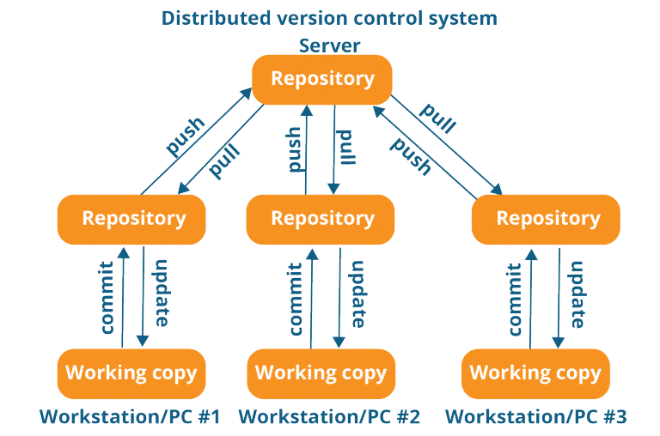
Central vs Distributed Version Control System
Central Version Control System
Distributed Version Control System
A central server stores all files and enables team collaboration
Works on single repository
Not available locally
Everyone maintains a local repository of their own which contains all files and metadata of main repository

Slide 4
Why use Git?
Store revisions in a project history in just one directory
Rewind to any revision in the project
Work on new features without disturbing the original codebase
Easily collaborate with other programmers

Slide 5
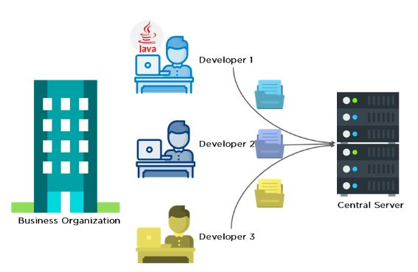
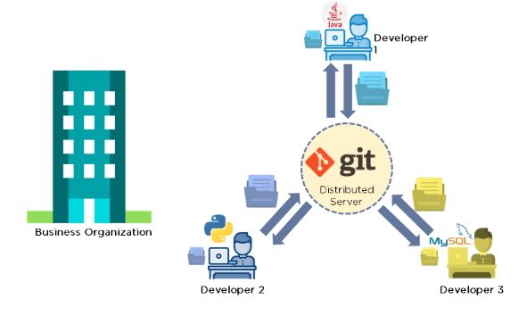
How does Git work?
Scenario before Git
Scenario after Git

Slide 6
Stages of Git
Modify :
  Make changes to file in ‘Working directory’
  Git is just aware of the files in this project
  and does not track changes
Index or Stage :
  Group, add and organize the files to be
  committed to Git for tracking their versions
  Indexing : Process of adding files to staging area
Commit :
  Commit the files stored in staging area to Git directory
  Snapshot of the files in commit is stored in Git directory
Working Directory
Staging
Area
Git
Directory
Checkout changes
Stage files
Commit

Slide 7
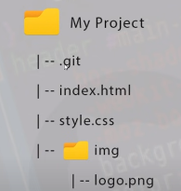
Git basics
Repository :
  Containers for projects you want to track
  Can be local or remote(stored on some cloud platform)
  Git tracks all contents of a repository
Commits :
  Kind of a save file command
  We are able to revert back to any previous commit
  Snapshot of repository at a certain point in time
Branch :
  Kind of an isolated environment to test a new addition to the original code
  A pointer to a specific commit

Slide 8
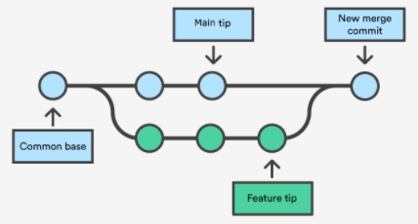
Git basics
Checkout :
  Switching between different versions of an entity
.git folder :
  Contains all information for version control
  Initialized by git init command
.gitignore file :
  Tells git which files are to be ignored when
  committing your repository
Merge :
  Combine multiple sequences of commits into one
Git branches

Slide 9
Git basics
Pull request :
  Used to fetch and download content from a remote repository and immediately update the local repository to match that content
  Combination of git fetch and git merge
Push request :
  Upload local repository content to a remote repository.

Slide 10
What is Github?
Online service that hosts repositories
Share our code with other developers
Developers can download the projects and work on them
Re-upload edits and merge with original codebase

