Slide 1


Slide 2
Points of Discussion
● Dataset Overview
● Problem Statements
● Features in Dataset
● Importing Libraries and Data Cleaning
● Data Exploration
● Hosts and Areas
● Neighbourhood Group Price Distribution
● Busiest Hosts by Reviews
● Room Type Preferred
● Neighbourhood Popularity
● Conclusion

Slide 3
Dataset Overview ● Airbnb, as in “Air Bed and Breakfast”, is a online business where lets property owners rent out their spaces to people looking for a place to stay. Travelers can rent a space for multiple people to share, a shared space with private rooms, or the entire property for themselves. ● The dataset Airbnb NYC 2019 that we are analyzing consists of the booking data on Airbnb from 2008 to 2019

Slide 4
Problem Statements 1. What can we learn about different hosts and areas? 2. What can we learn from predictions( prices, reviews,etc.)? 3. Which hosts are busiest and why? 4. Which room type is preferred in most popular neighbourhood? 5.Is there any noticeable difference of traffic among different areas, what could be the reason for it?

Slide 5
Features in dataset: The features in the dataset can be described as follows: • id - It is the identity number of the property listed by a particular host. • name - It is the name of the property listed by the host. • host_id - It is the identity number of the hosts • host_name – It is the name of the host • neighbourhood_group - It is the name of the neighbourhood groups in NYC • neighbourhood – It is the name of the neighbourhood in NYC. • latitude – It is the coordinates of latitude of the property listed. • longitude – It is the coordinates of longitude of the property listed

Slide 6
• room type – It is the type of room listed by host. • price - It is the rent of the property listed in US Dollars. • minimum nights – It is minimum nights customer rented the property. • Number_of_reviews – It is the number of customers reviews on the property. • last_review – It is the date when the property was last reviewed. • reviews_per_month - It is the count of reviews per month on the property • calculated_host_listings_count - It is the number of listings done by a host • Availability_365 – It is the number of days the property is available in a year

Slide 7
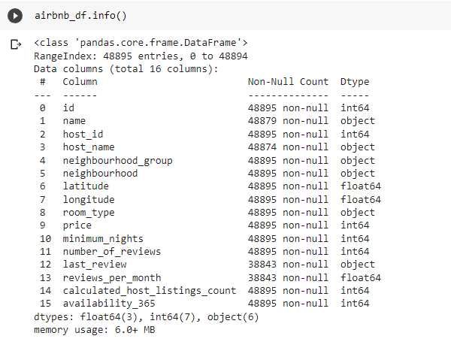
The dataset has 48895 rows and 16 features.

Slide 8
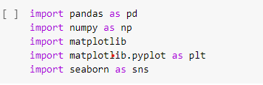
Importing Libraries and Data Cleaning Importing the required libraries

Slide 9


Dropping non-relevant features from the dataset. Replacing the NaN values from features.

Slide 10
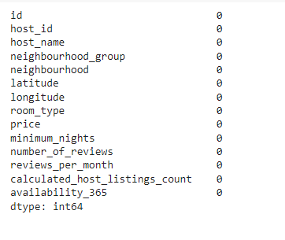
Updated dataset has no NaN values.

Slide 11
Data visualization
Visualization is the representation of data through use of common graphics, such as charts, plots, infographics, and even animations. These visual displays of information communicate complex data and data driven in a way that is easy to understand.
TYPES OF DATA VISUALIZATIONS:
1)Tables- This consists of rows and coulmns used to compare variables.
2)Pie charts and Bar charts- these graphs are divide into section that represents parts of whole.
3)Scatter Plots- they are commonly used with regression data analysis.
4)BoxPlot- it is a method for graphically demonstrating the locality, spreads and groups of numerical data through their quartiles.

Slide 12
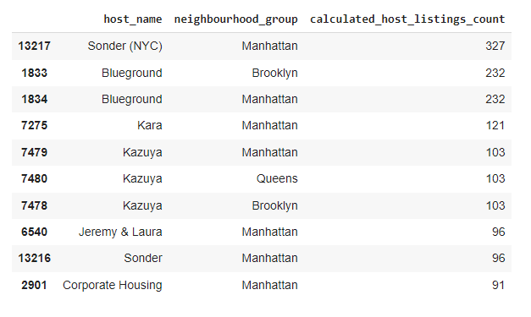
Hosts and Areas Top 10 hosts across different neighbourhood groups

Slide 13
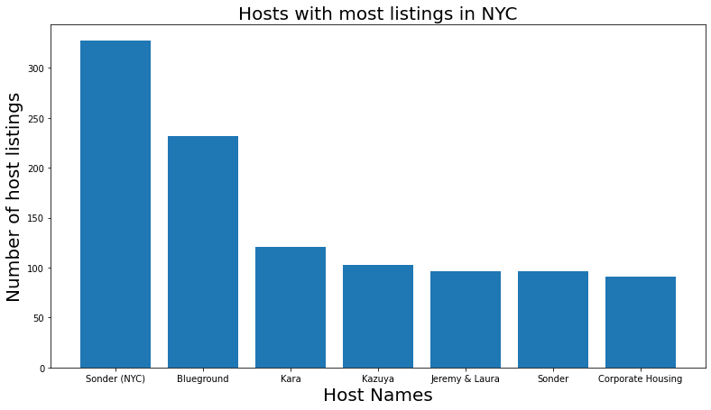
Hosts with most listings ● The host named Sonder(NYC) has highest number of listings of 327 in Manhattan neighbourhood group. ● The host named Blueground has 2nd highest listings of 232 in Manhattan Neighbourhood group. ● The host Blueground also has 232 listings in Brooklyn.

Slide 14
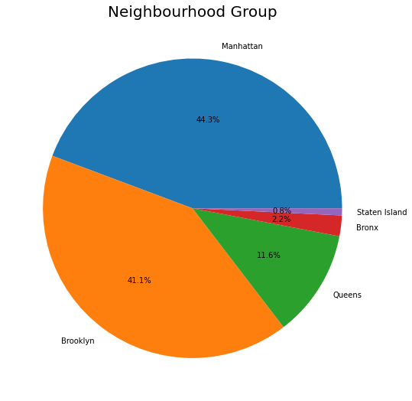
Neighbourhood Group • The pie chart shows Manhattan has 44.3% of the total listings which is the highest share. • Its followed by Brookyln with a share of 41.1% of total listings. • This means just Manhattan and Brooklyn have about 85% of the total NYC listings which is a lot. • Staten Island has the lowest number of listings in NYC with a share of only 0.8%

Slide 15
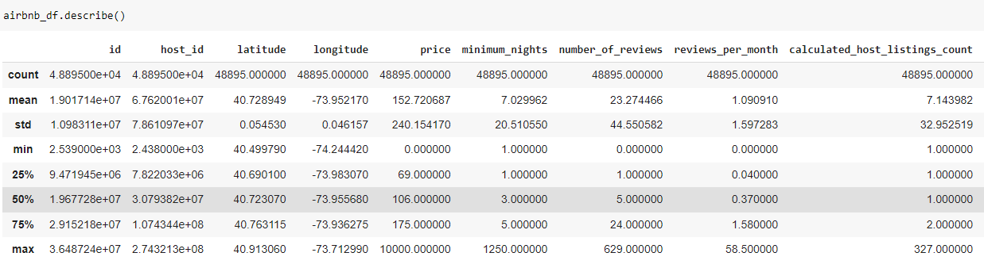
Dataset Statistics From the statistics we can see that maximum rental price is $10000 which is absurdly high and most probably skewed. Hence, we have to limit the price range to [price<500] in the plots to get an accurate display of the price ranges in different neighbourhoods.

Slide 16
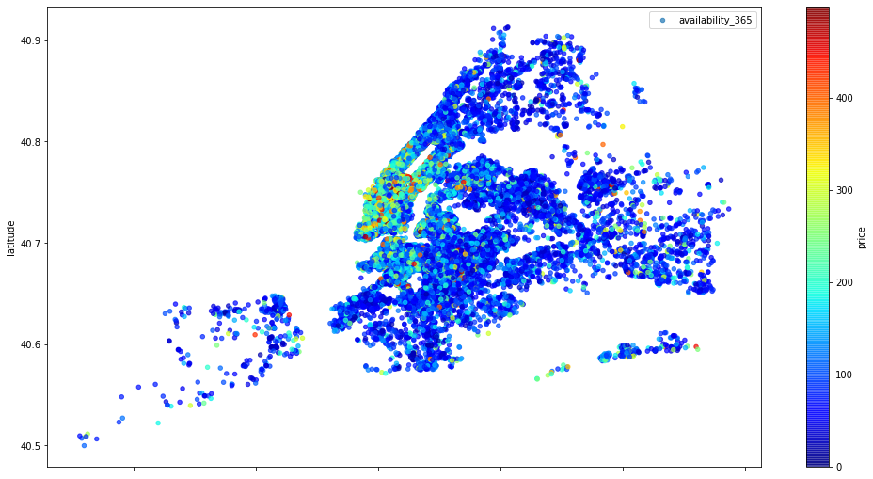
Neighbourhood Group Price Distribution • Red color dots are the rooms with a higher price and blue color dots are the rooms with a lower price. • Manhattan has the largest variation in price range. • Manhattan has the most number of green, yellow and red dots which means it has more expensive rooms than other neighbourhood groups.

Slide 17
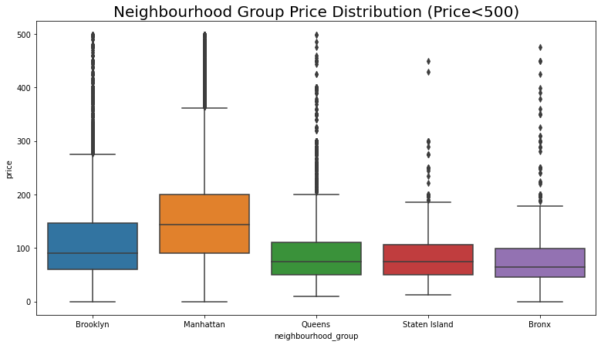
Price distribution further illustrated: Manhattan has the highest range price for the listings with about 140 USD as an average price, followed by Brooklyn with 90 USD. • Queens and Staten Island have a very similar range price. • Bronx has the lowest average price

Slide 18
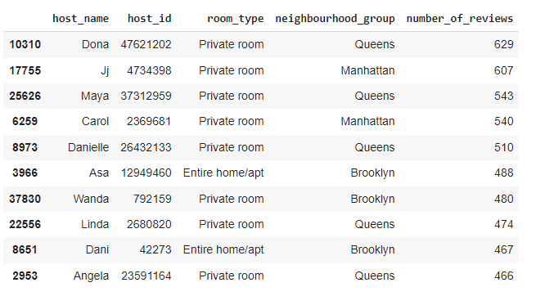
Top 10 busiest hosts by reviews

Slide 19
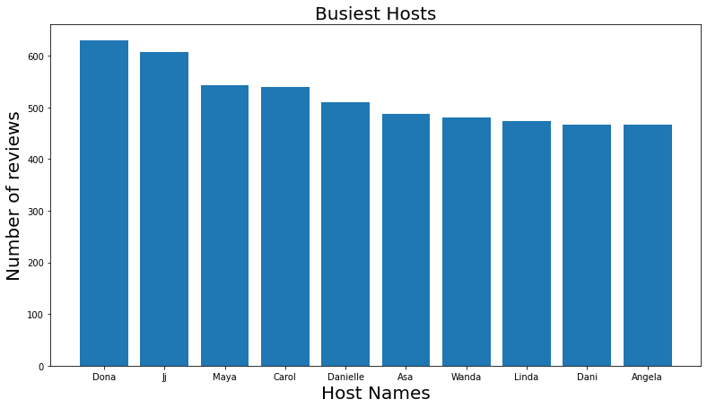
Busiest Hosts by Reviews ● Dona has highest numbers of reviews and we can assume that Dona is the busiest host followed by Jj and Maya ● The chart also shows that the busiest neighbourhoods groups are Manhattan, Queens and Brooklyn

Slide 20
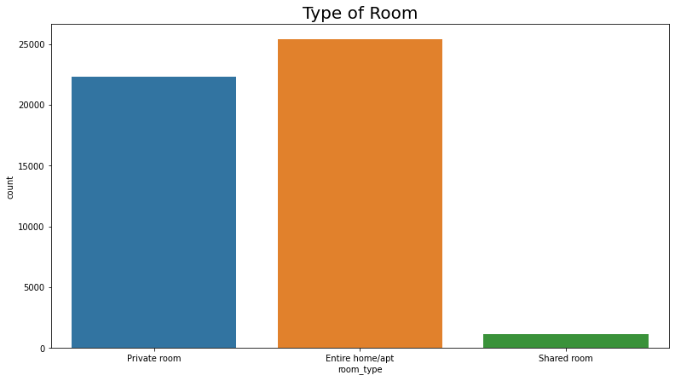
Room Type Preferred ● The most preferred room type is Entire home/apt as well as private room. ● Shared room is least preferred by people.

Slide 21
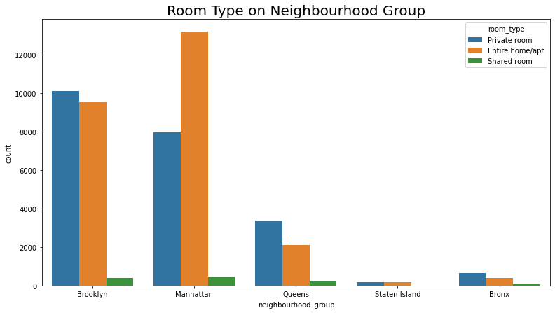
Room Type on Neighbourhood Group • Brooklyn has almost the same number of private rooms and entire home/apartments • Manhattan has significantly more entire home/apartments than private rooms • Queens has somewhat more private rooms than entire home/apartments

Slide 22
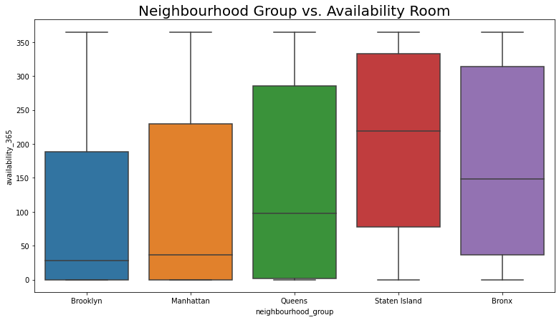
Neighbourhood Popularity Neighbourhood group room availability

Slide 23
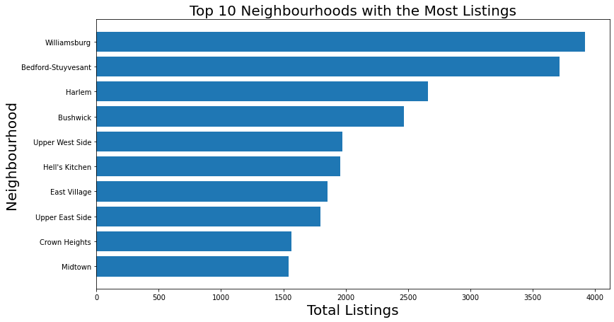
Neighbourhoods with the Most Listings ● Williamsburg In Manhattan has the highest numbers of listings which is 3920. ● It is followed by Bedford Stuyvesant in Brooklyn with 3714 listings. ● Harlem in Manhattan comes third with 2658 listing

Slide 24
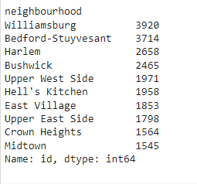
Top 10 neighbourhood with most listings.

Slide 25
Conclusion ● Hosts with most listings are from Manhattan and Brooklyn clearly stating that hosts prefer these two neighbourhood groups. ● Manhattan has the most number of listings out of all neighbourhood groups. Manhattan and Brooklyn have about 85% of the total NYC listings. ● Queens has significantly lower host listings than Manhattan. Staten Island has the lowest number of listings in NYC. ● Manhattan is the most expensive followed by Brooklyn. Bronx has the cheapest listings in NYC. ● The busiest hosts are from Manhattan, Queens and Brooklyn which is normal considering these are the most urban areas of NYC. ● Private room and entire home/apartment are the most in-demand room types.

Slide 26
● Manhattan has skyscrapers, world-famous museums, central parks, fastpaced lifestyle and a high standard of living. Brooklyn is home to beautiful parks, dining experiences and culture. This is why these neighbourhood groups are most preferred by hosts. ● Queens is geographically the largest of the five neighbourhood groups. Queens neighbourhoods have almost all the big-city perks. It has incredible cuisine and dining and has a fabulous culture and connectivity. This can be a strong enough motivation for a new hosts. ● Staten Island has the lowest number of listings in NYC which is based because Staten Island is the most suburban neighbourhood group in NYC. Public transit is very lackluster, no subway connections to other neighbourhood groups and the standard of living is relatively low. ● The neighbourhoods with the most listings are either in Manhattan or Brooklyn. Harlem and Williamsburg are the two neighbourhoods with the most listings in NYC

Slide 27
THANKYOU

