Slide 1


VeerAI:
Offline Desktop Based Personal AI
Rugved Sapkal – 24207011
Atharv Parab – 23107084
Abbas Sangameshwari – 23107116
Project Guide
Ms. Aishwarya Londhe

Slide 2
Outline
Introduction
Literature Survey of the existing systems
Limitations of the existing systems
Problem statement
System Design
Technologies and methodologies
Implementation
Conclusion
References

Slide 3
Introduction
In today’s digital era, users rely on virtual assistants for everyday tasks. However, most popular assistants like Siri, Alexa, and Google Assistant are cloud-dependent, raising privacy and latency concerns.
VeerAI solves this by offering a fully offline, privacy-first AI assistant that runs locally, integrating deeply with the user’s desktop environment.

Slide 4
Introduction
Objectives:
To enable offline AI processing using local LLM (Llama 3 via Ollama) for natural language understanding.
To implement persistent memory with ChromaDB and PostgreSQL for context-aware interactions.
To automate desktop tasks through modular actuators and APScheduler for seamless task execution.
To ensure user privacy and data security by processing all information locally without cloud dependence.

Slide 5
Literature Survey of the existing system
Sr. No. | Title | Author(s) | Year | Methodology | Outcomes | Result
1 | Hybrid Model for Intelligent Personal Assistant​ | Sharma, A. & Gupta, R.​ | 2023 | Integrated on-device NLP for core processing with selective cloud fallback for heavy tasks. Utilized context retention and adaptive learning modules to improve responsiveness. | Enhanced data privacy, reduced latency, and improved continuity in user interactions. | The hybrid model achieved a balance between performance and privacy, demonstrating high accuracy even with limited internet connectivity.
2 | Mycroft: Open Source AI Assistant | Mycroft AI Team​ | 2022 | Implemented a modular, open-source framework using rule-based intent parsing and plugin-based skill extensions for local execution. | Enabled offline, customizable AI interactions with community-driven development. | Delivered strong privacy and flexibility, though personalization and contextual understanding remain limited.

Slide 6
Literature Survey of the existing system
Sr. No. | Title | Author(s) | Year | Methodology | Outcomes | Result
3 | Whisper.cpp: Efficient STT Model | Radford et al. (OpenAI) | 2022 | Optimized the Whisper speech-to-text model into a lightweight C++ implementation for on-device inference without cloud dependency. | Achieved reliable offline speech recognition with reduced computational overhead. | Demonstrated high transcription accuracy and low latency, making it suitable for real-time local AI applications.
4 | Rhasspy: Offline Voice Assistant | Verspoor, J. | 2021 | Developed an open-source, modular speech assistant framework supporting multiple speech recognition and intent parsing backends. | Provided a fully offline, customizable alternative to cloud-based assistants. | Achieved effective local speech processing and automation, though limited by smaller model scalability.

Slide 7
Literature Survey of the existing system
Sr. No. | Title | Author(s) | Year | Methodology | Outcomes | Result
5 | Privacy-Preserving Personal AI using On-Device LLMs | Chen, L., Huang, Y., & Li, X. | 2020 | Proposed a local LLM architecture leveraging on-device computation and encryption-based data isolation. | Improved user data confidentiality while maintaining model performance. | Validated that on-device AI can preserve privacy without significant accuracy trade-offs.

Slide 8
Limitations of Existing Systems
Internet Dependency: Most assistants require constant cloud connectivity, failing in offline or low-network environments.
Privacy Concerns: User data is processed and stored on remote servers, raising serious privacy and security risks.
Limited Context Awareness: Assistants lack long-term memory, forcing users to repeat information across sessions.
Shallow System Integration: Unable to perform deep local operations such as file management or context-based desktop actions.

Slide 9
Limitations of Existing Systems
Fragmented Features: AI capabilities (chat, voice, automation, creativity) are split across multiple tools with no unified platform.
Restricted Customization: Proprietary ecosystems prevent users from adding new features or modifying assistant behavior.
High Resource Requirements: Some offline models demand powerful hardware, limiting accessibility for average users.

Slide 10
Problem Statement
Existing virtual assistants depend on cloud servers, compromising privacy, speed, and offline usability.
They lack local integration, context awareness, customization, creating a need for a secure, offline, and intelligent desktop assistant that ensures privacy with full functionality

Slide 11
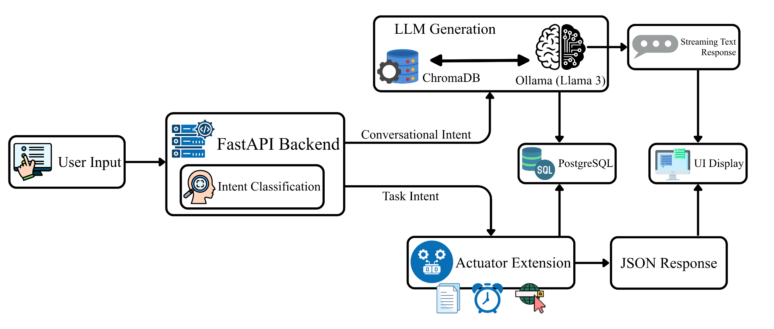
System Design

Slide 12
Technologies
Backend Development:
  Python
  FastAPI
  Uvicorn
Frontend Development:
  Electron.js
  HTML, CSS & JavaScript
Artificial Intelligence & Machine Learning:
  PyTorch
  NLTK
  Ollama
  Langchain
  Hugging face sentence transformers

Slide 13
Technologies
Databases:
  PostgreSQL
  ChromDB
Desktop Integration:
  APScheduler
  Plyer

Slide 14
Methodology
Understanding the Query
  User inputs a command via text.
  Input is vectorized and classified using custom PyTorch model to identify intent.
Processing the Request
  User inputs a command via text.
  Input is vectorized and classified using custom PyTorch model to identify intent.
Generating the Result
  Actuator Output: Returns a short confirmation message.
  LLM Output: Streams natural text responses in real time for smooth conversation flow.

Slide 15
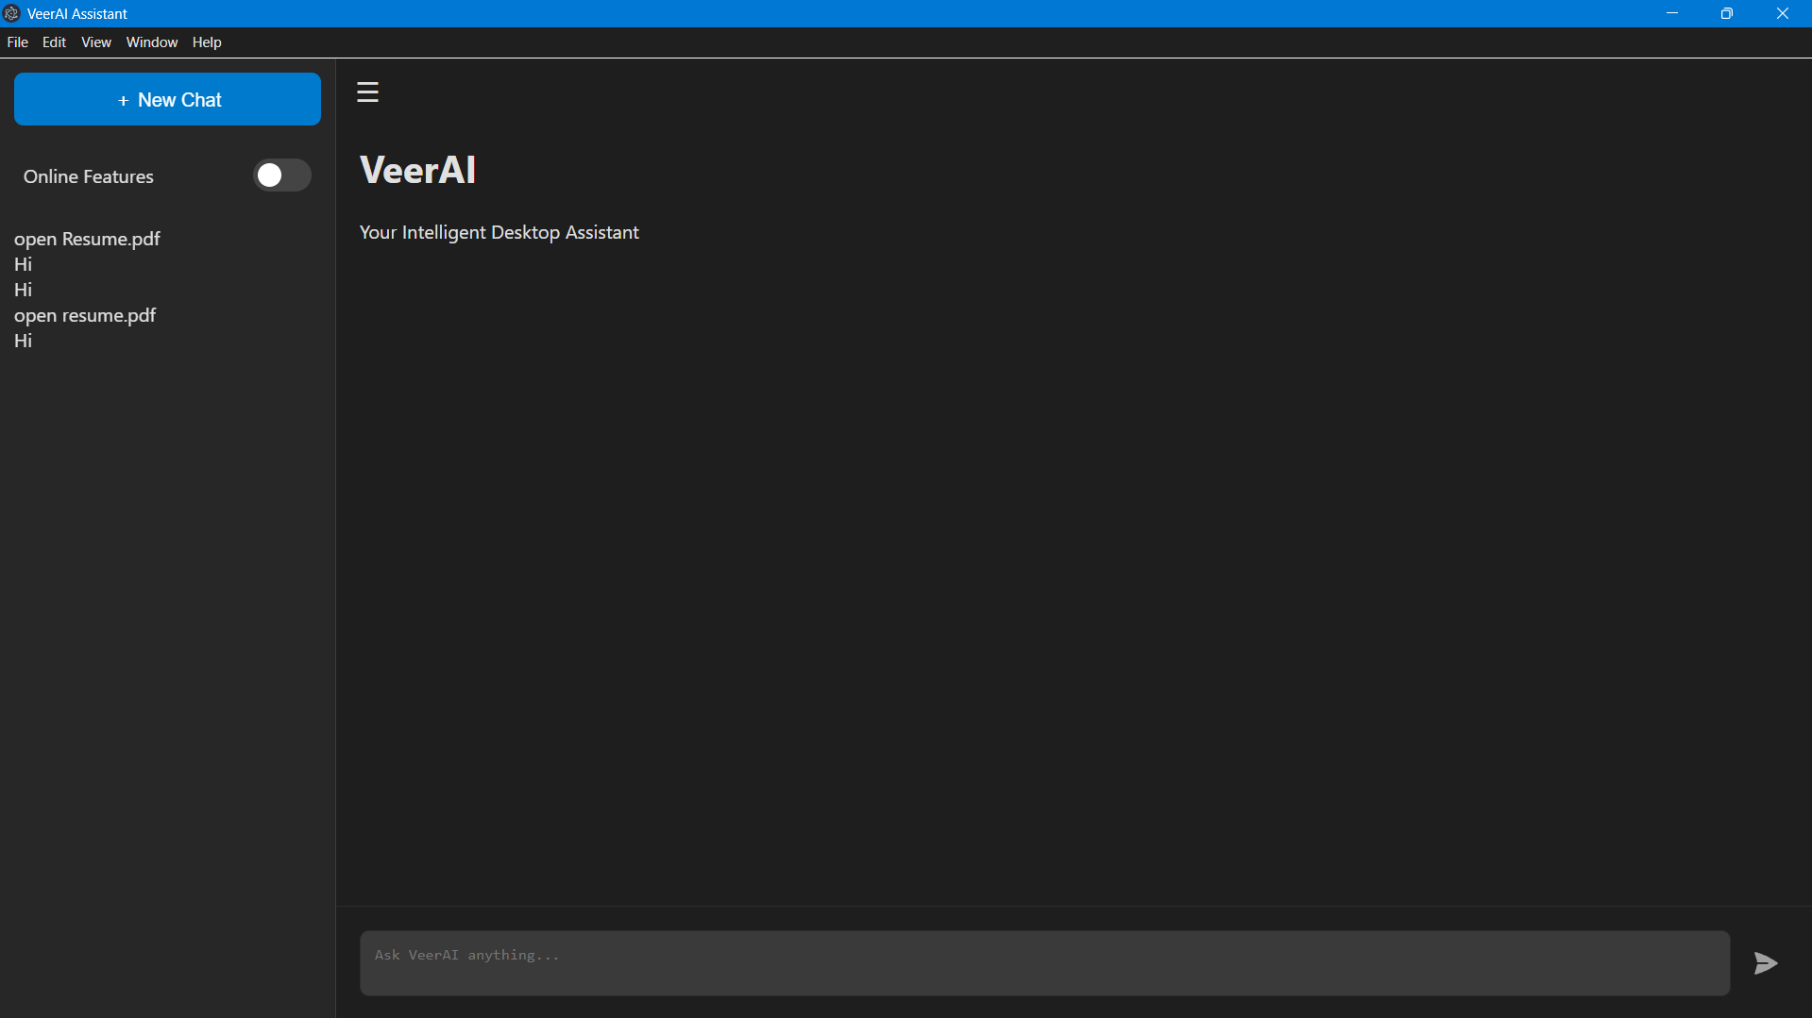
Implementation
Figure 7.1 Desktop UI

Slide 16
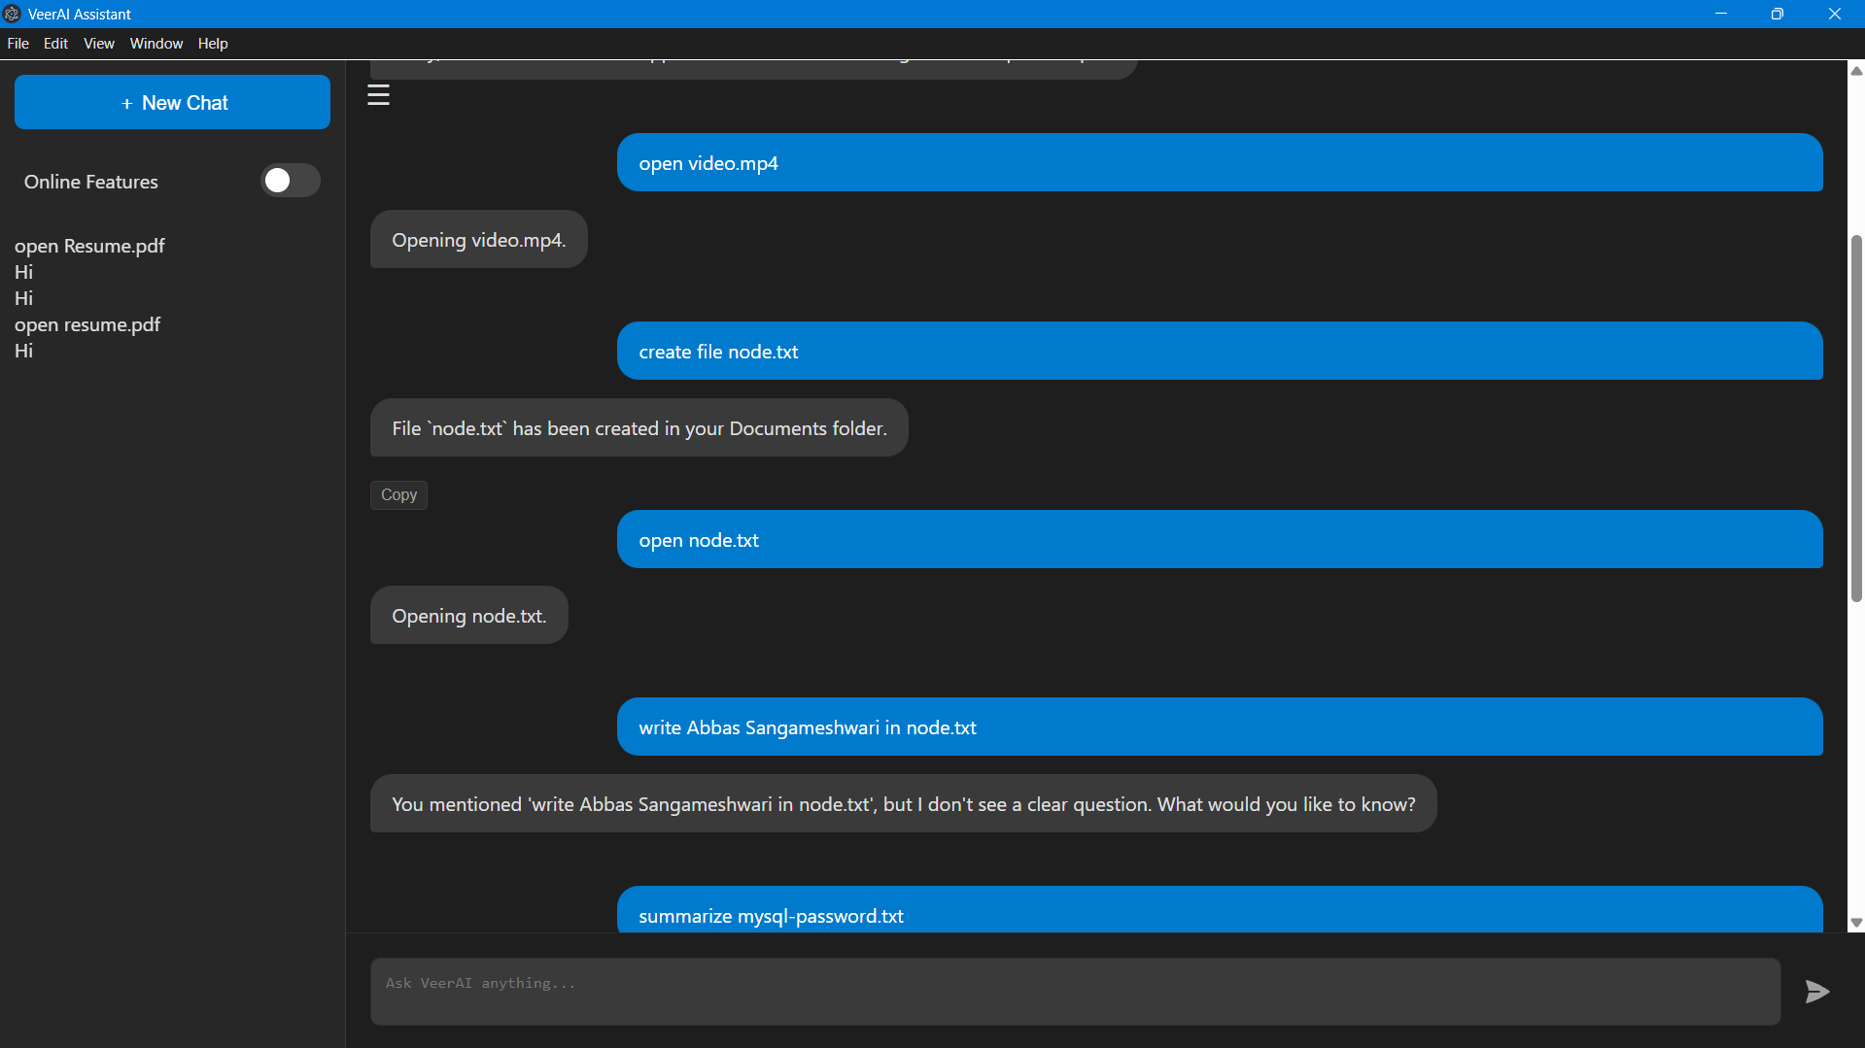
Implementation
Figure 7.2 Chat

Slide 17
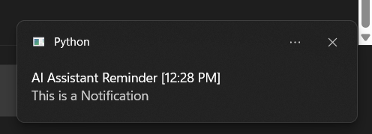
Implementation
Figure 7.3 Notification

Slide 18
Conclusion
Successfully developed VeerAI, a fully functional, offline-first AI desktop assistant with a modular and extensible architecture.
Utilized PyTorch to build a custom intent classifier and FastAPI to create a robust backend, ensuring a fast and responsive user experience.
Implemented a cutting-edge RAG pipeline using LangChain and a local Ollama LLM, enabling the assistant to understand and answer questions from private user documents.
Designed and built a modern, intuitive desktop interface using Electron.js, featuring a streaming chat display and persistent conversation history.

Slide 19
References
[1] Sharma, A., & Gupta, R. “Hybrid Model for Intelligent Personal Assistant.” International Journal of Computer Applications, Vol. 182, No. 12, pp. 25-32, 2023.
[2] Mycroft AI Team. “Mycroft: Open Source AI Assistant.” Mycroft Documentation, 2022.
[3] Radford, A., Kim, J. W., Xu, T., et al. “Robust Speech Recognition via Large-Scale Weak Supervision (Whisper).” OpenAI Research Paper, 2022.
[4] Verspoor, J. “Rhasspy: An Offline, Open Source Voice Assistant.” GitHub Project, 2021.
[5] Chen, L., Huang, Y., & Li, X. “Privacy-Preserving Personal AI using On-Device Large Language Models.” IEEE Access, Vol. 8, pp. 145392–145405, 2020.

Slide 20
Thank You...!!

