Slide 1

Flight Data Analysis

Slide 2

Why This Study?
Flight delay is one of the most common but an unpleasant experience that people dread to have. Every year, a lot of flights get delayed which involves some cost both for the airline and the passenger in different ways.
Due to inevitable factors such as weather conditions statistics of the flight delays becomes crucial factor in understanding the flight’s performance.
This study presents the analysis driven from flight delay data from various trips.

Slide 3

Design Approach
Once the vision of our study was clear, we performed a literature review by reading different research papers and articles to understand how the airplane dataset has been already used to create meaningful visualizations.
After carefully studying the available dataset, we made some sketches which could be turned into visualizations by using visualization tools.
Different types of sketches were created so as to observe the trends about the delays based on delay types and airplane carriers. Having the sketches ready, we implemented our designs on the visualization tool D3.js

Slide 4

Target Audience
The target audience for this study are the people such as passengers, airport officials, crew members, etc who are directly related to the airline industry and the people such as data analysts who are interested in the analysis of flight dataset.

Slide 5

Implementation of Designs
Goal 1: Checking Destinations and associated delays
Goal 2: Insights based on Carrier
Goal 3 : Analyzing Delay types based on time
Goal 4: Finding Patterns and Relationships

Slide 6
Libraries Used
Body-Parser
Csvtojason
D3
Ejs
Express
Jquery
ml-logistics-regression
mongoose
node-kmeans
nodemon

Slide 7

Data Pre-Processing
Data Cleaning
Removed missing values.
Replaced some missing values by mean
Data Reduction
deleted some columns with large number of missing values (Dimensionality reduction).
Selected the significant variables

Slide 8
CRUD Operations
Display
Display Document
Insert
Insert Document
Update
Update Document
Delete
Delete Document

Slide 9
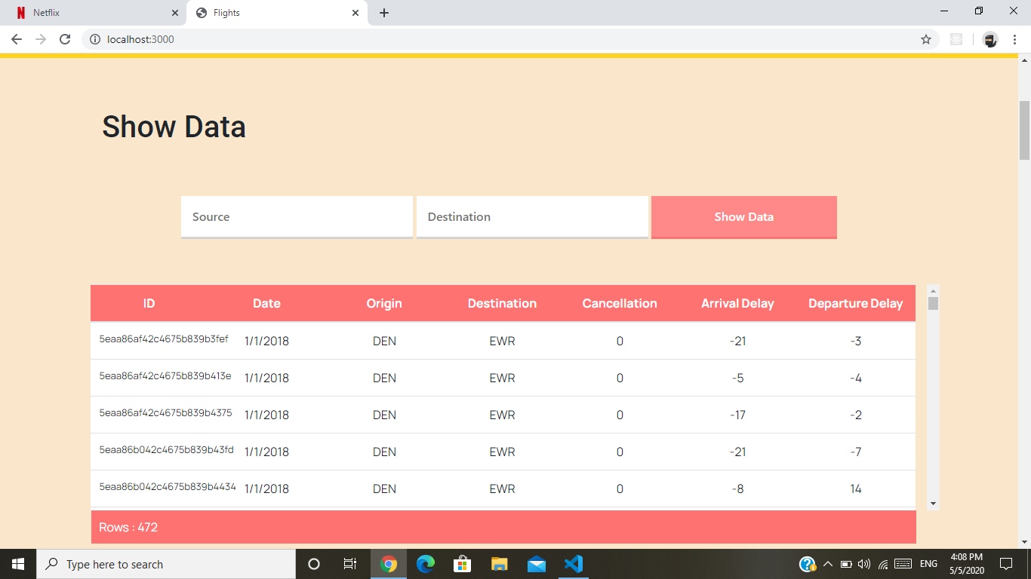
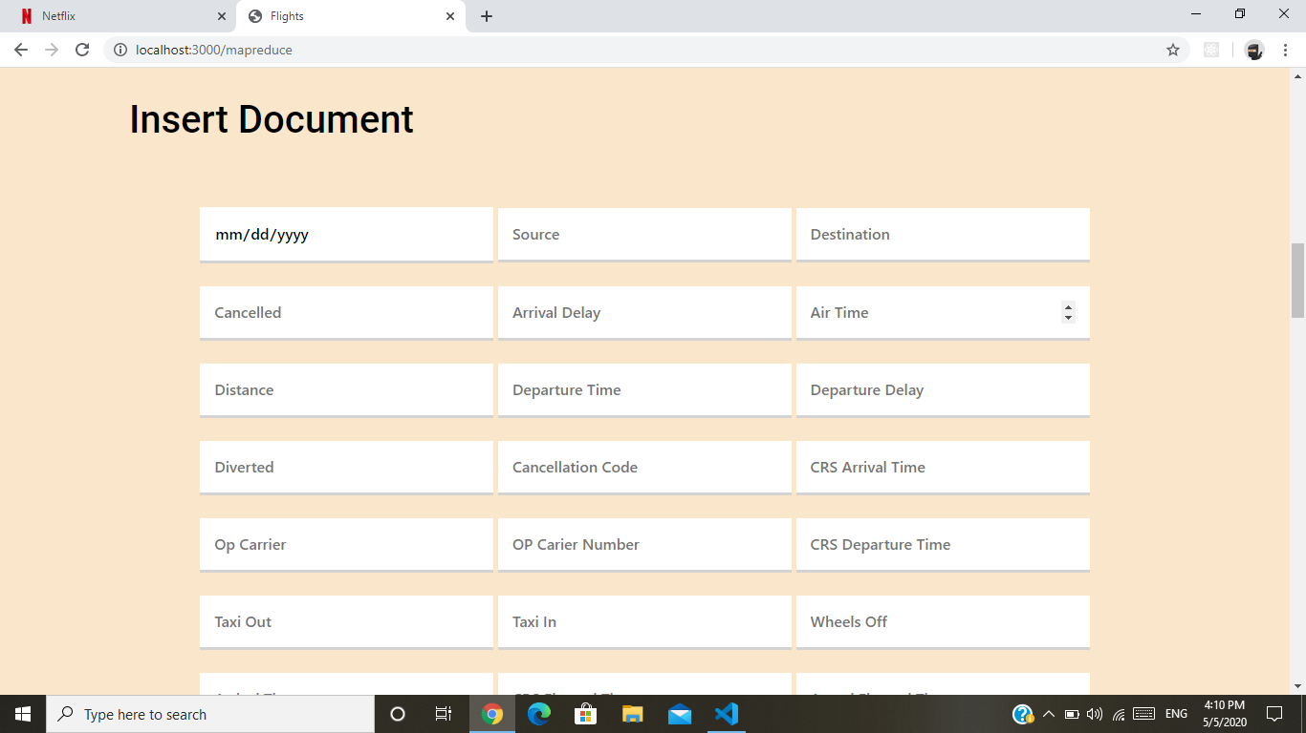
Fig 1.Show Data
Fig.2 Insert Document

Slide 10
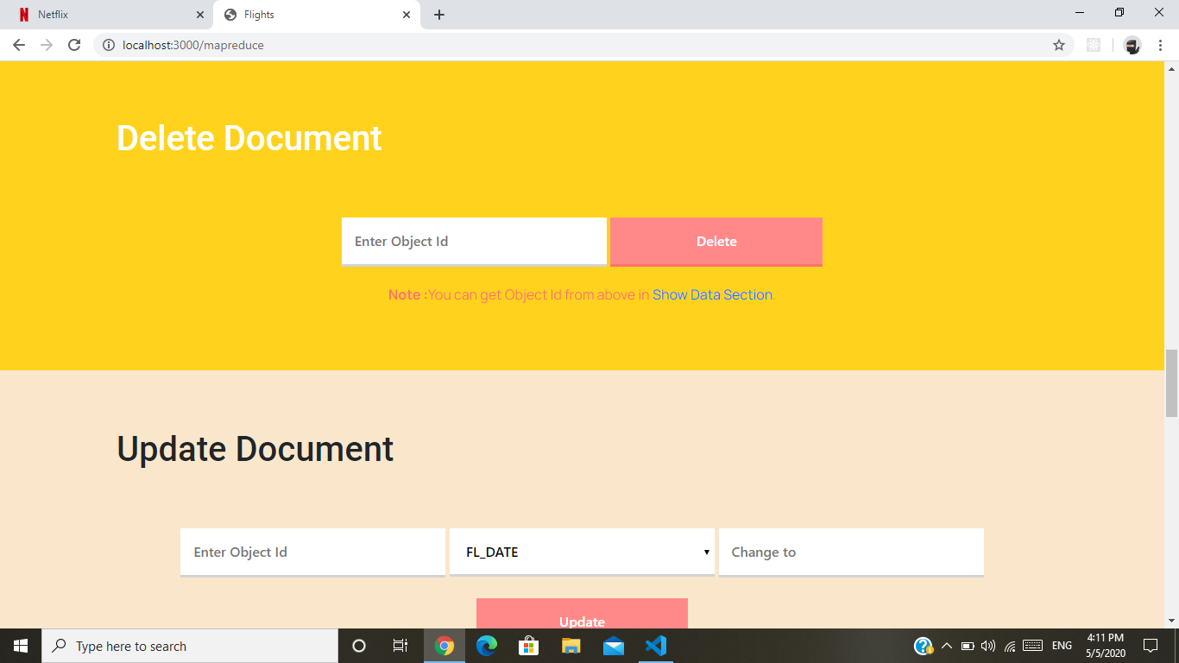
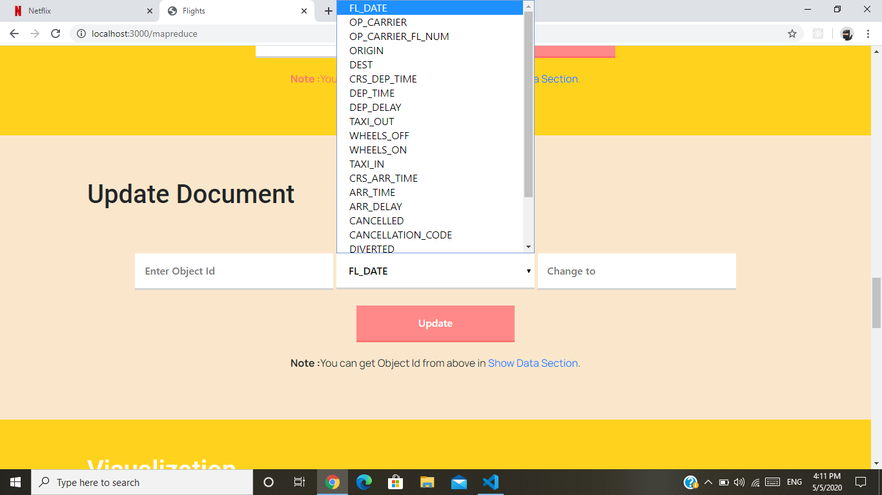
Fig.3 Delete Document
Fig.4 Update Document

Slide 11

Algorithms Used

Slide 12
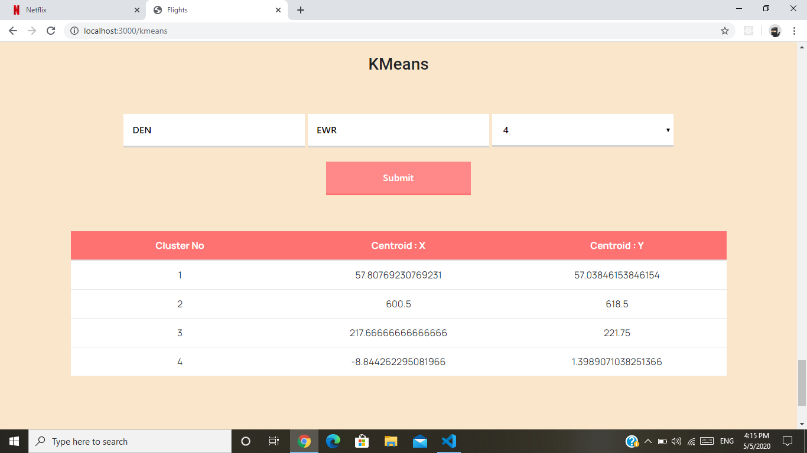
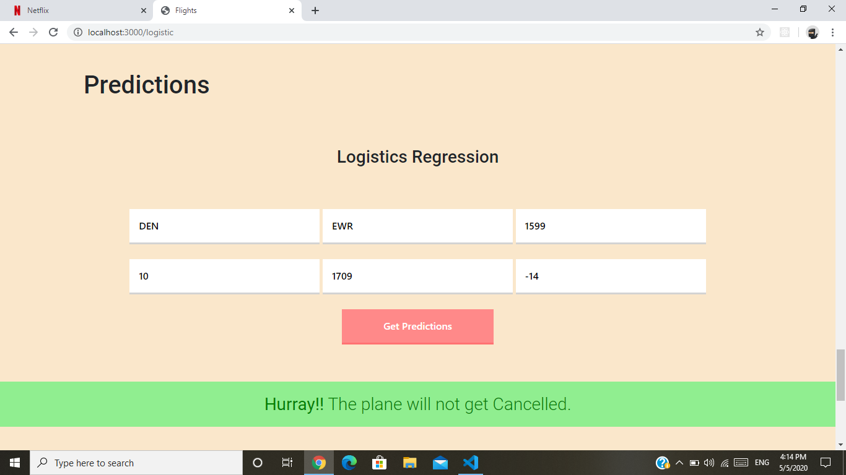
Algorithm Used
1. K-Means
2. Logistic Regression
Fig.5 K-Means
Fig.6 Logistic Regression

Slide 13

Front End
Body parser for passing and processed values
Ejs for templating html
Javascript Jquery for processing
Nodejs npm

Slide 14

Back End
Express as server​
Mongoose for mongodb connectivity​
Csvtojson to convert csv to json for insertion​
Node-kmeans - kmeans algorithm​
Nodemon - for running server continuously​
​Ml-logistics-regression for logistic regression for flight cancellation prediction

Slide 15

Data Visualization

Slide 16
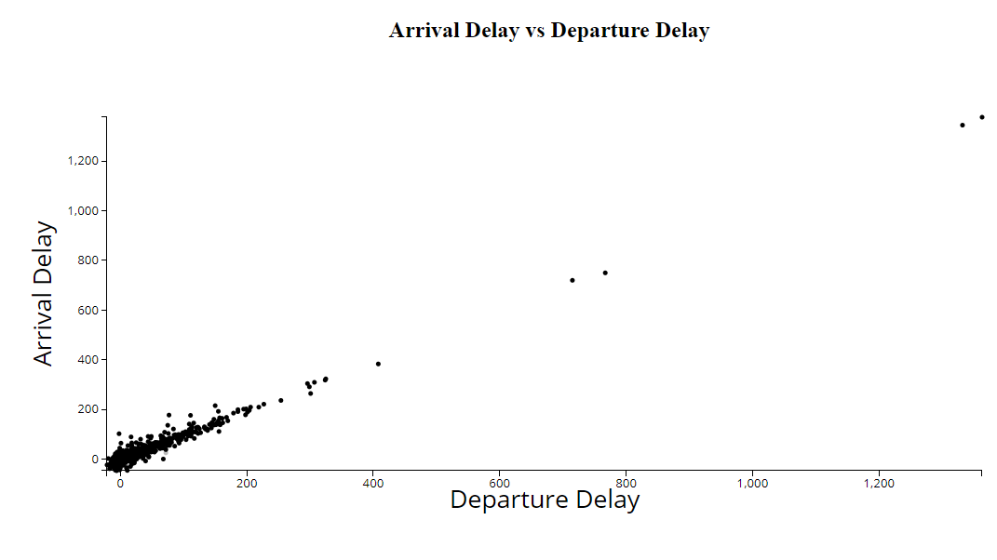
Fig.7 Scatter Plot

Slide 17
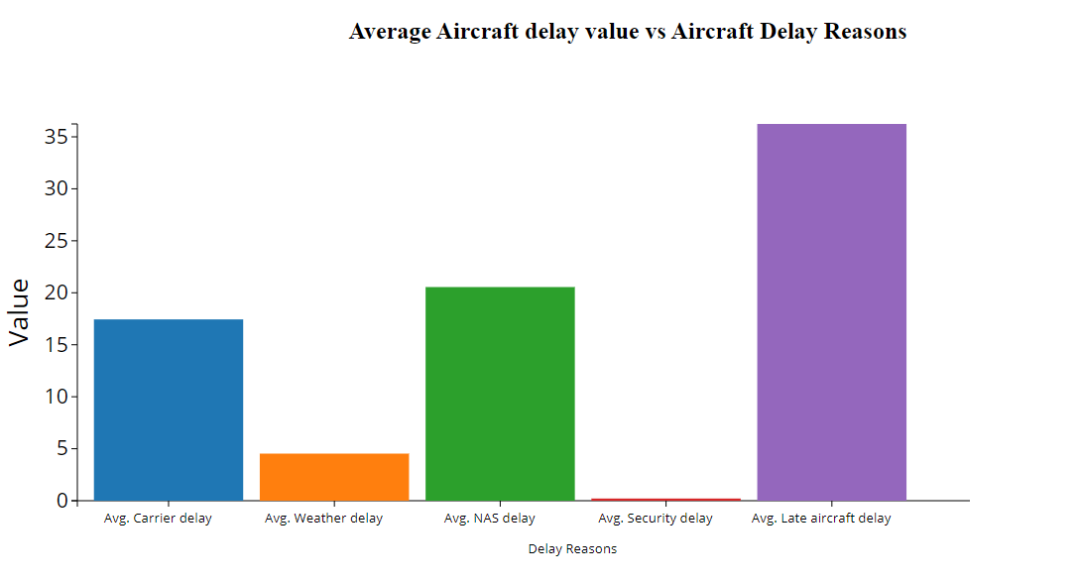
Fig .8 Bar Chart

Slide 18
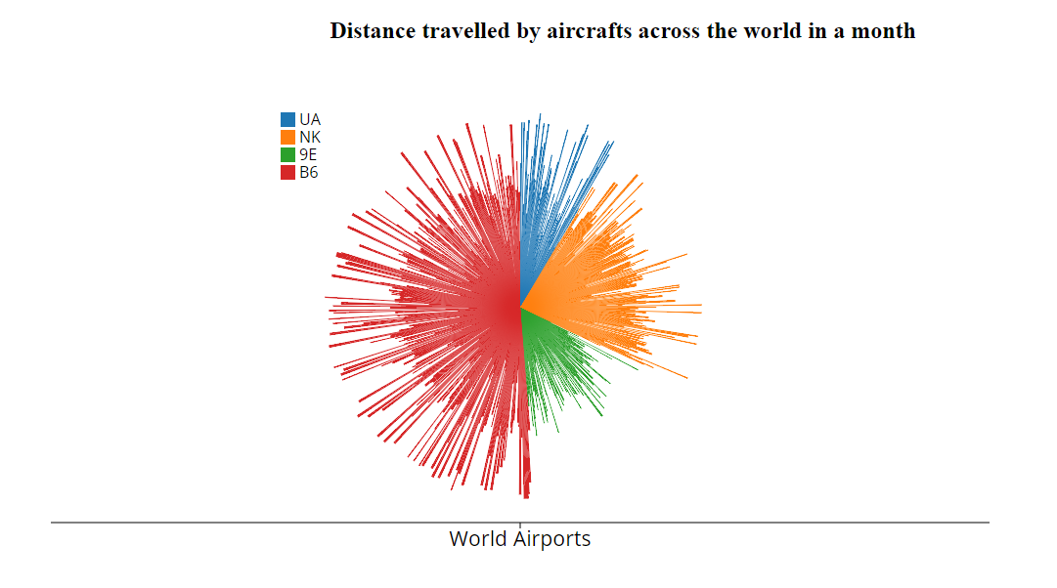
Fig.9 Polar Area Diagram

Slide 19
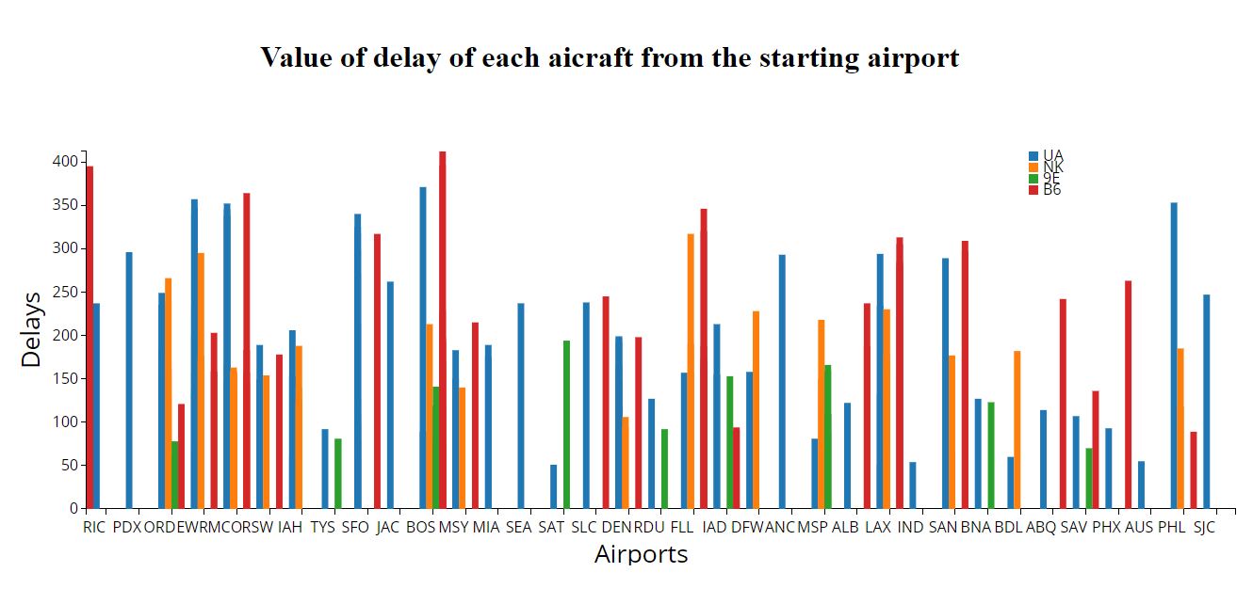
Fig.10 Four Scale Bar Chart

Slide 20

Thank you

