Slide 1
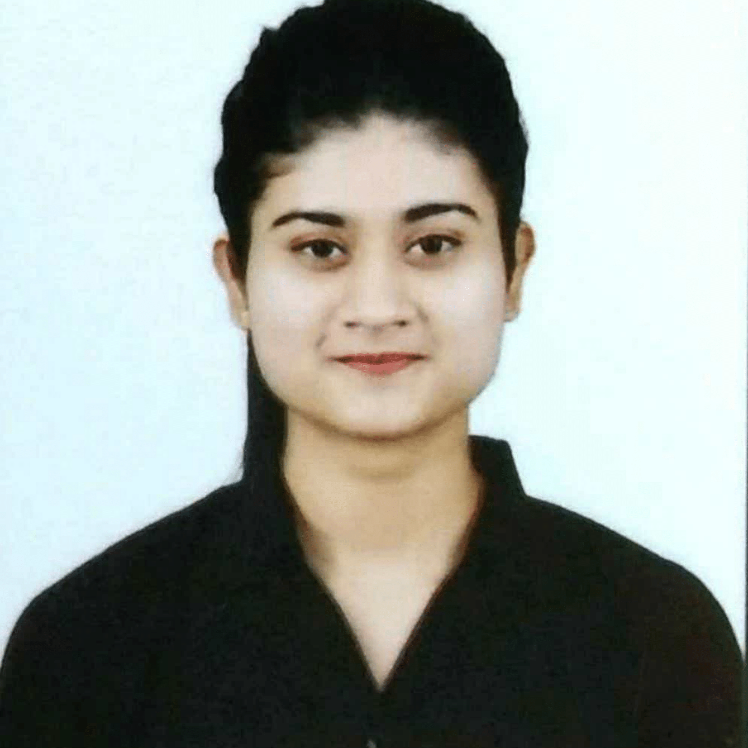
RUTUJA BHAVSAR
Analyst/Software Engineer
Bachelor of Technology,
Computer Science Engineering
2017-2021.
AWS Solution Architect Associate certified.
Pune
rutuja.tatendra-bhavsar@capgemini.com
Skills
+91 9834117352
JAVA | Basics, OOPS, Exception Handling, Arrays
C, C++, Python | Basics
Database | SQL(MySQL), NoSQL(MongoDB)
Tools | GIT, POSTMAN
UI Technology | HTML5, CSS & React JS
Add On Skills | Communication Skills, Team Management
A4
Practical understanding of Java, C, C++, SQL,RPGLE, RPG, CL and NoSQL concepts
1 and half year experience in Development – AS400 team as a developer to do analysis and design to development, implementation.
Ready to learn new technologies/Frameworks and implement them to further improve my knowledge.
I’ve keen interest in Cloud Computing, Problem-Solving learning new technologies and building meaningful software solutions.
Working as a developer in Penske Rental Project where I Analyze, design, develop and maintain IBM I software written in RPG, RPG ILE, RPG-FREE and SQL languages.
Follow functional specifications to create technical documentation or pseudo code.
Technologies used:
RPGLE, RPG,ILE.
SQL

