Slide 1
DATA VISUALIZATION
& STORYTELLING
$2.30M
$286K
12.5%
TOTAL SALES
TOTAL PROFIT
PROFIT MARGIN
Sample Superstore — turning charts into a business story
CENTRAL BUSINESS QUESTION
Why is strong sales growth not translating into equally strong profit?
Tools: Power BI / Tableau • Deliverable: 6-slide visual story
Data Visualization & Storytelling • Sample Superstore • 1/6

Slide 2
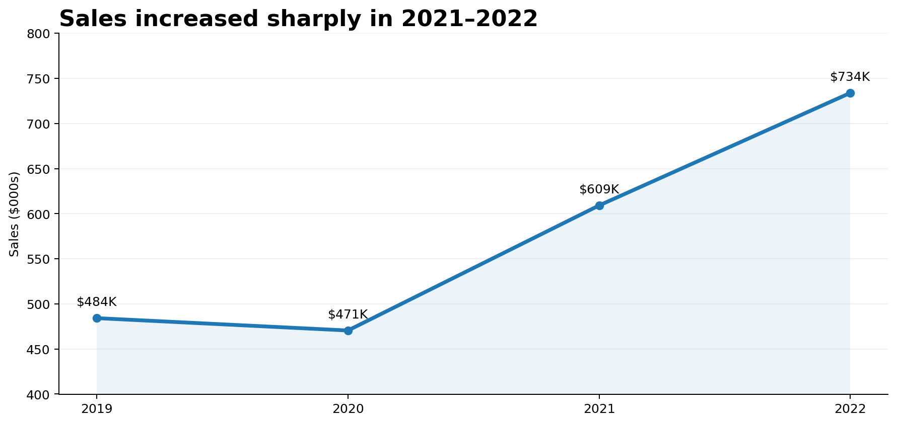
1. Context — sales are growing
The first question is whether the business has a demand problem.
WHAT CHANGED?
Sales rose from about
$484K in 2019 to
$734K in 2022.
The story is therefore not about generating demand — it is about protecting the value created by that demand.
TAKEAWAY | Sales growth is healthy; the business should focus on where sales are least profitable.
Data Visualization & Storytelling • Sample Superstore • 2/6

Slide 3
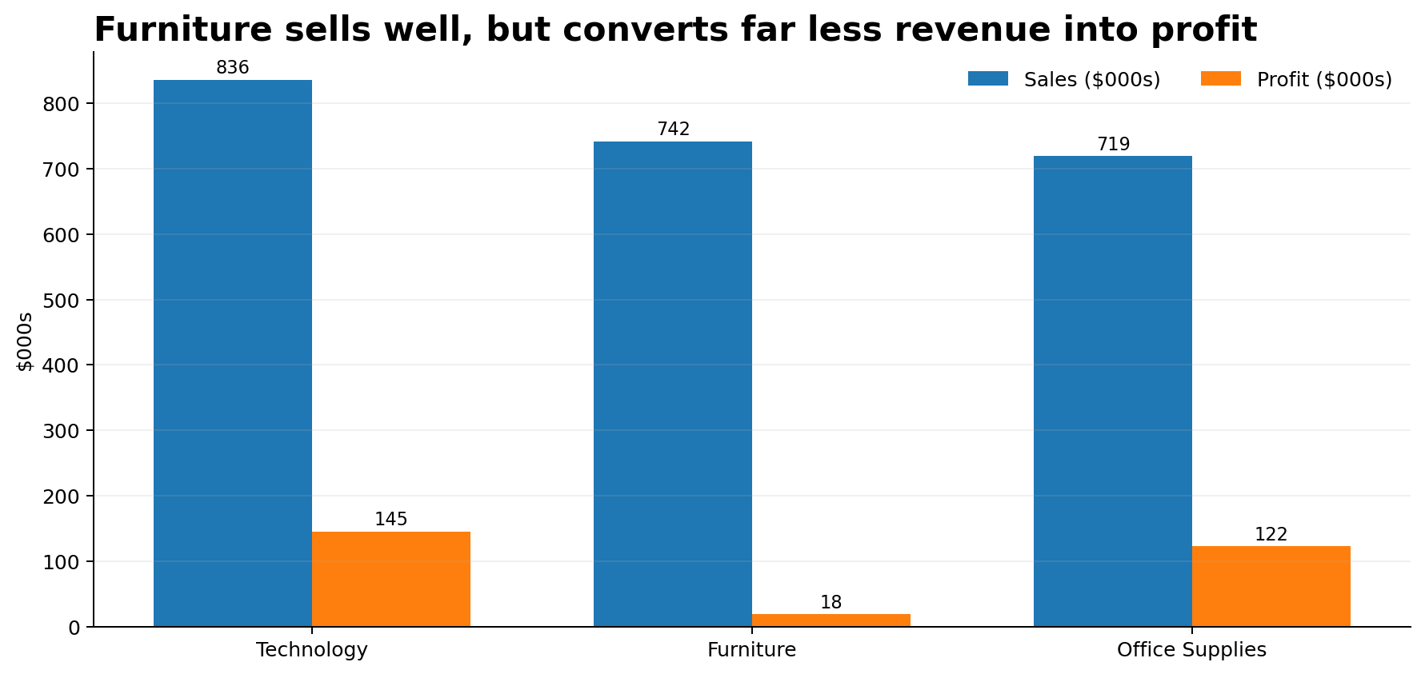
2. Problem — revenue and profit tell different stories
Compare the size of each category with the profit it actually keeps.
Furniture is the warning signal
• ~ $742K sales
• only ~ $18K profit
• ~2.5% profit margin
Technology leads both revenue and profit, while Furniture produces a large amount of sales with very little bottom-line return.
TAKEAWAY | Furniture is the clearest gap: high revenue does not mean healthy profitability.
Data Visualization & Storytelling • Sample Superstore • 3/6

Slide 4
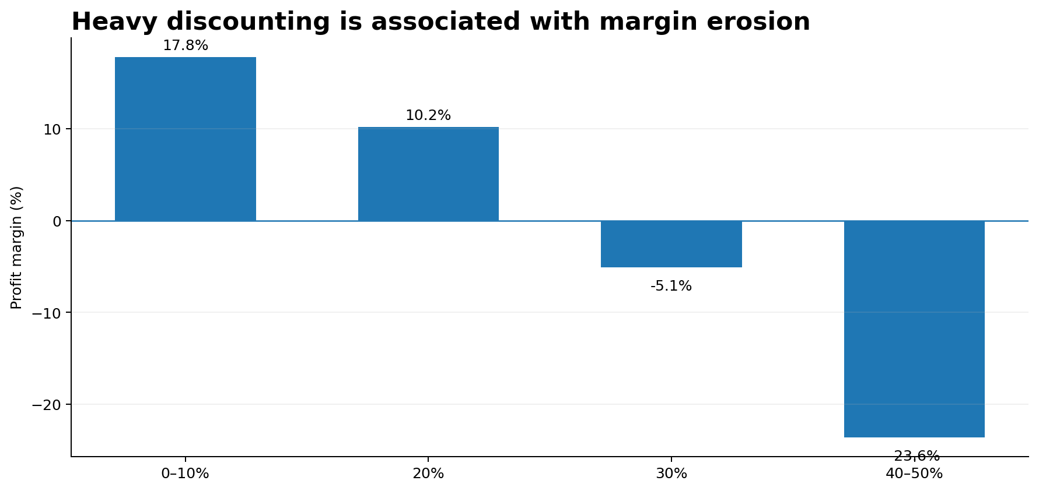
3. Evidence — discounting is a margin lever
The deeper the discount band, the more profit pressure appears.
What this suggests
20% discounts remain positive but weaken margin.
At 30%+, the relationship turns negative in the summarized view.
Discounts can stimulate volume, but blanket discounting can destroy value.
TAKEAWAY | Use discounts selectively — especially on low-margin Furniture items.
Data Visualization & Storytelling • Sample Superstore • 4/6

Slide 5
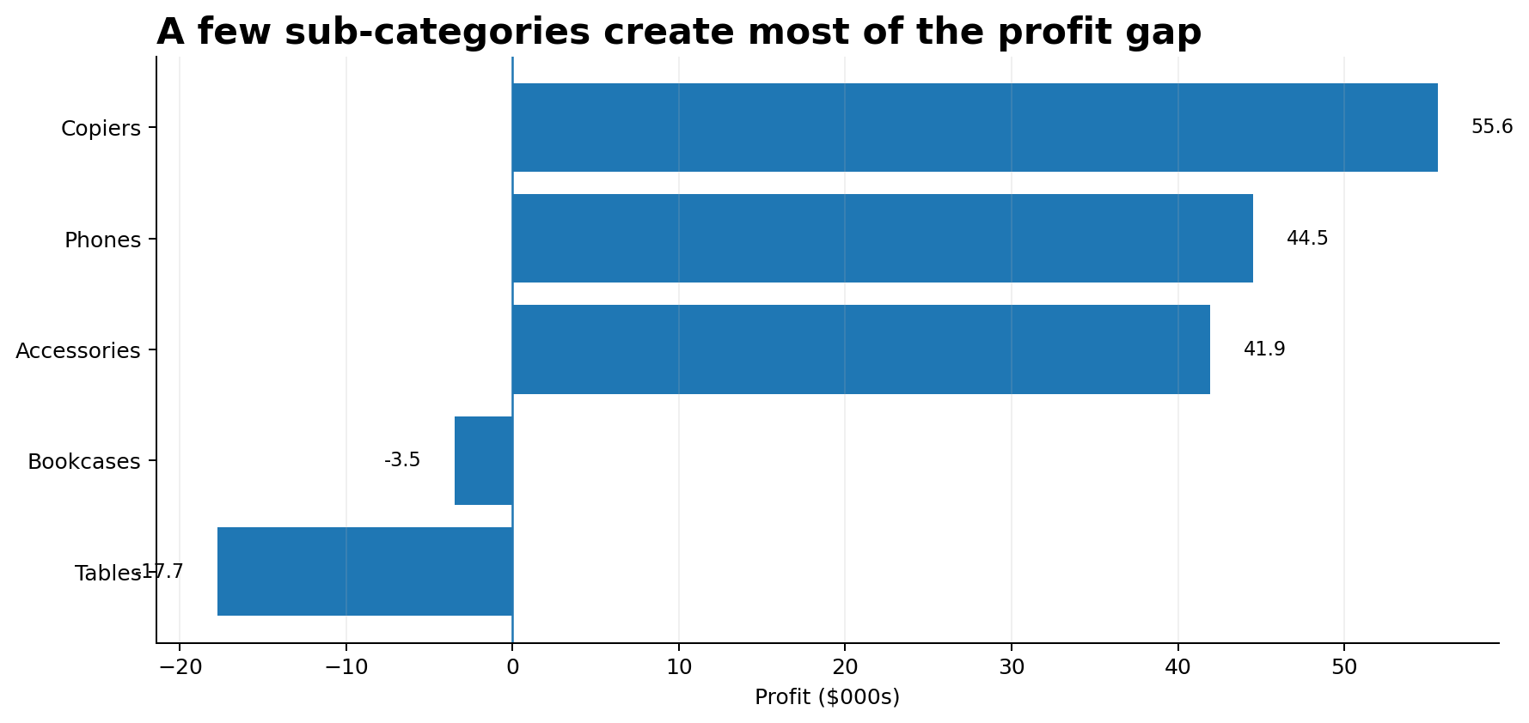
4. Evidence — a few sub-categories drive the gap
Profit concentration points to specific places where action can be targeted.
Profit engines
Copiers, Phones and Accessories are strong contributors.
Tables is the largest visible loss-maker in this view.
This means the business does not need a broad cost-cutting strategy. It needs focused pricing and product decisions.
TAKEAWAY | Protect high-profit sub-categories and fix loss-making ones before chasing more volume.
Data Visualization & Storytelling • Sample Superstore • 5/6

Slide 6
5. Recommendation — protect margin while keeping growth
Turn the analysis into three practical actions.
01
Reduce blanket discounts
Set approval thresholds for discounts above 20%, especially in Furniture.
02
Fix loss-making products
Review pricing, supplier cost and promotion strategy for Tables and Bookcases.
03
Scale profitable demand
Prioritize Technology and high-margin sub-categories in campaigns and sales focus.
STORY IN ONE LINE | Demand is growing — the next growth opportunity is better-quality revenue, not simply more revenue.
Data Visualization & Storytelling • Sample Superstore • 6/6

