Slide 1

Power BI Live Report
Click on here

Slide 2


1. Exploration of Clothing Sales: The analysis will comprehensively explore and understand Amazon's clothing sales from April 2022 to June 2022, focusing on sales performance by category and month.
2. Quantity Analysis: The quantity of clothing sold in different states, considering factors such as size and status, will be examined to identify patterns and preferences of Amazon customers.
3. Optimization of Shopping Methods: The objective is to optimize shopping methods by understanding customer behaviors and trends, ultimately enhancing the overall shopping experience for customers.
4. Trend Analysis: Conducting trend analysis to identify any emerging patterns or shifts in consumer preferences within the clothing sales on Amazon during the specified period.
5. Actionable Insights: The analysis aims to provide valuable insights that can be leveraged to make informed business decisions and strategies, ultimately enhancing sales performance and customer satisfaction.

Slide 3
Rutuja Vinod Deore
INSIGHTS :
SKU-wise Quantity and Amount Distribution Chart
Status by Quantity
Total Sales by Category
Sales by Month and Category
Ful fillment Analysis Chart
MRP Distribution Across Platforms Chart
B2B Sales Summation Chart
Revenue Distribution by Ship City
Stock Distribution by Category
Revenue Distribution by Ship State
Category and Size Revenue Distribution Chart
Order Metrics by Ship State
Order Metrics by Ship State

Slide 4
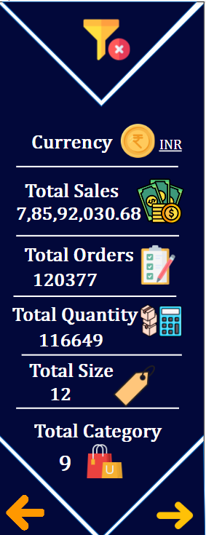
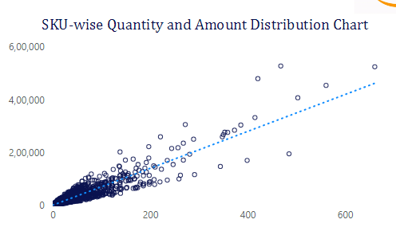
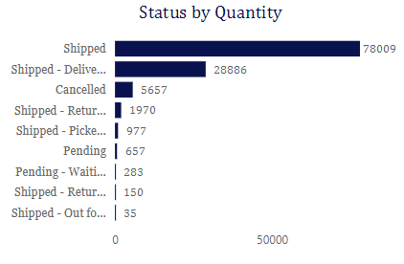
Rutuja Vinod Deore
Quantity and Amount Distribution Chart
A scatter plot showing the relationship between quantity and amount for different orders. The trend line indicates a positive correlation, implying that as quantity increases, the amount also increases.
Shipment Status by Quantity
This contains a distribution of shipment statuses:
Delivered: 8717
Packing: 165
Shipped: 3958
Storage: 4
Unfulfillable: 15

Slide 5
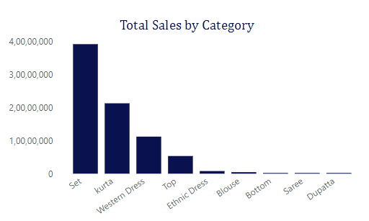
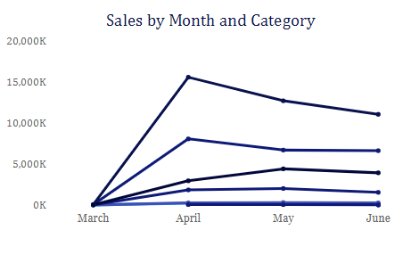
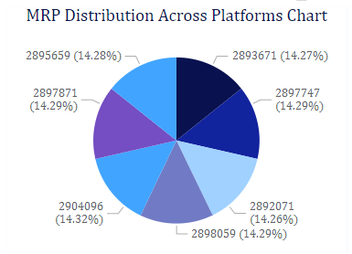
Rutuja Vinod Deore
A bar chart that shows sales distribution across different product categories. One category is particularly high compared to others, suggesting it is the best-selling category.
A line graph showing sales trends over a period from March to September. There are three lines, possibly indicating three different product categories or segments. Sales for all three fluctuate over time, with noticeable peaks and declines.
One segment is at 14.28% with a numerical value of 2895659.
Another segment is at 14.27% with a numerical value of 2893671.
A third segment is at 14.29% with a numerical value of 2897871.
The fourth segment is also at 14.29% with a numerical value of 2897747.
The fifth segment has the largest percentage at 14.32% with a numerical value of 2904096.
The sixth segment is at 14.29% with a numerical value of 2898059.
The last visible segment is at 14.26% with a numerical value of 2892071.

Slide 6
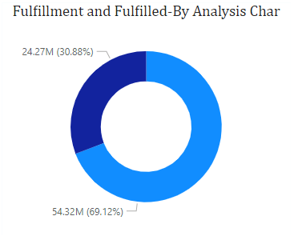
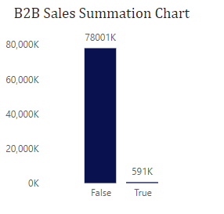
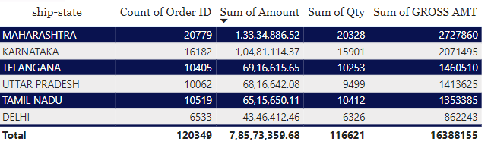
Rutuja Vinod Deore
One segment represents 54.32 million units (69.12%).
The other segment represents 24.27 million units (30.88%).
The total count of units is approximately 78.59 million.
Sales associated with the "False" category vastly exceed those associated with the "True" category.
The exact value for the "False" category is 78,001K (which could be interpreted as 78,001,000 if K stands for thousands).
The "True" category has a value of 591K (which could be interpreted as 591,000 if K stands for thousands)
Maharashtra leads in orders, total amount, quantity, and gross amount.
Karnataka follows with high performance in orders, total amount, and quantity.
Uttar Pradesh has slightly fewer orders than Tamil Nadu but higher total amount and gross amount.
Delhi has the lowest numbers in each category among the listed states.
The total figures for all the states combined are provided, giving an overview of the overall business performance by state.

Slide 7
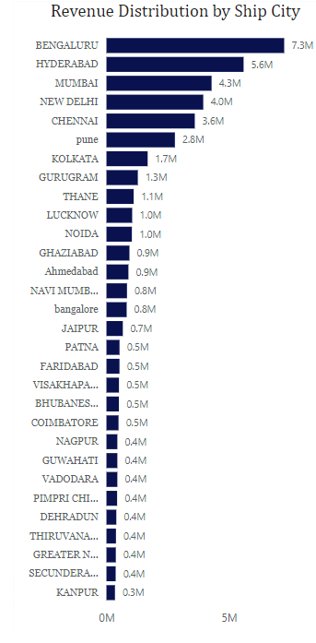
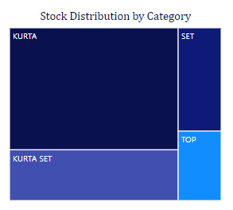
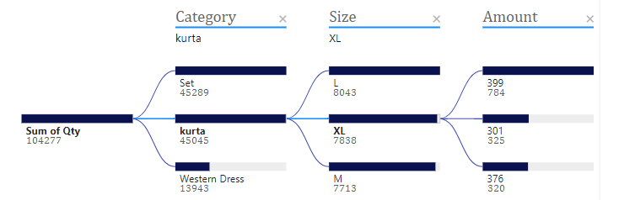
Hyderabad leads in revenue with around 6.3 million.
Bengaluru follows with approximately 4.3 million.
Other cities contribute varying amounts, with a notable drop after the top three.
Stock distribution is represented by a tree map chart.
The chart is divided into four sections, each representing a different category of stock items.
The categories are labeled as "KURTA," "SET," "KURTA SET," and "TOP."
The size of each section corresponds to the quantity or proportion of stock in that category.
"KURTA" is the largest category, followed by "SET," "KURTA SET," and "TOP" respectively.
The image shows a breakdown of data related to "kurta" items, including quantities and sizes. The total quantity is 104277, and specific quantities are listed for "XL" size and another subset, but the details are partially visible.

Slide 8
Recommendation
Embrace the Latest Fashion Trends: Drive nationwide sales by aligning your offerings with the hottest and most current fashion trends.
Modernize Ethnic Styles: Revitalize traditional attire, infusing new life and vitality into their sales performance.
Explore New Markets: Expand and diversify your customer base by venturing into untapped markets or regions, leveraging insights into consumer preferences.
Elevate Customer Experience: Customize pricing or promotions based on size or color preferences revealed by data to enhance overall customer satisfaction.
Prioritize High-Performing Categories: Amplify promotional efforts for top-performing categories such as Sets, Kurtas, and Western Dresses to drive increased sales.
Monitor Lucknow Sales: Keep a vigilant eye on sales in Lucknow and develop strategies to enhance its market presence and performance.

