Slide 1
Trends in Traffic Stops
Abhay Singh, Krupa Hegde and Rutuja Gurav

Slide 2


Outline
Introduction
Motivation
The Data
The Experiments
Our Implementations
Analysis and Results
Conclusion

Slide 3

1.
Introduction

Slide 4

How did we get started?
Analyzing traffic data is a hot topic.
Driving forces
Rise of autonomous vehicles
Data-driven social policing

Slide 5

How does our data qualify as Big Data?

Slide 6
How does our data qualify as Big Data?
Volume
Across the United States, police officers make more than 50,000 traffic stops on a typical day.
Variety
Data of these traffic stops is stored in a variety of formats and with high inconsistency across states.

Slide 7
2.
Motivation

Slide 8
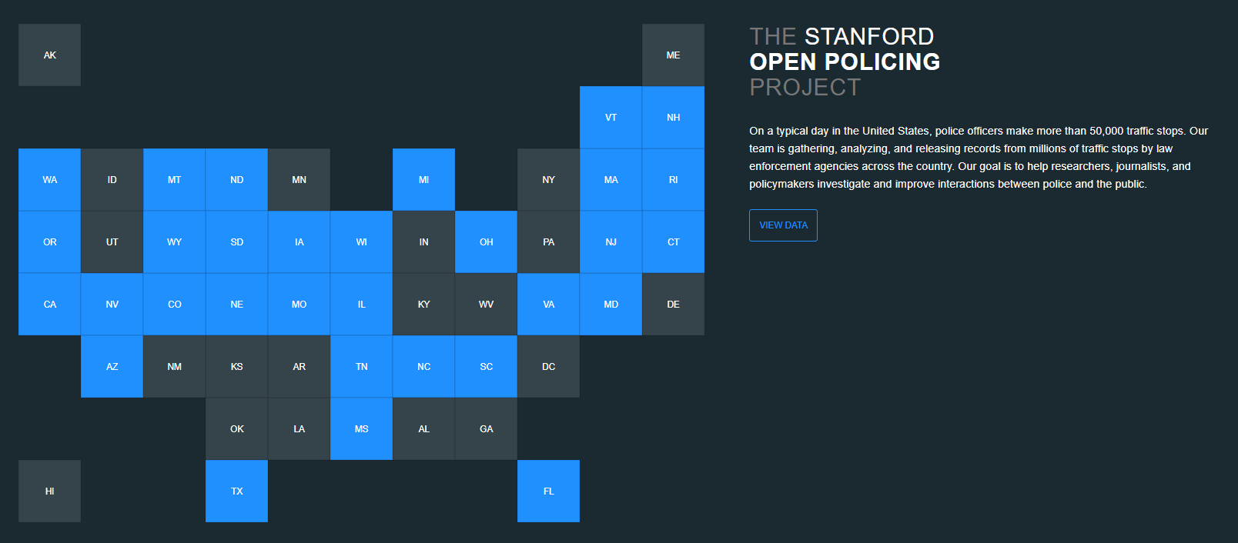

Slide 9
3.
The Data

Slide 10
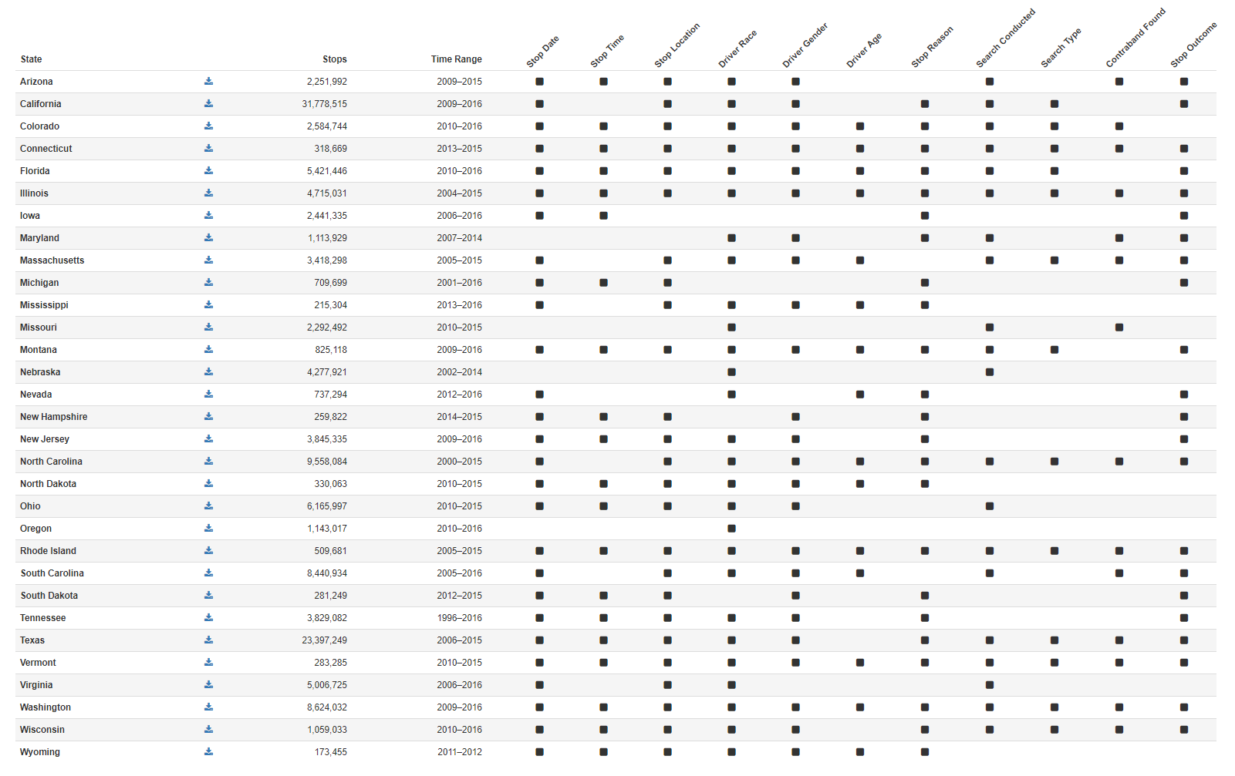
Features:
Stop Date
Stop Time
Stop Location
Driver Race
Driver Gender
Driver Age
Stop Reason
Search Conducted
Search Type
Is Arrested
Contraband Found
Stop Outcome

Slide 11
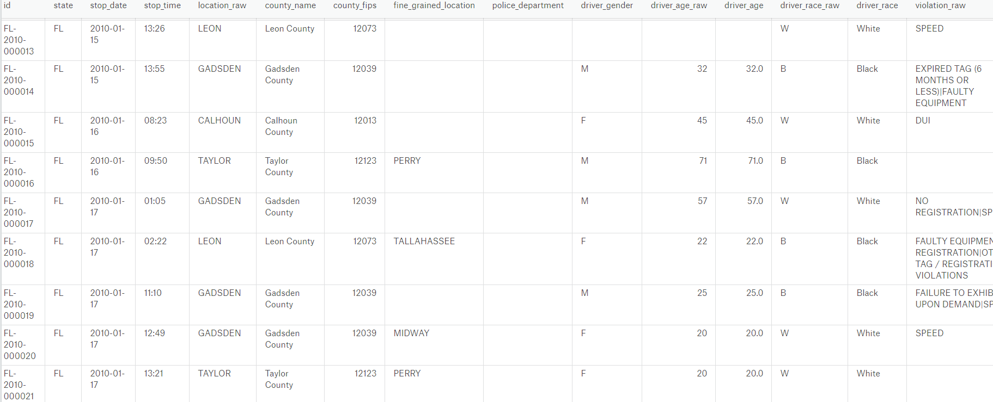

Slide 12
3.
The Experiments

Slide 13
Perform aggregations to find yearly number of stops at state level to see increase or decrease in trend.
Number of stops conducted for different age groups, gender or race.
Decision tree to predict likelihood of events.
Build a logistic regression model to see if age, race or gender determines, even weakly the possibility of being arrested, being searched or having found a contraband.

Slide 14
4.
Our Implementation

Slide 15
Spark DataFrame API
Spark SQL
Dataset<Row> genStopData =
bucketedStopData.select("state","stop_date","county_name","driver_gender")
.groupBy(year(col("stop_date")),col("driver_gender"),col("state"))
.count()
.withColumnRenamed("year(stop_date)","yearStop")
.withColumnRenamed("count","Count");
Spark Mllib
Bucketizer
VectorIndexerModel
StringIndexer
VectorAssembler
Pipeline

Slide 16
Bucketizer
Transforms a column of continuous features to a column of feature buckets.
VectorIndexerModel
Helps index categorical features in datasets of vectors.
StringIndexer
Encodes a string column of labels to a column of label indices.
VectorAssembler
A transformer that combines a given list of columns into a single vector column.
Pipeline
A Pipeline chains multiple Transformers and Estimators together to specify an ML workflow.

Slide 17
4.
Analysis Results

Slide 18
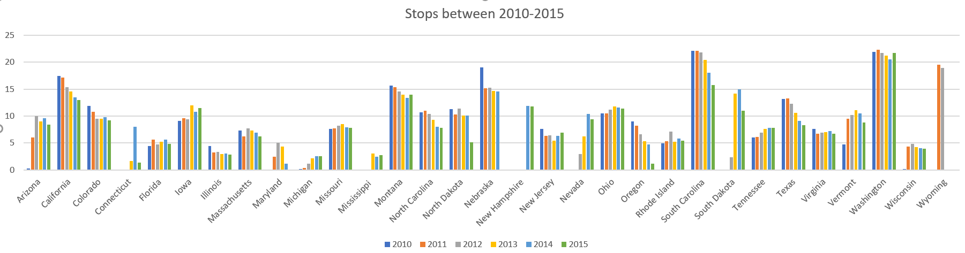
Aggregations to find yearly number of stops at state level to see increase or decrease in trend.

Slide 19
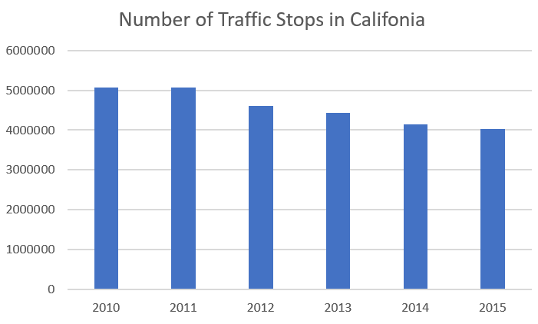
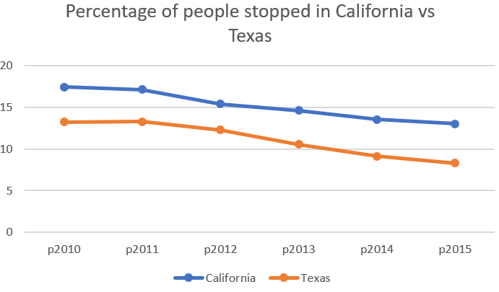
Aggregations to find yearly number of stops at state level to see increase or decrease in trend.

Slide 20
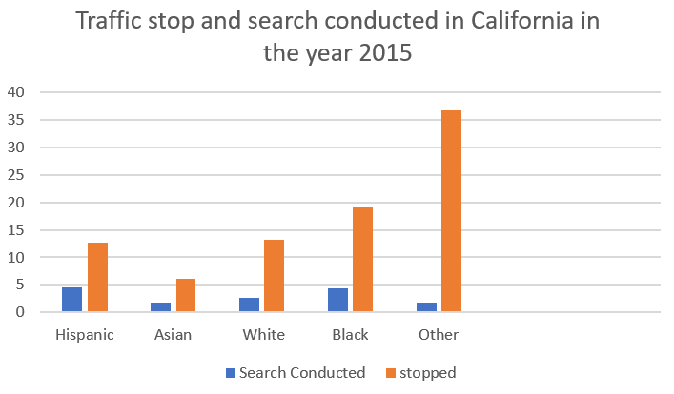
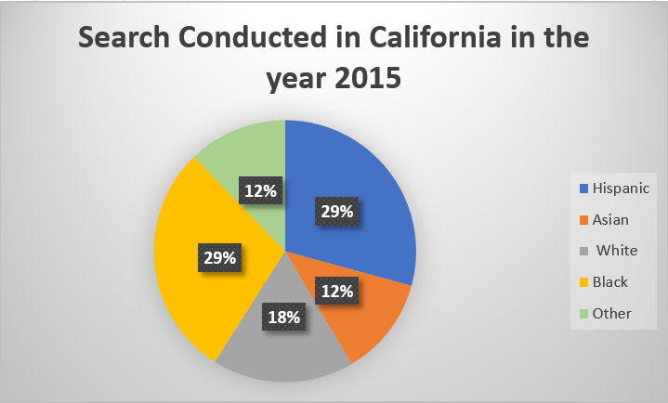
Search Conducted

Slide 21
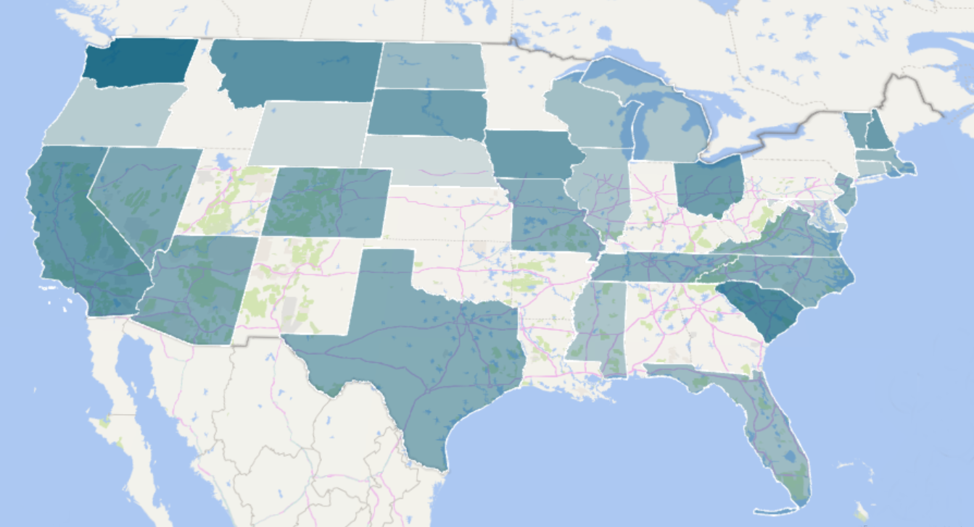

Slide 22
Decision Tree
Feature Columns: Driver Race, Gender, Age, Officer Race
Label Column: Search_conducted
Challenges: Unbalanced Data-Difficult to sample
Without sampling
Test Error= 0.0039620514864309175
Weighted Precision= 0.9920915948791192
With Sampling
Weighted Precision=0.673742738866459
Weighted Recall =0.681081081081081
Test Error = 0.3189189189189189Message Input

Slide 23
Trends in Number of stops conducted by Gender.

Slide 24
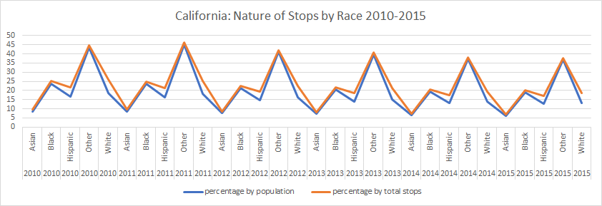
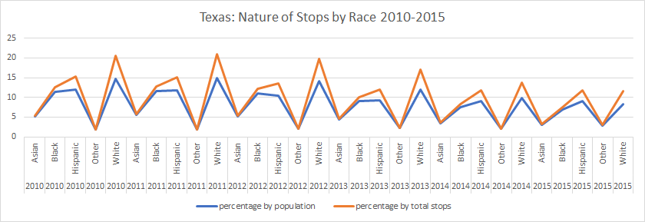
Number of stops conducted by Race

Slide 25
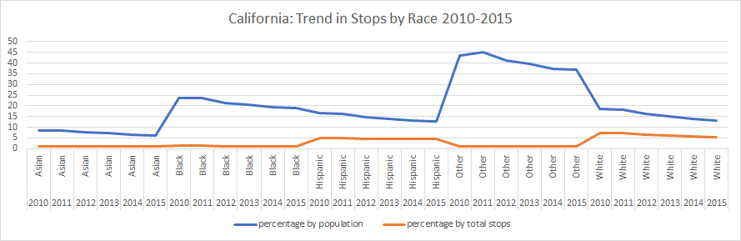
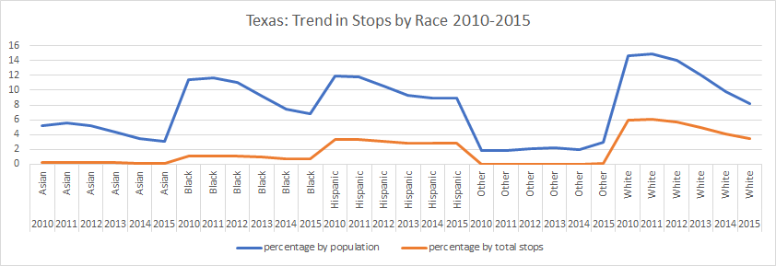
Number of stops conducted by Race

Slide 26
Trends in Number of stops conducted by Age group.

Slide 27
Logistic Regression Model
Basics
Background
Implementation
Results

Slide 28
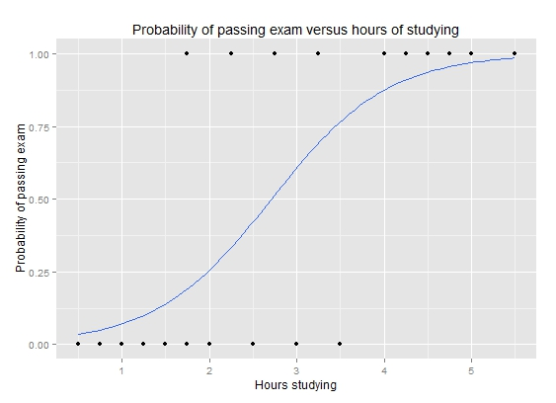
Logistic Regression Model I

Slide 29
Logistic Regression Model II
Predictors: Age, Gender and race.
Labels:
Arrested? True or false
Searched? True or false
Contraband Found? True or false
Challenges:
Highly skewed data – Sampling.
Data Inconsistency

Slide 30
Logistic Regression Model III
Implementation similar to the decision tree.
Bucketizer
Vector assembler
String indexer
Pipeline
Data Inconsistency- Results from 23 States only.
Only 11 states have all required data.
Others have some of either predictors or one of the labels missing.

Slide 31
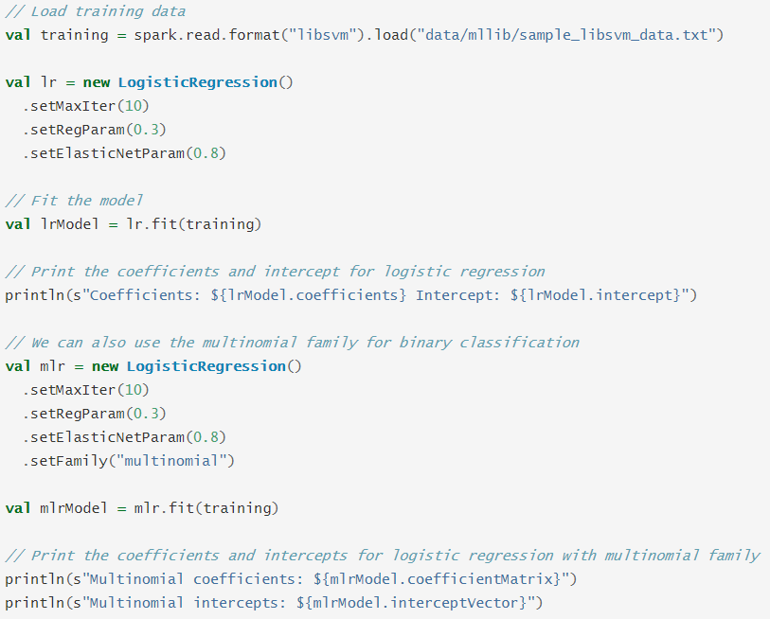
Logistic Regression Model III

Slide 32
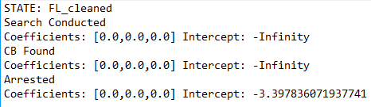
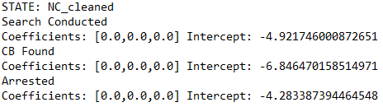
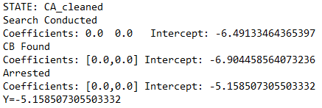
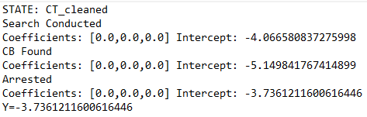
Logistic Regression Model IV

Slide 33
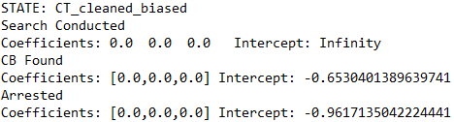
Logistic Regression Model IV
Sampled Model
Original

Slide 34
Closing Words

Slide 35
Thank You Q&A

