Slide 1

BANK DATABASE MANAGEMENT SYSTEM
Rutuja Santram chimane

Slide 2
ABSTRACT
This is a Bank Management System Database Project.
Abstract: The main aim of Bank Management Mini DBMS project is to keep record of customer transactions in the bank.
We aim to demonstrate the use of create, read, update and delete MySQL operations through this project.
Firstly, employee registration is done in the concern bank branch.
Branch employee creates customer account in the bank, then customer can credit amount, debit amount and check balance.
Customer can even use different services like insurance, loan, bill payments etc.

Slide 3
AIM :
The main goal of project of Bank Database Management System is to give information about the functioning of databases in banking system and to develop a software for solving financial applications of a customer in banking environment in order to nurture the needs of an end banking users to provide various ways to perform banking tasks using MYSQL.
INTRODUCTION :
This is a Bank Management System Database Project.
The main aim of Bank Management Mini DBMS project is to keep record of customer transactions in the bank.
We aim to demonstrate the use of create, read, update and delete MySQL operations through this project.
Firstly, employee registration is done in the concern bank branch.
Branch employee creates customer account in the bank, then customer can credit amount, debit amount and check balance.
Customer can even use different services like insurance, loan, bill payments etc.
Day to day life banking system is most useful and important thing in economical world and which is very useful to develop country as well as economic power.
In our project we also provide the facility to change location of account with branch that mean the user can change the branch which is convenient for it. They will also change or update data like address, mobile number using online banking system.

Slide 4
OBJECTIVE OF PROJECT :
The main objective of bank management is to build an organic and optimal interaction system between the elements of banking mechanisms with a view to profit.
It will be easy to able track the details of employees, customers, branch and accounts.
It will give proper relation about which customer have bank account in which branch.
It will give details regarding type of loans have been taken by customers.
To track client accounts, balances, and deposits, banks employee databases and to hold information about customers.

Slide 5
ER-DIAGRAM :
Branch_name
Branch_id
Loan_id
Loan_ammount
Loan_type
Cust_id
Location
Branch
Loan
Branch_id
Date_issuedd
Acc_id
Bank
Mob_no
Acc_status
Account
Customer
DOB
Balance
Cust_id
Cust_id
First_name
Acc_type
Address
Lastname

Slide 6
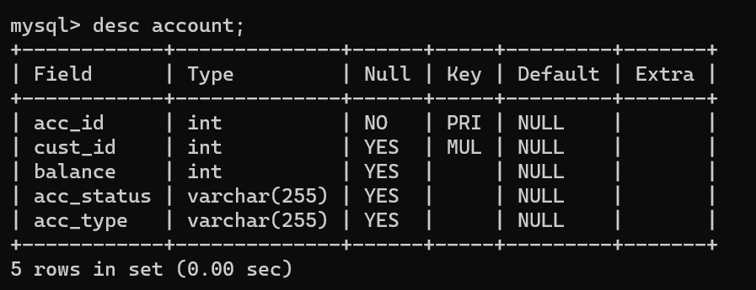
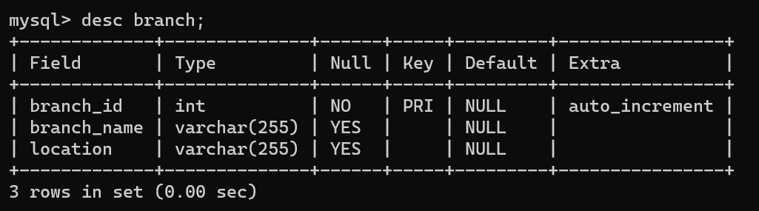
STRUCTURE OF TABLES
ACCOUNT :
BRANCH :

Slide 7
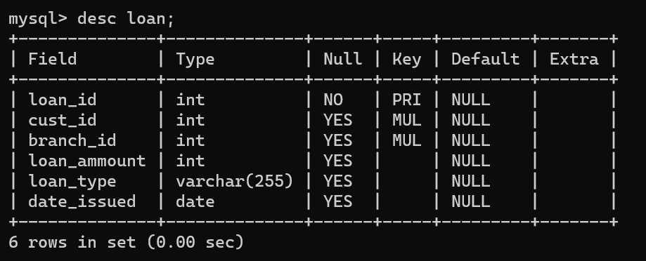
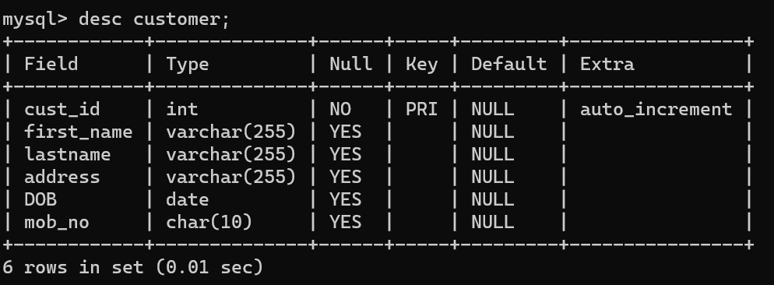
LOAN :
CUSTOMER :

Slide 8
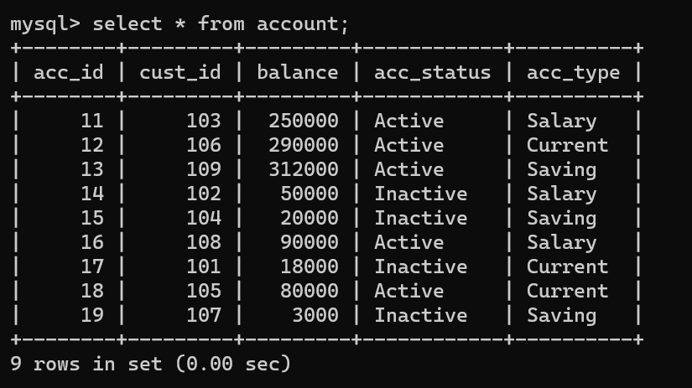
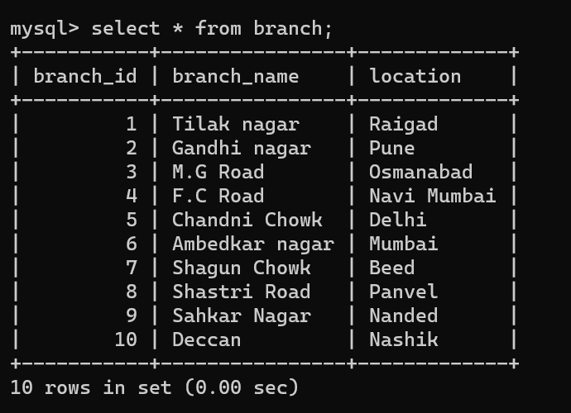
CONTENTS OF TABLES
ACCOUNT :
BRANCH :

Slide 9
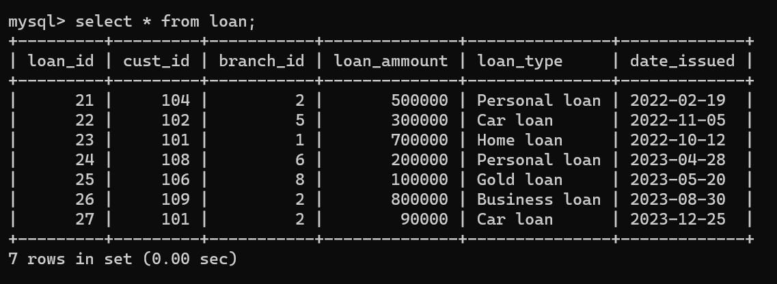
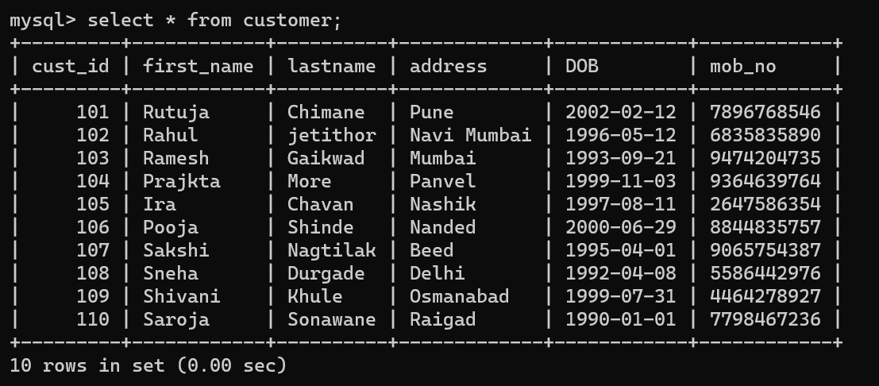
LOAN :
CUSTOMER :

Slide 10
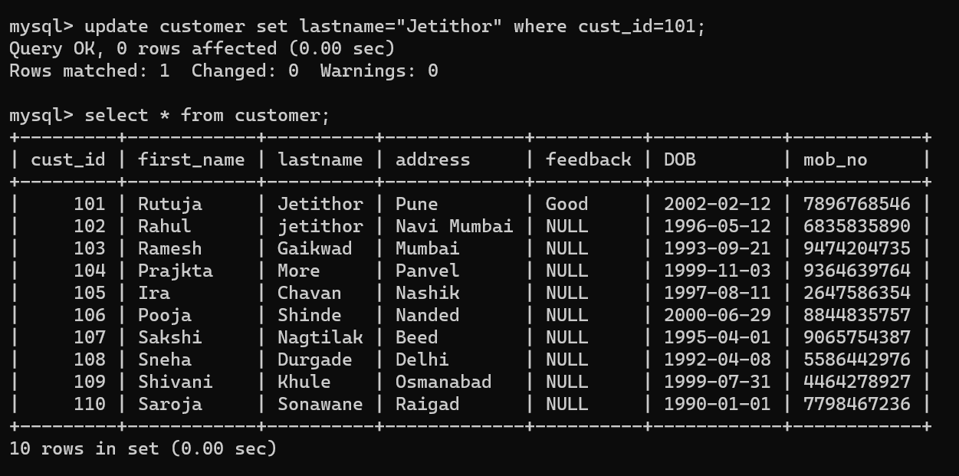
VIEWS :
Update the details of Customer :

Slide 11
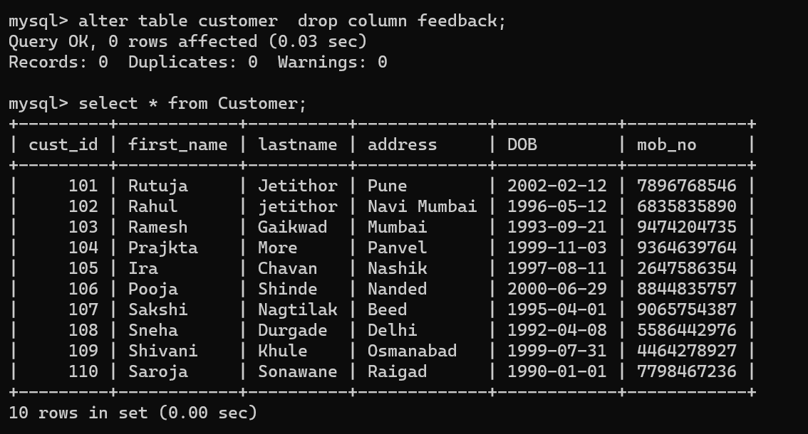
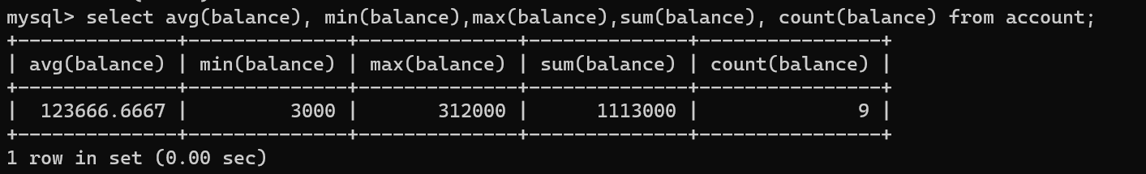
2. Delete column Feedback :
3. Display the Avg, Min, Max, sum and count of balance from account :

Slide 12
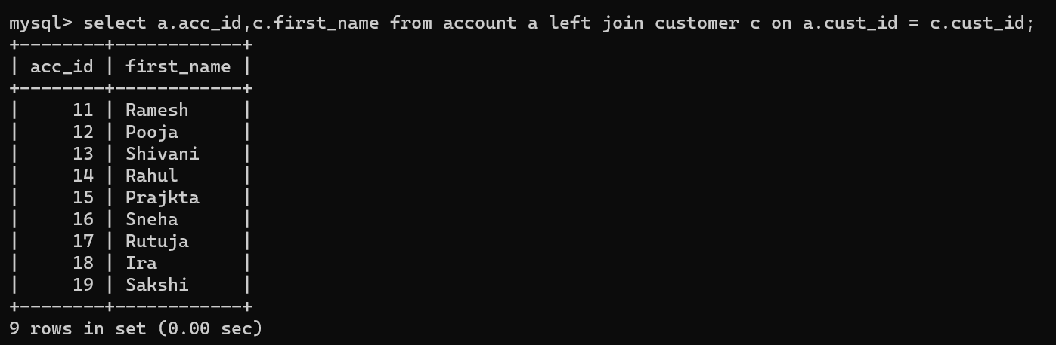
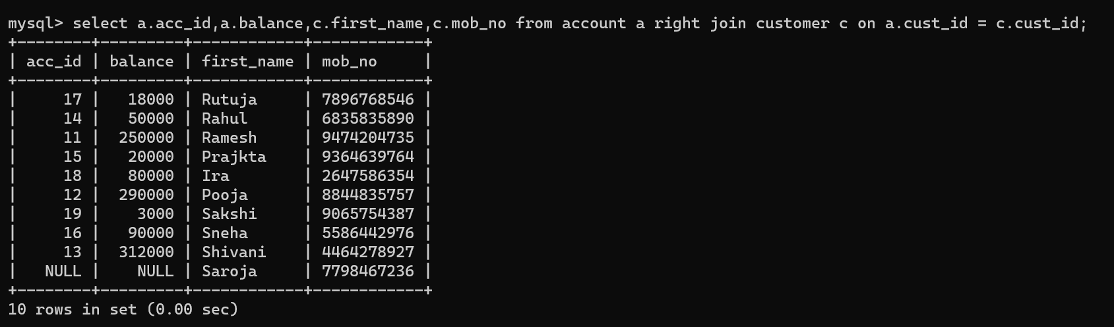
JOINS
LEFT JOIN :
RIGHT JOIN :

Slide 13
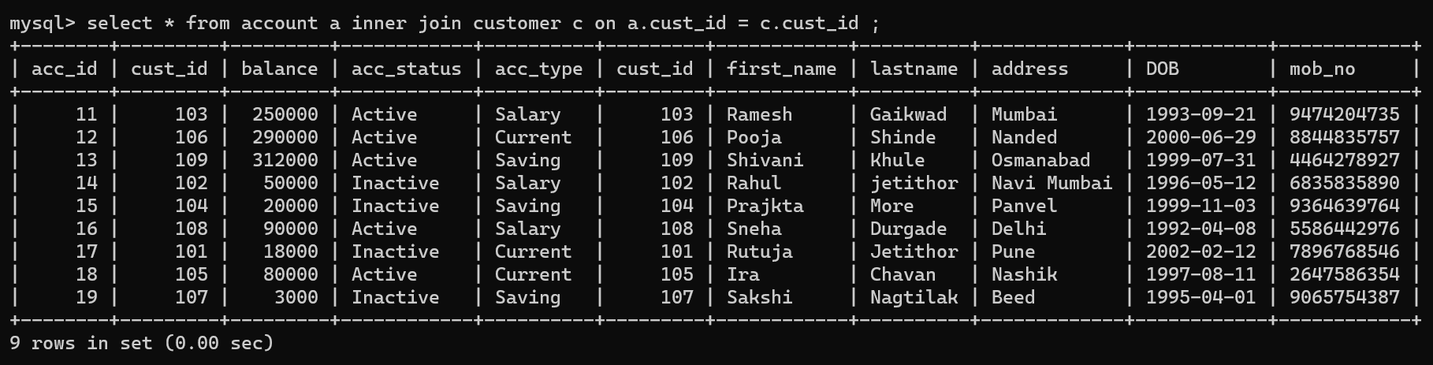
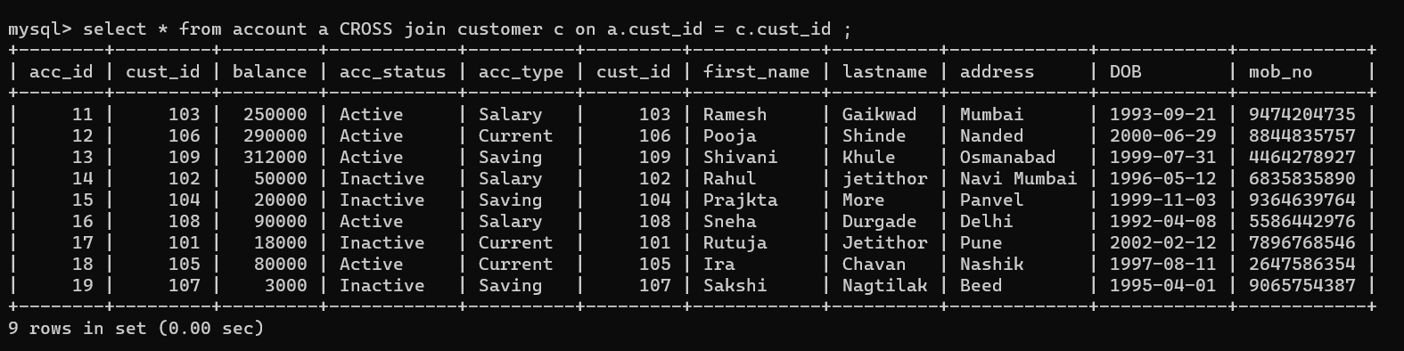
INNER JOIN :
CROSS JOIN :

Slide 14
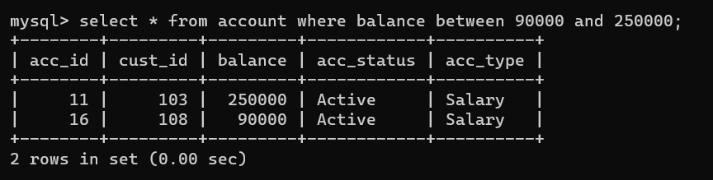
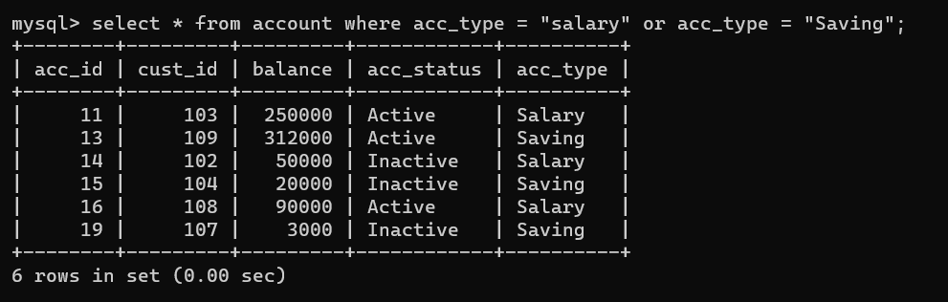
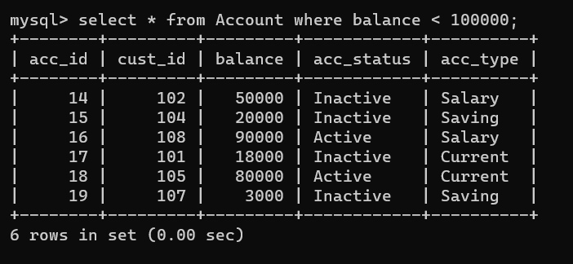
1. Display records of a customer who has balance between 90000 and 250000 :
2. Display records of table who has salary account or saving account :
3. Display records of a table who has balance less than 100000 :

Slide 15
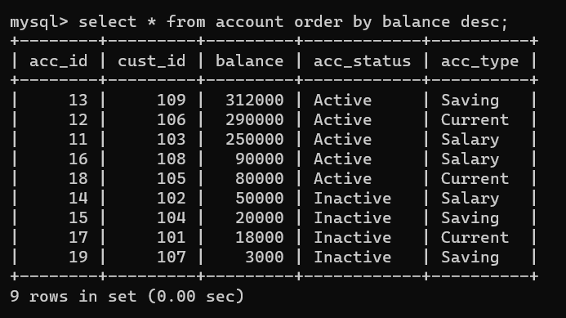
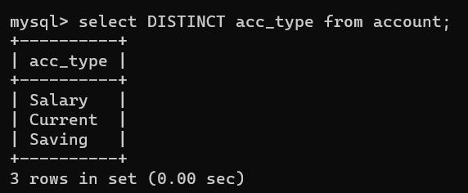
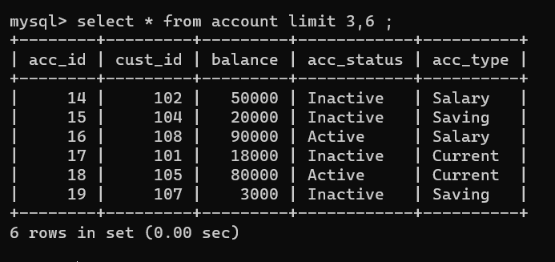
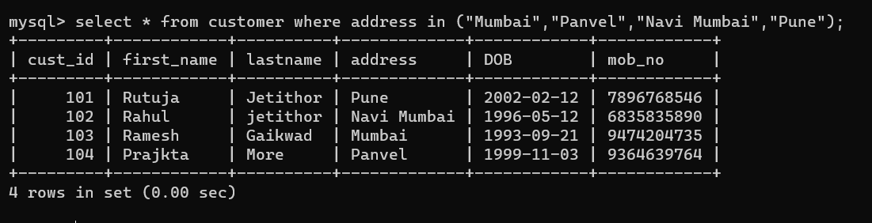
1. ORDER BY CLAUSE :
2. DISTINCT CLAUSE :
3. LIMIT CLAUSE :
4. Display records of customers whose address is from Mumbai, navi Mumbai, pune, panvel .

Slide 16
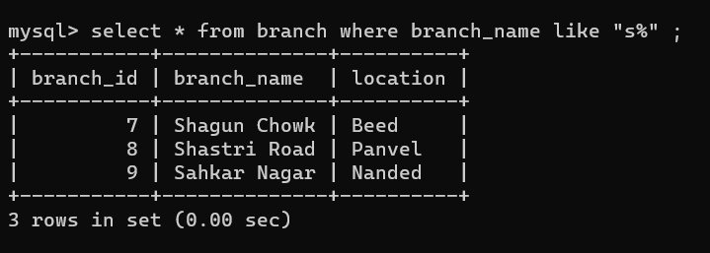
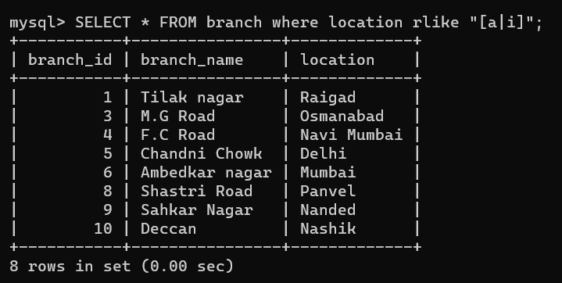
LIKE OPERATOR :
RLIKE OPERATOR :
To display the details of branch whose location has a and i in their name anywhere?

Slide 17
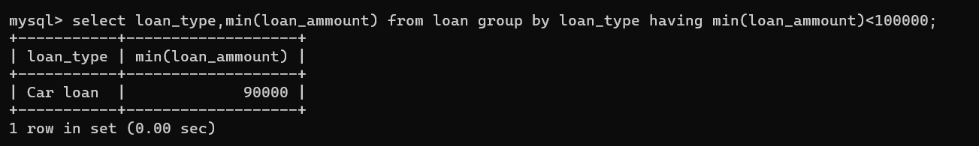
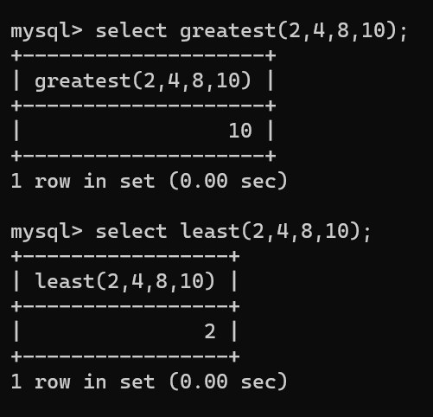
TO DISPLAY DETAILS USING GROUP BY CLAUSE WITH HAVING :
AGGREGATE FUNCTION :

Slide 18
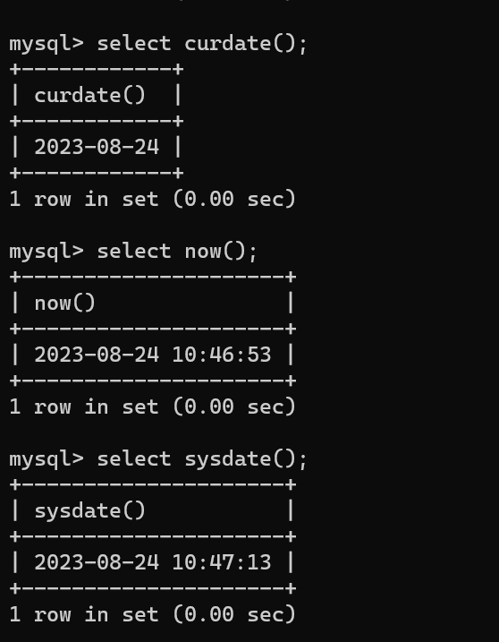
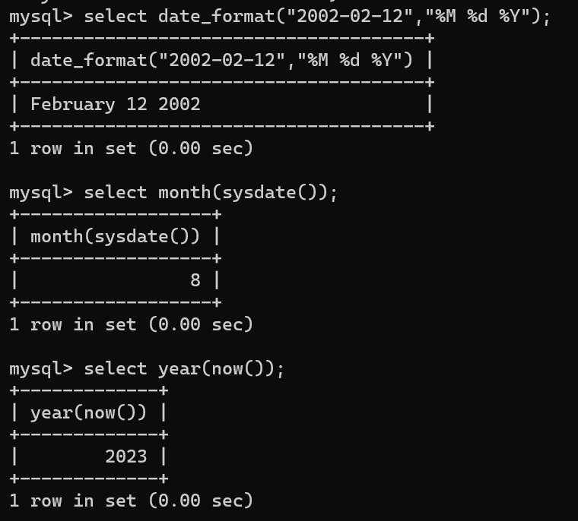
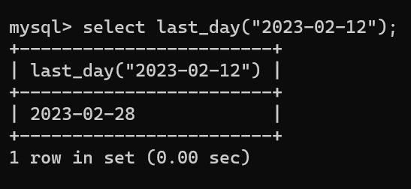
DATE FUNCTIONS

Slide 19
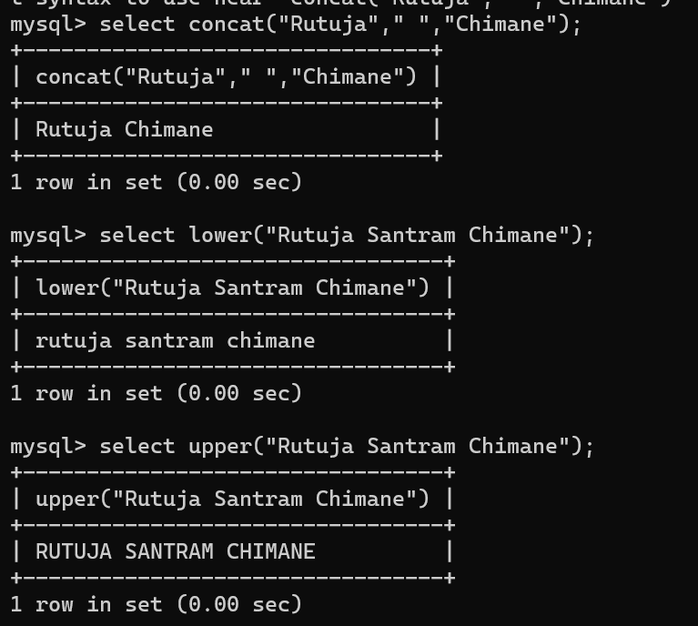
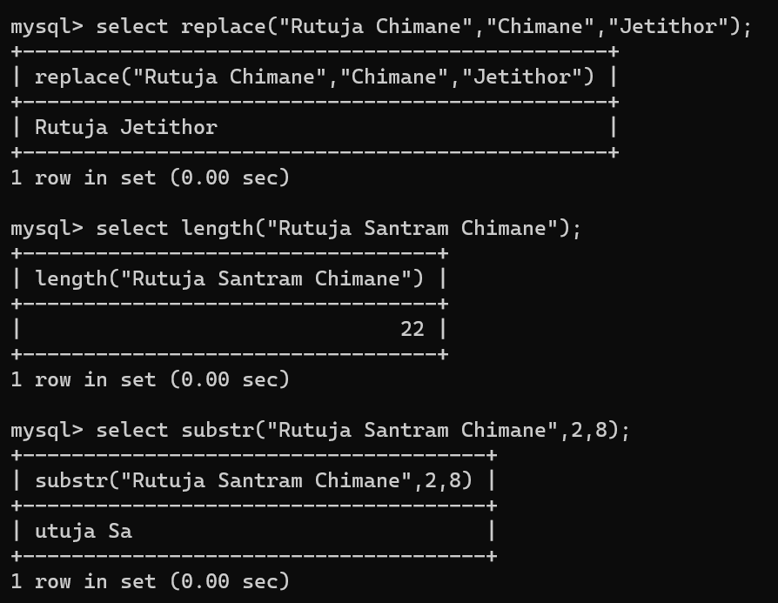
STRING FUNCTIONS

Slide 20
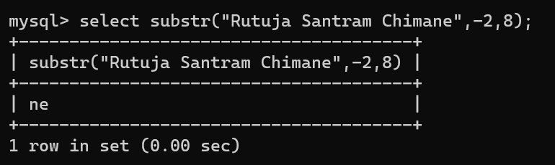

Slide 21
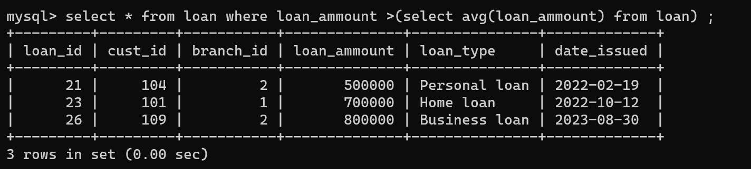
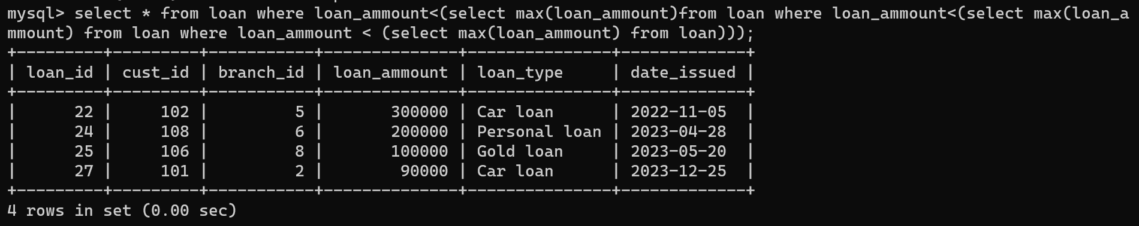
SUBQUERIES
Display the details of all the customer whose loan ammount is more than the average loan ammount .
Display the details of all the customers who has loan ammount less than the 3rd highest loan amount.

Slide 22
THANK YOU

