Slide 1

Airline Reservation Systems
Airline Reservation Systems

Slide 2
Group Member:-
Kadam Rutuja Balasaheb (71209)
Bhapkar Mitali Yogesh(71208)
Chavan Tejasvi Maruti(71214)
Project Guide:-
Ms. Buchade Manali R.

Slide 3
Introduction
The “Airline Reservation System” main aim is to provide the online ticket & seat reservation of National and International Flights and also given us the information about Flight departures.
It helps the customers to search the availability off fights ,book and cancel the tickets
This project also covers adding ,deleting or modifying the customer details and flights.
In General ,this website would be designed to perform like any other airline ticketing website available online

Slide 4
Objectives
To create a portal to add new flights in the system . Also to on filling flight details like flight name ,code from and to destinations ,capacity timings , and frequency etc. new flights get successfully added to the system.
To make proper search results of flight details , timings and availability and make sure that users can successfully select single or more than one seat.
To add features like selecting seats, entering passenger details and making payment the selected seats get booked

Slide 5
Goals
It aims to increase customer’s and airline agencies ’ relationships through the user of “Airline Reservation System” and make convenient for customers to book flights.
To increase the number of valuable customer and also improve the brand image of company.

Slide 6
Proposed System
The System contain various pages regarding the flight Management :-
Main and login page
Ticket booking page
Registration screen
Administration page
Ticket cancellation page
Flight details
Ticket conformation

Slide 7
ER- Diagram:-
C_Contanct no
C_adhar no
f_id
f_name
C_id
B_sets
f_time
Flight
Customer
e_sets
C_email
f_sets
B_price
C_password
C_name
e_price
f_price
has
book
payment_receipt
B_name
B_id
B_email
Files
B_flight_name
have
B_date
Booking
identity_proof
B_ticket_count
B_from
B_travel_class
B_to

Slide 8
Airline Reservation System
Ticket Management
System User Management
Customer Management
Airline Management
DFD
Zero level Diagram :-

Slide 9
Airline Management
Generate Airline Report
Ticket Management
Generate Ticket Report
Airline ReservationSystem
First Level Diagram:-
C
Customer Management Management
Generate Customer Report
Login Management
Check User Login Details
System user Management
Generate System User Report

Slide 10
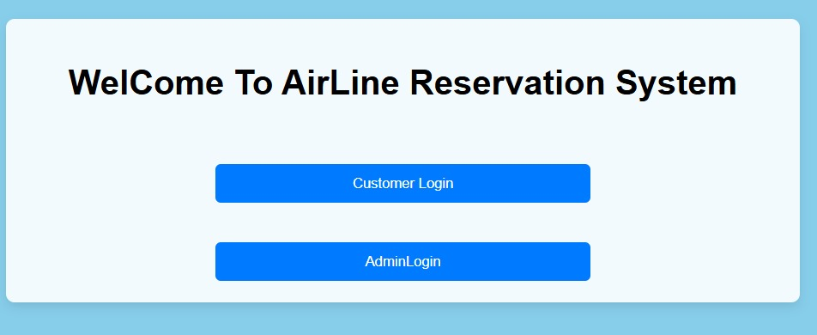
Results
This is login Selection page in which we give two options for login.
First one is Customer login in which customer login in our application.
Second one is Admin login this is login used for administration purpose.

Slide 11
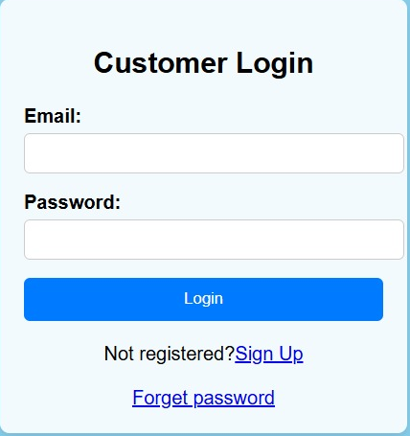
It is Customer Login page .
This screen is used for data security purpose . The login screen is used for authentication purpose. The login screen asks the user to enter the Email and password.
If the customer does not know the password , he can forget the password.
If Customer don’t have account then he/she sign up in this application.

Slide 12
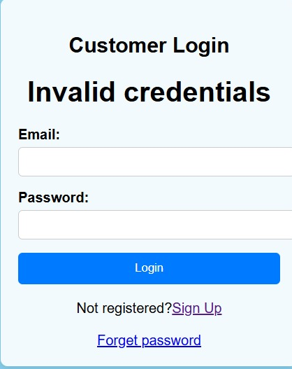
If you see an “Invalid Information” error when logging in ,it means something is wrong with the details you entered.

Slide 13
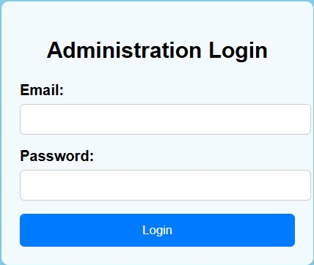
It is Administration login.
This login specified for a administration

Slide 14
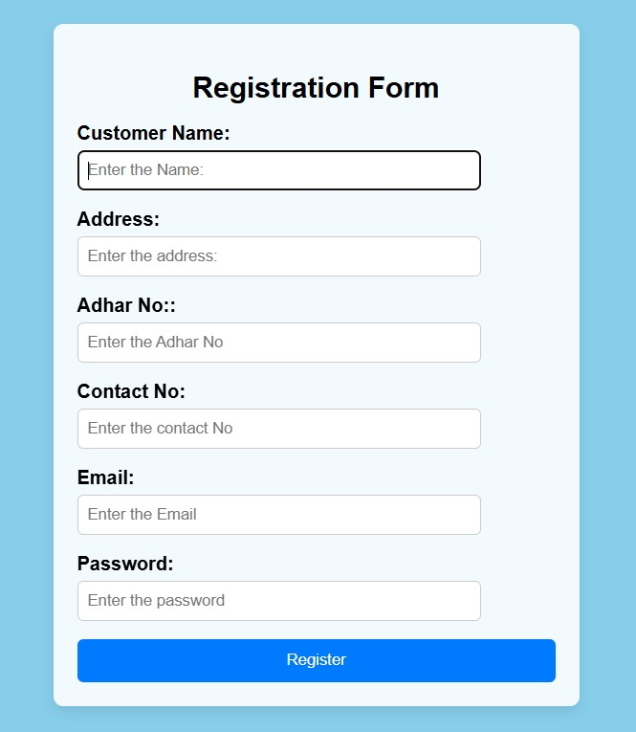
A Customer Registration Form typically collects essential details about a customer for record-keeping, communication , and service purposes.

Slide 15
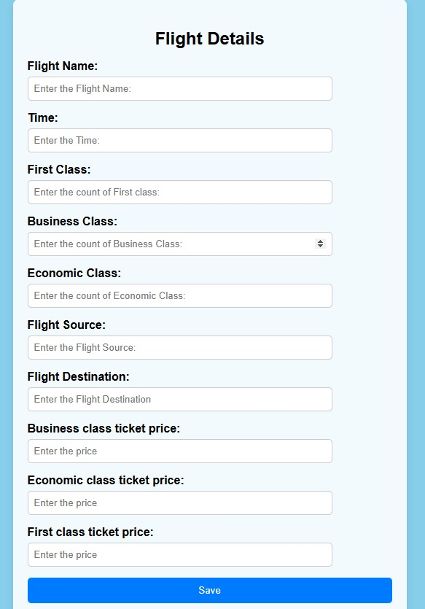
Flight Details typically include essential information about a scheduled flight.
This page can only be accessed by admins.

Slide 16
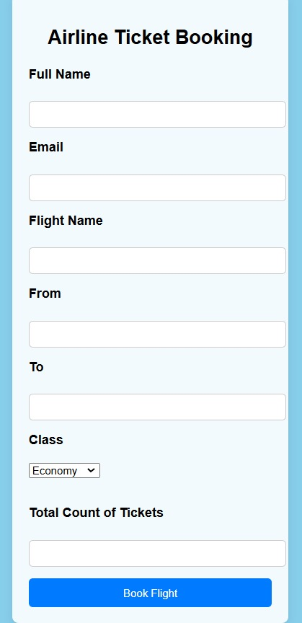
This Form a used for flight ticket booking in which customer can book the flight ticket.
Booking an airline ticket involves several essential details to ensure a smooth travel experience.

Slide 17
Thank you

