Slide 1
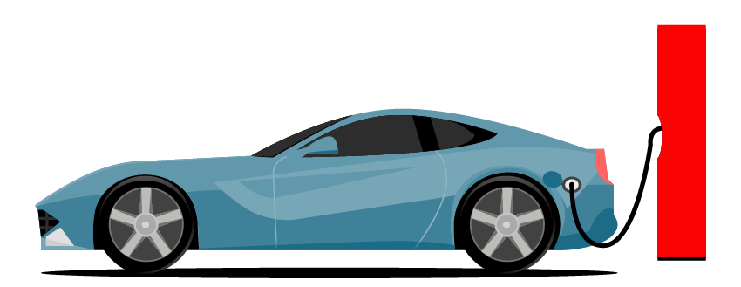
Shoppers Guide for EV's In The US. December 06, 2023 Rutuja Kokate

Slide 2
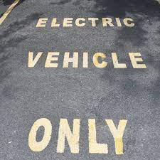

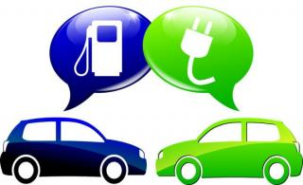


Data Sources
Electric Vehicle Population Data from DATA.WA.gov
Charging Stations dataset from EVAdoption.
Visualizations used:
Line Graphs with Trend Line.
Bubble chart.
Drilldown Scatterplot.
Stacked Bar Chart.
Donut Pie chart.
Map.
Details from Marks Pane to show Numbers.

Slide 3
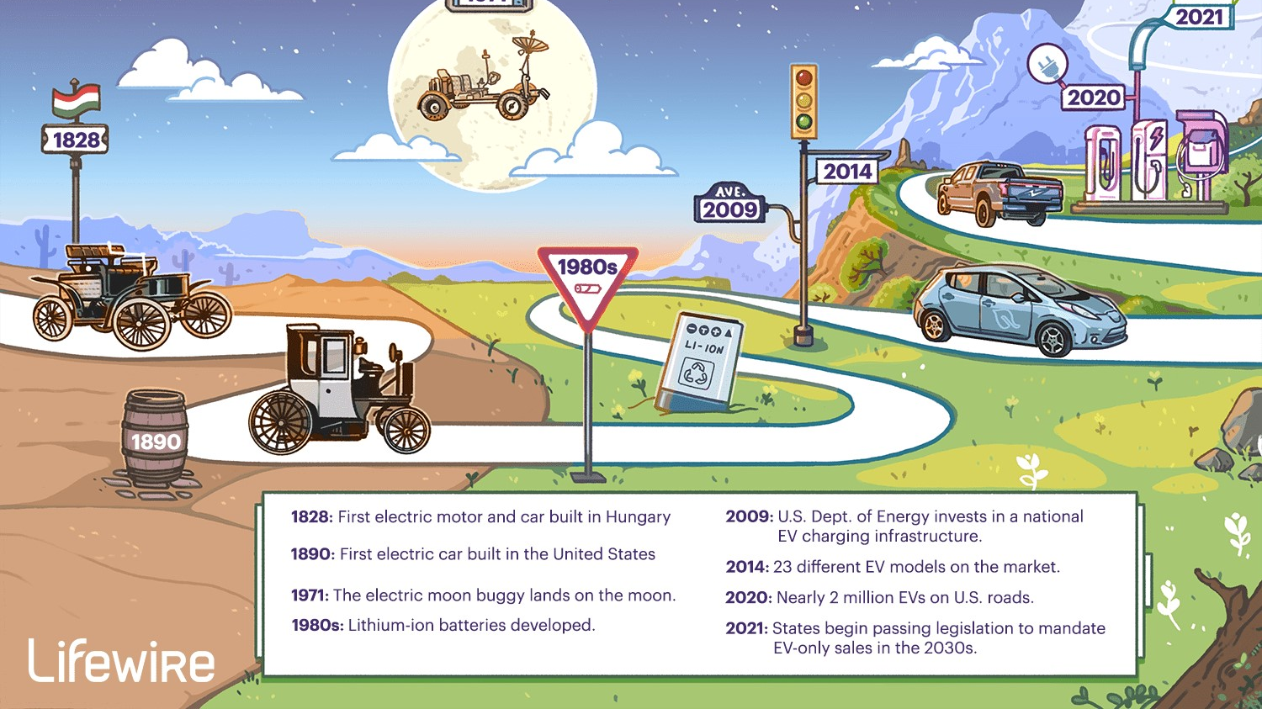

Slide 4

Is an EV right for me?
Are electric vehicles affordable?
How are they good to the Environment
How and where would I charge an EV?
What type of EV is the best for me?
Which EV should I buy
Will an EV go enough miles between “fill-ups”?

Slide 5
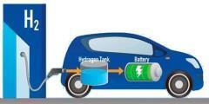
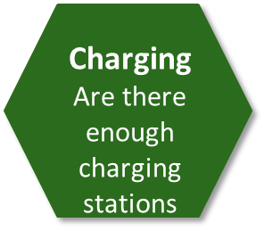

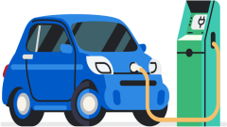
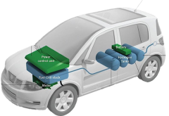
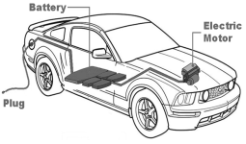
Comparison Shopping
Which are the most popular brands
Most popular EV;s
Which Charging stations will provide fast charging
DCFC ports
Charge Station
To Total Ev’s Ration
Convenience to charge
Electric Range
How far can I travel

Slide 6
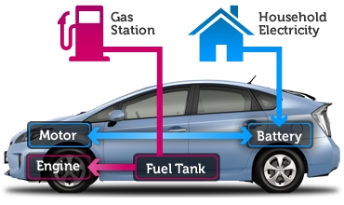

What kind of EV is right for me?
ADVANTAGES
PHEV
ADVANTAGES
BEV
Simple, low maintenance
Electric Motor
Many Choices of Vehicles
Long Driving Range
How does it work?
How does it work?
Many Choices of Vehicles
Versatile Fuel Source

Slide 7
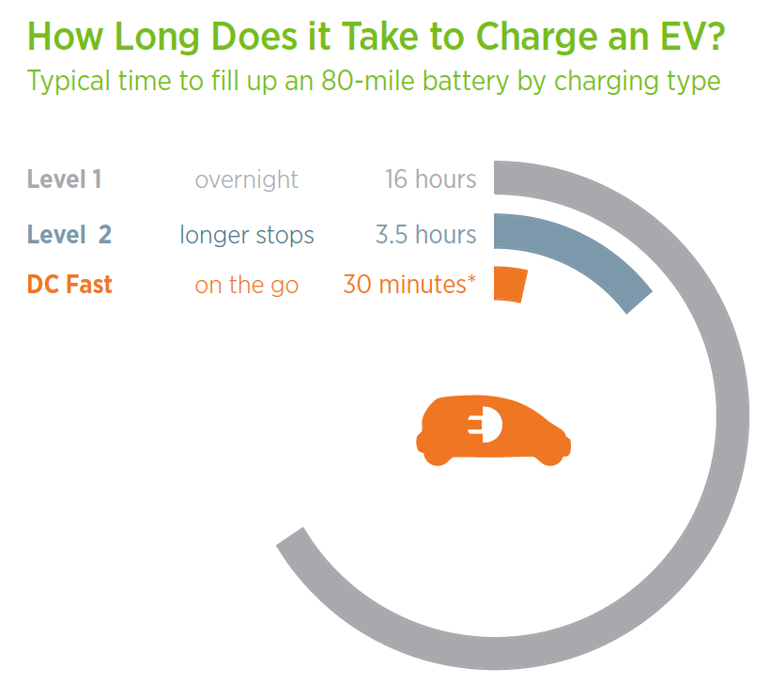
How it Works:
High Power (50-300W)
Public Only
Charges up to 80% in ~30 min, then slows to protect battery
Best for: Quick charging on the road

Slide 8

CAFV Eligibility:
Clean Alternative Fuel Vehicles (CAFVs) categorizes vehicles as based on the fuel requirement and electric-only range requirement.
CAFV-eligible vehicles may be eligible for various incentives and rebates. Governments at the federal, state, and local levels often provide financial incentives to promote the adoption of clean and alternative fuel vehicles.
New Rebates (November 2020)

Slide 9

Which EV will fit my Budget ?
Manufacturer Suggested
Retail Price (MSRP)

Slide 10

Thank you ☺

