Slide 1


Olist E-Commerce Analysis
Presented by, Group 5
Conveyed by,
- Rutuja Mahadeorao Lokhande
- Abhijeet Satyavan Tekawade
- Varshasree Pasupuleti
- Laxman Kunwar
- Mahesh Sahu

Slide 2








The OLIST STORE is an e-commerce business headquartered in Sao Paulo, Brazil. This firm acts as a single point of contact between various small businesses and the customers who wish to buy their products. In this project we are given multiple tables in CSV format and a schema depicting how these tables are connected. After connecting all the 8 tables, we analyze the entire dataset. It contains multiple categorical and numerical columns and information about 100k orders made at multiple marketplaces between 2016 to 2018.
In this project we are provided with 5 KPI. During this project we worked in different phases & tools.
Finally to present the in depth analysis for each KPI in the form of an interactive dashboard we used,
MS-Excel
MySQL
Power BI
tableau

Slide 3
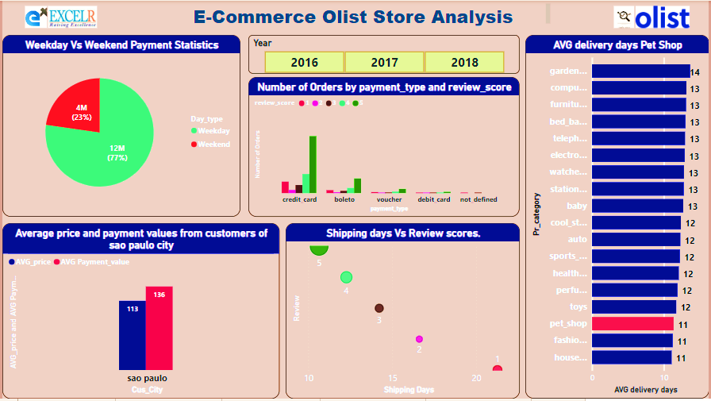
Main dashboard which represents
the analysis for the 5 KPI
Dataset-
Problem Statements (KPI):
Weekday Vs Weekend Payment Statistics
Number of Orders with review score 5 and payment type as credit card
Average number of days taken for Pet Shop
Average price and payment values from customers of Sao Paulo city
Relationship between shipping days Vs review scores

Slide 4

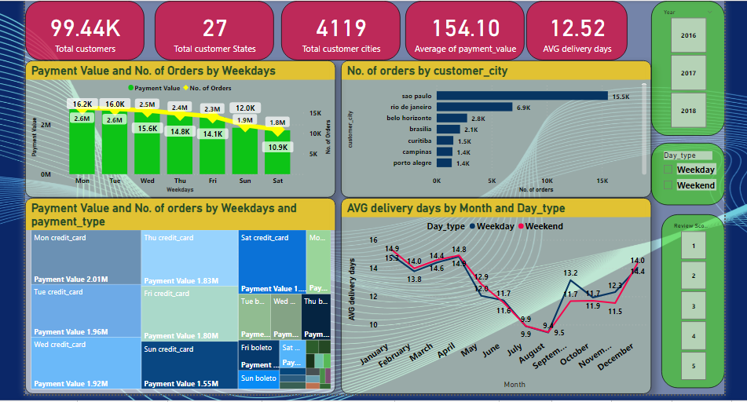
1. Weekday Vs Weekend Payment Statistics
Conclusion
In Weekday the Sum of Payment Value is 77% and in Weekend its only 23%, So here we can say that Weekday has more Sum of payment Value than Weekend may be because people head out more on weekends. Which means they are offline. Based on this logic, a business site will get more hits during the weekdays.
When we consider Weekday: Monday has the highest payment value and for Weekend: Sunday has the highest payment Value and here in both Weekday as well as in the Weekend the payment was done more through credit card.
Highest payment value is 2.01M which is paid on Monday using Credit card payment type.
Maximum count of orders(15.5K) and customers are from Sao Paulo city during weekdays and weekends.
Maximum orders are placed during March to August (61.73K). So, sales for this months are higher.

Slide 5
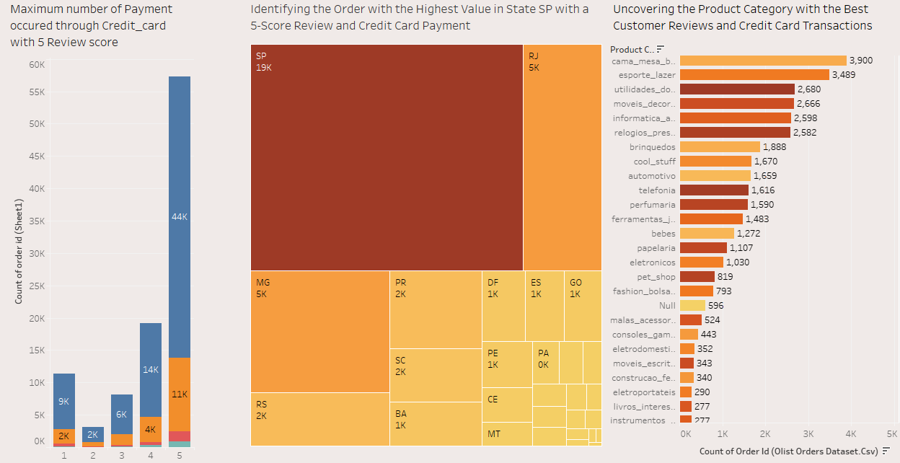
2. Number of Orders with review score 5 and payment type as credit card
In the interval of 2016 to 2018 year, number of orders rises and customer prefers their payment by Credit card payment type.
In State wise SP has highest number of payment value occupied for both 5 Score review and Credit card payment type.

Slide 6
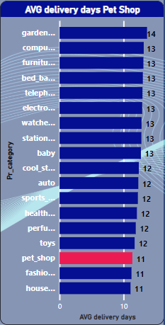
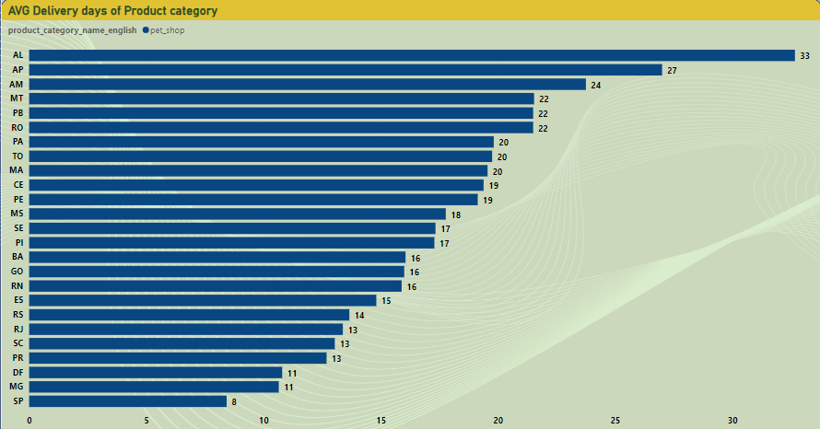
KPI 3: Average number of days taken for order_delivered_customer_date for pet_shop
Conclusion
When we consider the payment type, the average 11 days to deliver for Pet shop for overall states, and for state AL is taking 33 more days as compare to average delivery days.
Similarly when we consider state the average number of days to deliver order to the customer is more in AL and less in SP.
So from this we concluded that our target should be more on the product, city as well as the state which taking more Average Number of days to deliver order to the customer.

Slide 7
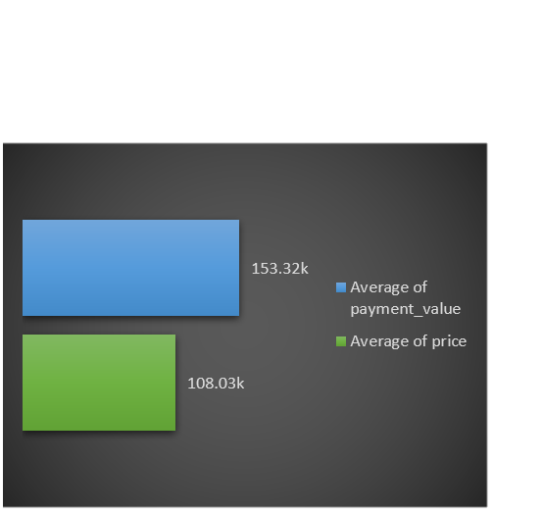
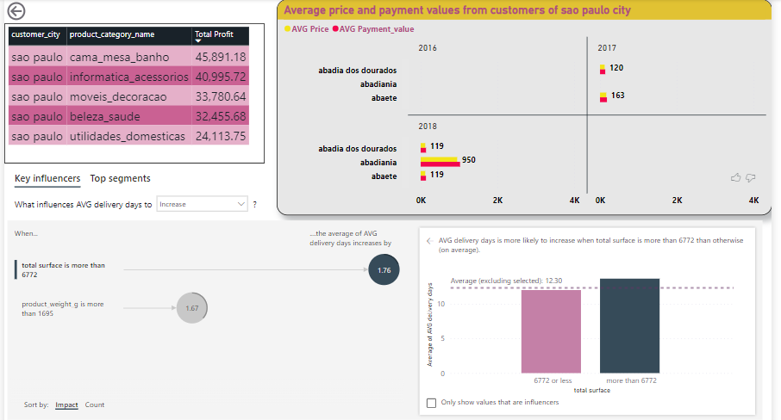
KPI 4: Average price and payment values from customers of Sao Paulo city
Conclusion
The Product Category name pcs has the highest price and payment value where as casa_conforto_2 has the less price and payment value.
The highest average price and payment values from customers of Sao Paulo city is done through credit card and Boleto.
When we consider other cities, pianco has highest price and payment value and when we consider states, BA has the highest price and payment value.

Slide 8
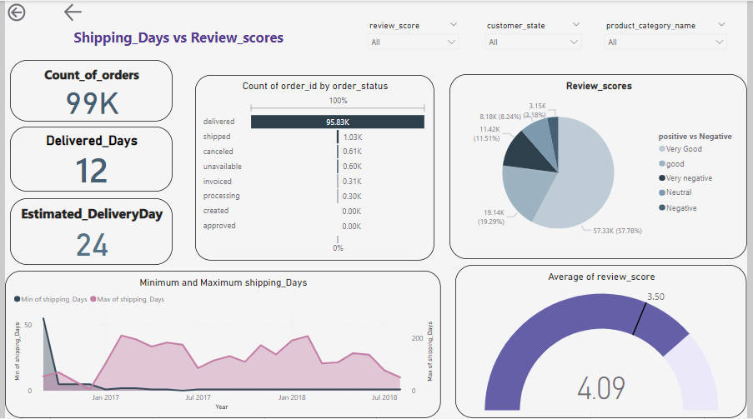
KPI 5: Relationship between shipping days (order_delivered_customer_date - order_purchase_timestamp) Vs review scores.
Over 76% of orders got more than 3.5 star rating, which is closer to overall average rating of 4.09.
Delivery days are directly influencing review scores. When delivery days are more than 30, the average review score is 1.87, which is 2.21 units lower than the overall average of 4.09.
Similarly we got 5 review score for both highest as well as lowest number of shipping days.
As delivery days increase, delivery costs also increase with the exception of a few products.

Slide 9


Terminal Observation
Maximum orders are placed between March to August(60.38K) because of which sales during this month are higher($8.34M) which is 61.36% of total sales. Which shows that the store is performing well during this month.
Currently credit cards are the most preferred payment type by customers which contributes a major role in overall sales(78.44%). To improve sales & to promote other payment types, Olist Store can provide discounts & offers on other payment types.
From 5th KPI we can conclude that if sellers take longer days to deliver the product then customers provide less review score which shows it is one the factor that influences review score.
Sellers should improve on delivery days & should keep customers informed about status of delivery it will make time go much faster for customer and will create personalize experience because they know what's happening.

Slide 10
Thank You !

