Slide 1

Name: Rutuja Parab & Shubham Rajput
Enrolment Number: EN12026094776,
Batch Code: DA-74
Mentor: Rohit Kamboj
OTT PLATFORM BUSINESS
ANALYTICS
From viewer behaviour to data-driven content &
retention decisions

Slide 2
Business Objective:
Problem Statement:
Why is this OTT analysis needed ?
OTT platforms generate large volumes of content, viewing, customer, subscription and feedback data.
The business needs evidence to identify what drives engagement, content performance and retention.
Key decisions: which content deserves promotion, which audiences/devices show stronger engagement, and where churn is concentrated.
Target audience: Content & Programming, Product & Engagement, Marketing & Retention, and Business Leadership.
Analyze Content Performance and Viewer Engagement
Evaluate Platform and Content Portfolio Performance
Analyze Viewing Behavior Across Customer Segments
Analyze Device and Time-Based Viewing Patterns
Analyze Subscription Retention and Churn Drivers
Evaluate Ratings and Feedback as Indicators of Content Success

Slide 3
Business Objective wise Questions
There are 30 analytical questions divided in all 6 objectives
O1.
Content Performance & Engagement
O2.
Platform & Content Portfolio
Which genres have the highest average watch duration?
Which genres have the highest average completion percentage?
Does viewer engagement differ between Movies and TV Shows?
Does content age affect popularity and completion percentage?
Which content titles have the strongest popularity and engagement indicators?
Which platform has the highest number of available titles?
Which platform generates the highest viewing activity?
Which platform has the highest average completion percentage?
Which platform has the highest average watch duration?
Which genres perform best on each platform?
O3.
Demographic Viewing Behavior
O4.
Device & Time Patterns
Which age group has the highest viewing activity?
Which region has the highest average engagement?
How does viewing behavior differ across gender groups?
Which age group has the highest average watch duration?
Which regions have the highest completion rates?
Which device type is used most frequently?
Which device has the highest average watch duration?
Which device has the highest average completion percentage?
Which time-of-day slot has the highest viewing activity?
Does viewing behavior vary across devices and time slots?
O5.
Subscription Retention & Churn
O6.
Ratings, Feedback & Content Success
Which subscription type has the highest renewal rate?
Which subscription type has the highest churn rate?
Is engagement level associated with renewal and churn?
How do Premium and Basic users differ in retention patterns?
Is monthly subscription fee associated with renewal or churn?
Which content receives the highest average user rating?
Which content receives the highest number of likes?
What is the distribution of Positive, Neutral and Negative feedback?
Is user rating associated with completion percentage?
Does higher-rated content have a higher rewatch rate?
* Not all 30 questions require formal hypothesis testing. Descriptive questions will be answered through Excel, SQL, Python and Power BI. Comparison
and relationship questions will be shortlisted for formal statistical validation.

Slide 4
Dataset Description
Five cleaned datasets form one analytical ecosystem
USER PROFILE
CONTENT LIBRARY
VIEWING ACTIVITY
RATINGS & FEEDBACK
SUBSCRIPTION & RETENTION
2,000
17,797
30,000
12,000
2,000
Who are the users?
What content is available?
How do users watch?
What do viewers think?
Who renews or churns?
Dataset | Key Variables | Business Purpose
👤 User Profile | User_ID, Age, Gender, Region | Understand customer demographics and audience segments
🎬 Content Library | Content_Key, Genre, Type, Duration, Release Year, Popularity | Analyse content portfolio and content performance
▶️ Viewing Sessions | User_ID, Content_Key, Watch Duration, Completion %, Device, Time | Analyse viewing behaviour and engagement
⭐ Ratings & Feedback | User_ID, Content_Key, Rating, Likes, Feedback, Rewatch | Measure user response and content satisfaction
💳 Subscription & Retention | User_ID, Plan Type, Monthly Fee, Renewal, Churn | Analyse customer retention, renewal and churn

Slide 5
Technology Stack
Excel — PivotTables, formulas, descriptive statistics and initial business visuals.
Python — EDA, distributions, group comparisons, correlations, hypothesis testing and ML.
SQL — joins, aggregations, CASE, CTEs, window functions, summary tables and reporting views.
Power BI — interactive KPI dashboards and decision-support exploration.
Statistics — validate important observed differences and relationships.
Machine Learning — feature selection and Simple Linear Regression.

Slide 6
Data Cleaning & Fixes Applied
Domain-based preparation before analysis
Checked missing values, duplicates, data types, identifiers and categorical consistency.
Validated Completion_Percentage within the 0–100 business range.
Checked watch duration and paused-times for invalid values.
Viewing-duration outliers were investigated and retained where they were plausible behavior rather than automatically deleted.
Standardized content keys and category values for consistent joins and reporting.

Slide 7
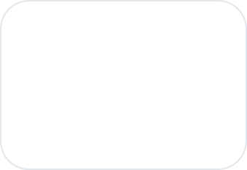
Tools and Techniques Used
TOOLS
🟢 Microsoft Excel
• Data cleaning & validation
• Descriptive analysis
• Initial business analysis
🔵 Python
• Exploratory Data Analysis (EDA)
• Statistical analysis
• Data visualization
• Machine Learning
ANALYTICAL TECHNIQUES
EDA | Descriptive Statistics | Hypothesis Testing
Welch Independent t-test
Movie vs TV Show Completion
Two-Proportion Z-test
Free Trial vs Paid Churn
Chi-square Test
Engagement Level vs Churn
Pearson Correlation
Rating vs Completion & Rewatch
Feature Selection — SelectKBest
Identify the strongest predictor
Simple Linear Regression
Predict Watch Duration from Content Duration
🟠 SQL
• Data querying
• Joins & aggregations
• Business-question analysis
🟣 Power BI
• Interactive dashboard
• KPI development
• Slicers & filtering
• Data visualization
⚫ Git / GitHub
• Version control
• Project & code management

Slide 8
Possible Analysis
Analysis Type | What Can Be Analysed?
Descriptive Analysis | Overall users, content, sessions, watch duration, completion, ratings and churn
Univariate Analysis | Distribution of age groups, ratings, completion, watch duration and subscription types
Bivariate Analysis | Movie vs TV completion, rating vs popularity, device vs watch duration, subscription vs churn
Multivariate Analysis | Region × Age × Engagement, Device × Content Type × Completion, Platform × Content Type × Performance
Statistical Analysis | Validate differences and relationships using t-test, Z-test, Chi-square and Pearson correlation
Predictive Analysis | Identify important predictors and predict watch duration using feature selection and linear regression

Slide 9
Hypotheses
Six hypotheses tested at α = 0.05
H1: Movie and TV Show completion rates differ.
H2: Content age/release year has a linear relationship with completion.
H3: Engagement level and churn are associated.
H4: Free Trial and Paid churn rates differ.
H5: Rating has a linear relationship with completion.
H6: Rating has a linear relationship with rewatch behavior.

Slide 10
KPIs
KPIs
OTT PLATFORM BUSINESS ANALYTICS
KEY PERFORMANCE INDICATORS
MEASURE | ANALYSE | OPTIMISE
1. CUSTOMER & RETENTION
Measures the user base and subscription health of the platform.
Total Users
Renewal Rate
Churn Rate
2,000
55.60%
44.40%
MEANING
MEANING
MEANING
Total unique users on the platform.
Percentage of users who renew.
Percentage of users who churn.
2. VIEWING & ENGAGEMENT
Measures how actively and deeply users consume content.
Total Viewing Sessions
Average Watch Duration
Average Completion %
Rewatch Rate
30,000
181.00 min
52.36%
49.78%
MEANING
MEANING
MEANING
MEANING
Total number of viewing sessions.
Average viewing time per session.
Average percentage of content completed.
Repeat viewing behaviour.
3. CONTENT & FEEDBACK
Measures catalogue size, viewer ratings and content popularity.
Total Content
Average Rating
Average Popularity Score
17,797
3.01
4.20
MEANING
MEANING
MEANING
Total unique content items.
Average viewer rating.
Average popularity of content.

Slide 11
Exploratory Insights

Slide 12
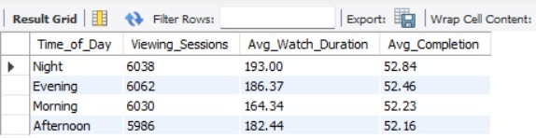
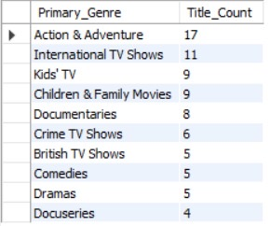
Insights from SQL Scripts
O1: Content Performance & Viewer Engagement &
O2: Platform & Content Portfolio Performance
Analysed content types and genres to understand which content attracts viewers and keeps them engaged through watch duration and completion rate.
Content Type Performance
Compared platforms based on content availability, viewing activity, watch duration and completion to identify stronger-performing platform portfolios.
Platform & Content Type portfolio

Slide 13
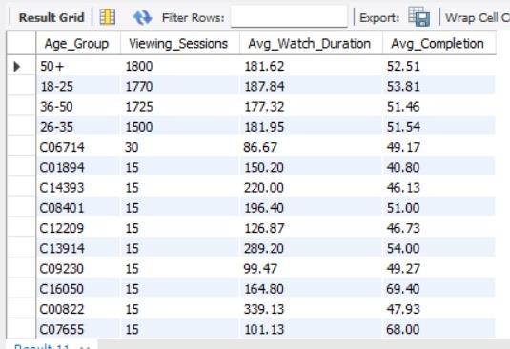
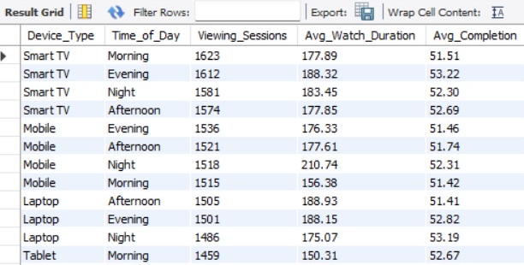
Insights from SQL Scripts
O3: Customer Viewing Behaviour &
O4: Device & Time-Based Viewing Patterns
Age Group wise Viewing Behaviour
Device & Time-Based Behaviour
Analysed viewing patterns across customer segments to understand who watches more and which segments show stronger engagement.
Examined viewing behaviour by device and time of day to identify when and where customers are most engaged.

Slide 14
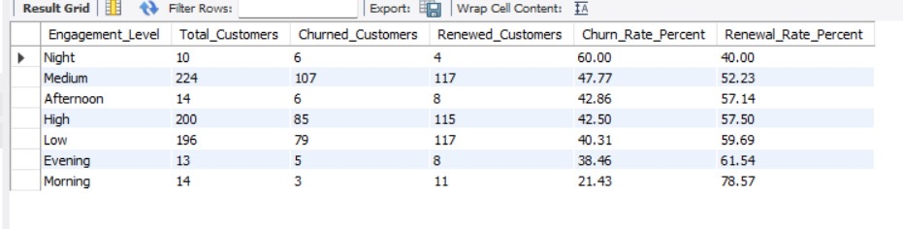
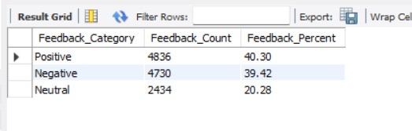
Insights from SQL Scripts
O5: Subscription Retention & Churn &
O6: Ratings, Feedback & Content Success
Ratings & Feedback
Engagement vs Churn Scorecard
Analysed renewal and churn patterns across subscription and engagement segments to identify customers at higher retention risk.
Analysed ratings and customer feedback to understand satisfaction and identify signals of successful content

Slide 15

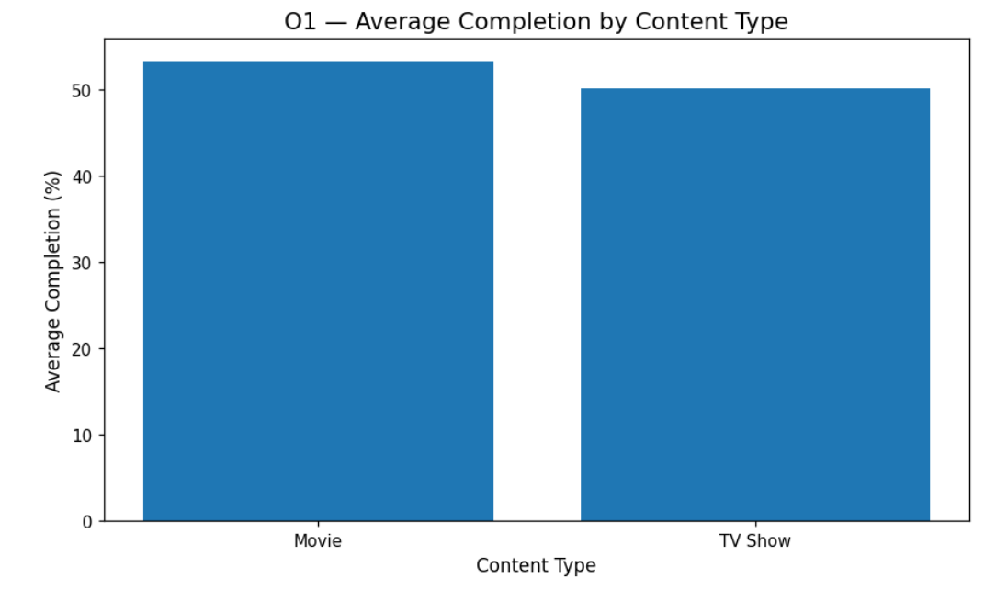
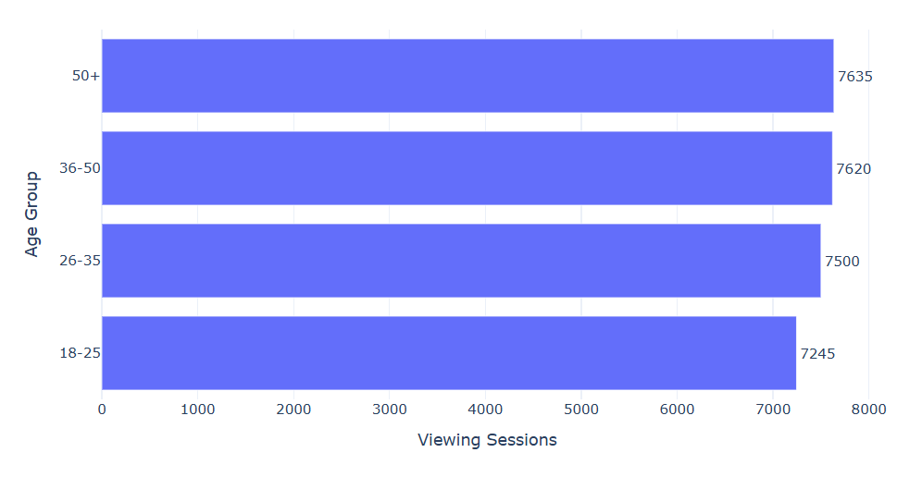
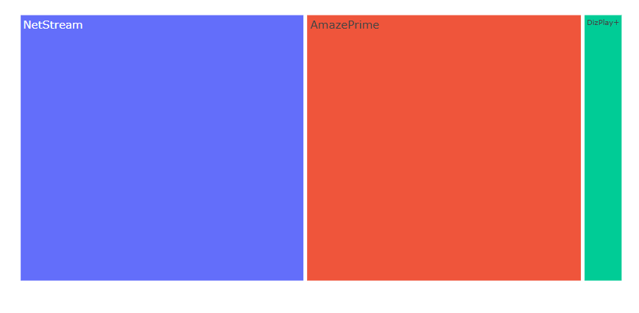
Insights from EDA
Exploratory patterns across key objectives
O1
Completion by Content Type
Platform Viewing Sessions
O3
Viewing Sessions by Age Group
O2
KEY EDA FINDING
KEY EDA FINDING
KEY EDA FINDING
Movies had higher average completion: 53.22% vs 50.04% for TV Shows, indicating stronger viewer engagement with Movies.
NetStream recorded the highest viewing activity with 14,174 sessions.
The 50+ age group recorded the highest viewing activity with 7,635 sessions.
13

Slide 16
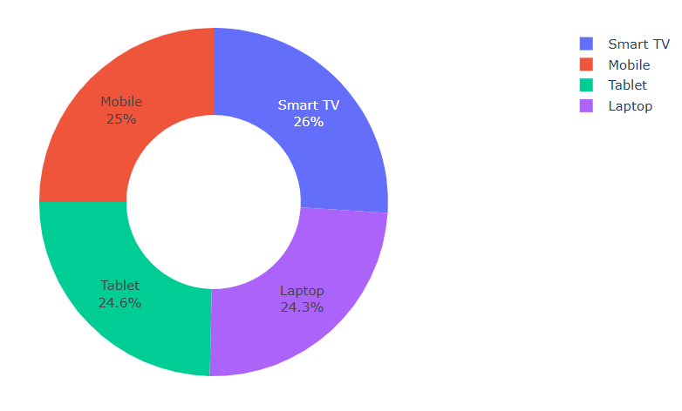
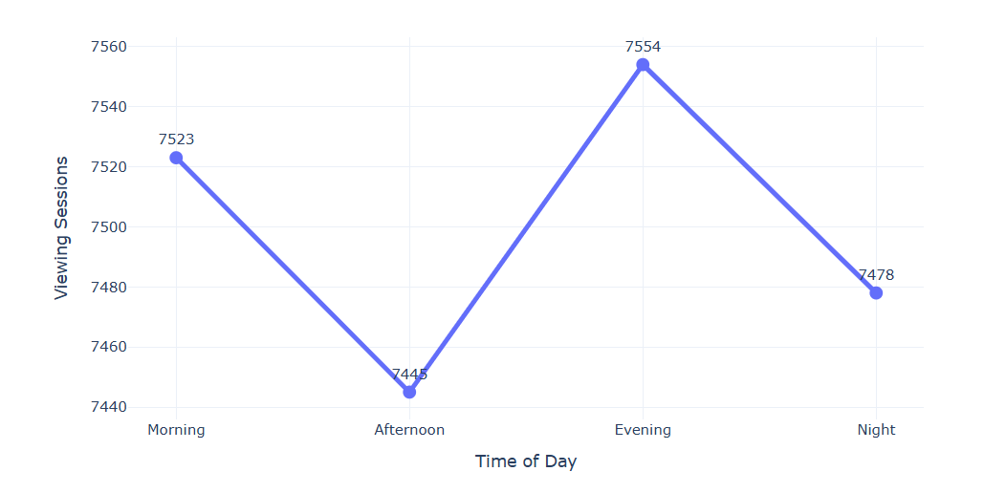
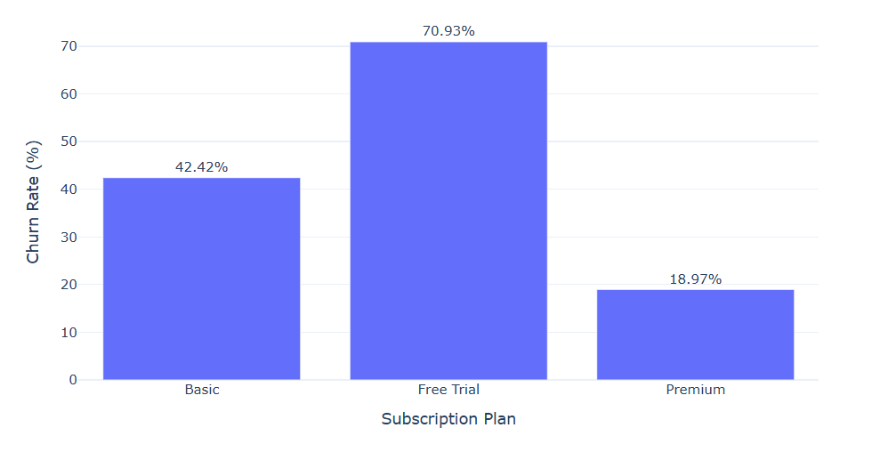
Insights from EDA
O4–O5 | Viewing & Retention Patterns
O4
Viewing Sessions by Device
O4
Viewing Sessions by Time of Day
O5
Churn Rate by Subscription Plan
KEY EDA FINDING
KEY EDA FINDING
KEY EDA FINDING
Smart TV recorded the highest viewing activity with 7,800 sessions, followed by Mobile, Tablet and Laptop.
Evening was the peak viewing period with 7,554 sessions, while Afternoon recorded the lowest activity.
Free Trial had the highest observed churn at 70.93%, while Premium had the lowest at 18.97%.
14

Slide 17
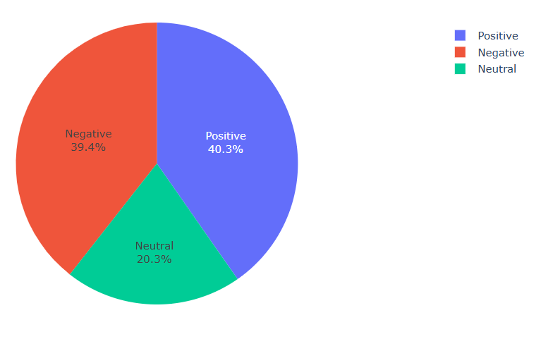
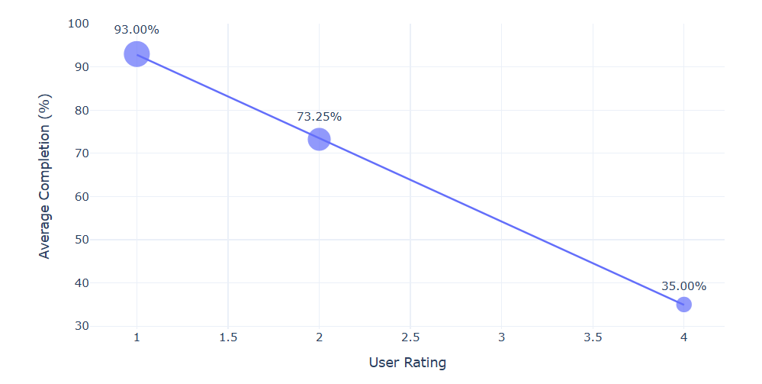
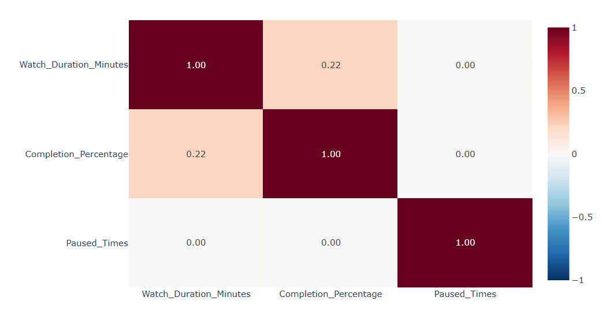
Insights from EDA
O6 & Overall EDA | Ratings, Feedback & Behaviour
O6
Feedback Distribution
O6
Rating vs Completion %
EDA
Viewing Behaviour Correlation
KEY EDA FINDING
KEY EDA FINDING
KEY EDA FINDING
Positive feedback was the largest category with 4,836 responses (40.30%), while Negative feedback was also significant with 4,730 responses (39.42%).
The chart shows the observed relationship between viewer rating and completion; it does not establish causation.
The heatmap highlights the strength and direction of relationships among Watch Duration, Completion % and Paused Times. These relationships are exploratory.
15

Slide 18
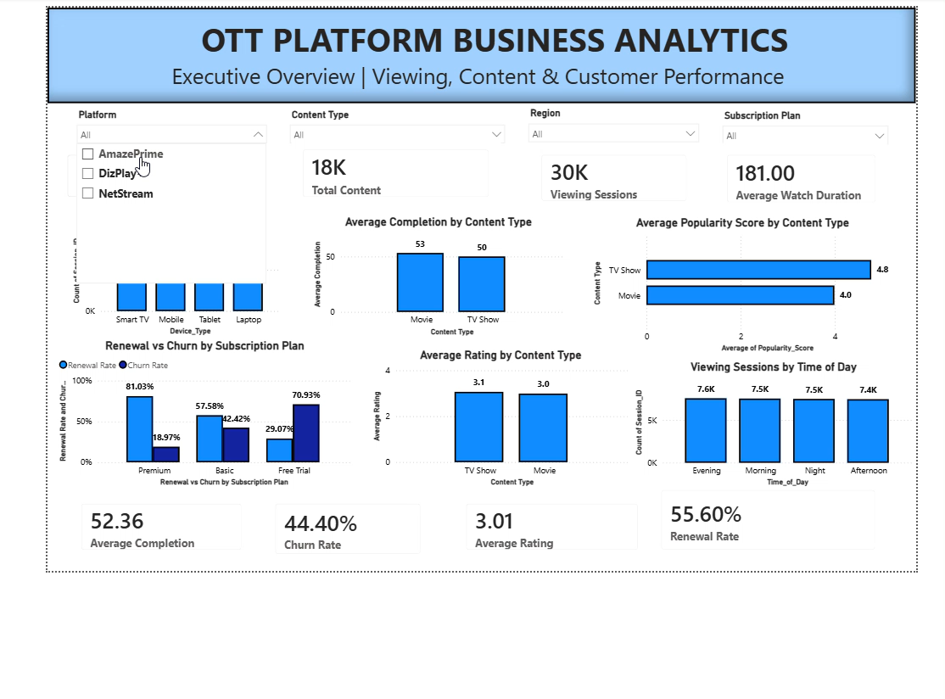
POWER BI DASHBOARD – WORKING DEMONSTRATION
Interactive filtering | Cross-filtering | Objective-wise analysis
OBSERVATIONS
30K viewing sessions were analysed, with an average watch duration of 181 minutes and average completion of 52.36%.
Smart TV recorded the highest viewing activity with approximately 7.8K sessions, while Evening was the highest viewing period.
Premium users showed stronger retention, with 81.03% renewal and 18.97% churn, compared with Basic and Free Trial users.
AmazonPrime showed the highest average content popularity, while the dashboard allows comparison of content performance across platforms and content types.
Dashboard takeaway: Interactive views help compare viewing behaviour, customer retention and content performance across key business segments.
16

Slide 19
Statistical Insights
T-TEST | MOVIES VS TV SHOWS
Z-TEST | FREE TRIAL VS PAID CHURN
t = 8.5933
z = 17.1551
p = 9.32e-18 → Reject H0
p = 5.75e-66 → Reject H0
Test | Business question | Decision | Evidence
H1 | Movies vs TV completion | Reject H0 | 53.22% vs 50.04%
H2 | Content age vs completion | Fail to reject H0 | r = 0.0008
H3 | Engagement vs churn | Fail to reject H0 | χ² = 0.6703
H4 | ₹0 vs paid churn | Reject H0 | 70.93% vs 30.71%
H5 | Rating vs completion | Fail to reject H0 | r = -0.0115
H6 | Rating vs rewatch | Fail to reject H0 | r = 0.0079
Movie completion (53.22%) is statistically higher than TV Show completion (50.04%) in this sample.
Free Trial churn (70.93%) is statistically higher than Paid churn (30.71%).
Content age, engagement vs churn, rating vs completion and rating vs rewatch were not statistically supported in these tests.
Statistical significance supports evidence of a difference/relationship; it does not establish causality.
Use descriptive patterns for exploration and validated results for stronger business claims.

Slide 20
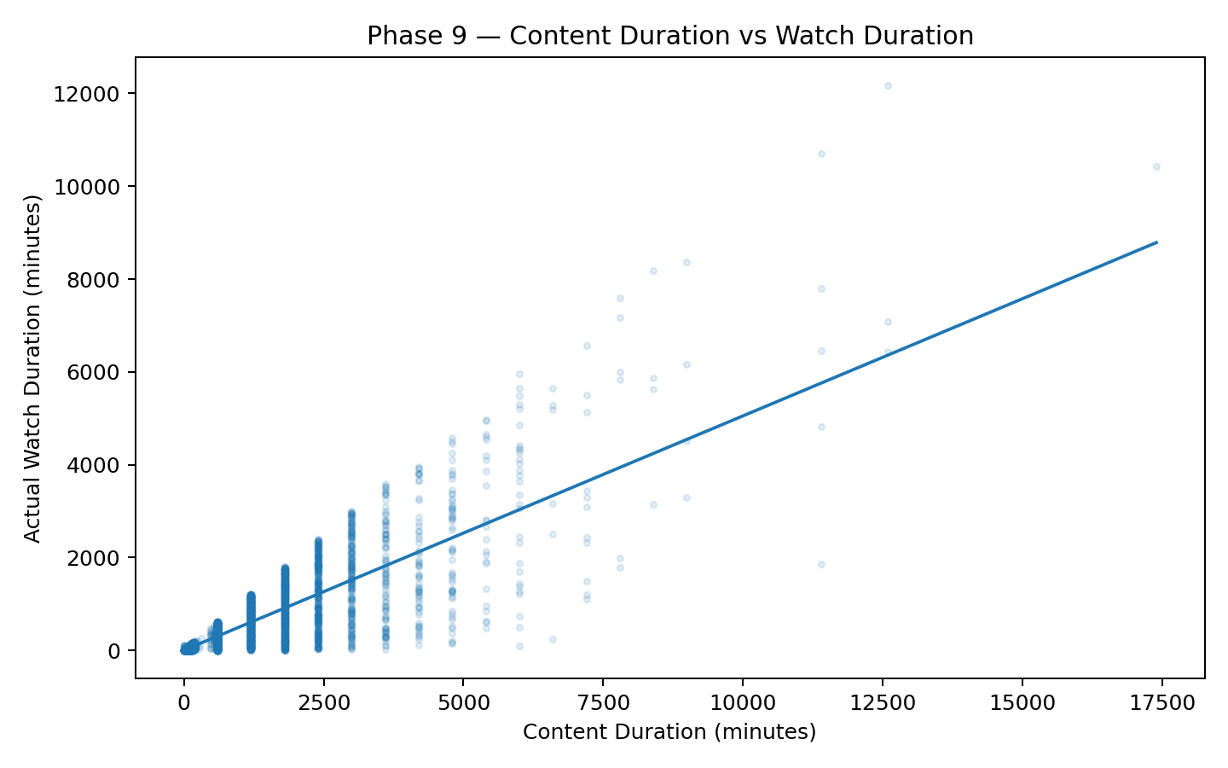
Machine Learning Models’ Insights
Phase 9 | Simple Linear Regression: Can Content Duration predict Watch Duration?
MODEL WORKFLOW
TEST R²
MAE
RMSE
REGRESSION
74.23%
88.61 min
218.46 min
1
Feature Selection
Variation explained
Typical absolute error
Larger errors weighted more
Ŷ = 1.1354
+ 0.5049 ×
Duration
SelectKBest + f_regression
2
Selected Predictor
CONTENT DURATION VS WATCH DURATION
Duration_Minutes
KEY FINDING
Duration is the strongest single predictor of watch duration.
Association ≠ causation.
3
Model
Simple Linear Regression
4
Evaluation
R² • MAE • RMSE
Estimate expected watch duration for new content based on its duration.
Support content planning and scheduling using predicted viewing time.
Use predictions as a benchmark, together with genre, platform, device and audience factors.
BUSINESS USE
18

Slide 21
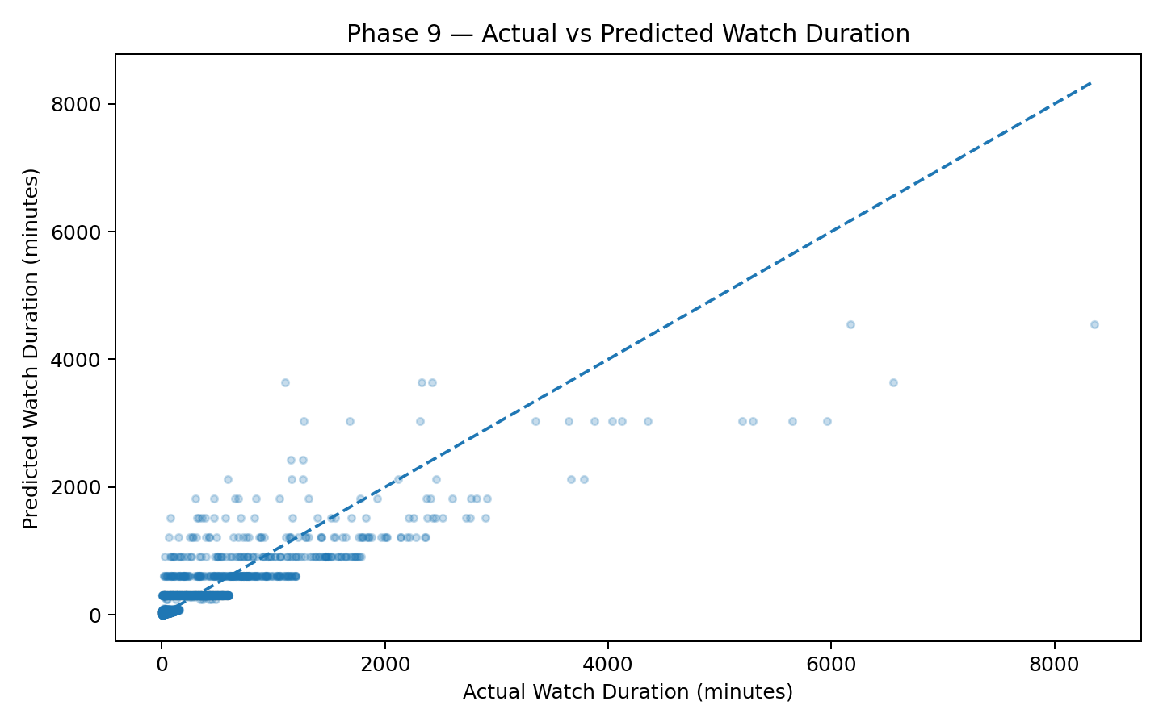
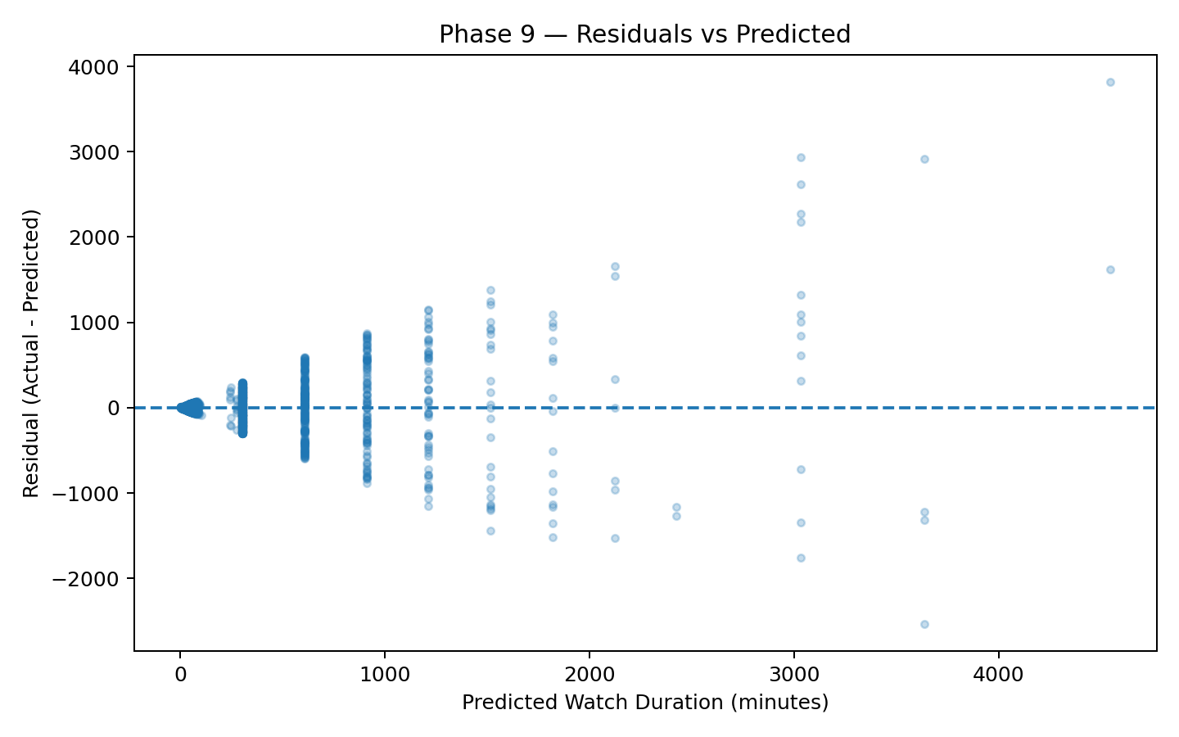
Regression Diagnostics & Validation
Phase 9 | Actual vs Predicted performance and residual analysis
ACTUAL VS PREDICTED WATCH DURATION
RESIDUALS VS PREDICTED
DIAGNOSTIC FINDINGS
We checked whether the regression errors were consistent. The test found unequal error spread, so we used HC3 robust standard errors to make the results more reliable.
19

Slide 22
Summary
Objective-wise key findings from the complete analysis
O1
CONTENT PERFORMANCE
Movies showed higher average completion than TV Shows (53.22% vs 50.04%).
O2
PLATFORM PERFORMANCE
NetStream recorded the highest viewing activity with 14,174 sessions.
O3
AUDIENCE BEHAVIOUR
The 50+ age group contributed the highest viewing activity with 7,635 sessions.
O4
DEVICE & TIME USAGE
Smart TV was the most-used device, while Evening had the highest viewing activity.
O5
RETENTION & CHURN
Free Trial churn was substantially higher than Paid churn (70.93% vs 30.71%).
O6
RATINGS & FEEDBACK
Rating showed no statistically significant relationship with completion or rewatch behaviour.
Overall: Retention is the strongest business priority; other findings support content, platform, audience and viewing optimization.
20

Slide 23
Business Implementation / Suggestion
Turning project findings into actionable business decisions
01
Improve Free Trial → Paid Conversion
02
Optimize Content by Format
• Free Trial churn is much higher than Paid churn.
• Strengthen onboarding, personalized recommendations and trial-to-paid offers.
• Movies show higher completion than TV Shows.
• Prioritize content formats and genres with stronger completion and engagement.
03
Strengthen High-Usage Experiences
04
Use Data-Driven Content & Retention Decisions
• Smart TV and Evening have the highest viewing activity.
• Optimize TV experience and promote content during peak viewing periods.
• Combine platform, audience, viewing and feedback insights.
• Use Power BI KPIs and predictive analysis for continuous decision-making.
From Insight to Impact
21

Slide 24
Business Implementation of Simple Linear Regression Model
Predicting viewer watch duration to support content planning
Actual vs Predicted Watch Duration
MODEL PURPOSE
Predict viewer watch duration from content duration.
Input: Content Duration (minutes) | Output: Predicted Watch Duration (minutes)
MODEL RESULT
Predicted Watch Duration = 1.135 + 0.505 × Content Duration
R² = 74.23% | MAE = 88.61 minutes
BUSINESS USE
• Estimate expected viewing time for new content.
• Support content planning and scheduling.
• Identify content likely to generate higher watch duration.
HOW IT CAN BE USED
New Content Duration → ML Model → Predicted Watch Duration → Business Decision
Example: 120-min content → ≈ 62 min predicted watch duration.
22

Slide 25
Limitation and Future Scope
Key constraints of the current analysis and opportunities for extension
LIMITATIONS
FUTURE SCOPE
1
Dataset Limitation
1
Advanced ML
The analysis is based on the available OTT datasets and may not represent the complete real-world OTT population.
Extend the model with content, user, platform, device and engagement features to improve prediction.
2
Model Limitation
2
Real-Time Analytics
The current regression focuses mainly on content duration; other factors such as genre, platform, device and audience behaviour are not included in the model.
Integrate live viewing and subscription data for real-time monitoring and proactive churn and content decisions.
Current Analysis → Expanded Features → Advanced Prediction → Real-Time Decisions
23

Slide 26
Conclusion
Overall outcome of the OTT platform business analytics study
01
Content & Engagement
Movies achieved higher average completion than TV Shows (53.22% vs 50.04%), supporting format-specific content decisions.
02
Platform & Audience
Platform, age, region, gender, device and time analysis identified important viewing patterns for audience segmentation.
03
Retention
Free Trial churn was substantially higher than Paid churn (70.93% vs 30.71%), making trial-to-paid conversion a key priority.
04
Feedback & Behaviour
Ratings and feedback were analysed alongside completion and rewatch behaviour to support content evaluation.
05
Predictive Analytics
The regression model achieved R² = 74.23%, showing that content duration can provide a useful basis for estimating watch duration.
Overall: The project converts OTT data into actionable insights for content, engagement, customer retention and predictive decision-making.
24

Slide 27
Q&A

Slide 28
THANK YOU

