Slide 1

Data visualization for Flight Delay and cancellation Analysis for USA domestic airline for Year 2015

Slide 2
Project “ Flight delay analysis for USA domestic airlines for the year 2015” Data Source: URL:https://www.kaggle.com/datasets/usdot/flight-delays # Tool for Visualization – TABLEAU PUBLIC WORKBOOK # This data deals with the data on the flights taken from the U.S.Department of Transportation’s(DOT) Bureau of transportation statistics. # It tracks the on-time performance of domestic flights operated by different air carriers over different airports.
COURSE- Data230-22
Name- Rutuja Pohare
Date – 29TH NOV 2022

Slide 3
Csv Files considered for this project: 1). Flights.csv –(31 columns) 2). Airport.csv –(4 columns) 3). Airplane.csv –(2 columns) These three csv filles are connected to each other by 3 different means as follows. And different operations are performed on it separately to analyze the data source precisely: 1).Inner joins 2). union joins 3). Many to many relationship

Slide 4
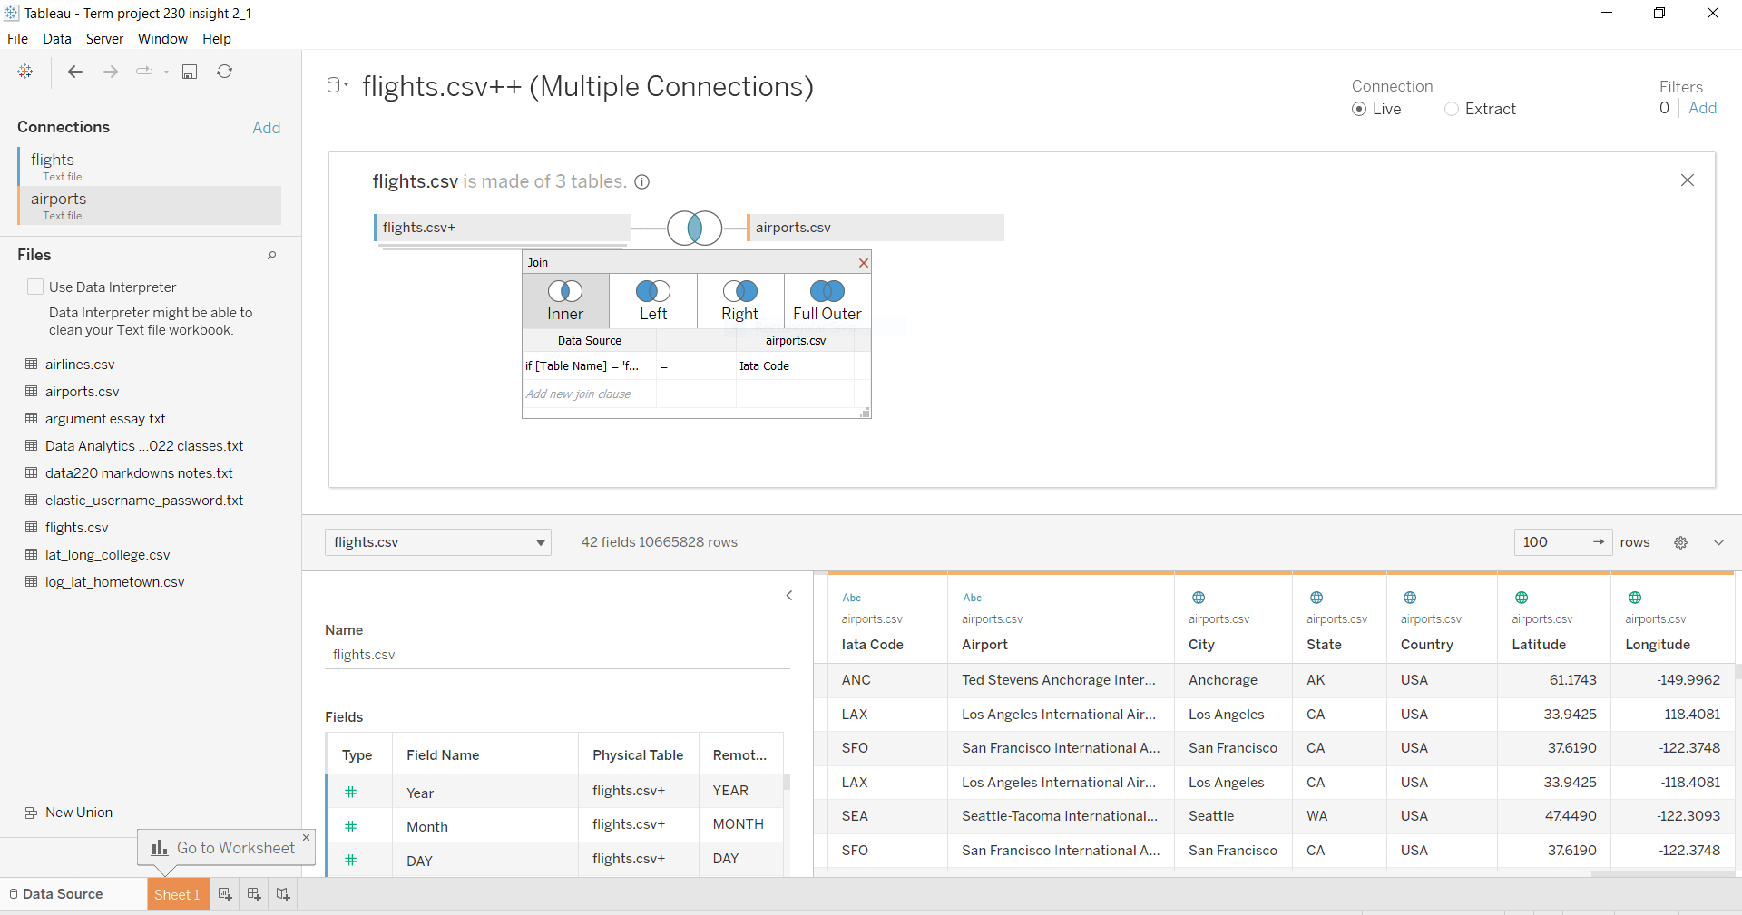
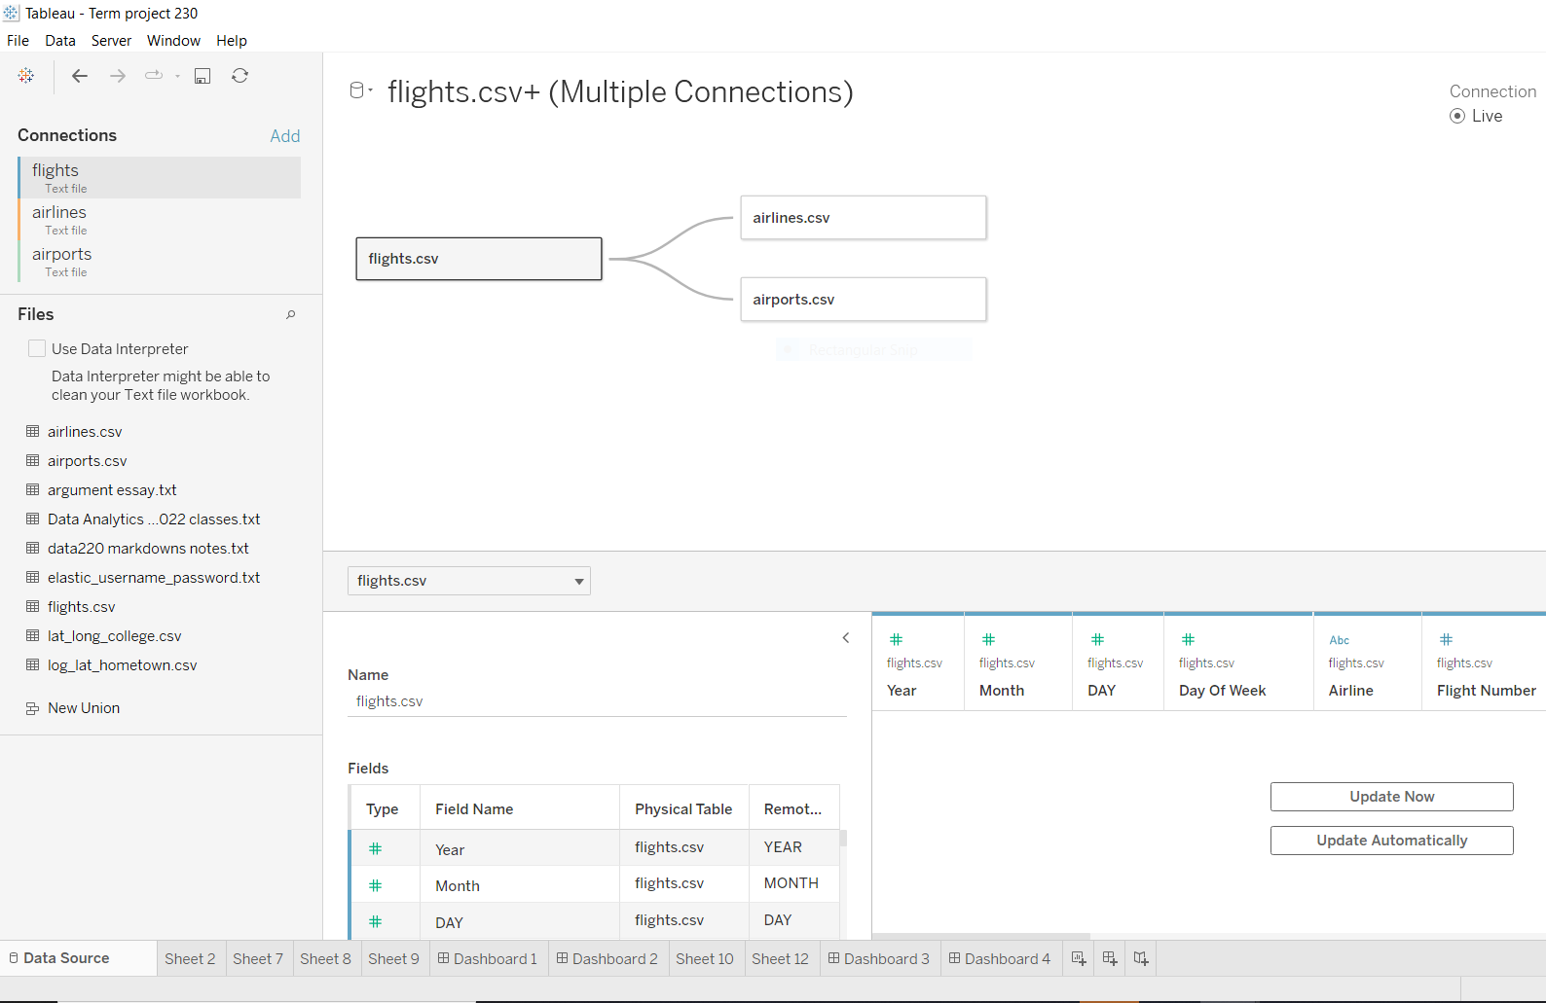
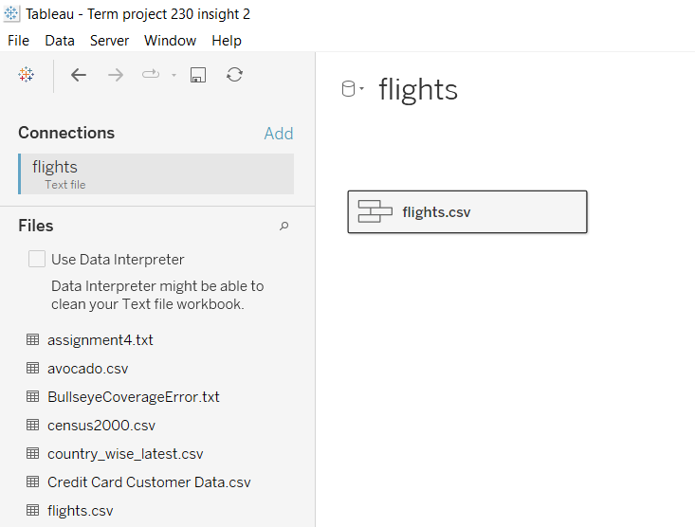
Representation of join operation and relationship on data source:

Slide 5
Purpose of Visualization: 1). Visualize departure, arrival and airline delay for different airlines and airports. 2).Visualize delay information by origin and by destination for the respective airline and airports. 3). Visualize the delay information by weekdays and considering the correlation between the average arrival delay and average departure delay using the regression or trend line for each airline. 4). Visualize the reasons for the delay with respect to the airlines

Slide 6
DATA WRANGLING: - In order to analyze the complete data source some data wrangling has been done on the datasets. Some calculated fields has been created to create fields such as follows: 1. origin_route_destination 2. Route_order 3. Route_location 4. Table_name 5.Rank1,Rank2 6.Curve 7. t 8. Sigmoid

Slide 7
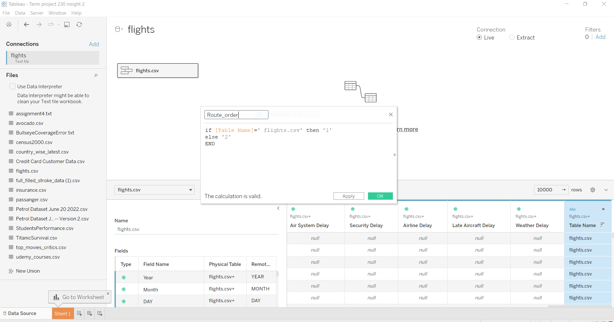
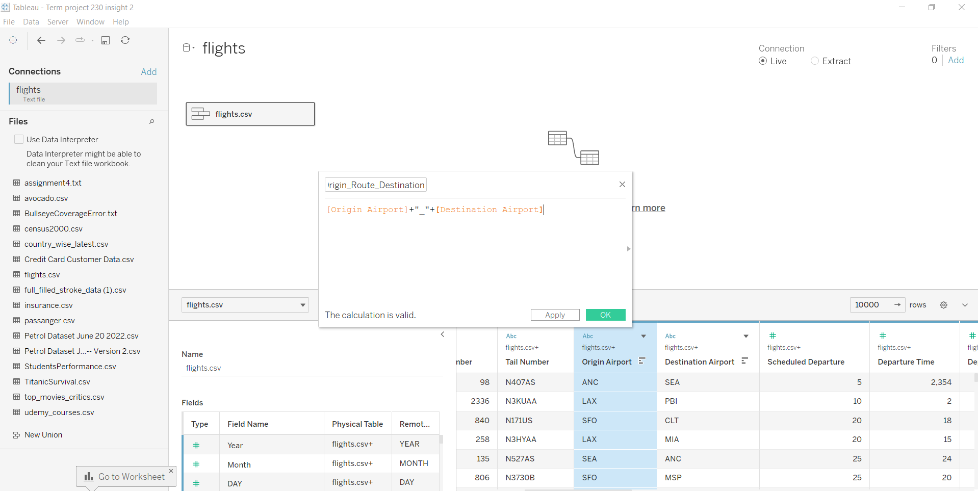
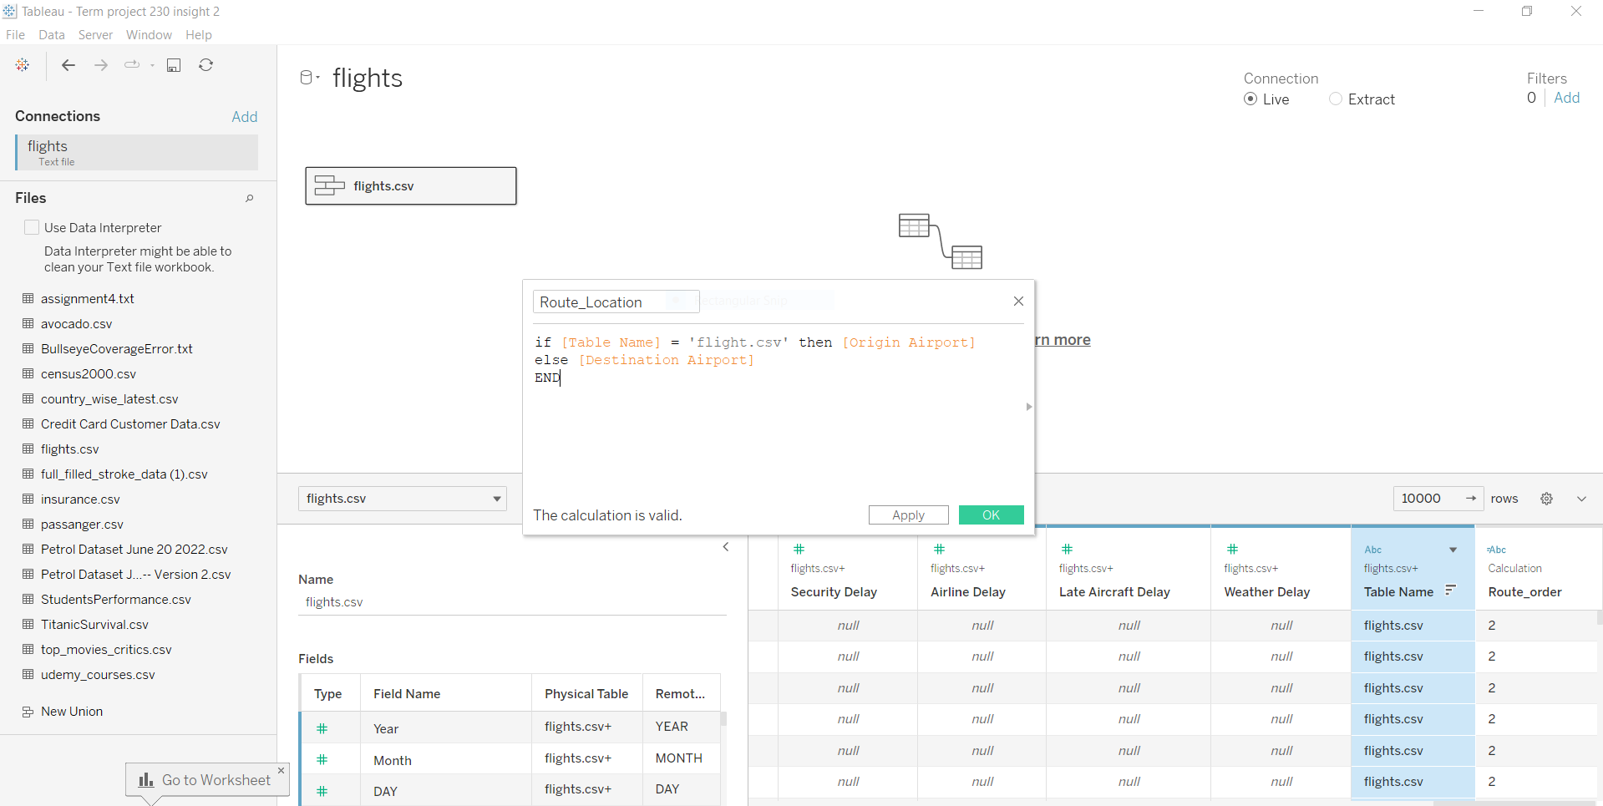
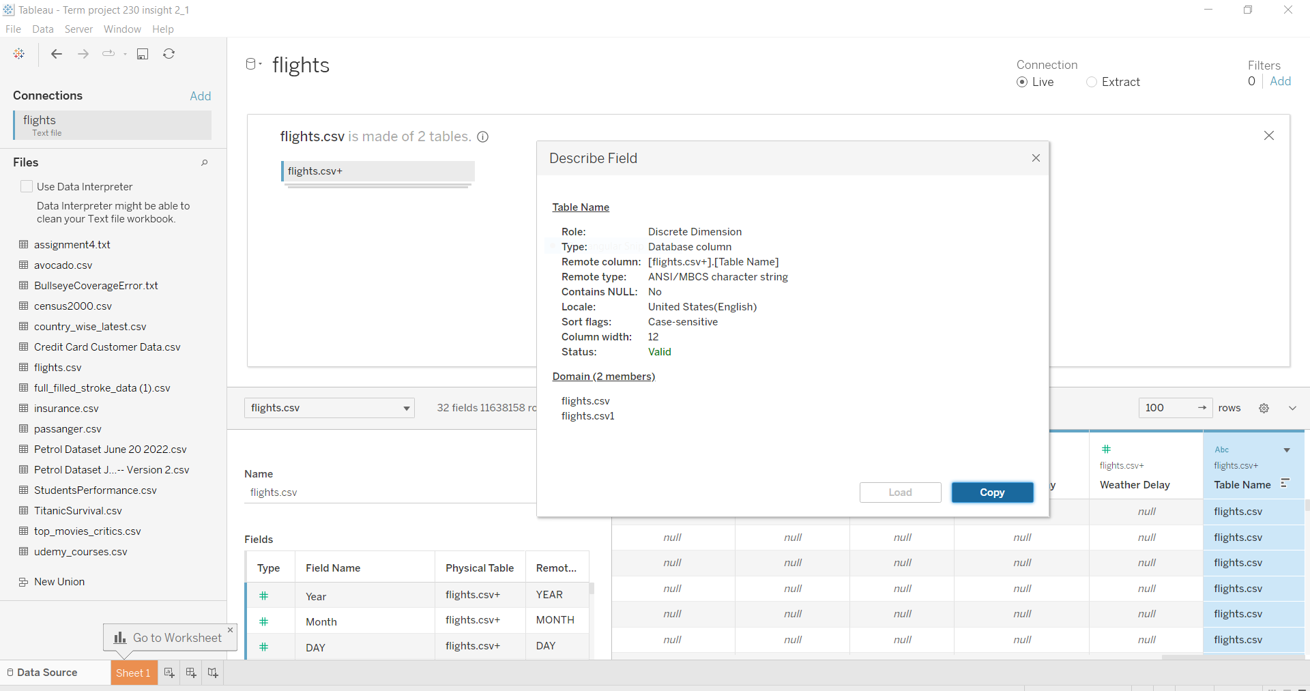
Representation of DATA WRANGLING:

Slide 8
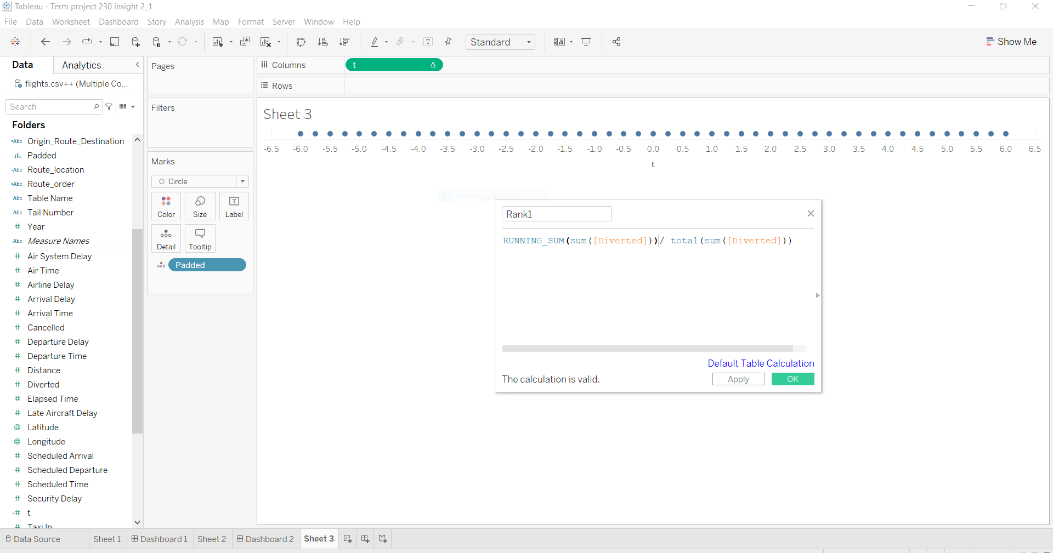
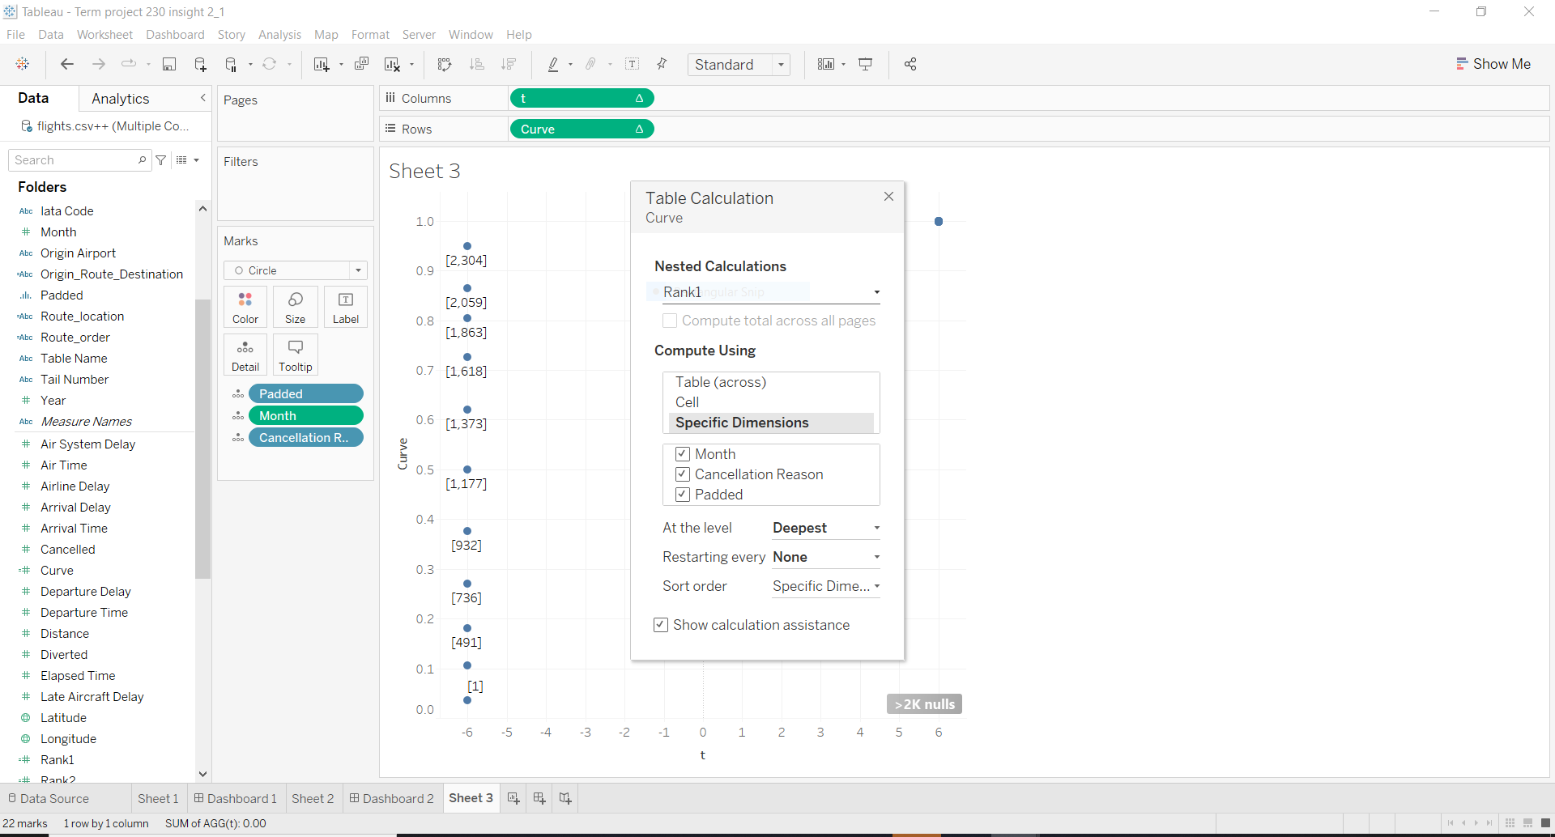
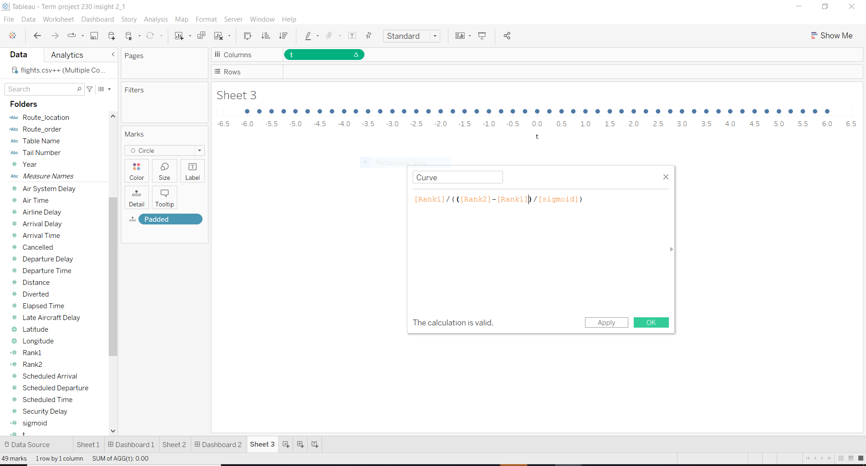
Representation of DATA WRANGLING:

Slide 9
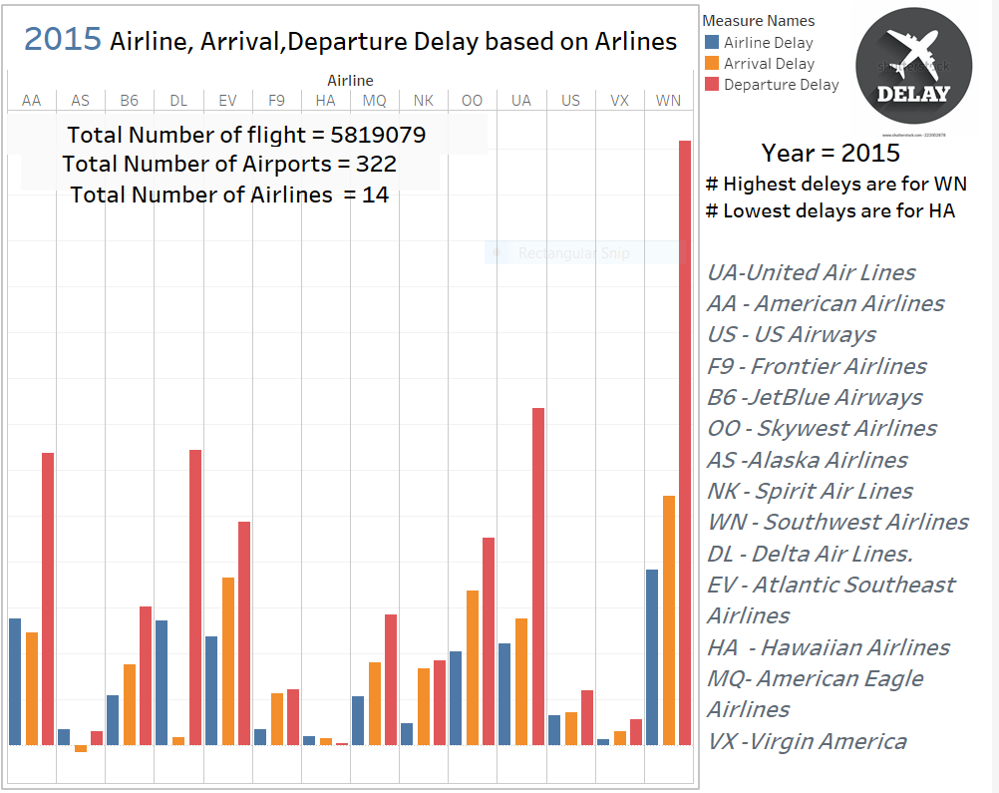
Insight 1: Everyone wants to travel by best airlines. Therefore, in this part we tried to evaluate performance of different airlines based on the Airline, Departure and Arrival Delays.

Slide 10
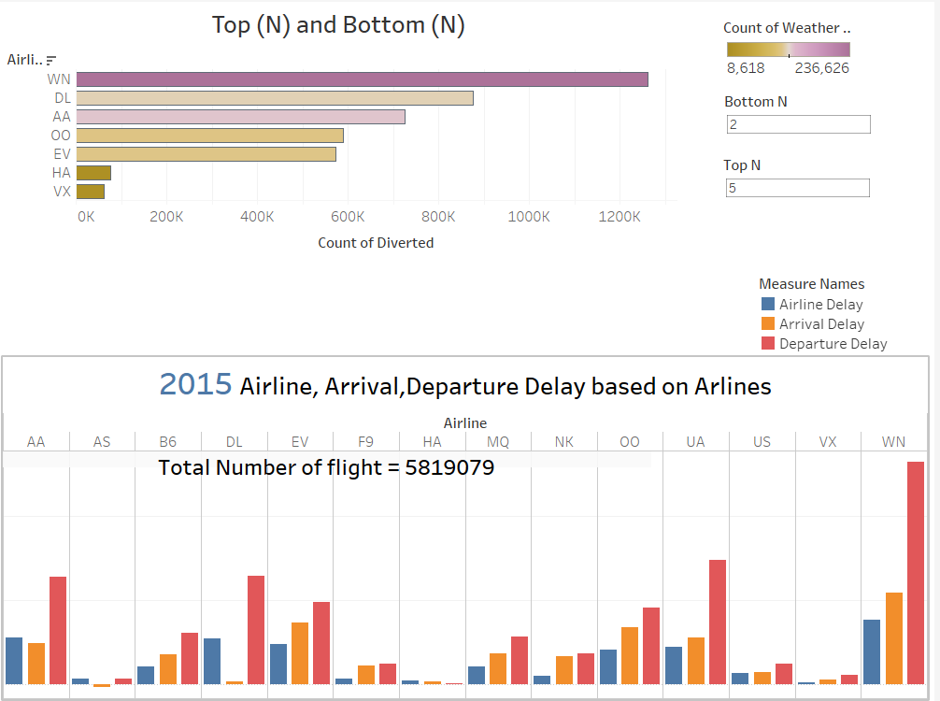
Extension of insight 1: Further, we can also eliminate the top airlines which are causing more weather and diverted delays by using the analysis of bar chart stating top(N) and bottom (N). And we can consider the bottom airline which will cause less weather and diverted delay for the trip.

Slide 11
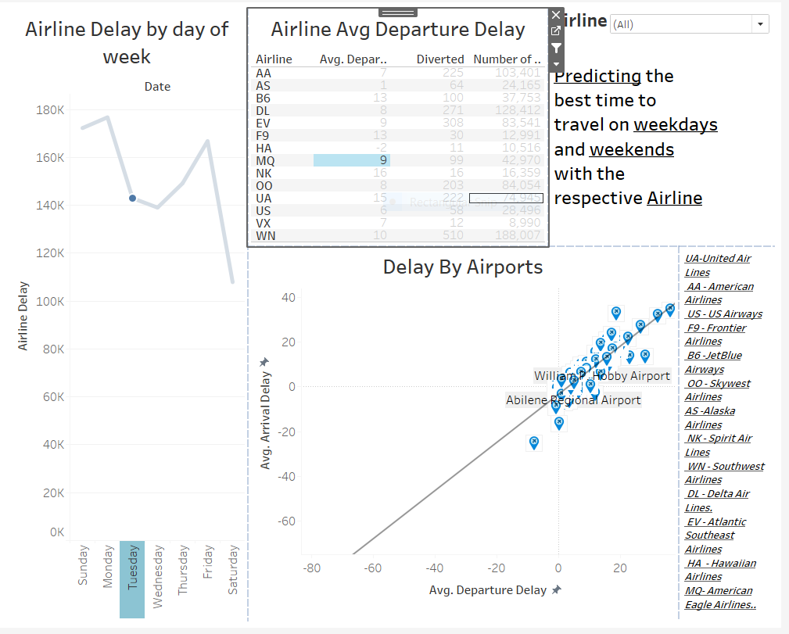
Extension of Insight 1: Again, to select the best airline based on the weekdays, we can predict which airline to travel by. In addition, we have plotted, a correlation graph between avg arrival delay and avg departure delay and used the trend line to figure out which airport causes more delay and which one causes less based on the weekdays and the airline.

Slide 12
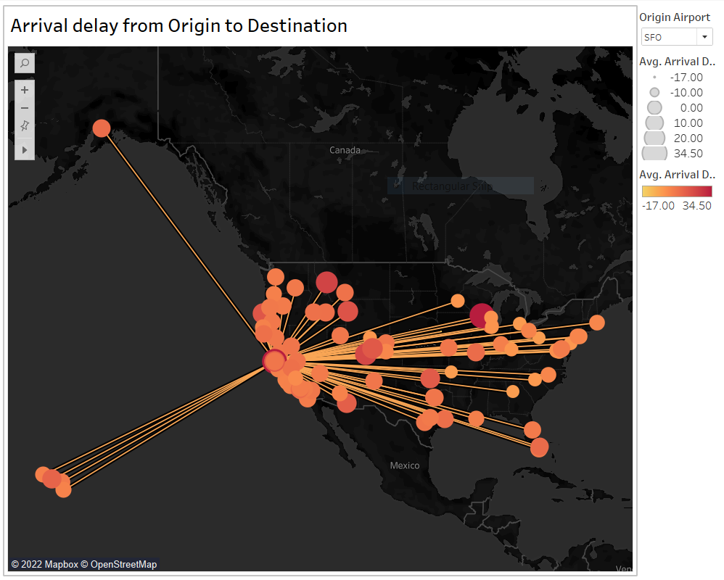
Insight 3: This is a destination map, through this we can determine which all flights are departing from a specific origin. In addition ,we can also determine the avg arrival delay for each flight.

Slide 13
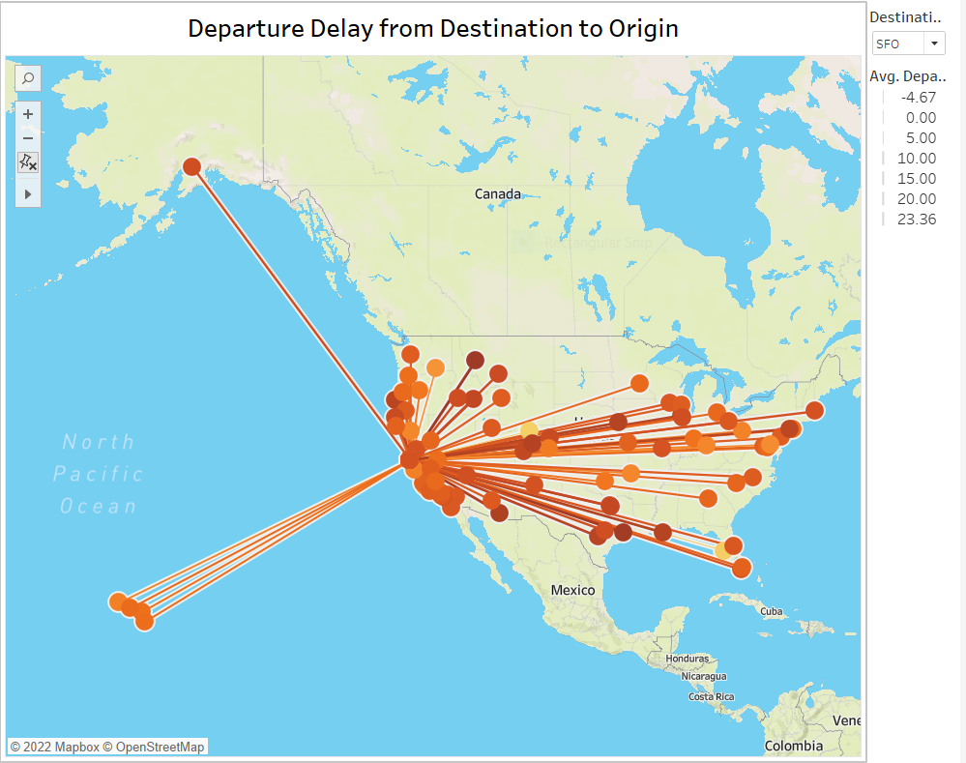
Insight 4: This is the origin map, from this we can see different flights coming from different destination to a specific origin. And we are able to analyse the avg departure for each specific flight.

Slide 14
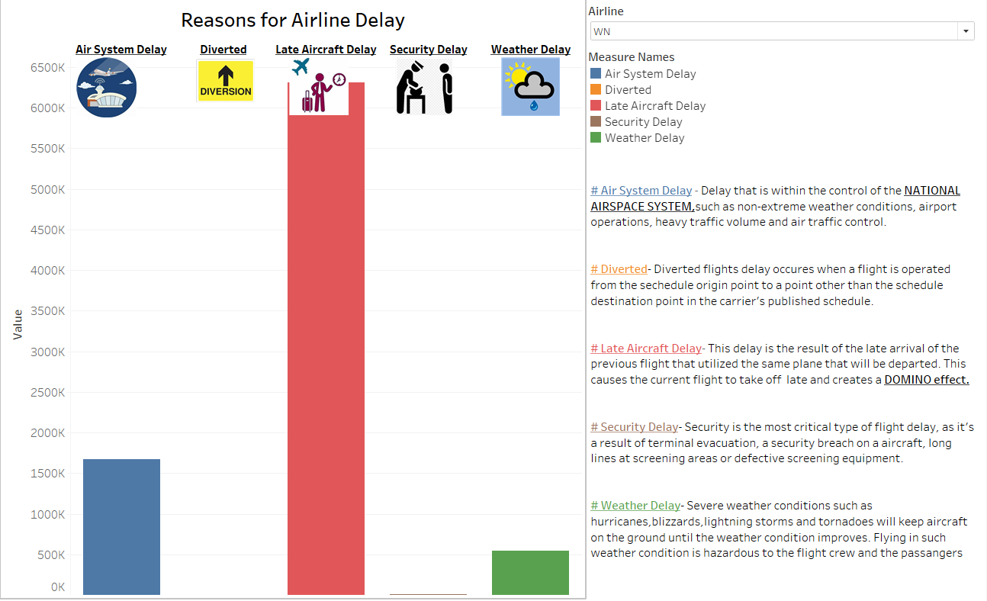
Insight 5: Using Bar chart between multiple reasons for airline delay and airline we can predict which airline to be travel by to avoid the reasons which is causing those delays.

Slide 15
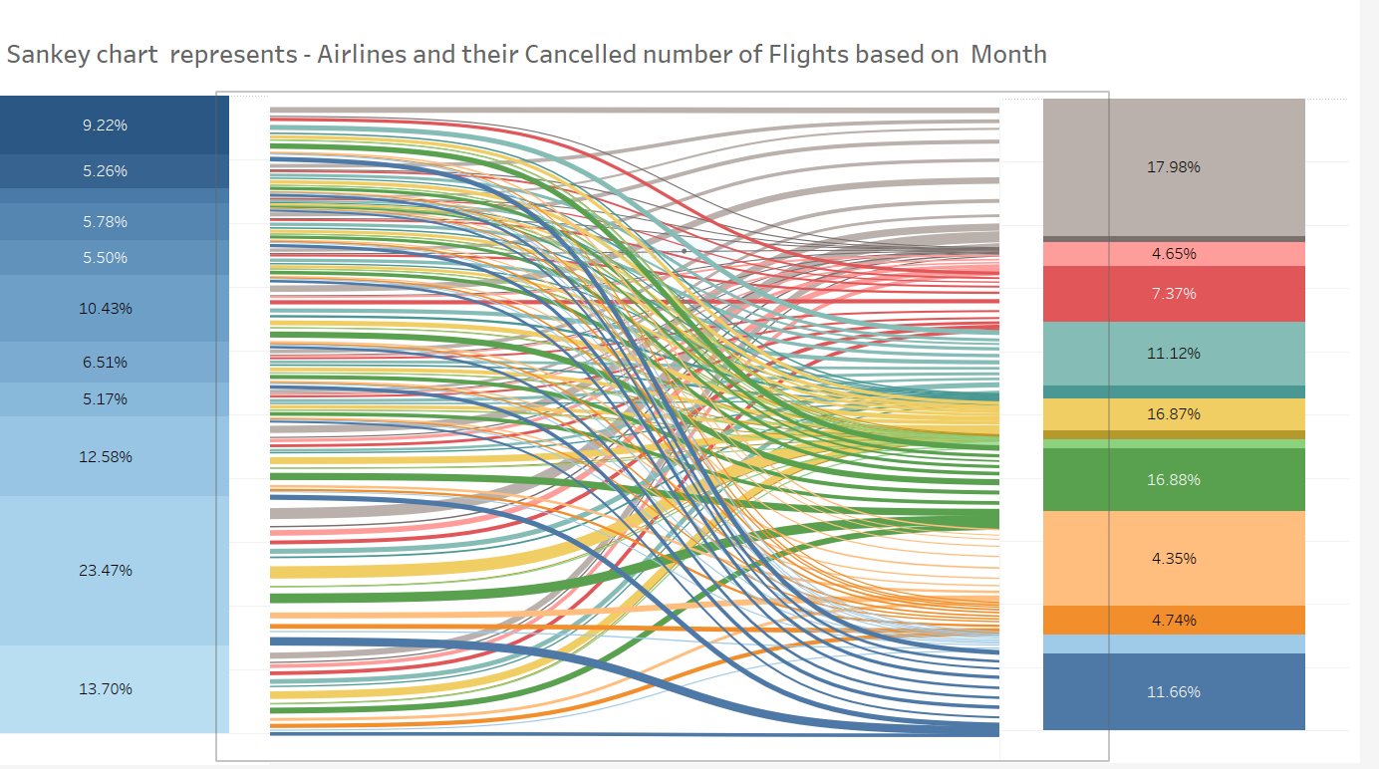
Insight 5: Through this insight we can determine using Sankey chart which airline has higher percentage of total cancelled flights based on each month in descending orders.

Slide 16
Summary for each insight: 1). From the above analysis based on the plotted and calculated charts, we can select the best airline to travel with and by considering the reasons such as best weekdays and avoiding reasons for multiple delays. 2). We can determine which all airline are going from specific origin to the different destination and plot their avg arrival delay. On the other hand ,we can plot the inverse of this by plotting the avg departure delay from different destination to a specific origin. 3).We have calculated the cancelled flights between months of 2015 and airlines by using the “ SANKEY CHART ”. The visualization shows what accounted for the flight cancellation in a particular month. Finally, it gives the percentage contribution of all airline for the overall delays in a year divided in months.

Slide 17

THANK YOU !!

