Slide 1

SKN Sinhgad College of Engineering
Korti -Pandharpur
Presentation On Project
Tittle of Project : “YOUTUBE VIDEO SUMMARIZATION”
Name of Department : Computer Science and Engineering
Class : TY BTECH
Academic Year : 2023-2024

Slide 2
Presented By
Ms.Gauri Shashikant Pawar
Ms.Sakshi Vikas Pawar
Ms.Rutuja Savata Raut
Ms. Nikita Vivek Pawar
Project Guide
Asst. Prof. S. G. Linge

Slide 3
Introduction
Automatic summarization is a technique for quickly introducing key information by abbreviating large sections of material.
Summarization may apply to text and video with a different method to display the abstract of the subject Some videos are long and boring or take more time to display the information that sometimes finds in a few minutes.
Therefore, the essence of the proposed system is to find the way to summarize the long video and introduce the important information to the user as a text with few numbers of lines to benefit the students or there searchers that have no time to spend with long videos for extract the useful data

Slide 4
Contents:
Introduction
Objective
Methodology
Implementation
Software Requirement
Hardware Requirement
Conclusion

Slide 5
Objective
To provide a brief overview of the videos content and the main ideas
To create a user-friendly interface for users to paste their YouTube video link
To optimize the system for quick processing to provide timely results to users
To improve the transcription algorithm to minimize errors and enhance accuracy
To enhance the accuracy and reduce the processing time
To provide a user concise and informative summaries

Slide 6

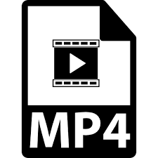
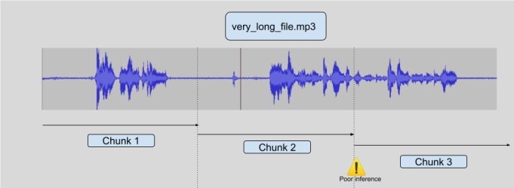
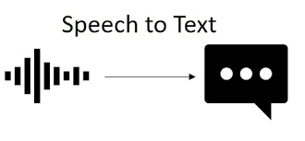
Block Diagram
Automatic summarization is a technique for quickly introducing key information by abbreviating large sections of material.

Slide 7
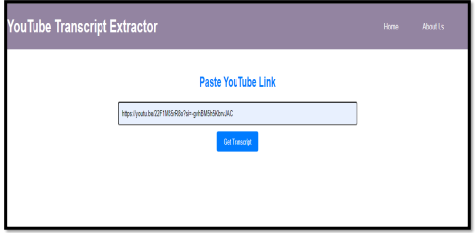
Implementation
Home Page

Slide 8
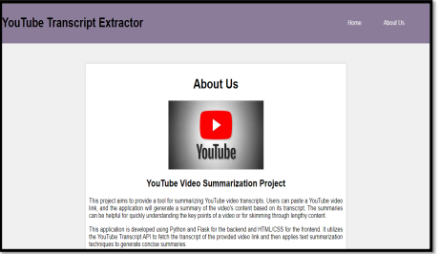
About Us

Slide 9
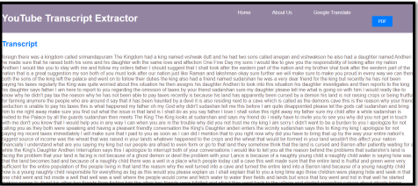
Final Result

Slide 10
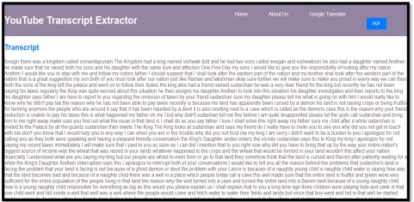
English Transcript

Slide 11
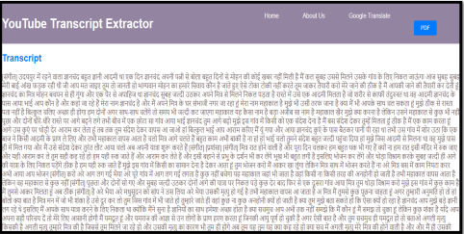
Hindi Transcript

Slide 12
Hardware & Software Requirement
Hardware Requirements:
Computer
Storage (decent amount of RAM 16 GB )
Software Requirements:
Programming Language and IDE: Python Language, Jupyter Notebook
Video Processing Libraries: Libraries like OpenCV or FFmpeg
Natural Language Processing (NLP) Libraries: Libraries like NLTK, or Gensim provide tools for tasks like speech recognition, text analysis, and summarization.

Slide 13
Conclusion
Our project successfully demonstrate power of Natural Language Processing for summarizing
YouTube videos .Our approach produced concise and informative summaries, improving the
Users experience. Future scope is that we can add one more option is the pdf and the goggle
translator

