Slide 1
Hotel Management System
Team Leader: Rutuja Sabale
Enrollment No. : EBEON1222703301
Name | Enrollment No
Rutuja Sabale | EBEON1222703301
Anjali Jadhav | EBEON1222703298
Shraddha Bansode | EBEON1222703
Aarati Tavate | EBEON1222703
Shravani Mohite | EBEON1222703
Guided by
Varadharajan A sir

Slide 2
Hotel Management System
Login Module
Admin Module
Home Page
Booking module
Availability module
Payment module
About us , Contact us

Slide 3
Hotel Management System
1)Login module:
a)User Registration
b)Forgot Password
2)Admin module:
a) Room:
1)View room
2)Add room
3)Home Page:
a)GUI of website

Slide 4
Presenting Module 1
Login module
a)User Registration
b)Forgot Password

Slide 5
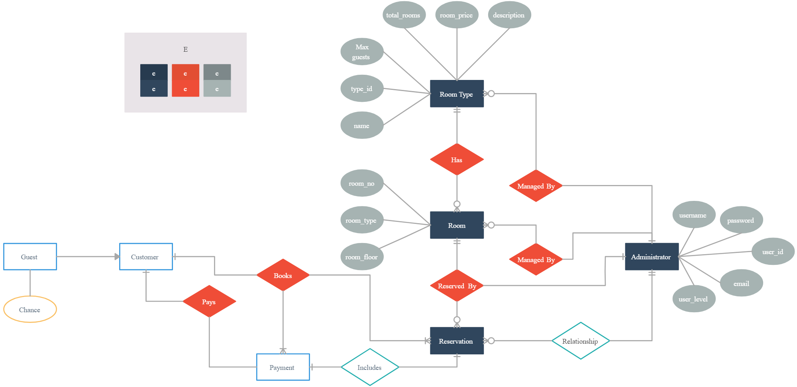
Project overview

Slide 6
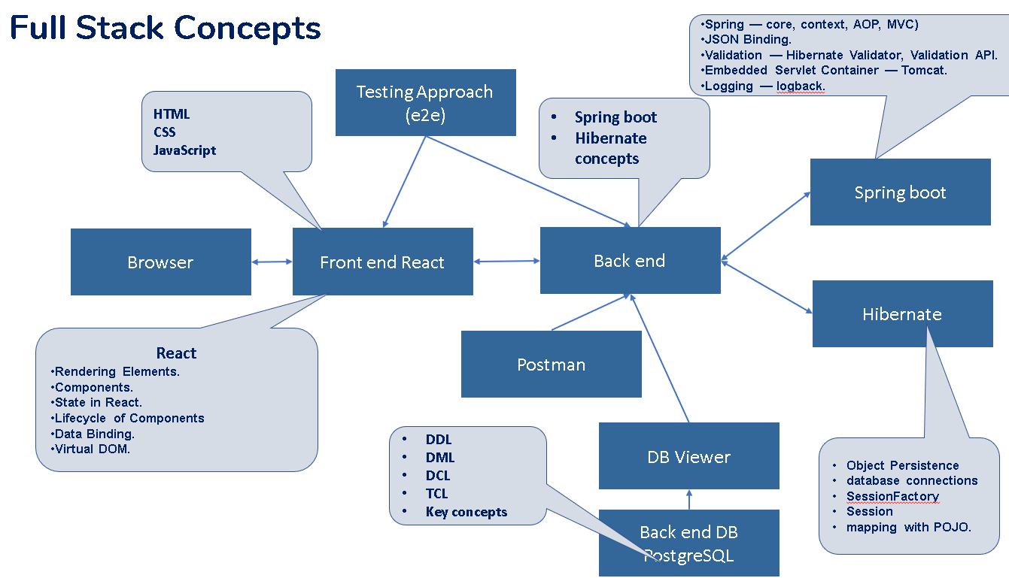
Technology architecture

Slide 7
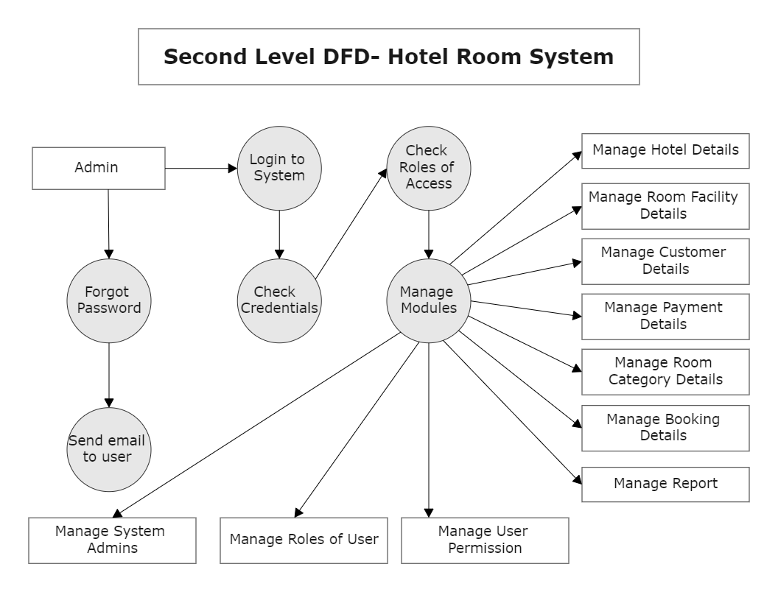
Dataflow diagram Admin Module

Slide 8
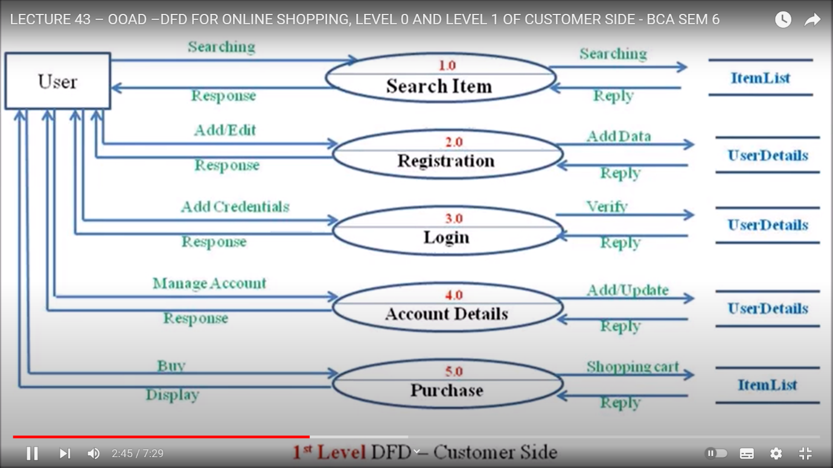
Dataflow diagram User Module

Slide 9
Challenging issues
1) While Running project port no. problem
2)Issues faced during database connectivity
3)Changes made in code are not reflected into live Project

Slide 10
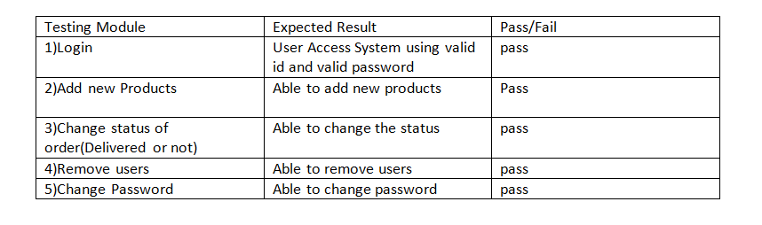
Testing

Slide 11
Conclusion
Hotel Management websites are becoming increasingly popular due to their convenience and time-saving features.
This project is made in such a way that it is easy to use/ handle for new users
Person with little technical knowledge can also use/ interact with this project
User Friendly GUI.

