Slide 1
CAPSTONE PROJECT 2-PPT FOR ENDSEMESTER ASSESSMENT – July 2022
CP2_TITLE:Home Automation using Arduino Nano and Bluetooth
Div:-L CP2_Group No:-L7 Day:- Saturday Date:- 02/07/2022
Presented by Project Guide
Aditya Vinod Nagrale(12110845)
Rutuj Naresh Nagrale(12110525)
Sumaiyya Nadaf Jahangir(12111185)
Hrucha Gajanan Nagre(12110911)
Prof. Smt. Smita Mande
DEPARTMENT OF ENGINEERING SCIENCES AND HUMANITIES(DESH)
VISHWAKARMA INSTITUTE OF TECHONOLOGY, PUNE

Slide 2
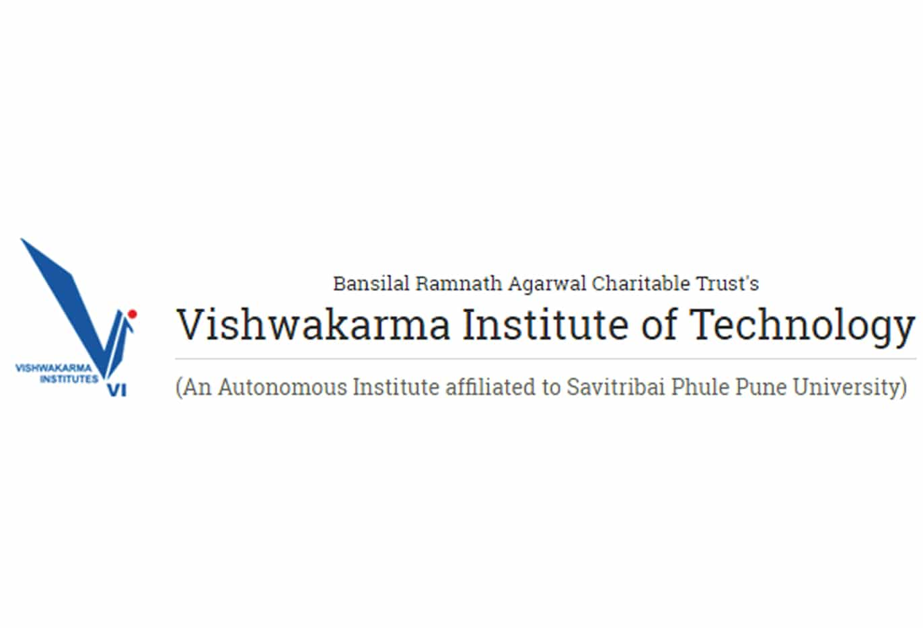
Guide: Prof. Smt. Smita Mande

Slide 3
Vishwakarma Institute of Technology Batch Group :- L7 Title of the project: Home Automation using Arduino Nano and Bluetooth HC-05.
Our Members, Roll No.
Sumaiyya Nadaf 33
Aditya Nagrale 34
Rutuj Nagrale 35
Hrucha Nagre 36

Slide 4
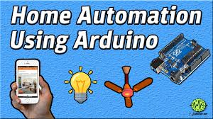
Contents of our presentation
1.Introdution
2.Literature survey
3.Problem statement
4.Objective of project
5.System Architecture
6.Methodology/Algorithms used
7.Software and hardware requirements
8.Advantages and disadvantages
9.Limitations
10.Conclusion
11.Future scope
12 References

Slide 5
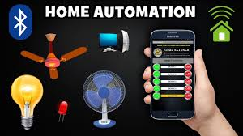
1.Introduction
Home automation allows to control house appliances like door, light, fan, oven… etc. It also provides emergency system and home security. It enables the consumer more control of his home it facilitates many conditions, for example, if the consumer is on his way to his home, controlling light turning on, or pre- heating oven when he got home, therefore, many manual actions is replaced by home automation which reduce human efforts and time saving.

Slide 6
2.Literature Review
Sr. No | Publication Year | Name of Author | Title of Paper | Features Provided | Limitations
01. | 2018 | Kashif Nisar & Ag Asri Ag Ibrahim | A Smart Home Model Using Android Application | Wireless communication has been introduced into smart home model | The area of network range is limited due to upgrading the system.
02. | 2020 | Crispin Coombs , Donald Hislop , Stanimaira k. Taneva , Sarah Barnard. | The strategic impacts of Intelligent Automation for knowledge and service work: An interdisciplinary review. | conceptualisation and definition, business value-based model , understanding of the strategic impacts of Intelligent Automation . | limited guidance regarding how organizations determine which jobs or tasks are appropriate for Intelligent Automation factors that shape this decision-making process.
03. | 2020 | Rahabul Islam, Md. Wahidur Rahman, Rahmina Rubaiat, Md. Mahmodul Hasan, Md. Mahfuz Reza, Mohammad Motiur Rahman | LoRa and server-based home automation using the internet of things (IOT). | Easily affordable. An android application operates all electronics components . | Only short and medium range wireless communication is operated by LoRa. There is no solution for long range .

Slide 7
Sr. No | Publication Year | Name of Author | Title of Paper | Features Provided | Limitations
04. | 2021 | S. Karthick ,Venkatesa Prabhu Sundarmurthy , Susheela Devi B. Devaru , Rakesh Narayanswamy, Anand Mohan, Sailesh Chandra Akkaraju , M. Jemaimah Carmichael , T.C. Manjunath. | Realization of industrial automation using Bluetooth technologies. | The detailed analysis of economic automation using Bluetooth module and PIC microcontroller. | The system can be controlled in just short range .
05. | 2021 | Abiodun E. Amoran, Ayodele S.Oluwole, Enaitan O. Fagorola, R.S. Diarah. | Home automated system using Bluetooth and an android application | System is controlled by microcontroller, Bluetooth device and by MIT app inventor. It is easy to use, fast, readily available, and reliable in communications | Both two inputs , voice prompt or a graphical user interface (GUI) command can’t serves as input to the mobile smartphone through the Android application at same time .

Slide 8
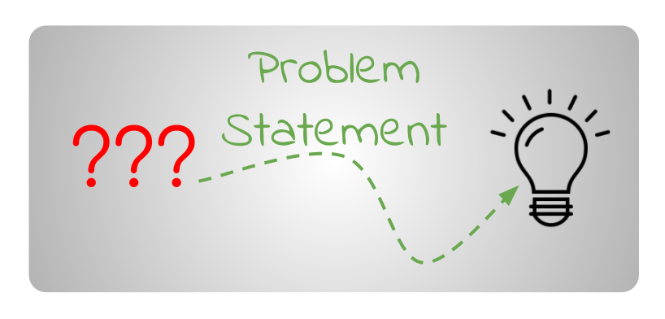
3.Problem statement
Automation has not yet penetrated in the homes especially in India.
So we have decided to make a low cost Embedded System in which the smart phones can be used to help automate home appliance.

Slide 9

4.Objective of project.
The main objectives of this project is to design and to implement a cheap and open source home automation system, that is capable of controlling and automating most of the house appliance through an easy manageable web interface to run and maintain the home automation system.
The proposed system has a great flexibility by using Bluetooth technology to interconnect its distributed modules to home automation server.
That will decrease deployment cost and will increase the ability of upgrading, and system reconfiguration. System will make use of secure wireless LAN connections between distributed hardware modules and server, and secure communication protocols between users and server.

Slide 10
5.System Architecture
Step down transformer
(Mobile Charger)
Arduino Nano
Bluetooth Moudule
HC-05
Relay Drivers
1
2
3
4

Slide 11
6.Methods/Methodology
First
All the parts needed to design the project are collected and a primary concept is designed based on it.
Then
The connection between the Arduino Nano and the Bluetooth via the Bluetooth module. After all the connection is being done, the Arduino board needs to be programmed and the Arduino software has to be installed.
In the end
The Android based mobile phone is used to control the Arduino Nano via Bluetooth.

Slide 12

Hardware Requirements
All the hardware
Bluetooth module (HC-05)
Arduino Nano
4 Relay Module
Android application
With MIT
Invertor
Jumpers wires
2 Lamp holder with 2 bulb

Slide 13
Pros and cons
Advantages | Disadvantages
Energy Efficient , low cost | Internet Reliance
Hands-free convenience | Setup and Configuration
Enhanced Security | More Technical Security Threats
Save Time with Automated Tasks | Bluetooth connectivity may take some time.
Customization | App may takes some time to connect with Bluetooth

Slide 14
9.Limitations
The connection between the relay module and the Arduino module was a problem encountered due to the cross-checking of the connections.
A second problem was also encountered with the use and the calibration of the code to the Arduino module due to connection and library issues.
Another problem is that the Arduino board doesn’t allow enough current to flow through the circuit to allow the light bulb to glow. It required a high current and high voltage which Arduino nano can’t handle.

Slide 15
10.Conclusion of project
It can be concluded from the above discussion that Home automation is a special kind of device which controls home appliances without extra effort.
And form this, we demonstrated how the home automation is made, discussed about methodology and what its application can be.
. The need of making a device is to create a device which saves the electricity and improve human life style.

Slide 16

11. FUTURE SCOPE
Implements more hardware interface modules, and modify server application software to handle them.
Modify hardware interface module to be able to communicates with sensors and actuators that use wireless technologies like X10, Zigbee, etc.
By doing this system will increase system mobility, configurable, and scalability.
Replace the Bluetooth module with more reliable and stable Bluetooth module, to increase system reliability.

Slide 17
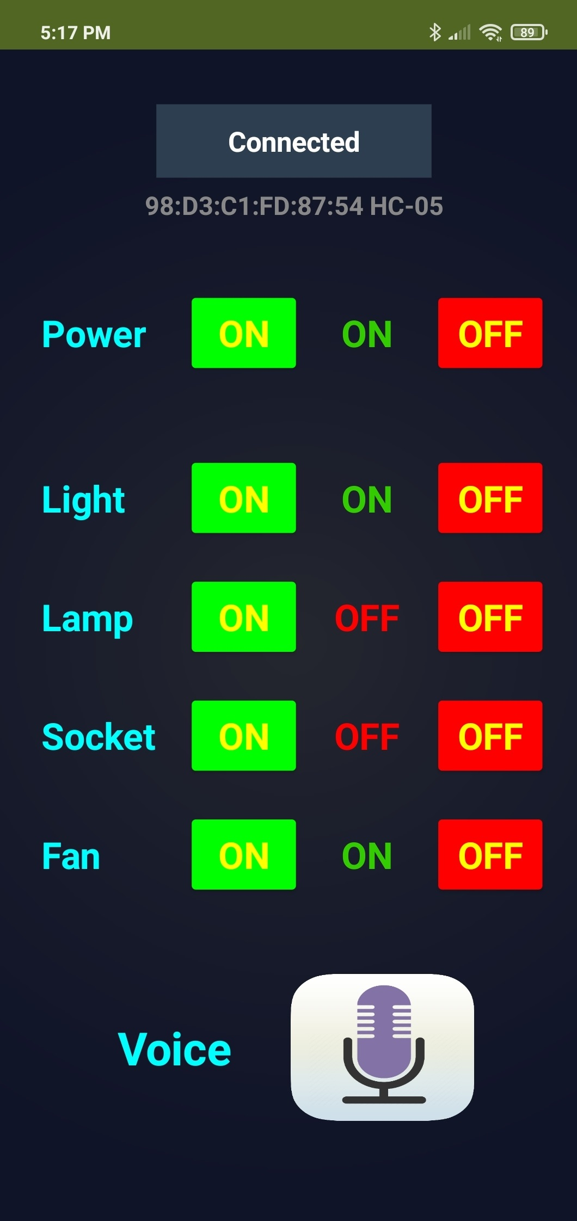
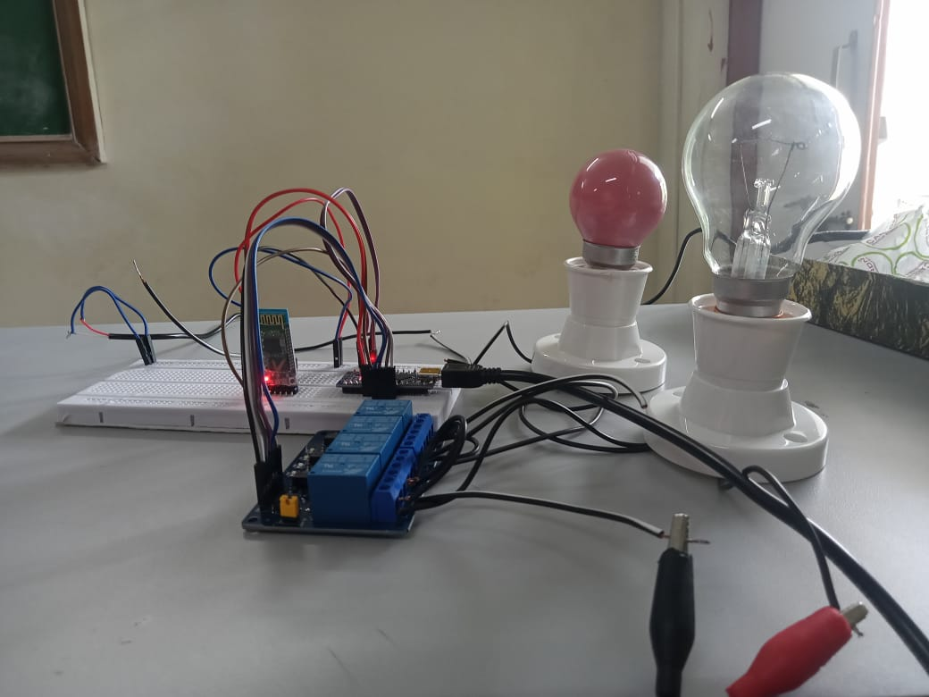
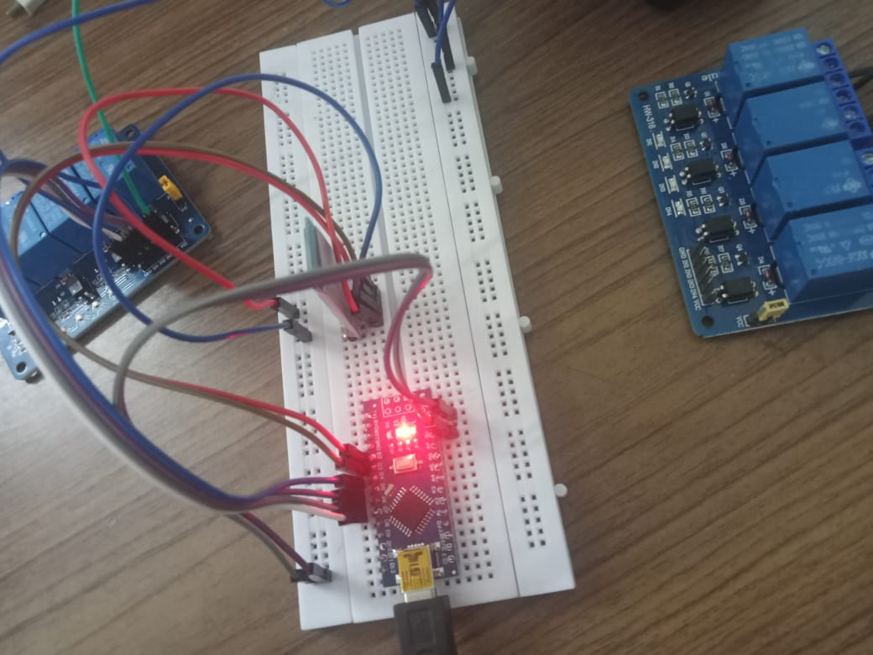
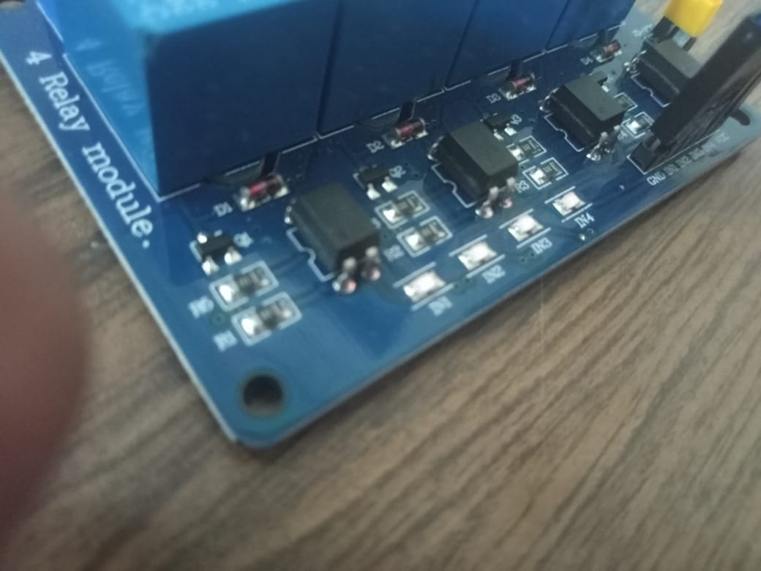
Result

Slide 18
12.References
[1]. 2018 Kashif Nisar & Ag Asri Ag Ibrahim, A Smart Home Model Using Android Application . https://link.springer.com/chapter/10.1007/978-981-10-8612-0_1
[2]. 2020 Crispin Coombs , Donald Hislop , Stanimaira k. Taneva , Sarah Barnard. The strategic impacts of Intelligent Automation for knowledge and service work: An interdisciplinary review. The strategic impacts of Intelligent Automation for knowledge and service work: An interdisciplinary review – ScienceDirect
[3]. 2020 Rahabul Islam, Md. Wahidur Rahman, Rahmina Rubaiat, Md. Mahmodul Hasan, Md. Mahfuz Reza, Mohammad Motiur Rahman. LoRa and server-based home automation using the internet of things (IOT). https://www.sciencedirect.com/science/article/pii/S1319157820306285
[4]. 2021 S. Karthick ,Venkatesa Prabhu Sundarmurthy , Susheela Devi B. Devaru , Rakesh Narayanswamy, Anand Mohan, Sailesh Chandra Akkaraju , M. Jemaimah Carmichael , T.C. Manjunath. Realization of industrial automation using Bluetooth technologies . Realization of industrial automation using Bluetooth technologies – ScienceDirect
[5]. 2021 Abiodun E. Amoran, Ayodele S.Oluwole, Enaitan O. Fagorola, R.S. Diarah. Home automated system using Bluetooth and an android application. Home automated system using Bluetooth and an android application – ScienceDirect
[6]. You tube Reference for simulation https://youtu.be/_eFW_4HKhys

Slide 19
Contribution.
Rutuj Naresh Nagrale
Search paper,Read all the papers .
Merging each and every ppt of our topic by sequence wise.
contributed in making introduction ,contents, Objective of project, system architecture of our project, conclusion , future scope and references
and explains it during presentation .
and done abstract, future scope, conclusion and references in IEEE report Currently working on design part.
Hrucha Gajanan Nagre
Read a IEEE paper
Contributed literature survey , Advantages and disadvantage in ppt
Explained literature survey during presentation
Done Literature Review in IEEE report currently working on design part

Slide 20
Aditya Vinod Nagrale
Read IEEE Paper
Contributed the introduction, methodology, software/hardware requirements and limitations in presentation
Explained the above topics during the presentation Did the introduction, methodology and limitations in IEEE paper Currently working on design part
Sumaiyya Jahangir Nadaf
Read IEEE paper
Contributed problem statement , advantages and disadvantages
Explained problem statement and advantages and disadvantages during presentation Currently working on design part.

