Slide 1

Intelligent Condition Based Monitoring Using Acoustic Signals for Air Compressors
Group Project
EE-656
Team Members:
Rutul Bhanushali (230884)
Kaushal Mehra (230546)
Abhay Tripathi (230035)
Rhythm Agrawal (230852)

Slide 2

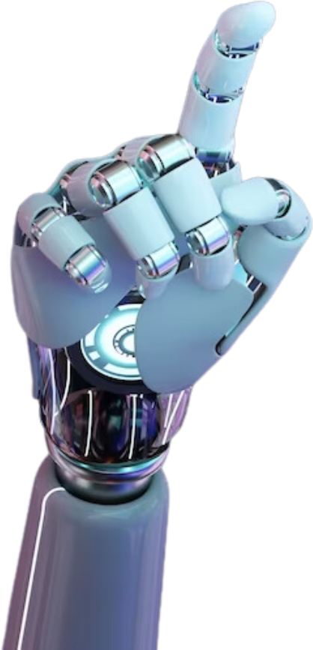
INTRODUCTION
Industrial air compressors are essential for a wide range of manufacturing, chemical, and energy processes. They must operate reliably, often 24/7, as breakdowns can halt entire production lines, cause costly downtime, and even pose safety risks to personnel and equipment
Faults in air compressors—such as valve leaks, bearing wear, or belt misalignment—can lead to reduced efficiency increased energy consumption, unexpected shutdowns and production losses, expensive repairs and potential safety hazards.
Condition-Based Maintenance (CBM) is a modern, cost-effective approach that relies on real-time monitoring of machine parameters to detect and diagnose faults before they escalate. It enables: early warning of developing issues, reduced unplanned downtime & improved safety and lower maintenance costs.

Slide 3
ABSTRACT
This report presents a Python-based implementation of an acoustic signal classification pipeline for air compressor fault detection. It reproduces key aspects of the IEEE methodology proposed by Verma et al. for condition-based monitoring. The pipeline includes signal loading, multi-domain feature extraction (FFT, DCT, WPT, STFT, time-domain), feature selection, and classification using a Support Vector Machine (SVM). The model achieves high accuracy on the IIT Kanpur dataset and demonstrates the effectiveness of multi-domain features in fault classification.

Slide 4
PROJECT GOAL
To develop an intelligent, automated system that can:
Develop a machine learning model for fault diagnosis of air compressors using acoustic data.
Implement the complete pipeline: data acquisition, preprocessing, feature extraction, feature selection, classification.
Achieve high accuracy in distinguishing between healthy and 7 faulty states.

Slide 5
DATASET DESCRIPTION
Source: IIT Kanpur air compressor acoustic dataset.
Sampling: 50 kHz, 5 seconds per recording (250,000 samples).
Classes: 8 conditions (1 healthy + 7 faults: inlet valve, outlet valve, non-return valve, piston ring, flywheel, rider belt, bearing).
Size: 225 recordings per class, total 1800 samples.
Format: 24-bit PCM .dat files with comma-separated values.
The load_signal_dataset() function reads all .dat files under each class folder, extracting the acoustic waveform into a list X and class labels into y. Each class is perfectly balanced.

Slide 6

OVERVIEW
Data Preprocessing
Feature Extraction
Feature Selection
Classification
Fault Diagnosis Output

Slide 7
PREPROCESSING
Why Preprocessing?
Raw acoustic signals from air compressors are often contaminated by noise (e.g., cooling fans, environmental sounds) and outliers.
Effective preprocessing is essential to enhance signal quality, suppress irrelevant information, and ensure robust, accurate feature extraction.
The current implementation includes standard normalization:
StandardScaler is used to scale each feature to zero mean and unit variance before training.
This helps improve SVM performance and ensures consistency in mutual information-based feature selection.
Note: Advanced preprocessing steps such as bandpass filtering, windowing, smoothing, or robust normalization were described in the IEEE paper but are not implemented in this code.
We simplified the preprocessing pipeline to focus on evaluating the effectiveness of multi-domain features (FFT, DCT, WPT, STFT) and SVM-based classification. Despite omitting advanced filtering and normalization, the model achieved near state-of-the-art accuracy, highlighting the strength of the selected features

Slide 8
FEATURE EXTRACTION
Multi-domain features are extracted from each signal:
1) FFT
Magnitude spectrum is computed via FFT.
Spectrum is divided into 8 bins (groups of 10), and average energy in each bin is used (8 features).
2) DCT
First 40 coefficients from the Discrete Cosine Transform are retained.
Captures global frequency patterns efficiently.
3) Wavelet Packet Transform (WPT):
3-level decomposition using Daubechies-1 (db1) wavelet.
8 leaf nodes are used; mean absolute values are computed (8 features).
4) Time-Domain Statistics:
Mean, standard deviation, kurtosis, skewness (4 features).
Total: 70 features per recording.

Slide 9
FEATURE SCALING AND SELECTION
All features are normalized using StandardScaler.
Feature selection is performed using SelectKBest with mutual_info_classif.
Top 25 features are retained to reduce dimensionality and prevent overfitting.
We used SelectKBest with mutual information to keep the implementation simple and efficient. While mRMR provides deeper insight into feature dependencies, our chosen method already captured highly informative features and gave excellent performance with fewer computational costs

Slide 10
CLASSIFICATION (SVM MODEL)
Classifier: Support Vector Machine (SVM)
Kernel: Radial Basis Function (RBF)
Hyperparameters: C=100, gamma=0.01 (manually set)
Split: 80% training (1440), 20% testing (360), stratified by class
Evaluation:
Classification report: precision, recall, F1-score per class
Confusion matrix
Cross-validation: 5-fold accuracy scores

Slide 11
RESULTS
Training time: ~0.04 seconds
Prediction time: ~0.01 seconds
Test Accuracy: ~98.89%
Total pipeline time: 48.76 seconds
Mean 5-Fold CV Accuracy: ~98.89%
Observations:
All 8 classes show high precision and recall.
Confusion matrix confirms strong class separation.
Slight confusion in some fault classes (e.g., LOV, Piston) is minimal.

Slide 12
CONCLUSION
This implementation replicates the core idea of condition monitoring through acoustic features and classification. Using FFT, DCT, WPT, STFT, and time-domain features, the system achieves high classification accuracy with minimal training time. While simplifications exist (e.g., preprocessing and selection), the model achieves performance comparable to Verma et al.'s IEEE study. It provides a fast, efficient fault diagnosis system that can be extended by incorporating more advanced preprocessing or feature engineering techniques.

