Slide 1
CS5100: Foundations of Artificial Intelligence First Order Logic
Dr. Rutu Mulkar-Mehta
Lecture 6

Slide 2
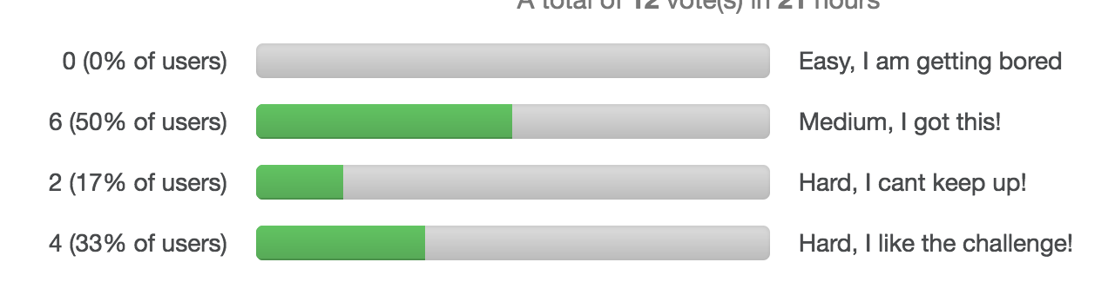
Administrative
EC1 (Constraint Satisfaction Problems) is graded and handed back to you
Poll Results about difficulty of class (12 votes):

Slide 3
Administrative
Project 1 – Grading in progress
Most of you have done well
Some have delayed submissions – 10% penalty per day
Project 2 – Out today! Build your own Chatbot.
Logic – some students expressed difficty in understanding the material. As a result, t oday’s In Class Assignment – Postponed to Next week – Lets discuss more Logic today!

Slide 4
EC1 Solutions

Slide 5
1 ) 0
2 ) 3 * 3 * 2 * 1 * 1 * 1 * 1 = 18
3 ) 4 * 4 * 3 * 2* 2* 2* 2 = 768

Slide 6
Give the constraint on the rose and corpse flower explicitly. r-c > 1 ^ (r-d>c-d or r > c) C >= r + 2
List all pairs of variables which have a constraint other than A = B. |r-d| > |c-d| ^ r < c, |r-c|>1, |v - r| > 1, |v-s| > 2, |v-t| > 1

Slide 7
What will the remaining domains be after arc consistency is enforced? C = {3,4,5} R={1,2,3} S={1,2,4,5} T={1,2,3,4,5} V={1,4,5}
Which variable or variables would be assigned first according to MRV? C,R,V have the least variables leftover;however, V reduces the most remaing

Slide 8
Assume that we assign T=3, enforce arc consistency. C={4,5} R={1,2} S={1,2,5} V={5}
List all solutions to this CSP when T=3 (R,S,T,C,V) (S,R,T,C,V)

Slide 9
Back to Lecture 6

Slide 10
Last week
Propositional Logic
A statement that can have the value – True or False
I am happy.
Seattle is sunny.

Slide 11
Last week
Propositions are connected using connectives
P | Q | ¬P
True | True | False
True | False | False
False | True | True
False | False | True

Slide 12
Last Week
P | Q | P ∨ Q
True | True | True
True | False | True
False | True | True
False | False | False
P | Q | P ⇒ Q
True | True | True
True | False | False
False | True | True
False | False | True
P | Q | P ∧ Q
True | True | True
True | False | False
False | True | False
False | False | False
P | Q | P ⇔ Q
True | True | True
True | False | False
False | True | False
False | False | True

Slide 13
Exercise
Consider the following statements:
p / sunny = It is sunny this afternoon
q / colder = it is colder than yesterday
r /swimming = We will go swimming
s / canoe = we will take a canoe trip
t / sunset = We will be home by sunset
It is not sunny this afternoon and it is colder than yesterday.
not sunny and colder
~p ^ q
Notes:
not p and q
r -> p
not r -> s
s -> t

Slide 14
Exercise
Consider the following statements:
p / sunny = It is sunny this afternoon
q / colder = it is colder than yesterday
r /swimming = We will go swimming
s / canoe = we will take a canoe trip
t / sunset = We will be home by sunset
We will go swimming only if it is sunny.
swimming → sunny
r → p
swimming | sunny | swim - sunny
True | True | True
True | False | False
False | True | True
False | False | True
Notes:
not p and q
r -> p
not r -> s
s -> t

Slide 15
Exercise
Consider the following statements:
p / sunny = It is sunny this afternoon
q / colder = it is colder than yesterday
r /swimming = We will go swimming
s / canoe = we will take a canoe trip
t / sunset = We will be home by sunset
We always go swimming if it is sunny.
sunny → swimming
p→ r
swimming | sunny | swim - sunny
True | True | True
True | False | True
False | True | False
False | False | True
Notes:
not p and q
r -> p
not r -> s
s -> t

Slide 16
Exercise
Consider the following statements:
p / sunny = It is sunny this afternoon
q / colder = it is colder than yesterday
r /swimming = We will go swimming
s / canoe = we will take a canoe trip
t / sunset = We will be home by sunset
If we do not go swimming then we will take a canoe trip.
not swimming → canoe
Notes:
not p and q
r -> p
not r -> s
s -> t

Slide 17
Exercise
Consider the following statements:
p / sunny = It is sunny this afternoon
q / colder = it is colder than yesterday
r /swimming = We will go swimming
s / canoe = we will take a canoe trip
t / sunset = We will be home by sunset
If we take a canoe trip, then we will be home by sunset.
canoe → sunset
Notes:
not p and q
r -> p
not r -> s
s -> t

Slide 18
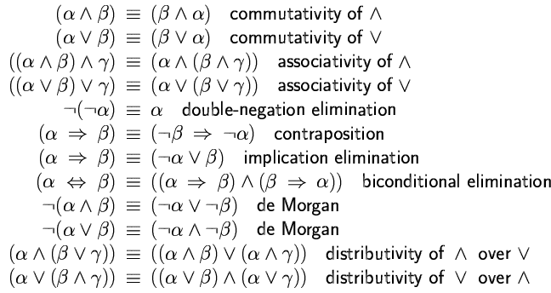
Logical equivalence
Two sentences are logically equivalent iff true in same models: α ≡ ß iff α╞ β and β╞ α

Slide 19
Last week
Entailment
A |= B
A entails B, B logically follows from A

Slide 20
Pros and cons of propositional logic
Propositional logic allows partial/disjunctive/negated information
Propositional logic is compositional:
meaning of B_{1,1} ∧ P_{1,2} is derived from meaning of B_{1,1} and of P_{1,2}
☺ Meaning in propositional logic is context-independent
(unlike natural language, where meaning depends on context)
☹ Propositional logic has very limited expressive power
(unlike natural language)
E.g., cannot say "pits cause breezes in adjacent squares“
except by writing one sentence for each square
E.g p11 -> p12 ^ p21 ^ …
p33 -> p32 ^ p23 ^ …

Slide 21
Outline
First Order Logic (FOL)
Syntax and semantics of FOL
Using FOL
Knowledge engineering in FOL
Inference using FOL
Prolog

Slide 22
First-order logic
Propositional logic assumes the world contains facts – that are true or false
First-order logic (like natural language) assumes the world contains
Objects: people, houses, numbers, colors, baseball games, wars, …
Relations: red, round, prime, brother of, bigger than, part of, comes between, …
Functions: father of, best friend, one more than, plus, …
Notes:
predicates = true or false value brother(john, mary)
functions - actual vaues father(mary) = richard

Slide 23
First Order Logic Syntax
S := <Sentence> ;
<Sentence> := <AtomicSentence> |
<Sentence> <Connective> <Sentence> |
<Quantifier> <Variable>,... <Sentence> |
"NOT" <Sentence>
<AtomicSentence> := <Predicate> "(" <Term>, ... ")" |
<Term> "=" <Term>;
<Term> := <Function> "(" <Term>, ... ")" |<Constant> | <Variable>;
<Connective> := "AND" | "OR" | "IMPLIES" | "EQUIVALENT";
<Quantifier> := "EXISTS" | "FORALL" ;
<Constant> := "A" | "X1" | "John" | ... ; (uppercase)
<Variable> := "a" | "x" | "s" | ... ; (lowercase)
<Predicate> := "Before" | "HasColor" | "Raining" | ... ;
<Function> := "Mother" | "LeftLegOf" | ... ;

Slide 24
Constants, Functions, Predicates
Constant symbols, which represent individuals in the world
Mary
3
Green
Function symbols, which map individuals to individuals
father-of(Mary) = John
color-of(Sky) = Blue
Predicate symbols, which map individuals to truth values
greater(5,3) = true
green(Grass) = true
color(Grass, Green) = true

Slide 25
Variables, Connectives and Quantifiers
Variable symbols
They can hold any value
E.g., x, y, foo
Connectives
Same as in PL: not (¬), and (^), or (v), implies (→), if and only if (⬄)
Quantifiers
Universal (Ax)
Existential (Ex)

Slide 26
Universal quantification
(∀x) P(x) means that P holds for all values of x in the domain associated with that variable
e.g.
Everyone at NEU is smart:
∀x At(x,NEU) ⇒ Smart(x)
All dolphins are mammals
(∀x) dolphin(x) ⇒ mammal(x)

Slide 27
Existential quantification
∃x P(x) means that P holds for some value of x in the domain associated with that variable
Someone at NEU is smart:
∃x At(x,NEU) ∧ Smart(x)
Some Mammals Lay eggs:
∃x mammal(x) ^ lays-eggs(x)
Permits one to make a statement about some object without naming it

Slide 28
Sentences, Terms and Atoms
A term (denoting a real-world individual) is a constant symbol, a variable symbol, or an n-place function of n terms.
x and f(x1, ..., xn) are terms, where each xi is a term.
A term with no variables is a ground term
An atom (which has value true or false) is either
an n-place predicate of n terms, or,
¬P, P V Q, P ^ Q, P =>Q, P ⬄ Q where P and Q are atoms
A sentence is an atom, or, if P is a sentence and x is a variable,
then (Ax)P and (Ex)P are sentences
A well-formed formula (wff) is a sentence containing no “free” variables. That is, all variables are “bound” by universal or existential quantifiers.
(Ax)P(x,y) has x bound as a universally quantified variable, but y is free.

Slide 29
Exercises
Every gardener likes the sun.
(Ax) gardener(x) → likes(x,Sun)
You can fool some of the people all of the time.
(Ex)(At) (person(x) ^ time(t)) → can-fool(x,t)
You can fool all of the people some of the time.
(Ax)(Et) (person(x) ^ time(t) → can-fool(x,t)
All purple mushrooms are poisonous.
(Ax) (mushroom(x) ^ purple(x)) → poisonous(x)
No purple mushroom is poisonous.
¬(Ex) purple(x) ^ mushroom(x) ^ poisonous(x)
(Ax) (mushroom(x) ^ purple(x)) → ¬poisonous(x)
There are exactly two purple mushrooms.
(Ex)(Ey) mushroom(x) ^ purple(x) ^ mushroom(y) ^ purple(y) ^ ¬(x=y) ^ (A z) (mushroom(z) ^ purple(z)) → ((x=z) V (y=z))
Clinton is not tall.
¬tall(Clinton)

Slide 30
Working with Quantifiers
Universal quantifiers are often used with “implies” to form “rules”:
(Ax) student(x) → smart(x) means “All students are smart”
Universal quantification is rarely used to make blanket statements about every individual in the world:
(Ax)student(x) ^ smart(x) means
“Everyone in the world is a student and is smart”
Existential quantifiers are usually used with “and” to specify a list of properties about an individual:
(Ex) student(x) ^ smart(x) means “There is a student who is smart”
A common mistake is to represent this English sentence as the FOL sentence:
(Ex) student(x) → smart(x)
But what happens when there is a person who is not a student?

Slide 31
Quantifier Scope
Switching the order of universal quantifiers does not change the meaning:
(Ax)(Ay)P(x,y) → (Ay)(Ax) P(x,y)
Similarly, you can switch the order of existential quantifiers:
(Ex)(Ey)P(x,y) → (Ey)(Ex) P(x,y)
Switching the order of universals and existentials does change meaning:
(Ax)(Ey) likes(x,y)
Everyone likes someone
(Ey)(Ax) likes(x,y)
Someone is liked by everyone

Slide 32
Connections between For-All and There-Exists
We can relate sentences involving A and E using De Morgan’s laws:
(Ax) ¬P(x) → ¬ (Ex) P(x)
¬(Ax) P(x) → (Ex) ¬P(x)
(Ax) P(x) → ¬ (Ex) ¬P(x)
(Ex) P(x) → ¬ (Ax) ¬P(x)

Slide 33
Quantified Inference Rules
Universal instantiation
Ax P(x) : P(A)
Universal generalization
Ax P(x) : P(A) ^ P(B) …
Existential instantiation
Ex P(x) : P(F) (skolem constant F)
Existential generalization
Ex P(x) : P(A)

Slide 34
Notations
Different symbols for and, or, not, implies, ...
– A E => ⬄ ^ V ¬
– p v (q ^ r)
– p + (q * r)
Prolog
cat(X) :- furry(X), meows (X), has(X, claws)
Lispy notations
(forall ?x (implies (and (furry ?x)
(meows ?x)
(has ?x claws))
(cat ?x)))

Slide 35
Summary so far
First-order logic:
objects and relations are semantic primitives
syntax: constants, functions, predicates, equality, quantifiers
Increased expressive power: sufficient to define wumpus world

Slide 36
Inference in first-order logic

Slide 37
Universal instantiation (UI)
Every instantiation of a universally quantified sentence is entailed by it:
∀v α Subst({v/g}, α)
for any variable v and ground term g
E.g., ∀x King(x) ∧ Greedy(x) ⇒ Evil(x) yields:
King(John) ∧ Greedy(John) ⇒ Evil(John)
King(Richard) ∧ Greedy(Richard) ⇒ Evil(Richard)
King(Father(John)) ∧ Greedy(Father(John)) ⇒ Evil(Father(John))
.
.
.

Slide 38
Existential instantiation (EI)
For any sentence α, variable v, and constant symbol k that does not appear elsewhere in the knowledge base:
∃v α
Subst({v/k}, α)
E.g., ∃x Crown(x) ∧ OnHead(x,John) yields:
Crown(C₁) ∧ OnHead(C₁,John)
provided C₁ is a new constant symbol, called a Skolem constant

Slide 39
Reduction to propositional inference
Suppose the KB contains just the following:
∀x King(x) ∧ Greedy(x) ⇒ Evil(x)
King(John)
Greedy(John)
Brother(Richard,John)
Instantiating the universal sentence in all possible ways, we have:
King(John) ∧ Greedy(John) ⇒ Evil(John)
King(Richard) ∧ Greedy(Richard) ⇒ Evil(Richard)
King(John)
Greedy(John)
Brother(Richard,John)
The new KB is propositionalized: proposition symbols are
King(John), Greedy(John), Evil(John), King(Richard), etc.

Slide 40
Reduction contd.
Every FOL KB can be propositionalized so as to preserve entailment
(A ground sentence is entailed by new KB iff entailed by original KB)
Idea: propositionalize KB and query, apply resolution, return result
Notes:
a ground term of a formal system is a term that does not contain any free variables

Slide 41
Problems with propositionalization
Propositionalization seems to generate lots of irrelevant sentences.
E.g., from:
∀x King(x) ∧ Greedy(x) ⇒ Evil(x)
King(John)
∀y Greedy(y)
Brother(Richard,John)
it seems obvious that Evil(John), but propositionalization produces lots of facts such as Greedy(Richard) that are irrelevant
With p k-ary predicates and n constants, there are p·n^{k} instantiations.

Slide 42
Unification
Unification – takes two similar sentences and computes the substitution that makes them look the same
Unify(α,β) = θ if subs(α,θ) = subs(β,θ)
p q θ
Knows(John,x) Knows(John,Jane)
Knows(John,x) Knows(y,OJ)
Knows(John,x) Knows(y,Mother(y))
Knows(John,x) Knows(x,OJ)

Slide 43
Unification
Unification – takes two similar sentences and computes the substitution that makes them look the same
Unify(α,β) = θ if subs(α,θ) = subs(β,θ)
p q θ
Knows(John,x) Knows(John,Jane) {x/Jane}}
Knows(John,x) Knows(y,OJ)
Knows(John,x) Knows(y,Mother(y))
Knows(John,x) Knows(x,OJ)

Slide 44
Unification
Unification – takes two similar sentences and computes the substitution that makes them look the same
Unify(α,β) = θ if subs(α,θ) = subs(β,θ)
p q θ
Knows(John,x) Knows(John,Jane) {x/Jane}}
Knows(John,x) Knows(y,OJ) {x/OJ,y/John}}
Knows(John,x) Knows(y,Mother(y))
Knows(John,x) Knows(x,OJ)

Slide 45
Unification
Unification – takes two similar sentences and computes the substitution that makes them look the same
Unify(α,β) = θ if subs(α,θ) = subs(β,θ)
p q θ
Knows(John,x) Knows(John,Jane) {x/Jane}}
Knows(John,x) Knows(y,OJ) {x/OJ,y/John}}
Knows(John,x) Knows(y,Mother(y)) {y/John,x/Mother(John)}}
Knows(John,x) Knows(x,OJ)

Slide 46
Unification
Unification – takes two similar sentences and computes the substitution that makes them look the same
Unify(α,β) = θ if subs(α,θ) = subs(β,θ)
p q θ
Knows(John,x) Knows(John,Jane) {x/Jane}}
Knows(John,x) Knows(y,OJ) {x/OJ,y/John}}
Knows(John,x) Knows(y,Mother(y)) {y/John,x/Mother(John)}}
Knows(John,x) Knows(x,OJ) {fail}

Slide 47
Unification
To unify Knows(John,x) and Knows(y,z),
θ = {y/John, x/z } or θ = {y/John, x/John, z/John}
The first unifier is more general than the second.
There is a single most general unifier (MGU) that is unique up to renaming of variables.
MGU = { y/John, x/z }

Slide 48
Example knowledge base
The law says that it is a crime for an American to sell weapons to hostile nations. The country Nono, an enemy of America, has some missiles, and all of its missiles were sold to it by Colonel West, who is American.
Prove that Col. West is a criminal

Slide 49
Example knowledge base contd.
... it is a crime for an American to sell weapons to hostile nations:
American(x) ∧ Weapon(y) ∧ Sells(x,y,z) ∧ Hostile(z) ⇒ Criminal(x)
Nono … has some missiles, i.e., ∃x Owns(Nono,x) ∧ Missile(x):
Owns(Nono,M₁) and Missile(M₁)
… all of its missiles were sold to it by Colonel West
Missile(x) ∧ Owns(Nono,x) ⇒ Sells(West,x,Nono)
Missiles are weapons:
Missile(x) ⇒ Weapon(x)
An enemy of America counts as "hostile“:
Enemy(x,America) ⇒ Hostile(x)
West, who is American …
American(West)
The country Nono, an enemy of America …
Enemy(Nono,America)

Slide 50
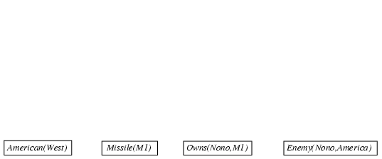
Forward chaining proof

Slide 51
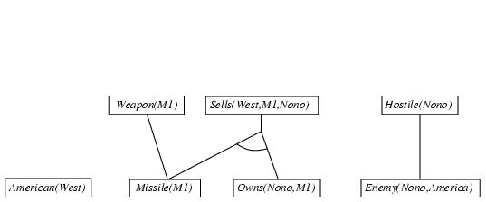
Forward chaining proof

Slide 52
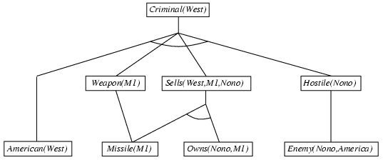
Forward chaining proof

Slide 53
Properties of forward chaining
Sound and complete for first-order definite clauses
Datalog = first-order definite clauses + no functions
FC terminates for Datalog in finite number of iterations
May not terminate in general if α is not entailed
This is unavoidable: entailment with definite clauses is semidecidable

Slide 54
Efficiency of forward chaining
Incremental forward chaining: no need to match a rule on iteration k if a premise wasn't added on iteration k-1
⇒ match each rule whose premise contains a newly added positive literal
Matching itself can be expensive:
Database indexing allows O(1) retrieval of known facts
e.g., query Missile(x) retrieves Missile(M₁)
Forward chaining is widely used in deductive databases

Slide 55
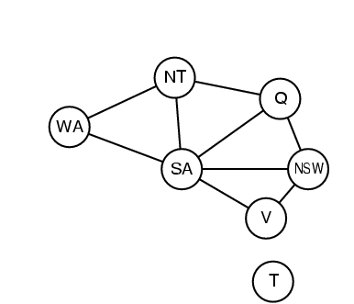
Hard matching example
Diff(wa,nt) ∧ Diff(wa,sa) ∧ Diff(nt,q) ∧ Diff(nt,sa) ∧ Diff(q,nsw) ∧ Diff(q,sa) ∧ Diff(nsw,v) ∧ Diff(nsw,sa) ∧ Diff(v,sa) ⇒ Colorable()
Diff(Red,Blue) Diff (Red,Green) Diff(Green,Red) Diff(Green,Blue) Diff(Blue,Red) Diff(Blue,Green)
Colorable() is inferred iff the CSP has a solution
CSPs include 3SAT as a special case, hence matching is NP-hard

Slide 56

Backward chaining example

Slide 57
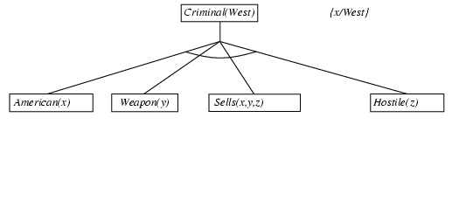
Backward chaining example

Slide 58
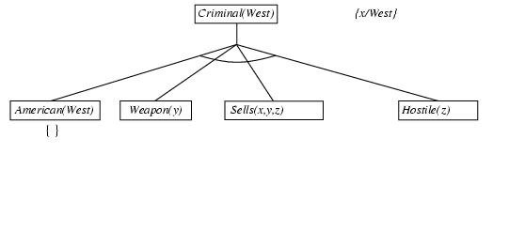
Backward chaining example

Slide 59
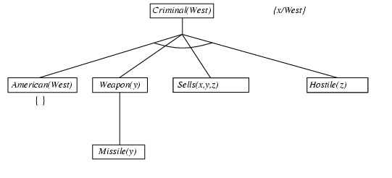
Backward chaining example

Slide 60
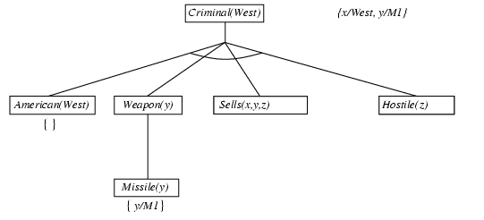
Backward chaining example

Slide 61
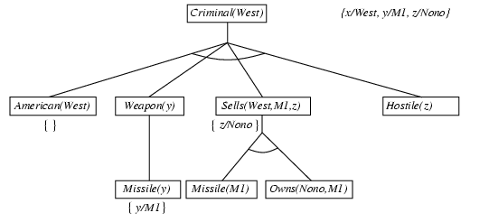
Backward chaining example

Slide 62
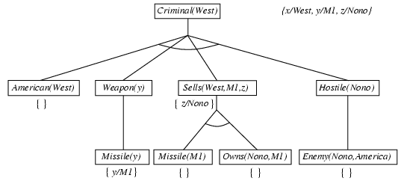
Backward chaining example

Slide 63
Backward chaining example

Slide 64
Properties of backward chaining
Depth-first recursive proof search: space is linear in size of proof
Incomplete due to infinite loops
⇒ fix by checking current goal against every goal on stack
Inefficient due to repeated subgoals (both success and failure)
⇒ fix using caching of previous results (extra space)
Widely used for logic programming

Slide 65
Logic programming: Prolog
Algorithm = Logic + Control (Programming Logic)
Prolog Programs are a set of definite clauses that are written in a notation that is somewhat different from standard first-order logic
Variables – Uppercase
Constants – Lowercase
Commas separate conjuncts in a clause
% is a comment in Prolog
Clauses are written backwards from what we are used to
American(x) ∧ Weapon(y) ∧ Sells(x,y,z) ∧ Hostile(z) ⇒ Criminal(x) criminal(X) :- american(X), weapon(Y), sells(X,Y,Z), hostile(Z).

Slide 66
DCG: Definite Clause Grammar
sentence --> noun_phrase, verb_phrase.
noun_phrase --> det, noun.
verb_phrase --> verb, noun_phrase.
det --> [the].
det --> [a].
noun --> [cat].
noun --> [bat].
verb --> [eats].
Notes:
Components on RHS, and final Composition on LHS

Slide 67
Prolog
f(a).
f(b).
g(a).
g(b).
h(b).
k(X):- f(X), g(X), h(X).
k(X). (which constant satisfies it?)

Slide 68
Criminal Scenario in Prolog
% it is a crime to sell weapons to hostile nations:
criminal(X):-american(X),weapon(Y),sells(X,Y,Z),hostile(Z).
% Nono ... has some missiles,
owns(nono,m1).
missile(m1).
% all of its missiles were sold to it by Colonel West
sells(west,X,nono) :- missile(X), owns(nono,X).
% Missiles are weapons
weapon(X) :- missile(X).
% An enemy of America counts as ``hostile'':
hostile(X) :- enemy(X,america).
% The country Nono, an enemy of America ...
enemy(nono,america).
% West, who is American ...
american(west).

Slide 69
Prolog
Appending two lists to produce a third:
append([],Y,Y).
append([X|L],Y,[X|Z]) :- append(L,Y,Z).
query: append(A,B,[1,2]) ?
answers: A=[] B=[1,2]
A=[1] B=[2]
A=[1,2] B=[]

