Slide 1
Learning by Reading: Two Experiments
Rutu Mulkar, Jerry Hobbs, Eduard Hovy, Hans Chalupsky, Chin-Yew Lin
Information Sciences Institute, University of Southern California

Slide 2
Outline
Background and Overview
Language Processing Techniques
Reasoning Engine
Evaluation
Summary
Future Work and Conclusion

Slide 3
Background and Overview

Slide 4
Overview of projects
High-School Chemistry Textbook
  (January 2006 - May 2006)
  Answering questions by reading text
  No pre-existing background knowledge available
Biology texts related to “heart”
  (June 2006 – December 2006)
  Learning concepts and theories by reading text
  Preexisting domain knowledge available

Slide 5
Overview of model
Natural Language Component
Syntactic Parsing of text
External Component
Knowledge Reasoning, learning and Question Answering
Conversion of parse to Shallow Logical form
Abductive Inferencing

Slide 6
Shallow Logical Form Primer and Example
Description
  Shallow Logical form (Hobbs 85,98) is a representation of the predicate argument relations in the text in FOL
Example
  “The heart is a pump.”
  Has the shallow logical form:
  heart-nn’(e2,x0) & be’(e0,x0,x1) & pump-nn’(e1,x1)
  Here, variables x0 and x1 represent the entities ‘heart’ and ‘pump’ and the variables e0, e1 and e2 reify the ‘be’ relation and the property of being a ‘heart’ and a ‘pump’

Slide 7
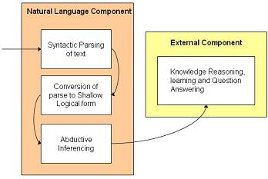
Abductive Inferencing (Hobbs 93)
The abductive system provided specific Interpretation for general information in the text.
Based on a set of axioms and a cost heuristic.
Backchaining was performed on axioms
Assumptions increased the cost of an interpretation
Lowest cost interpretation was assumed to be best possible interpretation, as it required fewer assumptions
Post processor converts interpretations to notations accepted by the external component.

Slide 8
Abductive Inferencing … Contd.
Mini-TACITUS implementation of “Interpretation by Abduction”
Development Complete: Dec 2005
Input: Base scenario/Interpretation, set of axioms
Output: Set of Interpretations of the base scenario, based on the relevant axiom set
Produces multiple sets of possible interpretations, ranked
Implemented in Java 1.4.2_09
Download: http://www.isi.edu/~rutu/tacitus.html
Example sentence output:
[Interpt Number: 20
Cost: 56
is(e0,x0,x1)
device-ot(e2,x0)
heart-nn(e2,x0)
pump-nn(e1,x1)
work-vb(e1)
lung-nn(e5,x3)
together_with(e2,e1,x3)
agent_of(E2,x3,e1)
agent_of(E1,x1,e1)]
[Interpt Number: 21
Cost: 71
…]
[Interpt Number: 23
Cost: 89
…]

Slide 9
Language Processing Techniques

Slide 10
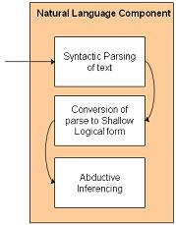
Chemistry Domain
Parser: Charniak Parser (Charniak, 2000)
Shallow Logical Form:
  BE : Basic Elements (Hovy Et Al. 2005)
    It is a triple of words, with a head, a modifier and the relation between the head and the modifier.
    BE kit can be downloaded from http://haydn.isi.edu/BE/
    E.g. BE for the sentence “Citric acid in lemon juice has a sour taste.”
        < citric _{JJ} | NN – JJ | acid _{NN} > NP
        < acid _{NN} | NN – NN | juice _{NN} > NP
        < lemon _{NNP} | NN – NNP | juice _{NN} > NP
        < acid _{NN} | has – AUX | ARG0 > V P
        < ARG1 | has – AUX | taste _{NN} > V P
        < a _{DT} | NN – DT | taste _{NN} > NP
        < sour _{JJ} | NN – JJ | taste _{NN} > NP
  Script converted BE to Shallow Logical form.
  E.g. citric’(e1,x1) & acid’(e2,x1) & in’(e3,x1,x2) & lemon’(e4,x3) & nn’(e5,x3,x2) & juice’(e6,x2) & have’(e7,x1,x4) & a’(e8,x4,e9) & sour’(e10,x4) & taste’(e11,x4)

Slide 11
Chemistry Domain
Three different types of axiomatic
data were captured in the Chemistry domain
General Facts: Assuming all information were generic, axioms were created where subject implies predicate
(Ax) Subject(x) → (Ey) Predicate(x,y)
Causal Facts: There were extracted due to the presence of keywords such as “because”, “when”, “implies”
Reaction Theory: These involved sentences dealing with reaction oriented words such as “association”, “dissociation”, “dissolve”, “interact”, “forms” etc.
Sentence: NaOH dissociates into Na+ and OH- ions when it dissolves in water .
Logical Form: naoh(e1,x1) & dissociate(e2,x1,e4) & into(e4,e2,e7) & na+(e5,x3) & and(e7,e5,e10) & oh-(e10,x2) & ion(e11,x2) & plural(e16,x2,s1) & when(e17,e2,e3) & dissolve(e3,x4) & in(e18,e3,x5) & water(e19,x5)
Concerned Axioms:
for-all(e17,e3,e2) → when(e17,e2,e3)
e2 when e3
COMP(e1,x1) & naoh(e1,x1) → naoh(e1,x1)
Being NaOH is one way of being a compound
FORMS(e1,x1,e7) → dissociate(e1,x1,e4) & into(e4,e1,e7)
Backchaining into canonical predicate
COMP(e5,x4) & REACTION(e3,x4,x5) & dissolve(e3,x4) → dissolve(e3,x4) & in(e18,e3,x5)
Dissolving is one kind of reaction

Slide 12
naoh(e1,x1) &…& dissociate(e2,x1,e4) & into(e4,e2,e7) &….& when(e17,e2,e3) & dissolve(e3,x4) & in(e18,e3,x5) &…
COMP(e1,x1) & naoh(e1,x1)
COMP(e99,x4) & REACTION(e3,x4,x5) & dissolve(e3,x4)
FORMS(e1,x1,e7)
for-all(e17,e3,e2)
x1=x4
Final Logical Form: COMP(e1,x1) & naoh(e1,x1) & FORMS(e2,x1,e7) & na+(e5,x3) & and(e7,e5,e10) & oh-(e10,x2) & ion(e11,x2) & plural(e16,x2,s1) & for-all(e17,e2,e3) &
dissolve(e3,x1) & REACTION(e3,x1,x5) & water(e19,x5)
Post-Processing to (For-all there exists notation - KIF)
(FORALL (?e3 ?x4 ?x5 ?e1)
(=> (AND (REACTION ?e3 ?x1 ?x5)
(COMP ?e1 ?x1) (naoh ?e1 ?x1)
( water ?e19 ?x5) (dissolve ?e3 ?x1) )
(EXISTS (?e2 ?e7 ?e5 ?e10 ?x2 ?x3 ?s1 ?e16 ?e11)
(AND (FORMS ?e2 ?x1 ?e7) (and ?e7 ?e5 ?e10)
(oh- ?e10 ?x2) (ion ?e11 ?x2) ( plural ?e16 ?x2 ?s1)
(na+ ?e5 ?x3)))))

Slide 13
Biology Domain
Parser: Contex Parser
  (Hermjakob and Mooney, 1997)
  More information than Charniak parser
  Support available
  E.g. “The heart is a pump.”
        (SUBJ) [2] The heart [S-NP]
        (DET) [3] The [S-DEF-ART]
        (PRED) [4] heart [S-COUNT-NOUN]
        (PRED) [5] is [S-AUX]
        (OBJ) [6] a pump [S-NP]
        (DET) [7] a [S-INDEF-ART]
        (PRED) [8] pump [S-NOUN]
Shallow Logical Form:
  LFToolkit :Toolkit for automated conversion of xml based syntax trees to their respective logical form. (Rathod and Hobbs, 2005)
  Approx. 280 context-free rules that recognize parse tree patterns and output LF triples
  E.g. heart-nn'(e2,x0) & be'(e0,x0,x1) & pump-nn'(e1,x1)
  Development Completion: January 2005
  Implemented in Java 1.4.2_05
  Download: http://www.isi.edu/~nrathod/wne/LFToolkit/

Slide 14
Biology Domain
Backchaining into some KR theories
Coreference by Factoring
  Unification of variables when the predications are the same
Patch LF fragments and parse errors by coreference
LF from “…heart(x1)….pump(x2,y2)…. blood(y3)…”
broken parse
device(x1)&heart(x1)
fluid(y3)&blood(y3)
x1=x2
y2=y3
device(x2) & fluid(y2)
Connected logical form: heart(x2) & device(x2) & pump(x2,y2) & blood(y2) & fluid(y2)
Concerned Axioms
blood(y) & fluid(y) → blood(y)
heart(x) & device(x) → heart(x)
device(x) & fluid(y) → pump(x,y)

Slide 15
Reasoning Engine

Slide 16
Chemistry Domain: PowerLoom
PowerLoom (Chalupsky et al. 2006)
Knowledge representation language developed by researchers in the Artificial Intelligence research group at the University of Southern California's Information Sciences Institute
PowerLoom uses a variant of KIF to express definitional and assertional content.
People: Hans Chalupsky, Robert M. Mac-Gregor, and Thomas A. Russ.
More Information: http://www.isi.edu/isd/LOOM/

Slide 17
Biology Domain: KR
KR (Bruce Porter and his Group, University Of Texas, Austin)
Mapping words to concepts from Wordnet
Create new concepts
Create new models
Knowledge Integration: Unifying Instances, Re-labeling Semantic relations
Generating new Hypothesis

Slide 18
Evaluation

Slide 19
Chemistry Domain
Powerloom was able to answer transitivity questions as well as what and how questions. Few sample questions:
Question (T/F): H3O+ causes certain dyes to change color.
Answer: True
Question (what): Soap has WHAT taste?
Answer: 1: ?what=taste 2: ?what=bitter
Question (how): Soap feels how?
Answer: 1: ?how=slippery

Slide 20
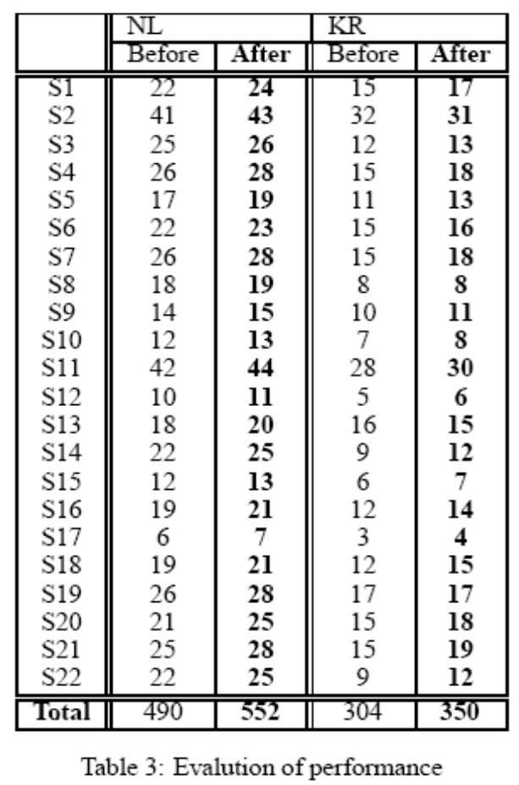
Biology Domain
Evaluation of effect of coreference techniques on data
The final system was evaluated by measuring the total number of concepts and relations captured by the KB from the NL outputs.
Evaluated on 22 sentences of a previously unseen text
13% increase in NL triples led to 15% increase in KR triples
16.7% increase in model creation by KR

Slide 21
Finally….

Slide 22
Summary
# | Chemistry | Biology
1 | Charniak Parse along with BE was used for parsing | Contex parse was used for parsing
2 | Effort to convert declarative sentences into Forall (A) → there exists (E) format | Effort to solve problems related to coreference in sentences
3 | Powerloom was the external reasoning engine used | KR was the external reasoning engine used
4 | Reasoning Engine was knowledge poor (not favorable) | Reasoning Engine was Knowledge rich (favorable)
5 | Question Answering on textual chemistry data, helps in external evaluation and understanding of system | Learning new concepts and theories, by enhancing existing models, required in internal debugging and evaluation

Slide 23
Future Work and Conclusion
Improvement of Language Processing to obtain Logical Form (LF) having greater accuracy
Using KR feedback loop, to disambiguate NL parses and logical forms
Using bootstrapping techniques and cycling of learned theories for learning newer theories

Slide 24
Thank You!
Questions?

