Slide 1
Positioners

Slide 2
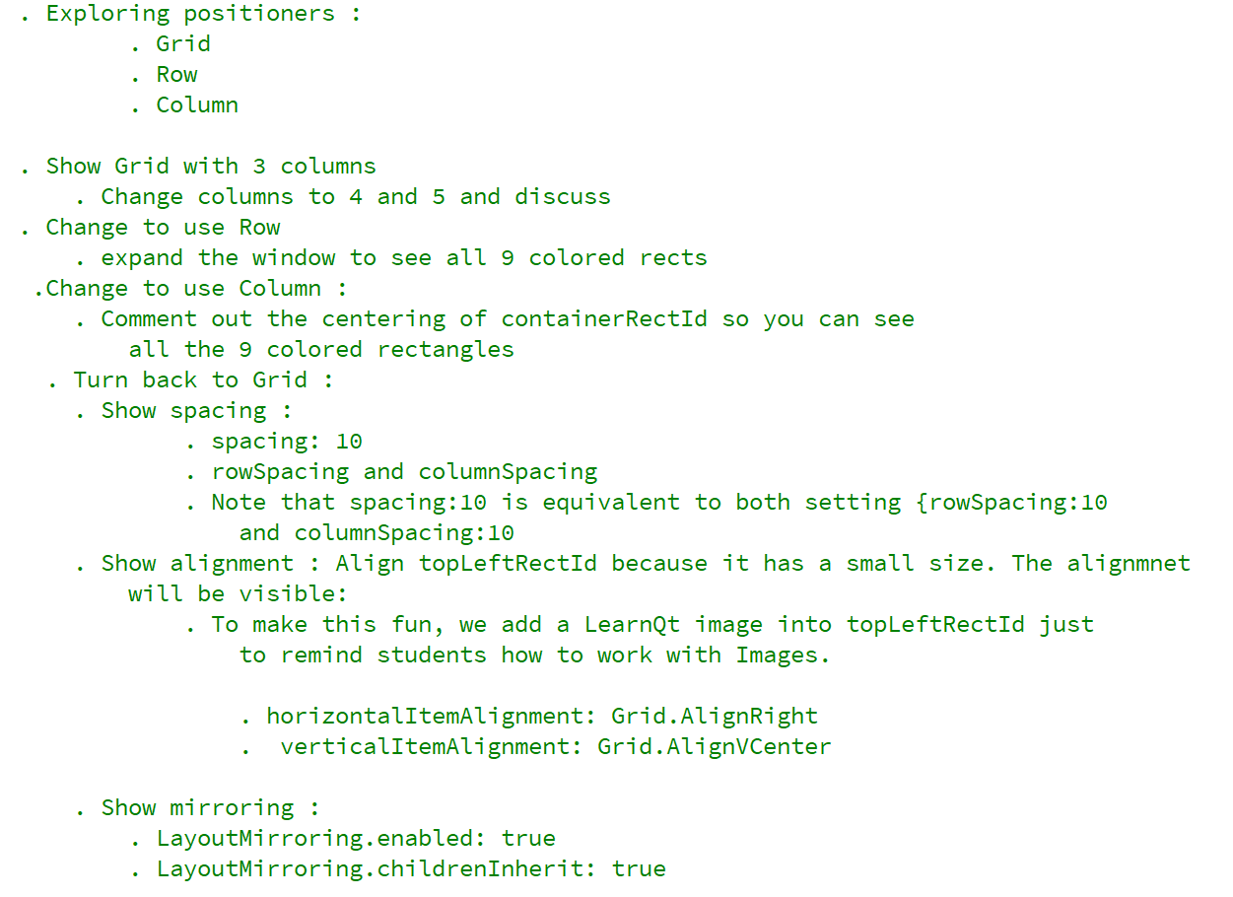
REFERENCE FOR SELF

Slide 3
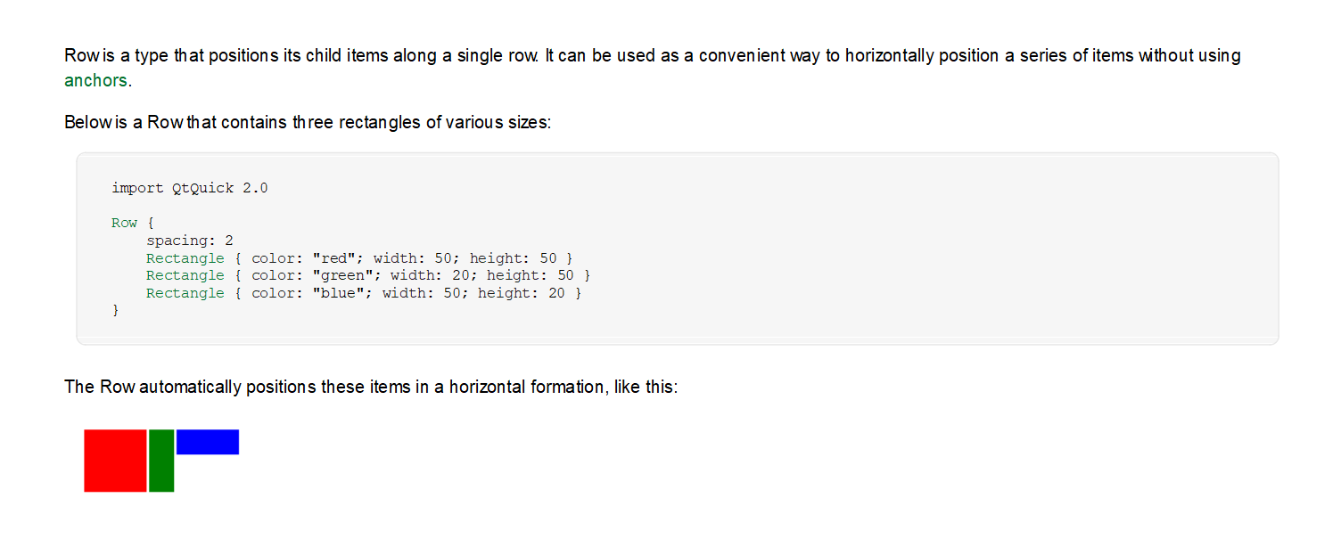
Row

Slide 4
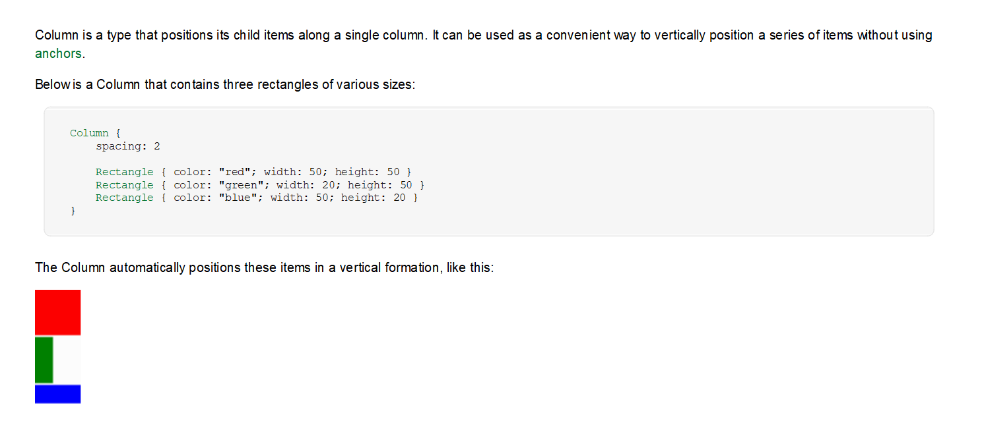
Column

Slide 5
