Slide 1
Anchors

Slide 2
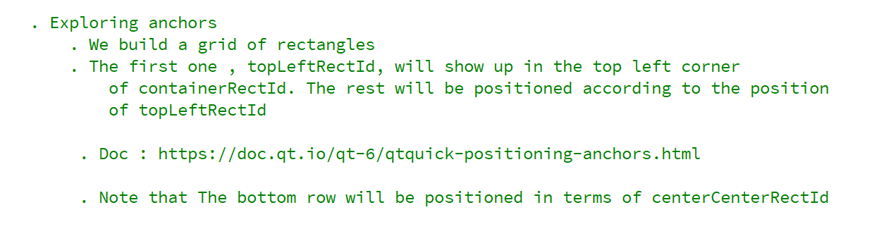
REFERENCE FOR SELF

Slide 3
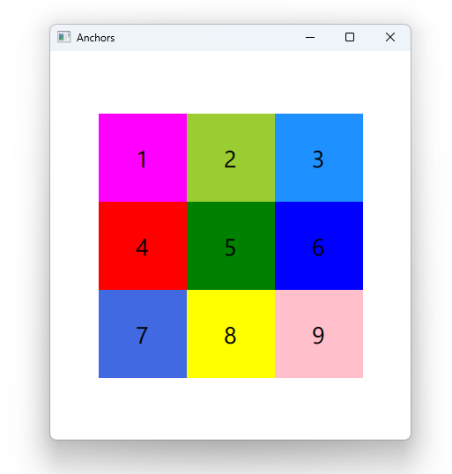

Slide 4
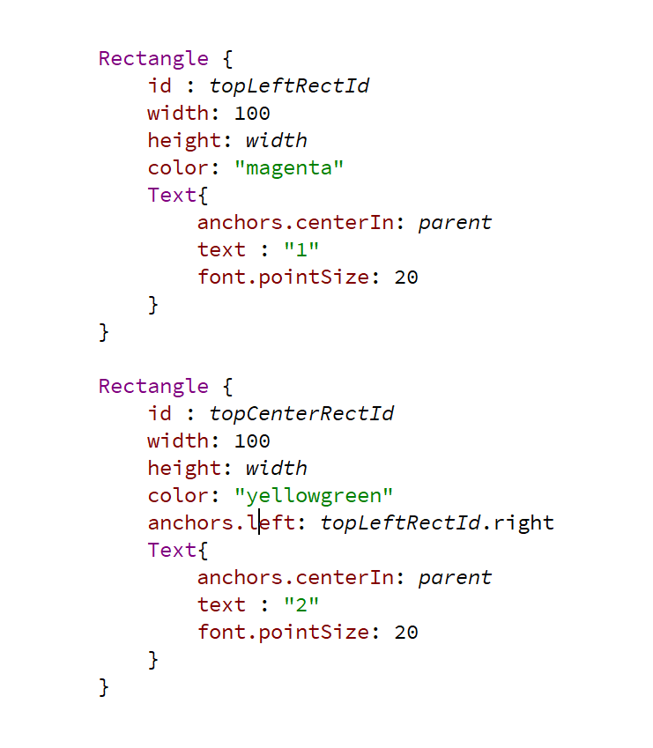

Slide 5
REFERENCE FOR SELF
Show the docs

