Slide 1
Anchors : Margins and offsets

Slide 2
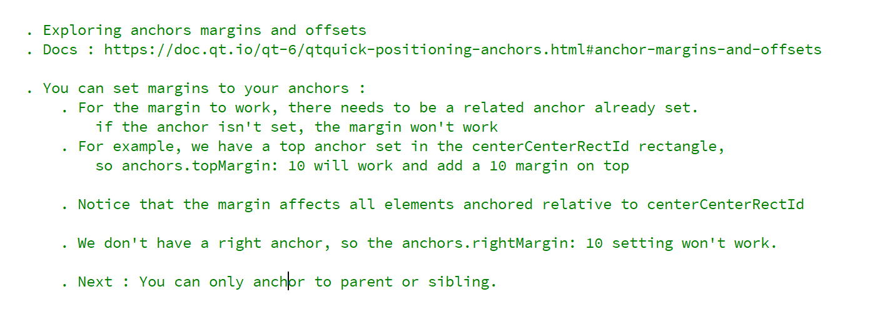
REFERENCE FOR SELF

Slide 3
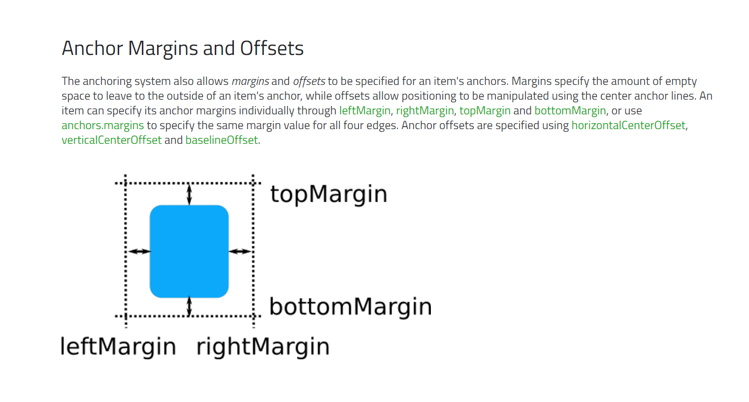
The docs

Slide 4
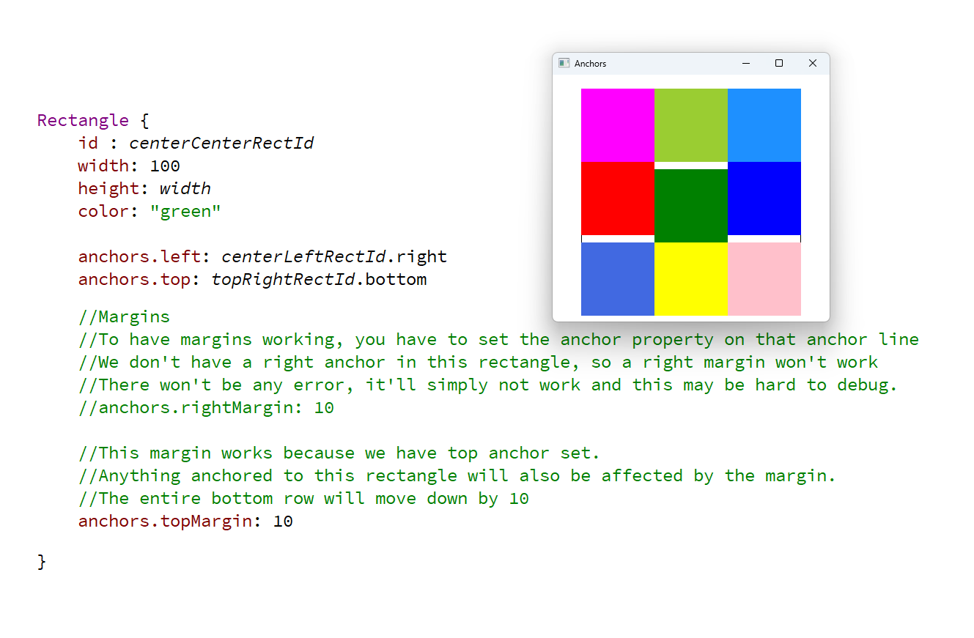
Margins

Slide 5
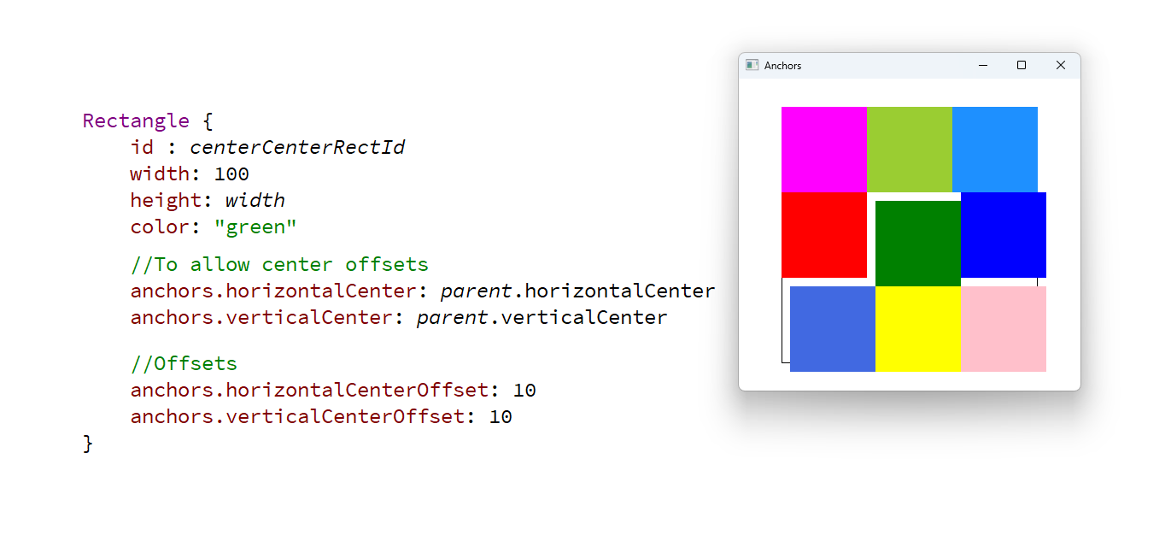
Offsets

Slide 6
Margins and offsets affect other elements anchored to the element with the margin/offset

