Slide 1
Anchors : Parents and Siblings

Slide 2
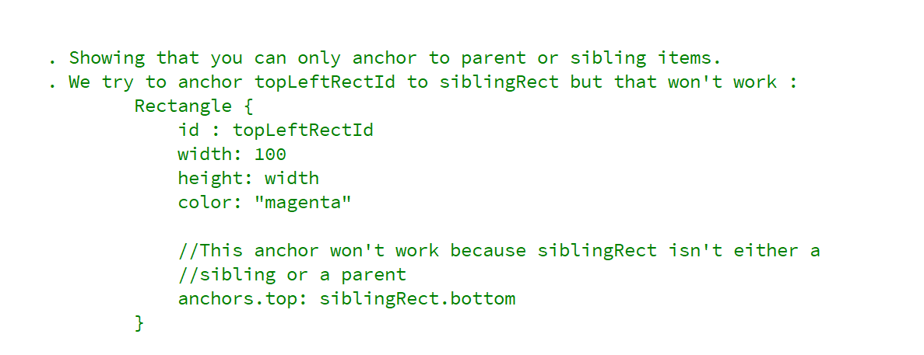
REFERENCE FOR SELF

Slide 3
We can only anchor to parent or sibling elements in QML

Slide 4
