Slide 1
Layouts

Slide 2
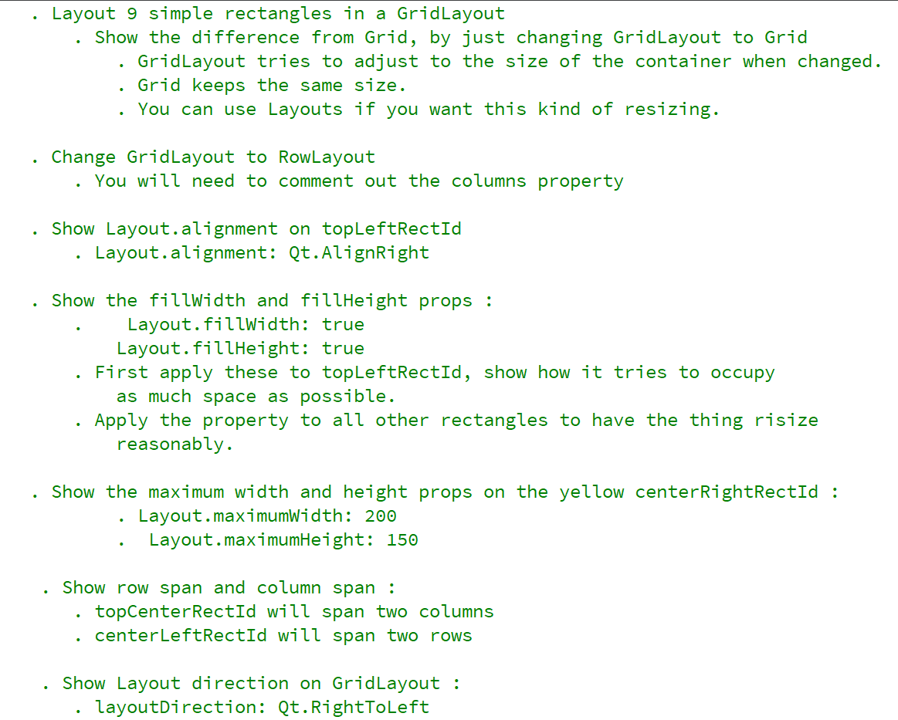
REFERENCE FOR SELF

Slide 3
RowLayout
ColumnLayout
GridLayout

