Slide 1
Flow

Slide 2
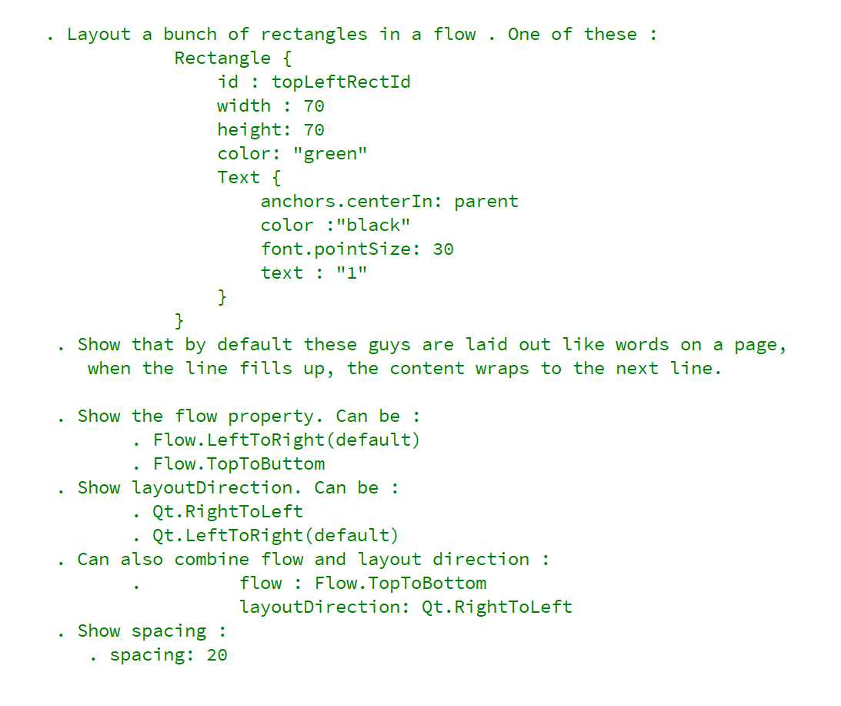
NOTES TO SELF

Slide 3
Items are laid out like words on a page

