Slide 1
QML Syntax Overview

Slide 2
REFERENCE FOR SELF
This is just an exploration of what qml looks like
Use the docs as much as you can in the process
When ready, also show the Column component (top,bottom)
Be as natural as you can and improvise

Slide 3
QML is a declarative language
Top down hierarchy
Components can have children
Components have unique IDs
Variables
Property bindings
Responding to things
Anchors : Positioning elements relative to others

Slide 4
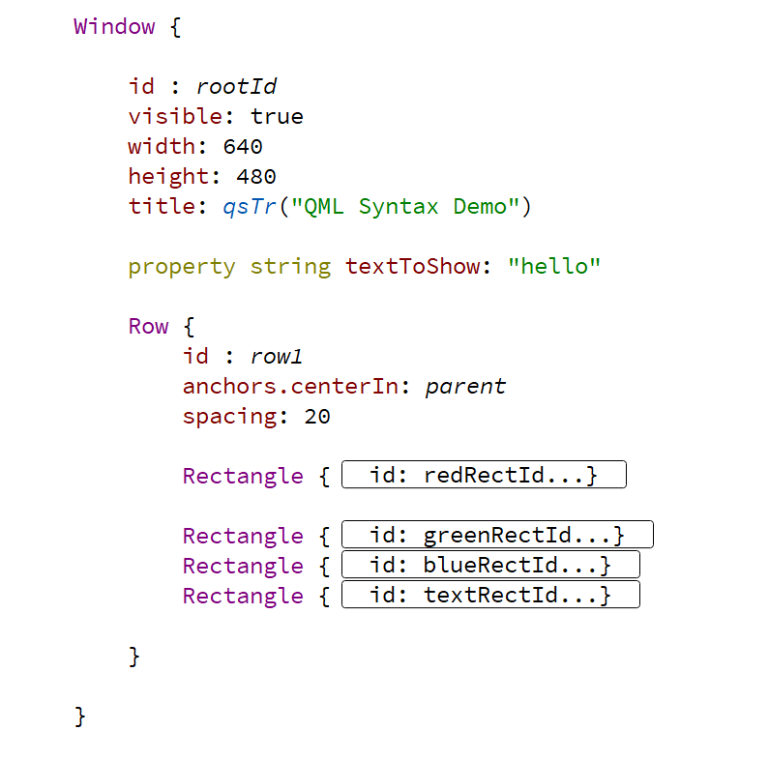
Declarative – Top Down

Slide 5
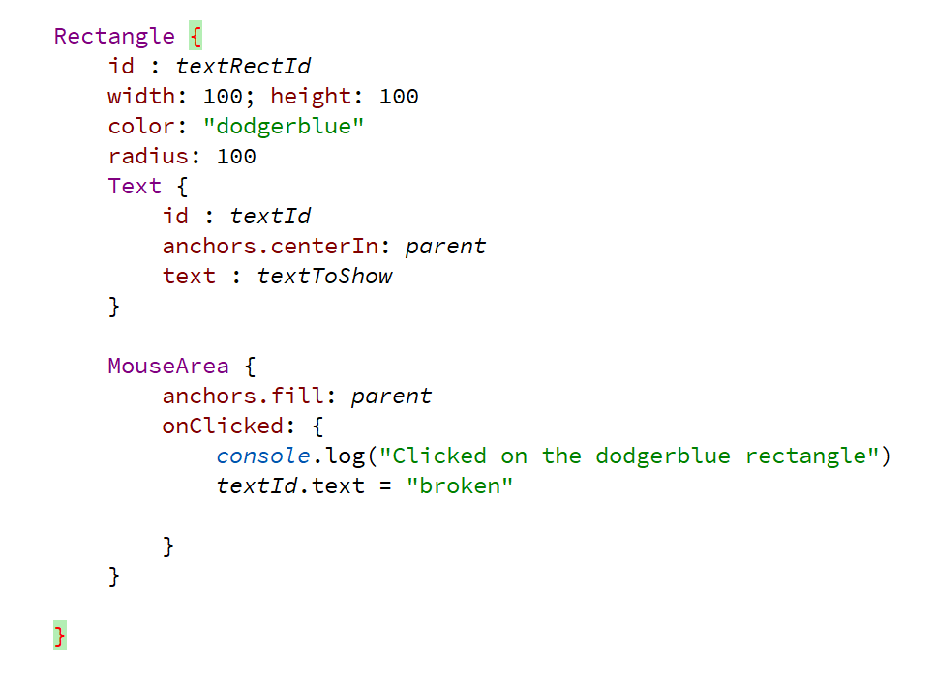
Child components – Property bindings

