Slide 1
Property Bindings

Slide 2
REFERENCE FOR SELF
Show that with prop binding, qml takes care of updating things when the depended upon value changes.

Slide 3
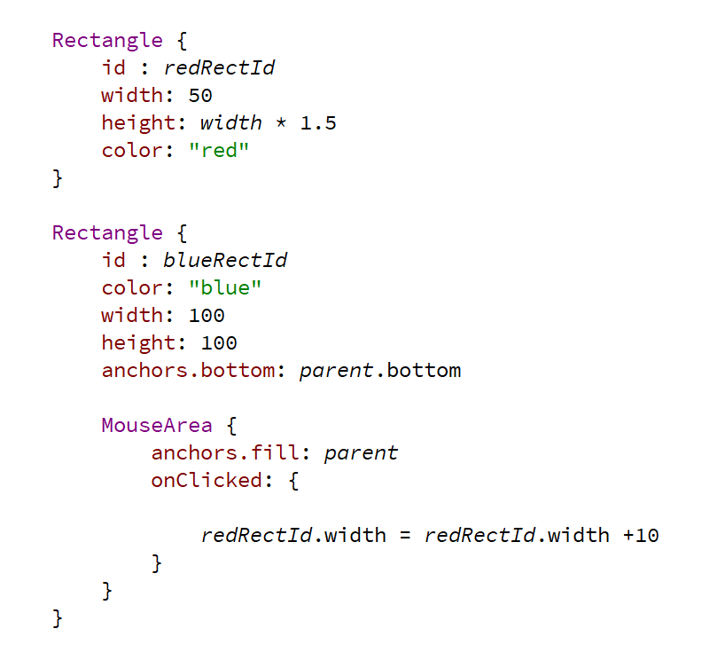
Property binding

Slide 4
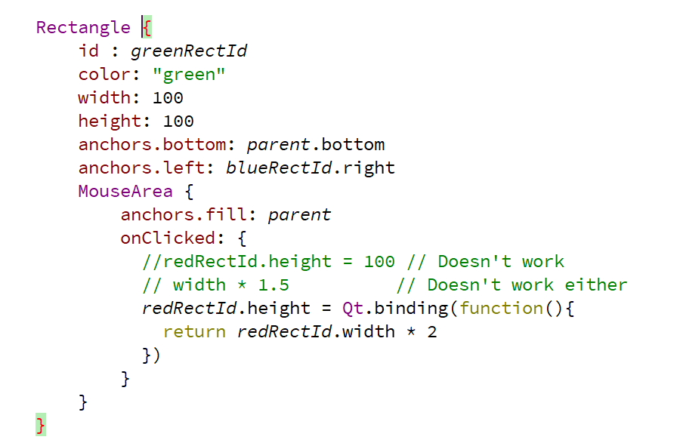
Break the binding

