Slide 1
The Qt Global Object

Slide 2
Also known as the Qt QML Type

Slide 3
REFERENCE FOR SELF
Show the docs for the Qt QML Type
Play with
Quitting apps
Listing fonts
Hashing a string
Opening urls and local file paths
Capturing platform information

Slide 4
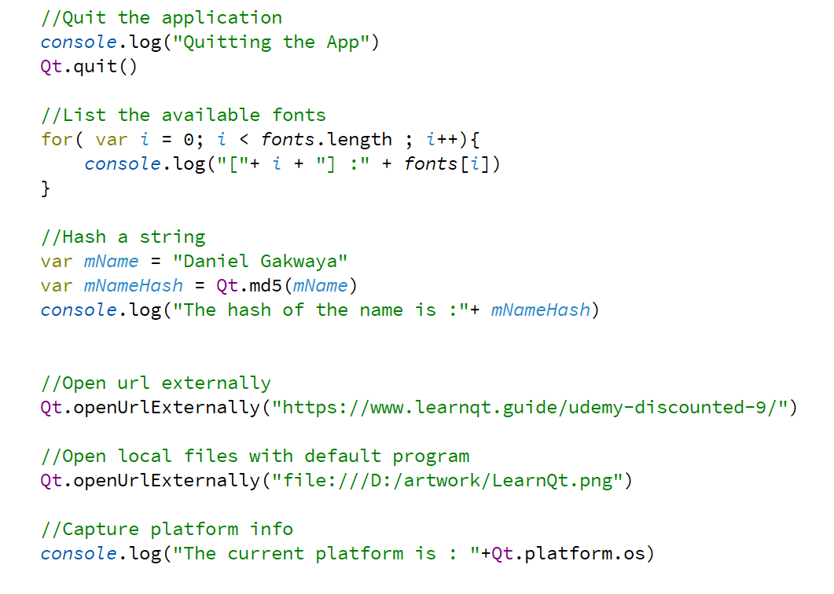
Qt Global object

