Slide 1
Property Handlers

Slide 2
REFERENCE FOR SELF
Show the handlers for custom properties like firstname in your example here
Show the handlers for built in properties like width and height. Use title as show in the code

Slide 3
Property Handlers
When a property is set up in QML, Qt defines a signal that’s fired every time the value of that property changes
You can respond to those signals using property handlers
The handlers are named on[Property name with first letter capitalized]Changed
These signals are also available for built in properties like width and height

Slide 4
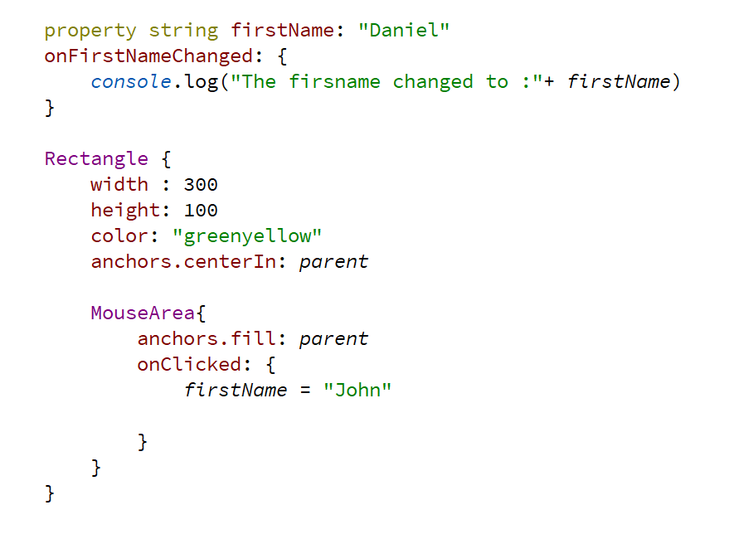
Property Handlers

