Slide 1
Rectangle, Item and Text

Slide 2
REFERENCE FOR SELF
Start off by showing Item and its docs
Move the container item and show that the contained child rects follow suit
Show different properties for Item in the docs
This will have also shown Rect
Show Text

Slide 3
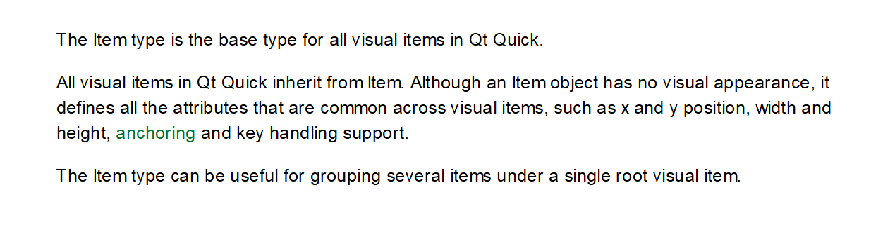
Item

Slide 4
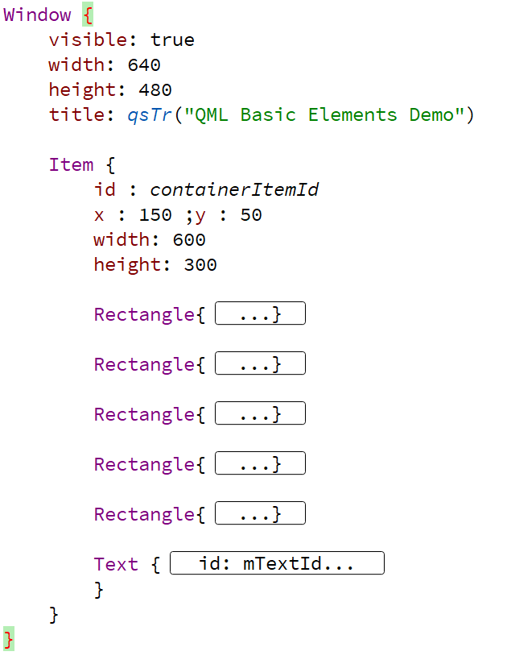
Item

Slide 5
Rectangle

Slide 6
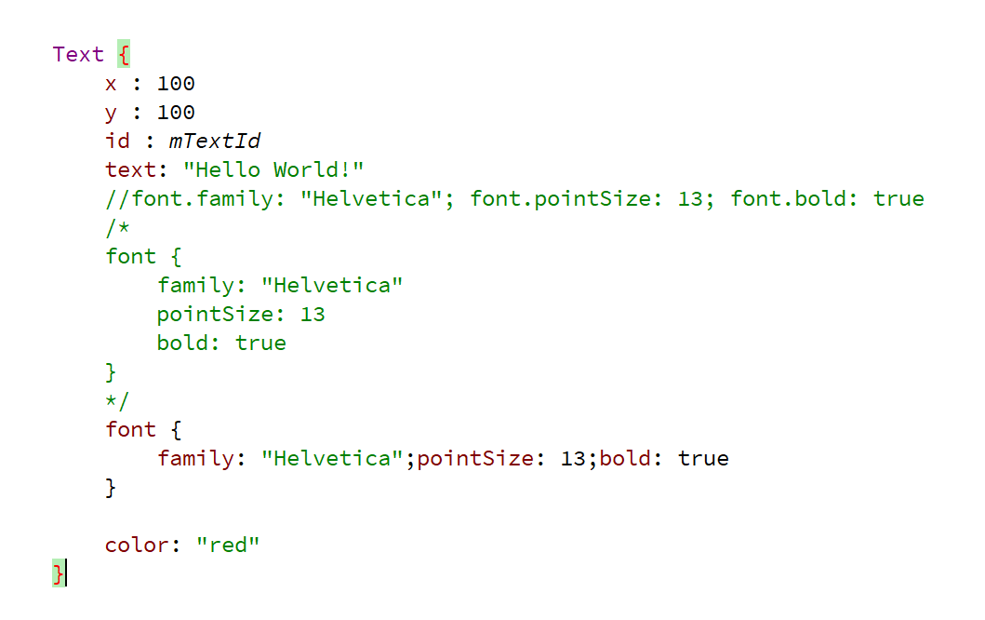
Rectangle

