Slide 1
Image

Slide 2
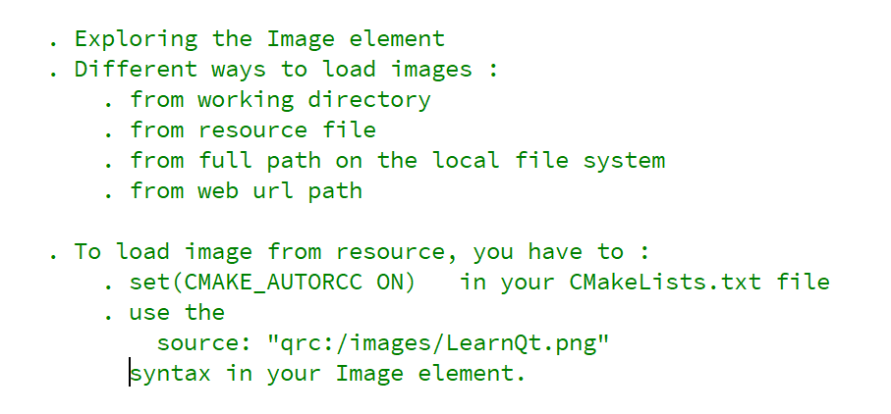
REFERENCE FOR SELF

Slide 3
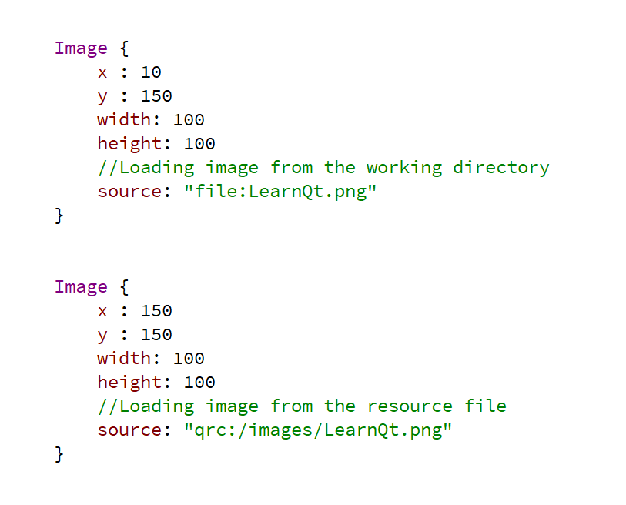
Working directory – Resource file

Slide 4
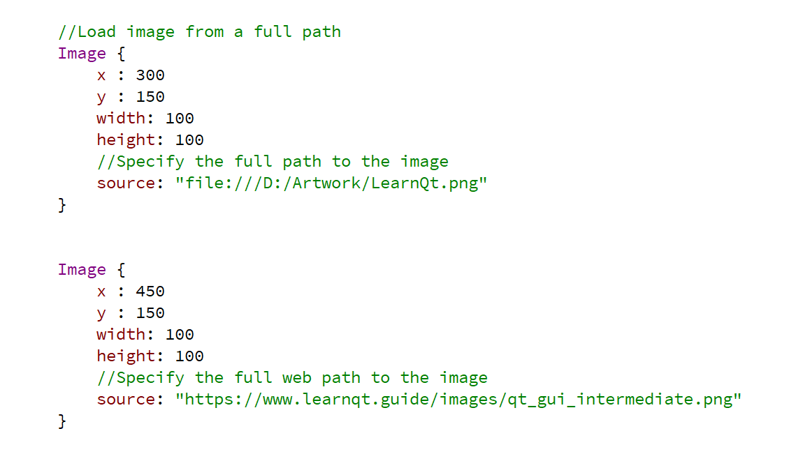
Item

