Slide 1
Signal Handlers

Slide 2
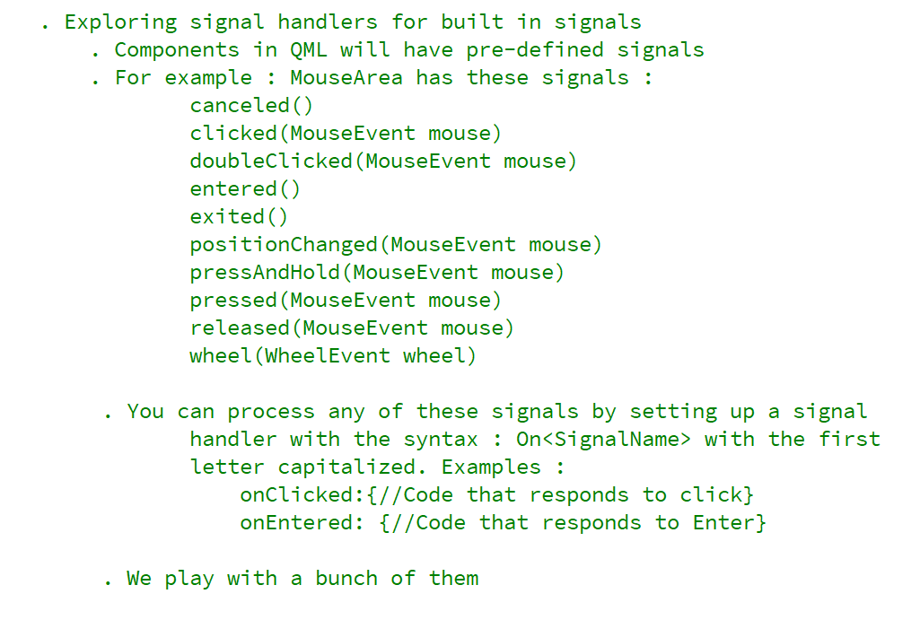
REFERENCE FOR SELF

Slide 3
