Slide 1
Signal Parameters

Slide 2
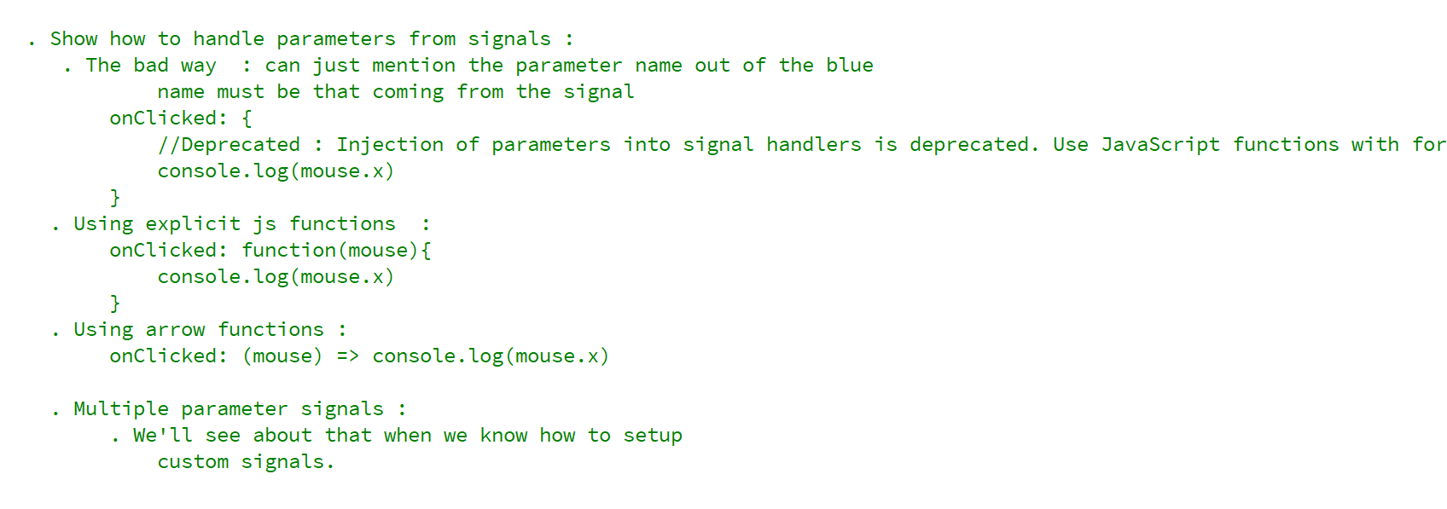
REFERENCE FOR SELF

Slide 3
