Slide 1
Property Changed Signals

Slide 2
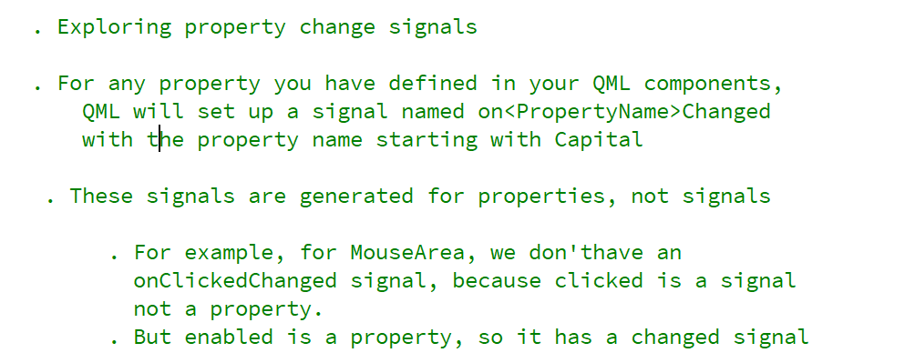
REFERENCE FOR SELF

Slide 3
