Slide 1
Connections

Slide 2
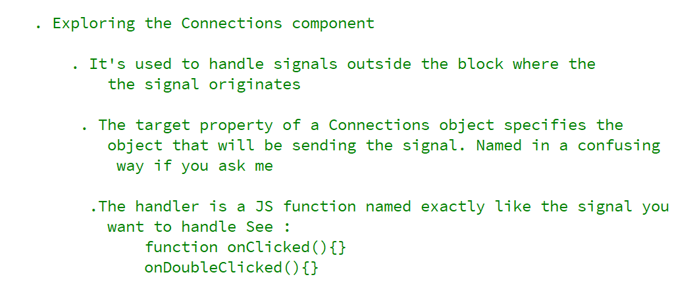
REFERENCE FOR SELF

Slide 3
