Slide 1
Attached Signal Handlers

Slide 2
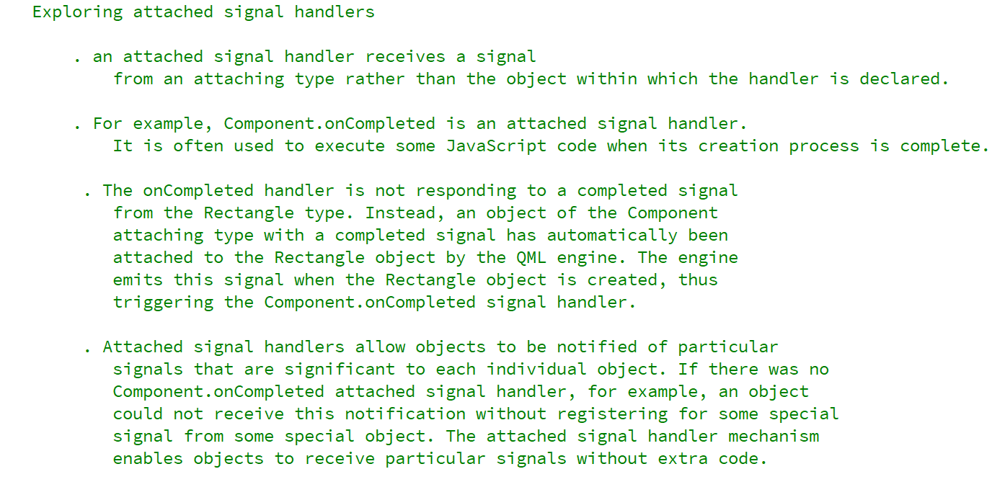

REFERENCE FOR SELF

Slide 3
