Slide 1
Custom Signals

Slide 2
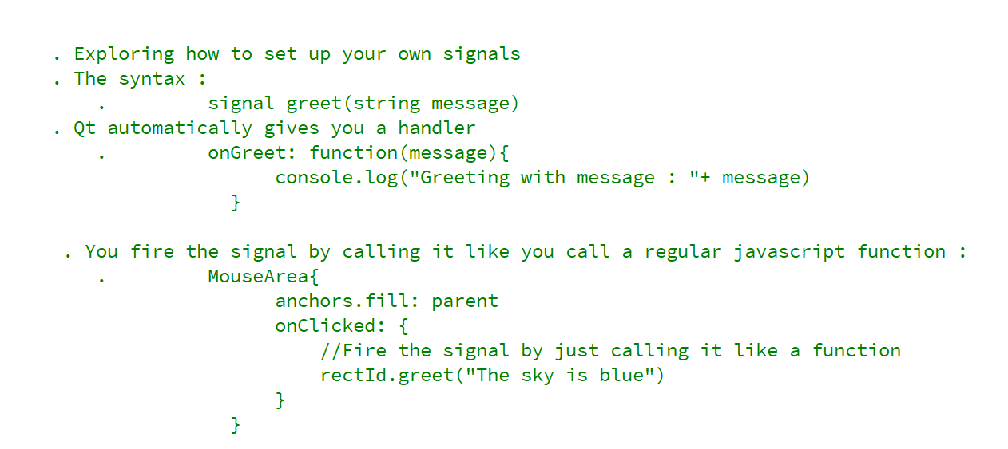
REFERENCE FOR SELF

Slide 3
