Slide 1
Connect Signal to Method

Slide 2
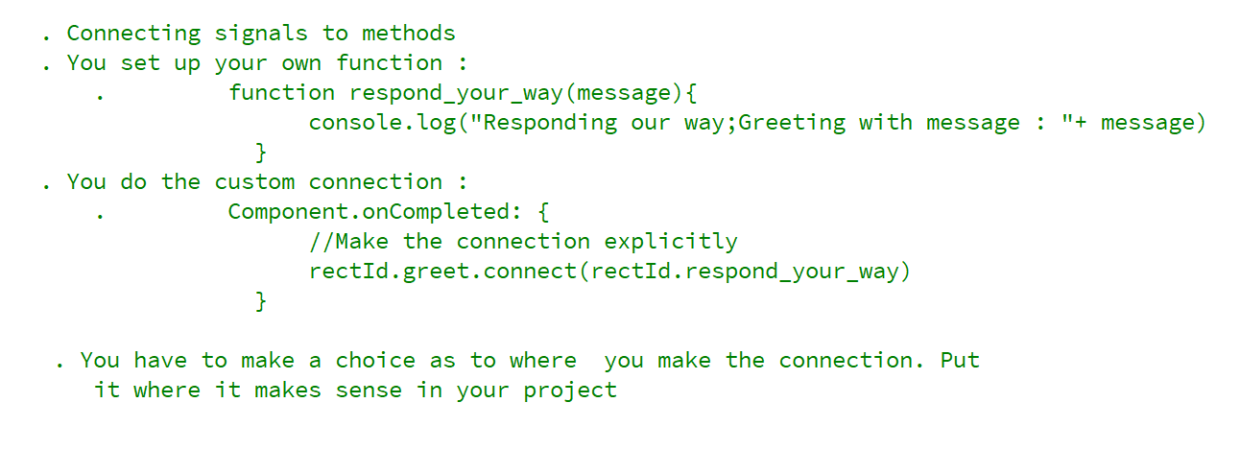
REFERENCE FOR SELF

Slide 3
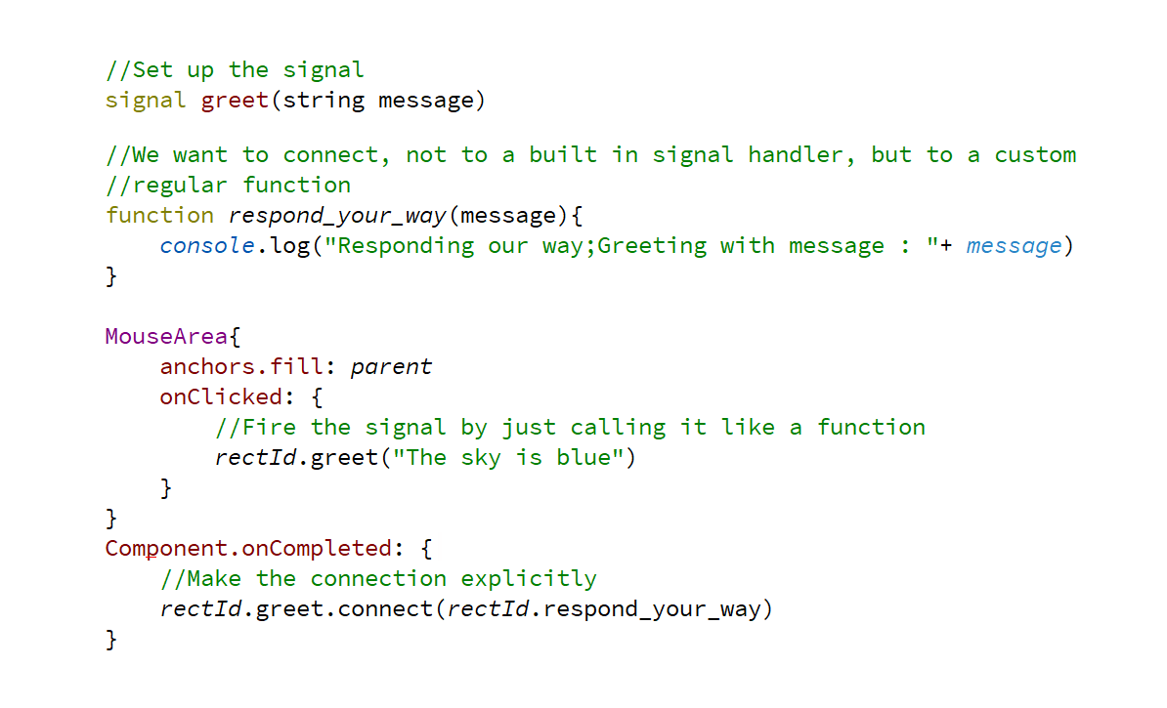
Connect signal to slot

