Slide 1
Connect Signal to Signal

Slide 2
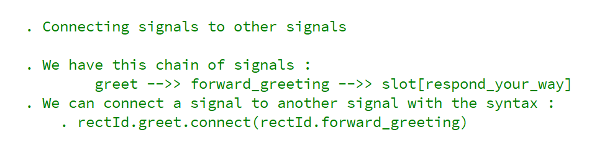
REFERENCE FOR SELF

Slide 3
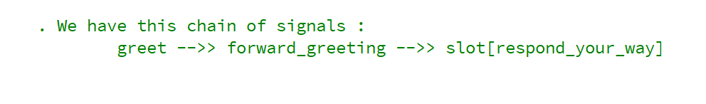
Connect signal to signal

Slide 4
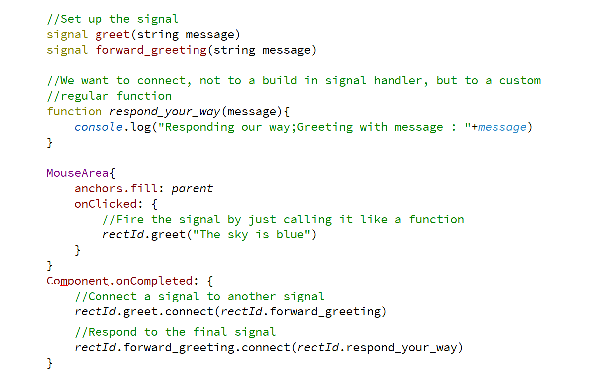
Connect signal to signal

